Slide 1
5th National Summit on Good and Replicable Practices and Innovations in Public Healthcare Systems for 2018
Swasthya Sewa Dapoon
Integrated MIS GIS System
J.V.N. Subramanyam, IAS
Mission Director
National Health Mission, Assam
Date: 31st October 2018
Venue: Kaziranga, Assam

Slide 2
Problem Statement
State has implemented online “Health Management Information System (HMIS)” from 2008 and “Mother & Child Tracking System (MCTS)” from 2011.
All required data were not being captured through HMIS and MCTS.
All systems were running in silos and there was no correlation between the systems.
Information Silos for HR data, ASHA related activities, VHND monitoring, financial monitoring, Health infrastructure development etc.
In fact there was no concrete HR database and for every instance, separate reports were collected from districts based on which decision of posting and transfer were done which often resulted erroneous decisions.

Slide 3
Strategies
Swasthya Sewa Dapoon – Integrated MIS GIS System
Use of GIS to build the MIS- All Health Facilities GIS mapped
All Health Databases in single platform and single database structure – same master tables in all module
Single entry – no duplication of data entry
Open Source Technology
PHP/MySQL DB/Apache web Server
Developed using in-house capacity
Hosted in own server
User Friendly
Customized Dashboards
Customized Reports

Slide 4
Swasthya Sewa Dapoon – Integrated MIS GIS System- Modules

Slide 5
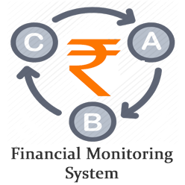
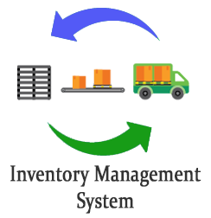
Major modules under Swasthya Sewa Dapoon
Swsthya Sewa Dapoon

Slide 6
GIS-MIS Linkages
GIS Mapping
GIS Layer
Updated Human Resource Master
Updated Health Institution Master with NIN
Masters
MIS Layer
Notes:
NIN: National Identification Number to Health Facilities of India.
It is an unique number provided for all health facilities of India

Slide 7
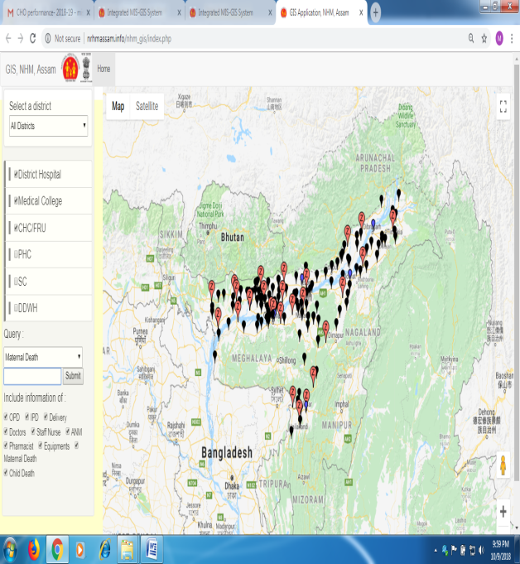
GIS Module
100% GIS mapping helped for proper planning of infrastructure development.
Used during preparation of State PIPs.
Used during review meetings.

Slide 8
HR MIS Module

Slide 9
HR-MIS System
Complete HR database of Health & Family Welfare
Both under State Health Service and NHM Contractual
Online Transfer and Posting/ joining for both Regular and NHM employees
Rationalization of posting based on HR-MIS database
Linked with Training Details.
Centralized salary disbursement of 100% NHM employees through DBT
Linked with PFMS for DBT payment

Slide 10
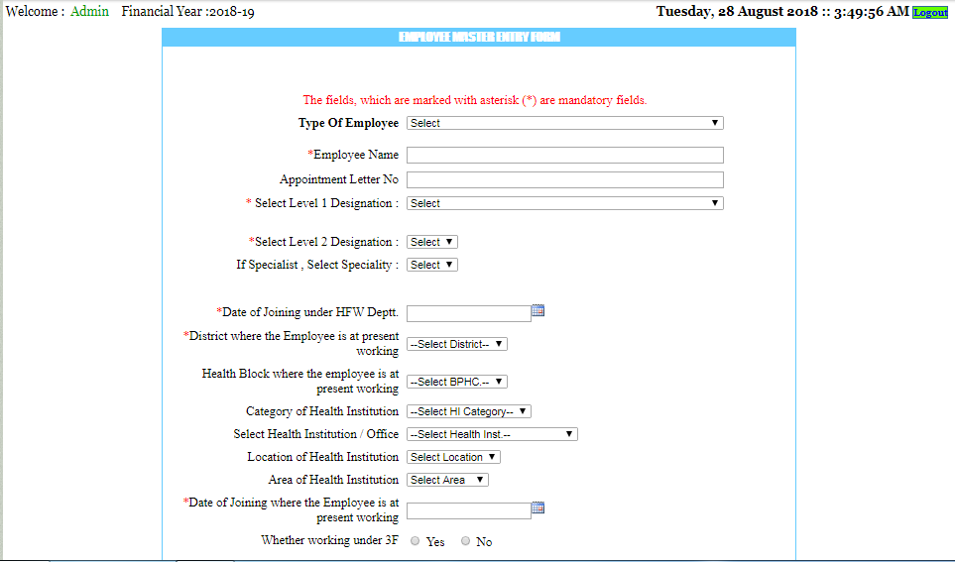
HR-MIS System – Complete details of each employee

Slide 11
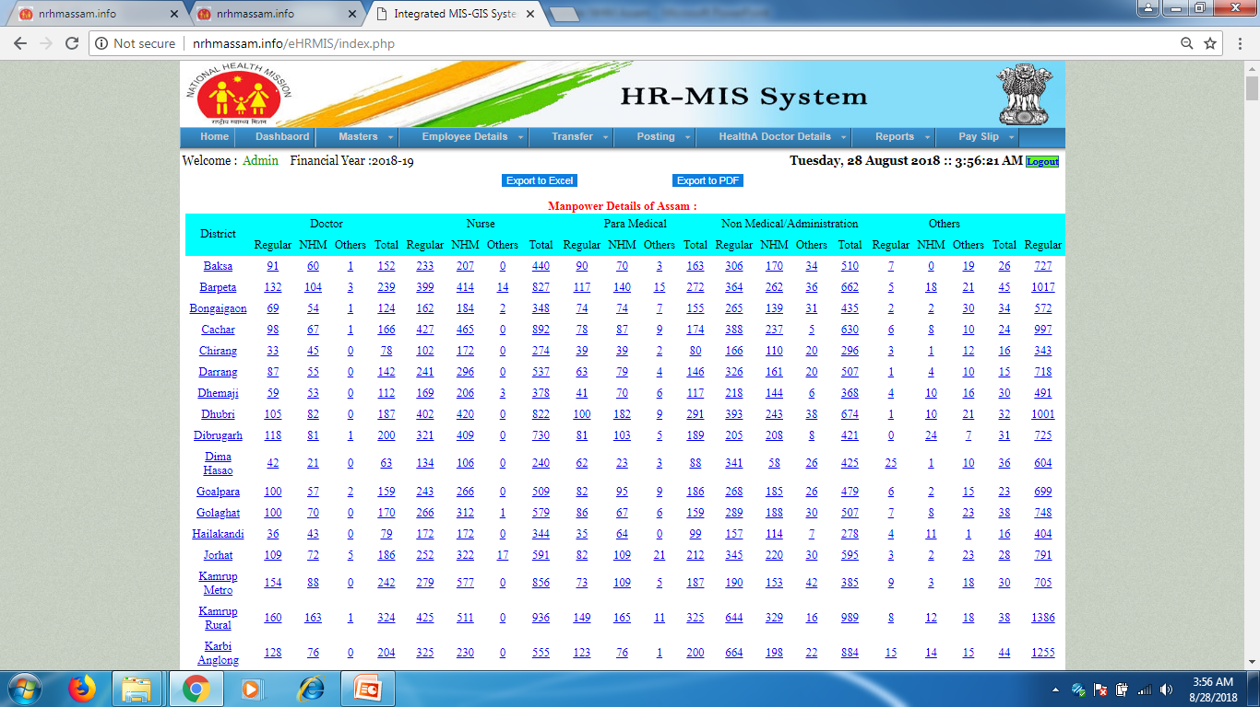
HR-MIS System – Management Reports with drill down

Slide 12
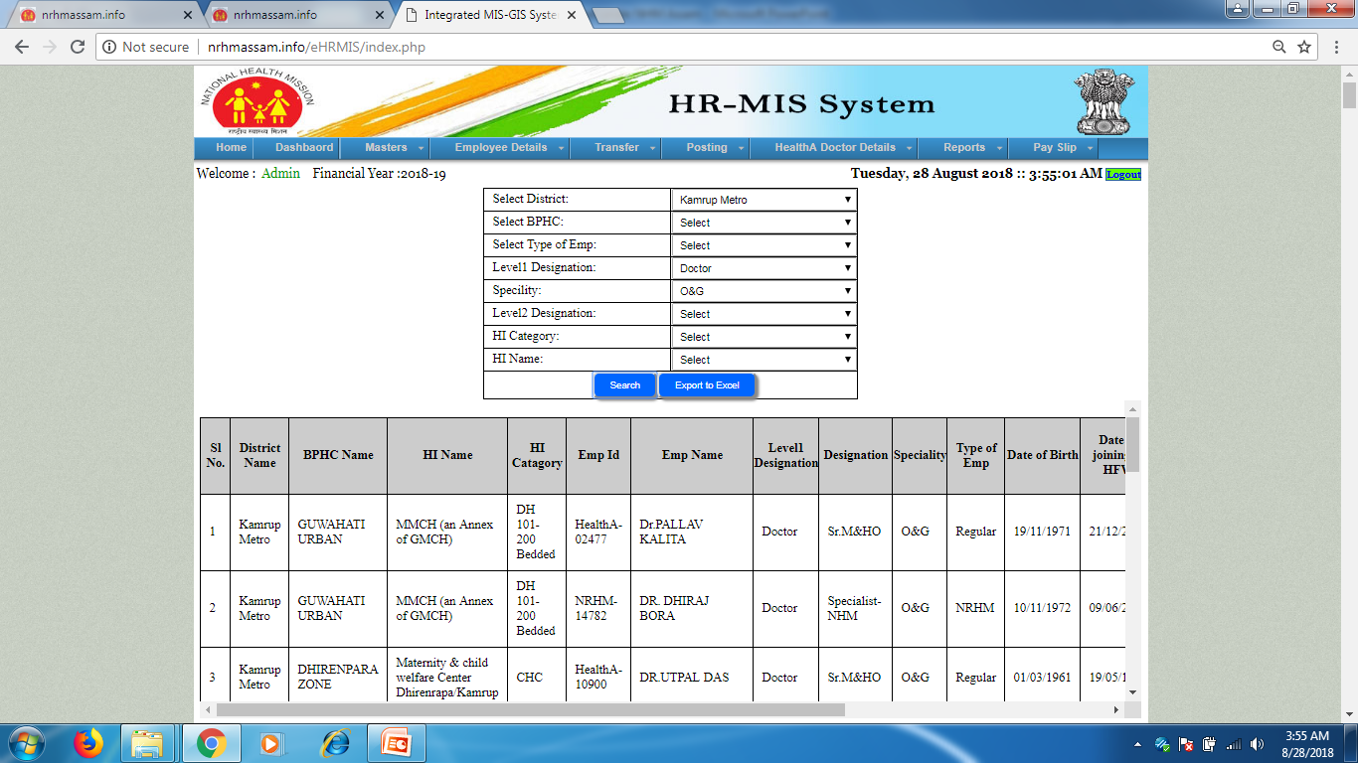
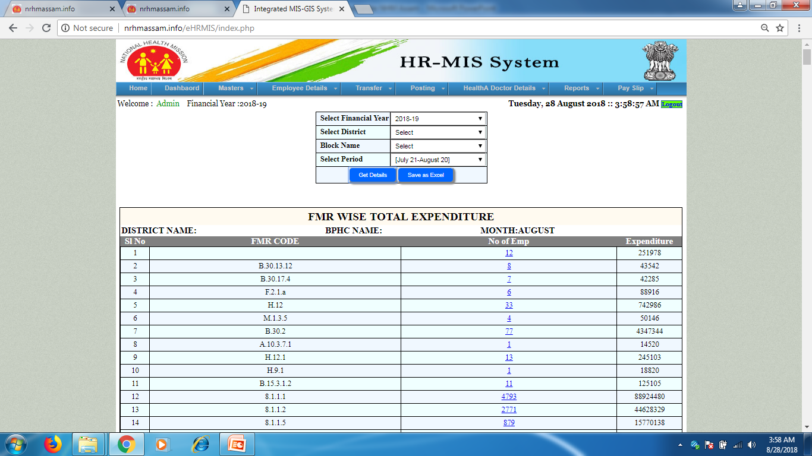
HR-MIS System – Management Reports
Management Reports
FMR wise HR expenditure

Slide 13
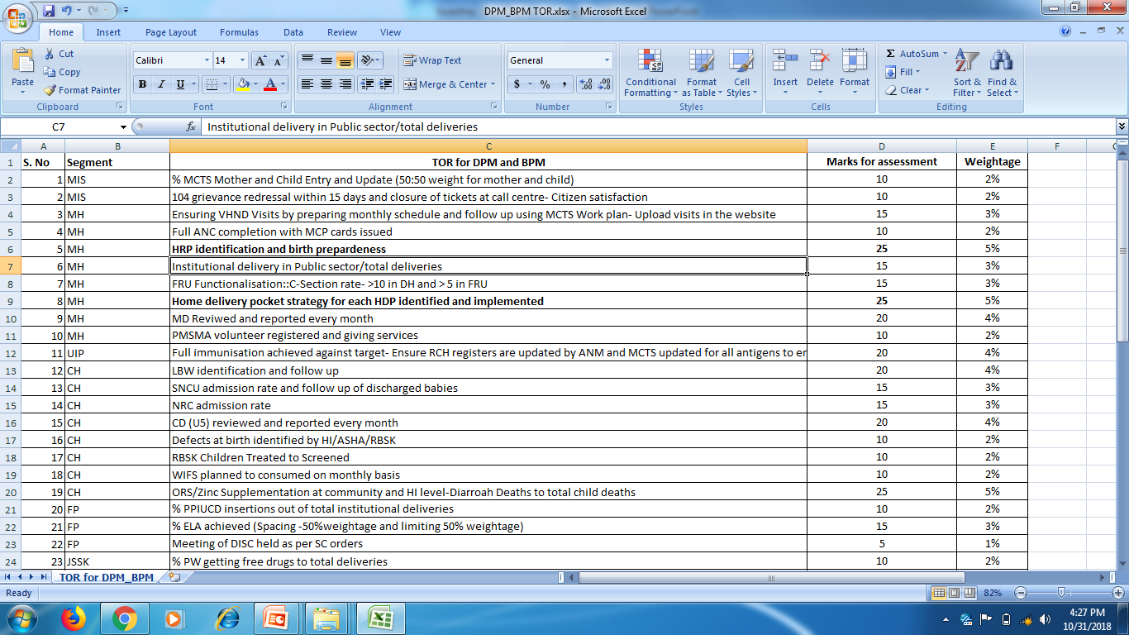
HR-MIS and HMIS integration for Performance Appraisal
ToR of NHM staff revised.
40 indicators for ToR of DPM and BPM

Slide 14
Human Resource for Health
HR Cadre | Performance Indicator | All India Per day | All Assam Per day | Minimum Caseload (Daily) | Maximum Caseload (Daily) | Aspirational Minimum Caseload (Daily) | Aspirational Maximum Caseload (Daily)
MO & Specialist | OPD attendance/ MO | 44 | 14.07 | Dibrugarh (7.32) | Dhubri (32.52) | Barpeta (13.87) | Dhubri (32.52)
Staff Nurse | IPD attendance per SN per shift | 4 | 1.96 | Chirang (0.75) | Kamrup (Metro) (4.30) | Barpeta (1.13) | Hailakandi (3.52)
Lab technicians | Total Number of Lab Tests per LT | 26 | 9.6 | Barpeta (2.9) | Goalpara (18.8) | Barpeta (2.9) | Goalpara (18.8)
Gynecologists | Number of C- sections per Gynecologist | 1 | 0.76 | Hailakandi (.05) | Lakhimpur (4.73) | Hailakandi (.05) | Barpeta (1.60)
Dental MOs/ Surgeons | Dental OPD per Dentist | 10 | 3.91 | Dibrugarh (0.74) | Dhubri (9.33) | Udalguri (1.99) | Dhubri (9.33)

Slide 15
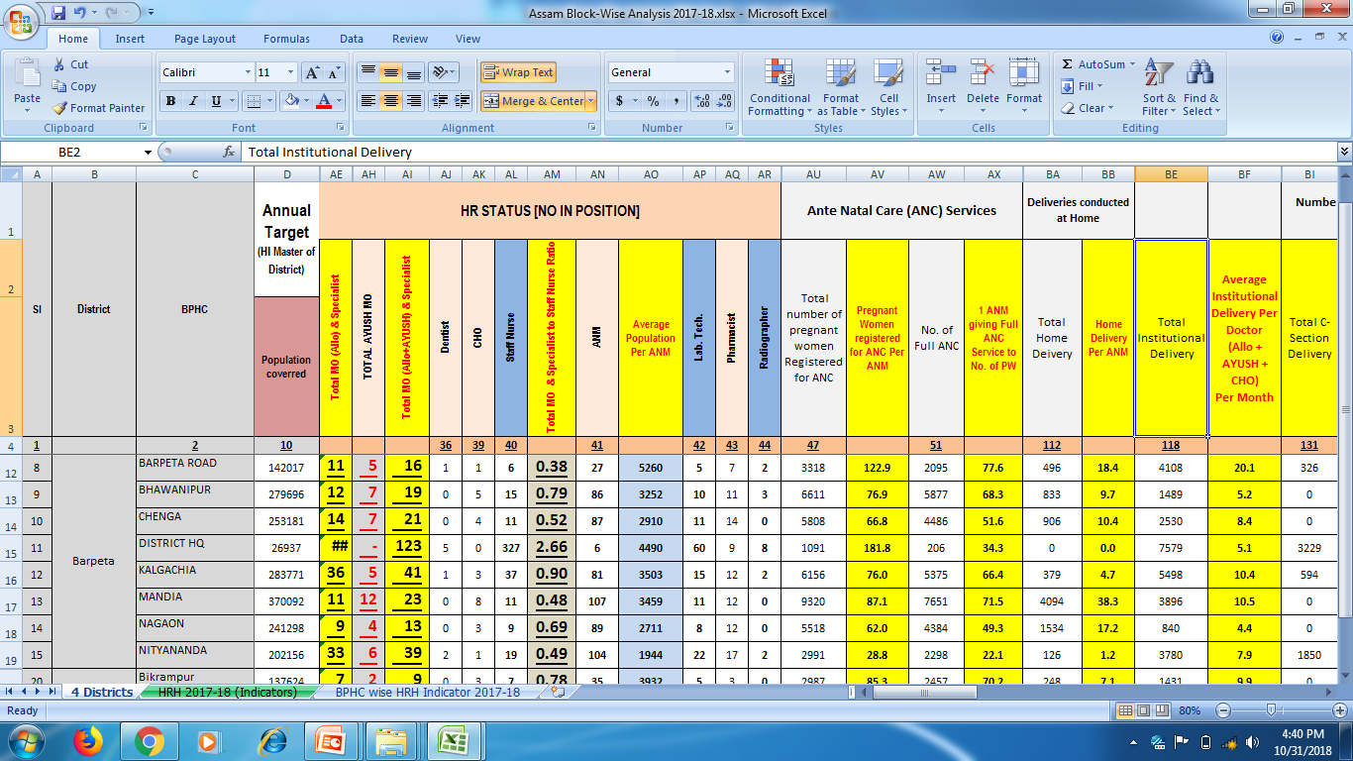
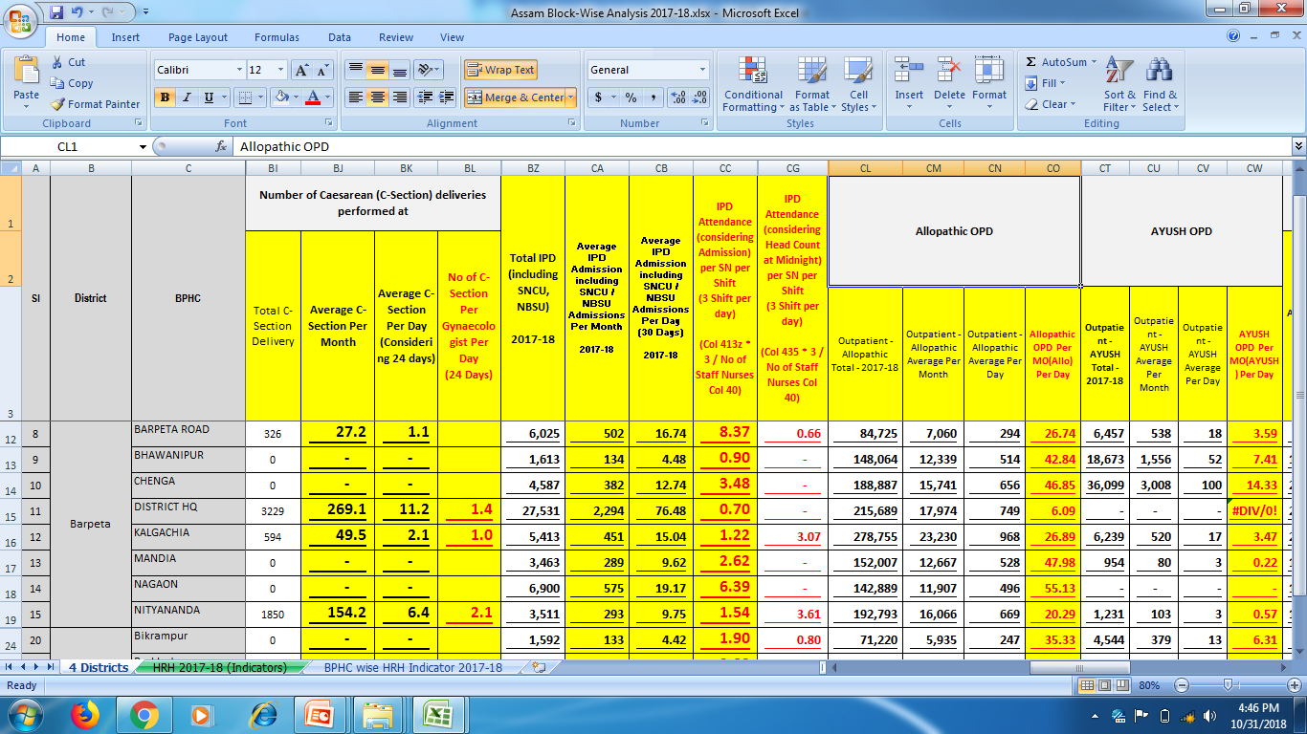
Human Resource for Health

Slide 16
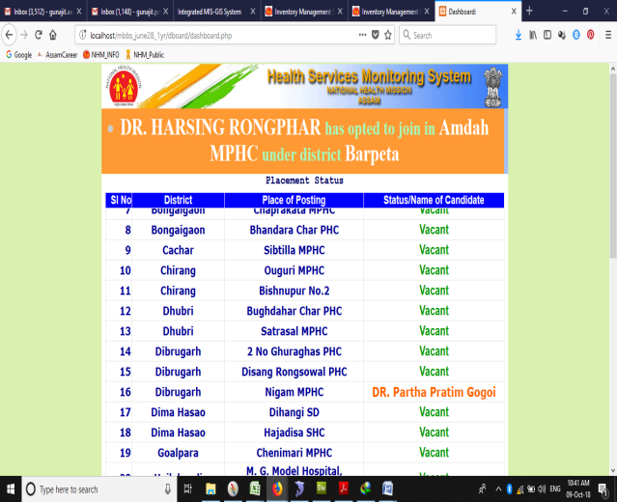
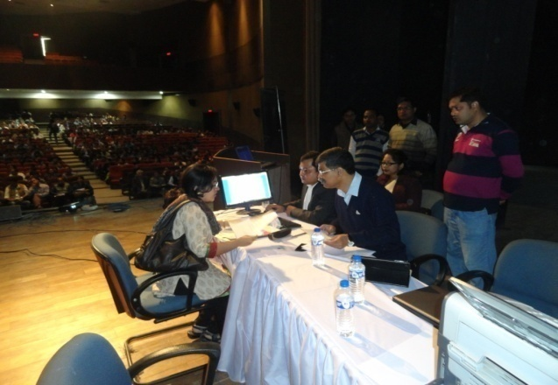
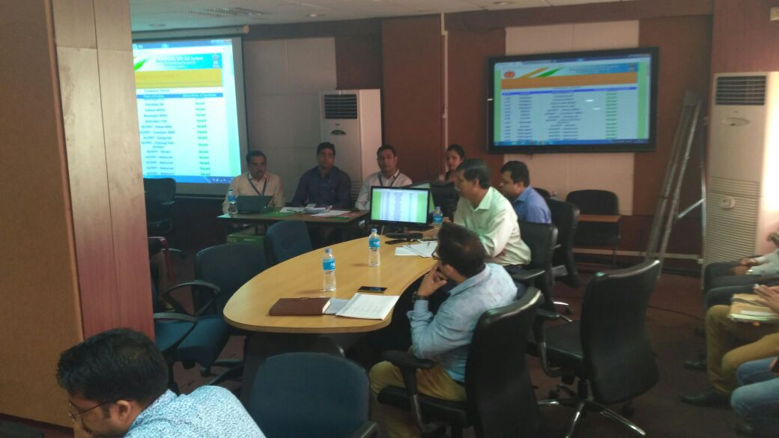
Transparent Posting Module
Merit list and place of posting is published in the public domain of website 2/3 days prior to counseling.
During counseling, candidates are called as per merit list and accordingly they choose their place of posting.
Once one post is selected, the place of posting is blocked and the same is reflected in the projector screen displayed in the hall.
Appointment letter is displayed automatically from the system and appointment letter is handed over on the spot.
The system has bring transparency in the posting system.

Slide 17
Outcome of HR-MIS System
Updated HR database of Health & Family Welfare Department is available readily
Centralized salary disbursement of 100% NHM employees within the last week of every month which has increased the motivational level of employees.
Salary linked with grading of performance appraisal.(A/B/C/D)
Faster recruitment process by using online application module which also helped for sorting eligible candidates.
Online transfer, posting and joining for both employees under State health service and under NHM which helped real time updating of information.
Transparency of system by publication of HR database in public domain.
Transparent posting on merit basis through counseling and on the spot distribution of appointment letter

Slide 18
Performance Monitoring System of Community Health Officers (CHOs) Module

Slide 19
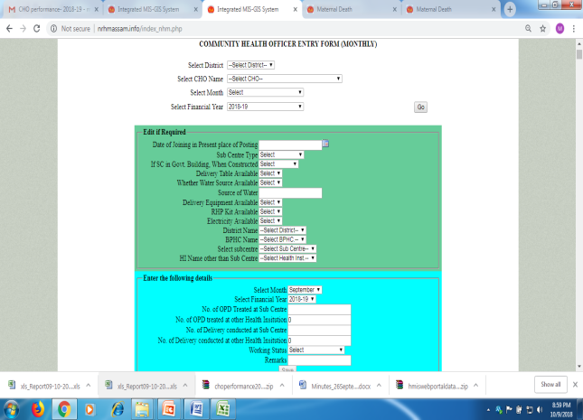
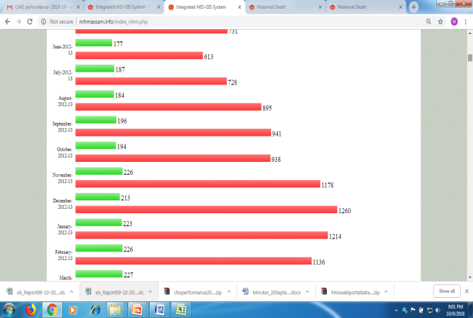
Performance Monitoring System of CHOs
NHM, Assam has developed and implemented online CHO performance monitoring system to monitor the progress of each and every CHOs in the State.
CHOs work as mid level service providers (MLP) for Health & Wellness Centres in the State.
At present 691 CHOs are working in the Sub Centres of hard to reach areas of the State.
Objective of the system is to review the gaps and take corrective steps for improvement of the performance of CHOs- OPD/Delivery
CHO Monthly performance entry form
Analytical reports – Month wise CHO performance

Slide 20
Outcome of the CHO Performance Monitoring System
Same HR Database used for CHO’s performance Monitoring
Due to proper monitoring and timely follow up, CHO programme became a success story as Mid Level Service Provider.
Total 103.75 lakhs OPD and 1.76 lakhs Deliveries conducted by CHOs till September 2018.
Total 36,258 Deliveries conducted and 15.10 lakhs OPDs seen by CHOs in the year 2017-18.
Posting of CHOs are rationalized based on performance and needs (mainly on home delivery pockets).
Now, the CHO performance module is being extended for reporting of H&WCs.

Slide 21
ASHA Payment and Performance Monitoring System (APPMS) MODULE

Slide 22
Before APPMS…
ASHAs were not aware about the list of activities for which they are entitled for Incentives.
There were no comprehensive guidelines.
Complex system of incentive claims by implementing multiple claim forms
No specific time frame for receipt of claim and release of payment resulting irregular and delay in release of payment.
Multiple Window Payment System.
Lack of transparency in the payment system.
Lack of Monitoring system to assess the performance of ASHAs.
Lack of digitized ASHA Database.
Quality of ASHA Trainings compromised due to lack of monitoring system.

Slide 23
APPMS Implementation Strategies
Development of comprehensive guidelines – in the form of booklet – distributed to all ASHAs.
Implementation of Master Claim Forms – all activities are claimed through single claim form.
Implementation of single window system for all claims.
Fixation of accountability for verification of claims.
Fixation of timeframe for submission of claim and release of payment.
Opening of Bank Account of all ASHAs- 100% PFMS /DBT for All
Development of online ASHA payment and Performance Monitoring System.
Monitoring of activity wise performance.
Monitoring of quality of ASHA Trainings.
ASHA Performance Dashboard

Slide 24
APPMS: with Defined Workflow
Process Flow - Creating ASHA Database (One time activities)
Creation of Maker and Checker
Agency Bank Account Mapping by Admin User and Bank Account Activation
Updation of ASHA Bank Account Information in PFMS by Maker
PFMS
Complete Validation of ASHA Bank Accounts from Bank Server in PFMS by Maker
Approval of ASHA Bank Account by Checker
Confirmation of Approval to be sent to Head Quarter
Import to ASHA Payment System
ASHA Payment System

Slide 25
APPMS: How the System Works
New ASHA Payment System (Monthly Activity)
ASHAs to submit Monthly all Claim Forms along with Supporting Documents (Fixed Date Range: 1st to 4th)
Receipt Claim Forms at BPHC along with Supporting Documents. To be entered on spot and provide print out of Acknowledgement. Single Window System for all identified Incentives (Fixed Date Range: 5th to 12th)
SMS Alert to ASHA regarding receipt of claim
Verification of Documents and approval of SDM&HO (Fixed Date Range: 13th to 22nd)
SMS Alert to ASHA regarding Approval of claim
Direct Bank Transfer to ASHA’s Bank Account using PFMS/ CPSMS Portal (Fixed Date Range: 23rd to 25th)
SMS Alert to ASHA regarding Payment of claim

Slide 26
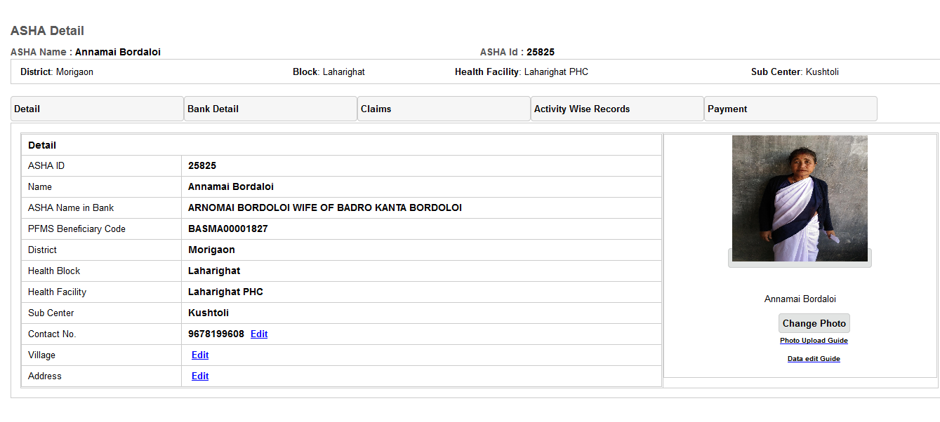
ASHA Comprehensive Database
ASHA Database with photographs
ASHA Database with Photographs

Slide 27
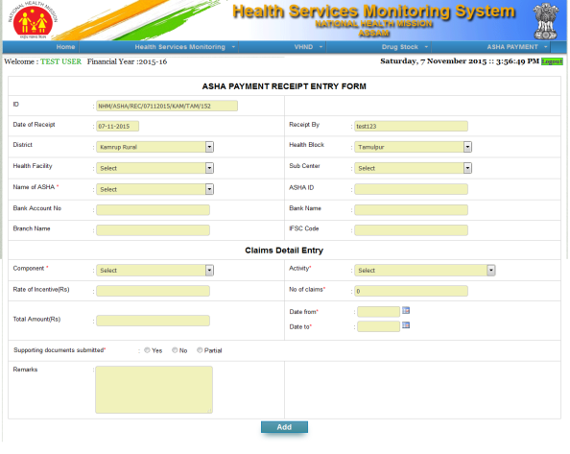
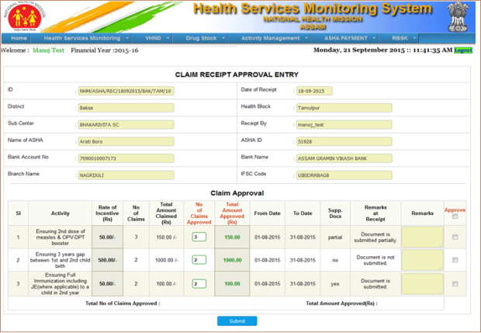
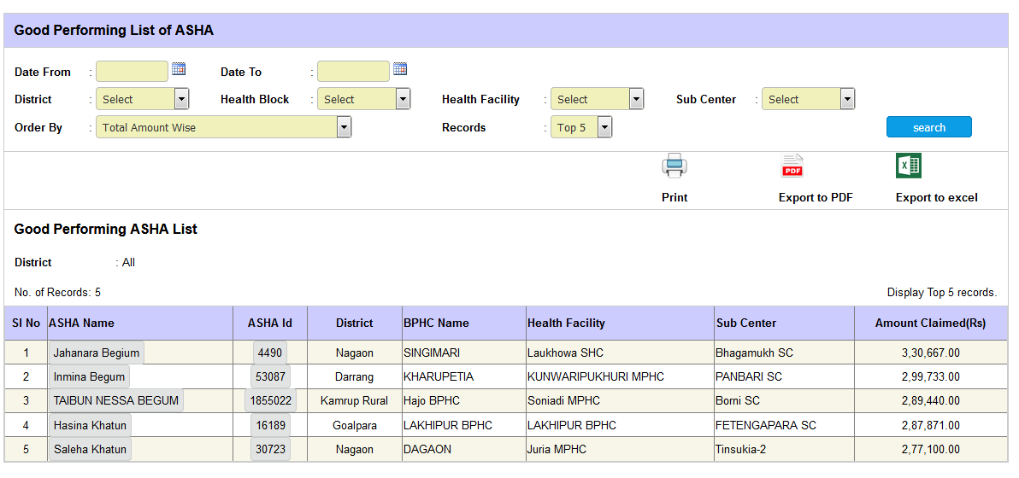
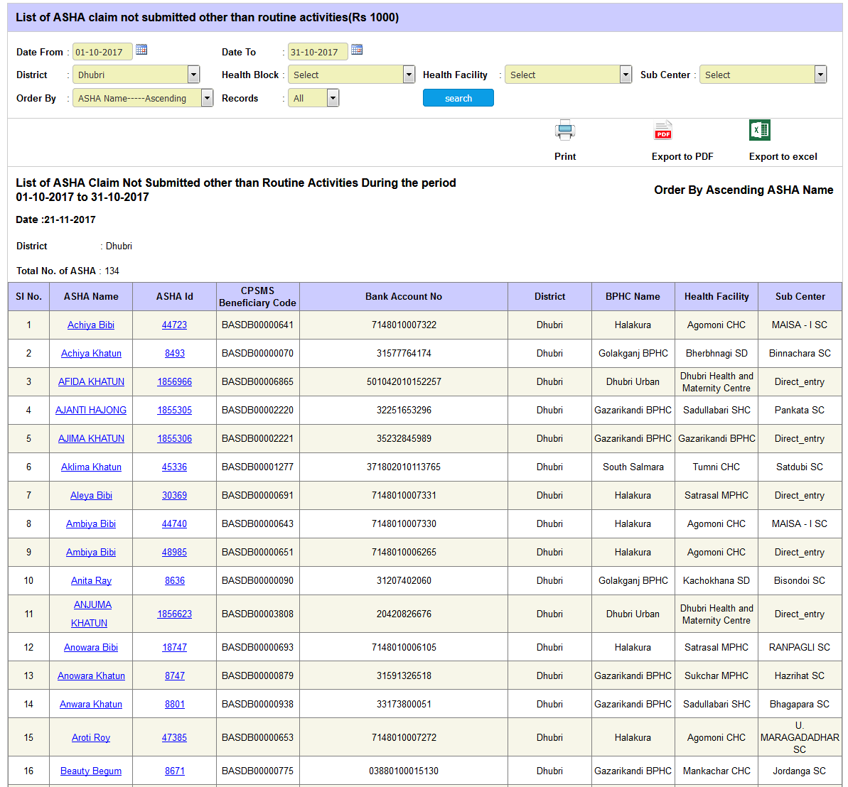
APPMS: Customized Workflows
Receipt Entry Form
Approval of receipt
Good performing ASHAs
Poor performing ASHAs

Slide 28
The USP for APPMS: Power of 100%
100% ASHA Master Database created with all vital information
100% Dashboard Analytics
100% DBT with link to GOI PFMS portal – more than Rs. 245 Cr. DBT payment
100% open source technology
100% in House capacity utilized
100% Drill Downs
100% SMS generated alarms
100% Categorization of ASHAs based on performance
Award to good performing ASHAs, re-orientation to poor performing ASHAs.
100% Categorization of activities based on performance
Restructuring poor performing activities.

Slide 29
Assam Health System Benefitted!!!
Transparency ( Being Aware…Beware!!!)
Improved Service Provider Satisfaction ( We Care.. You Take Care!!!)
Reduced stress on multiple complex procedures ( Will No more be Business As Usual !!!)
Improved Work Performance (What gets measured gets done!!!)
Quality of ASHA trainings improved (Learn More to Earn More!!!)

Slide 30
ASHAs Performed More Activities Earning More

Slide 31
Outcome of ASHA work: Highest Reduction of U5MR in the Country
7 points drop
4 points drop
10 points drop
15 points drop in 5 years
21 points drop in 3 years

Slide 32
VHND Monitoring Module

Slide 33
Village Health & Nutrition Day (VHND) Monitoring Module
VHNDs are monitored by health officials to ensure quality of services and the same is uploaded in online system along with photographs.
Micro-plan for VHND monitoring prepared- 24,856 VHND planning
One VHND can be revisited once all VHNDs of the Block completed.
It is linked with the HR database and performance appraisal of DPMU and BPMU staffs.
Verification of pregnant women and children as per MCTS Work Plan by all monitoring officer has been made mandatory.
Identification and tracking of High risk cases, ensuring availability of Drugs, vaccine and other consumables are monitored and reviewed during VHND visit- 31000 HRP identified and tracked

Slide 34
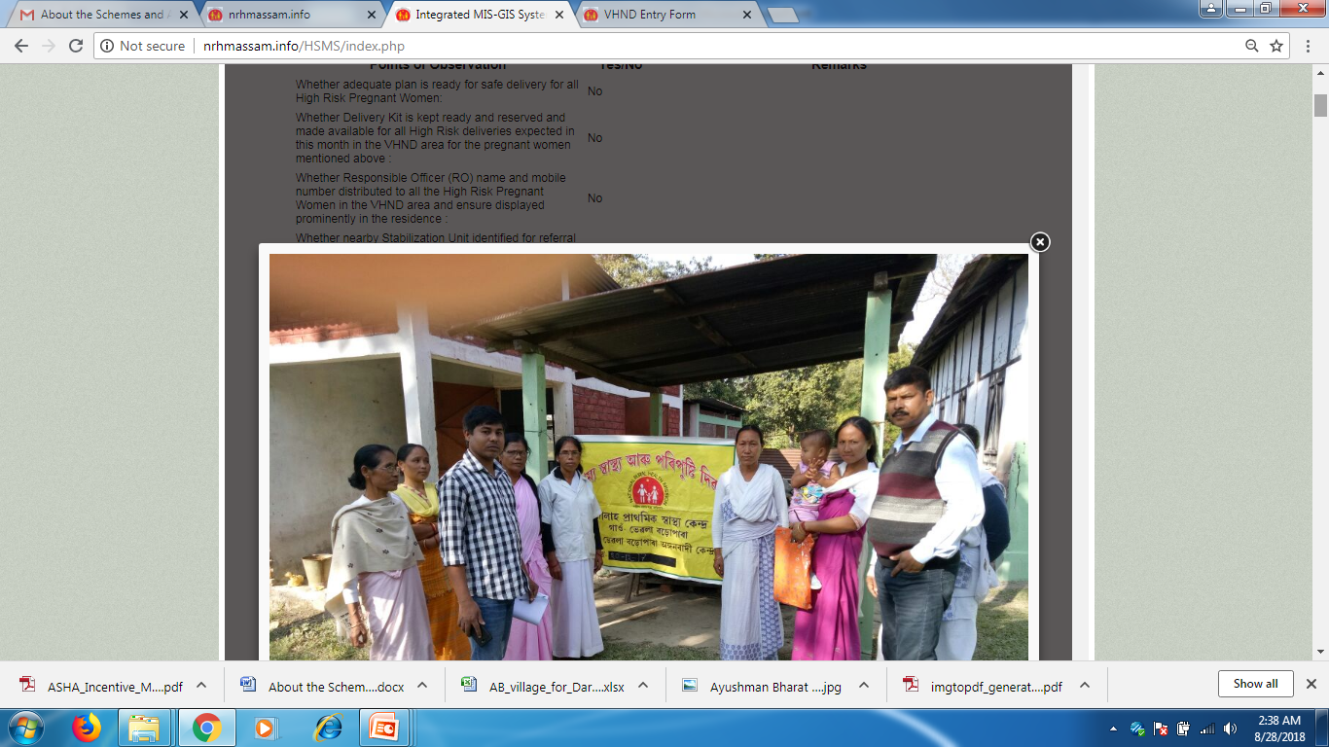
VHND Monitoring – 100% Drill down option
District wise upload status
VHND site wise upload status
Uploaded report of VHND – View option
Photographs uploaded

Slide 35
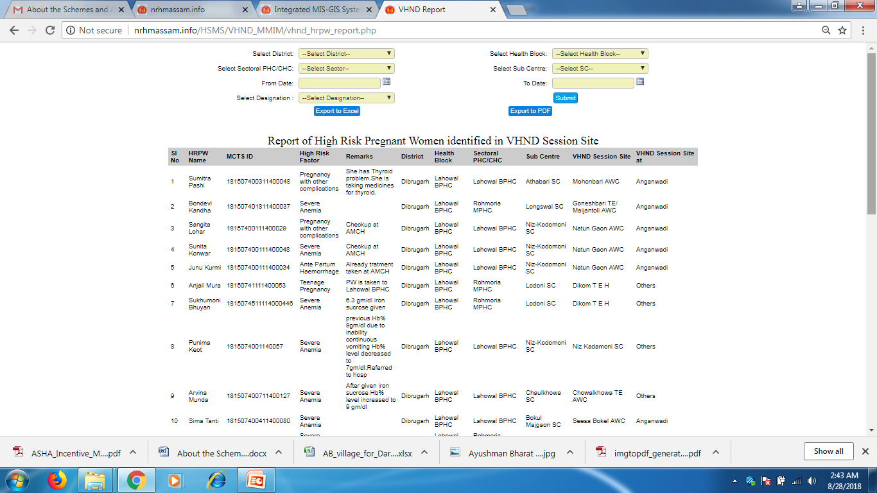
VHND Monitoring – Analytical reports with query builder
Analytical reports with query builder
HRPW Tracking

Slide 36
Outcome of VHND Monitoring
For 2018-19, mor than 52,399 VHND monitoring checklists uploaded in the system till 29th October 2018.
Improved VHND
Number of VHND organized:
2016-17 (Apr-Mar) = 2,90,258
2017-18 (Apr-Mar) = 3,08,299
Better service delivery at the VHND
Hand holding of ANMs during VHND for enhancement of capacity
Ensured regular VHND
Improvement in service delivery updation in MCTS as monitoring officers validate MCTS work-plan.

Slide 37
Maternal & Infant Death Reporting Module

Slide 38
Maternal and Infant Death Reporting Module
Timely getting of line listing of Maternal and Child Death is important for proper Maternal Death Review (MDR) and Child Death Review (CDR)
Any maternal or infant deaths occurred in any public health facility is uploaded immediately after death (within 1 hour).
Deaths occurred at home or transit are also captured within 48 hours through the system.
Basic information of the deceased along with MCTS Id is captured through the system.
Reflected in the online system and Dashboard.
Line listing of deaths are generated from the system and used for Maternal Death Review and Child Death Review.

Slide 39
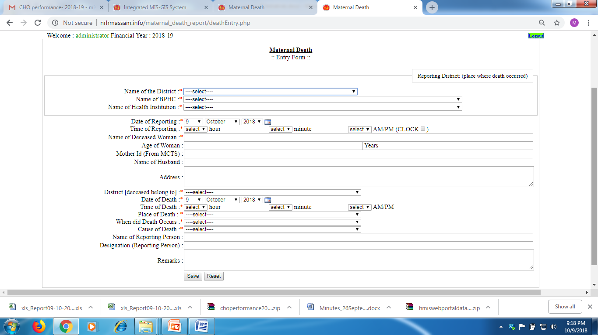
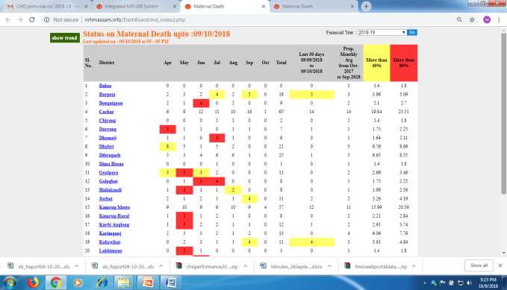
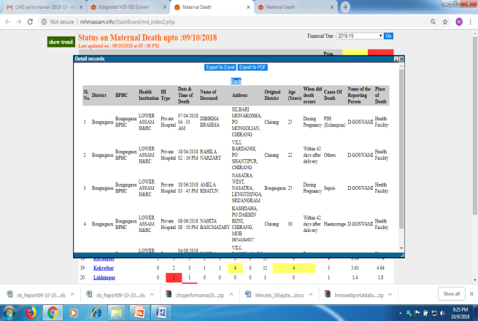
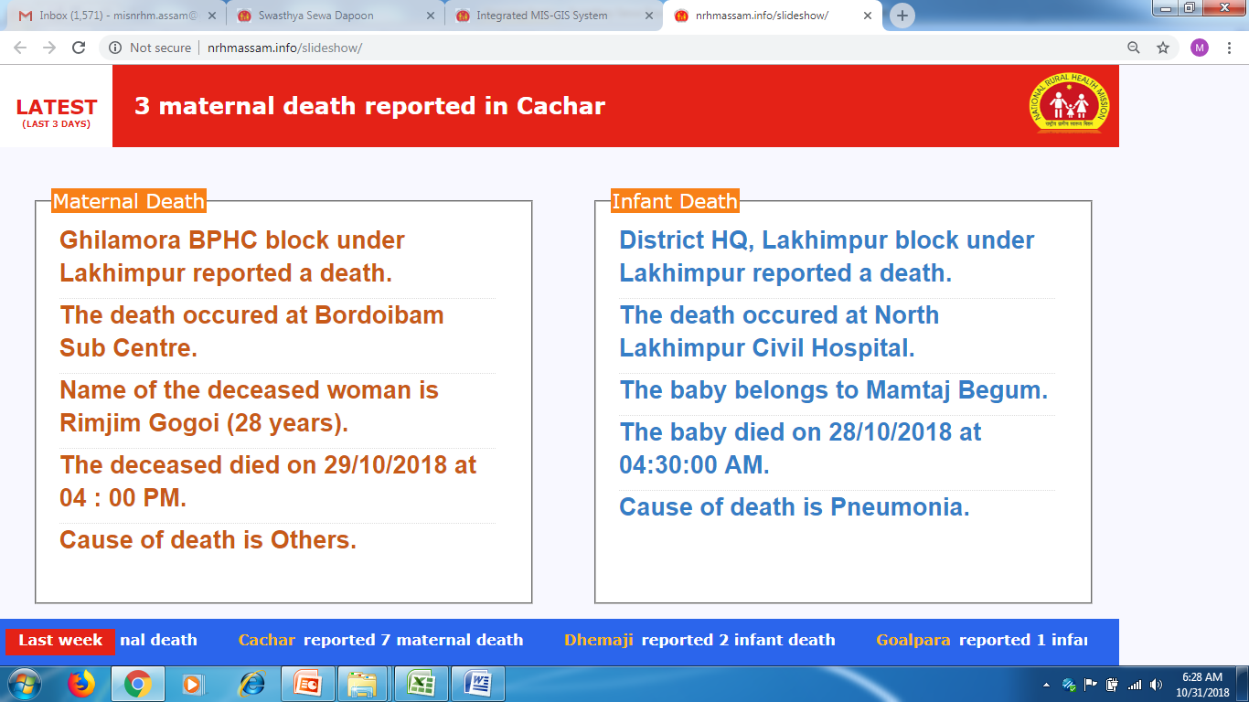
Maternal and Infant Death Reporting Module
First Information Report Entry Form
Dashboard report with alert
Line Listing of deaths
Control Room Dashboard

Slide 40
Outcome of Maternal and Infant Death Reporting Module
Significant improvement of reporting of Maternal and Infant Deaths.
Completion of MDR based on line listing.
Maternal Mortality Ratio (MMR) of the State was 480 in the year 2004-06. The MMR figure has come down to 237 in 2014-16.
Latest SRS published report highlighted 10 points drop of Under 5 Mortality Rate (U5MR) within one year where U5MR has come down to 52 (2016, SRS) from 62 (2015, SRS).
Similarly, there is significant reduction of Infant Mortality Rate (IMR) in the State by reducing 24 points from 68 (2005, SRS, RGI) to 44 (2016, SRS, RGI).
Child Death Review module has been developed and implemented successfully in two districts on pilot basis. It is being rolled out in all districts of the State.

Slide 41
Financial Monitoring System (FMS)

Slide 42
Financial Monitoring Module
Challenges:
Availability of fund at the periphery level health institution was a challenge.
It hampers programme implementation.
Irregular JSY, ASHA incentive payment due to irrational distribution of fund.
Though 100% Bank Accounts are mapped with PFMS and 100% payments are made through PFMS, but it is a challenge to monitor fund position of each account through PFMS.
Strategies:
NHM, Assam developed and implemented online Financial Monitoring System to track and monitor availability of fund at all levels.
Fund available in each Account at each health institution, Block and District are monitored through this system.

Slide 43
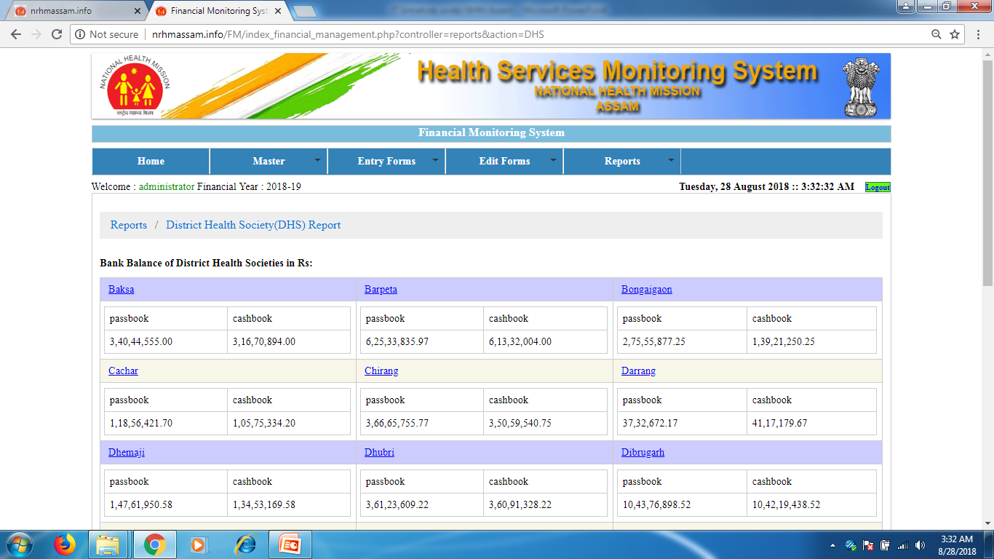
Financial Monitoring Module
District Health Society wise fund position
Health Institution wise fund position
There is no fund crisis in health facility in the financial year 2018-19 till date after implementation of the system from March 2018.
Helped rational distribution of fund at all health facilities.
Programmes not hampered due to shortage of fund.

Slide 44
Inventory Management Module

Slide 45
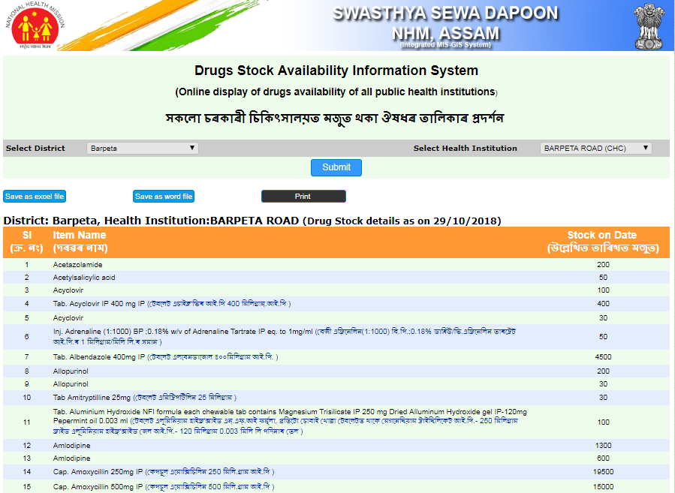
Inventory Management Module
To track the flow of items purchased from the procurement activities to the distribution of items up to Health Institutions across the states.
Passbook System - Notional Budget is allotted to every Health Institution for monitoring of Inventory and rational use of drugs.
Modules:
Purchase Order
Dispatch Clearance –Lab Test report and PBG
Receive Item
Issue Item
Passbook
Reports & Dashboard
Online display of stock of Medicine in Public Domain
Online display of Drugs Availability in local language in Public Domain

Slide 46
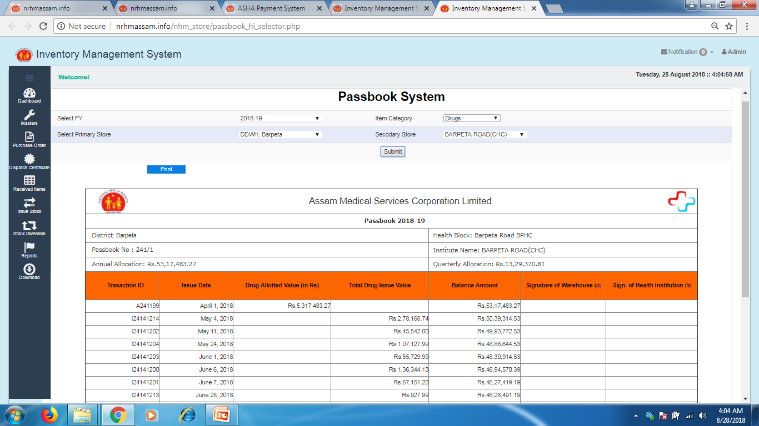
Inventory Management Module - Passbook
Online passbook generated from the system

Slide 47
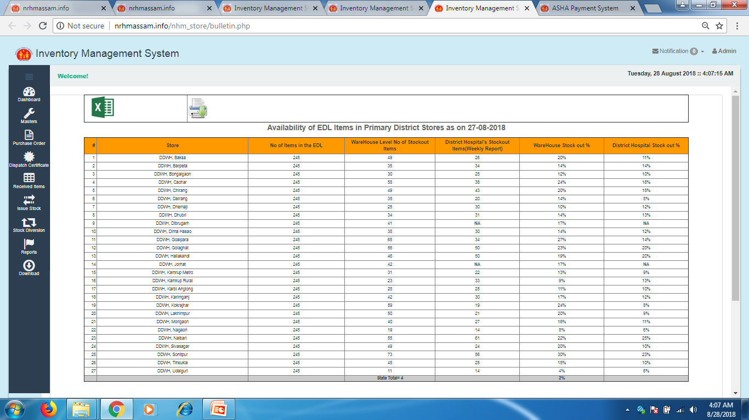
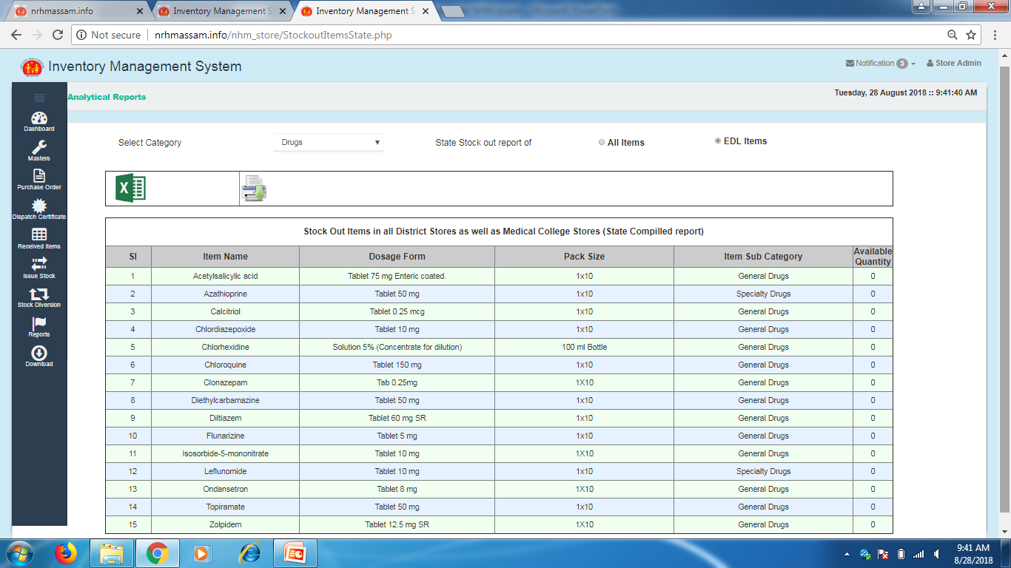
Inventory Management Module
Daily Bulletin
Stock out rate analysis

Slide 48
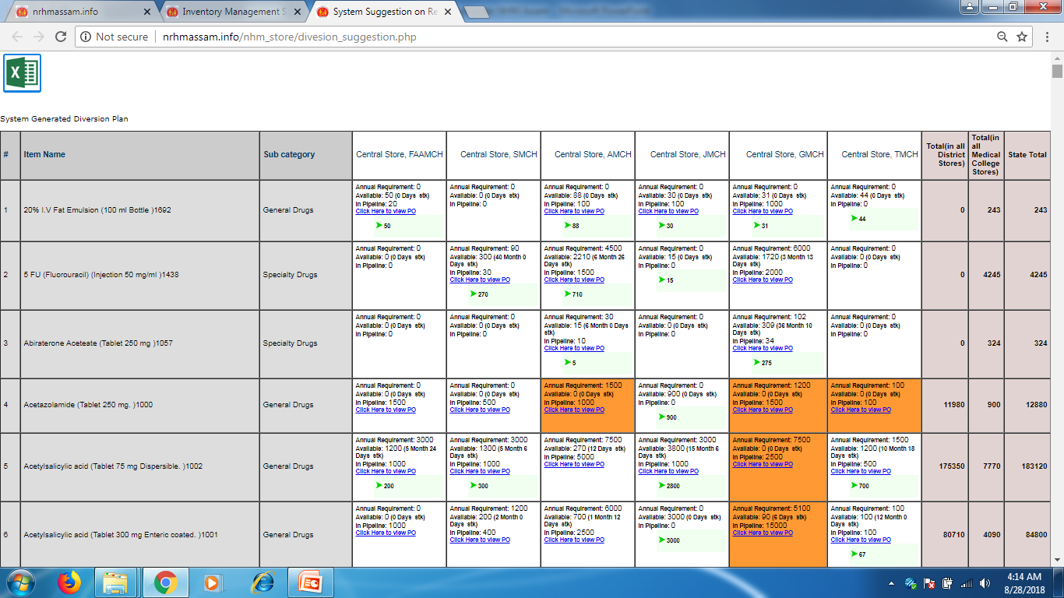
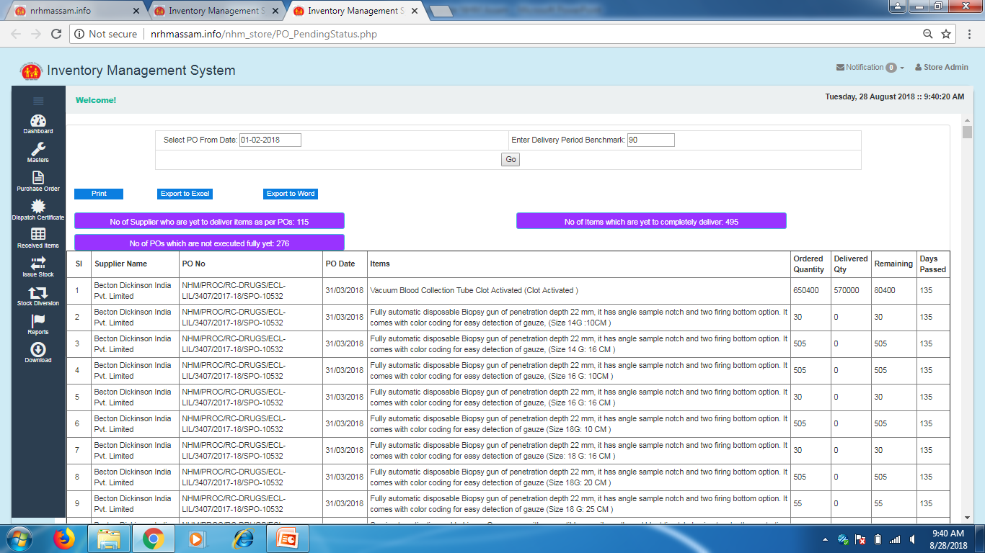
Inventory Management Module
Diversion Plan
PO Tracking

Slide 49
Outcome - Inventory Management Module
Availability of medicines has improved significantly and stock out rate of EDL has come down below 10%.
As FIFO based issue is ensured through the system, expired medicines number has decreased.
Easy decision making of authority to ensure availability of medicine by using diversion plan for emergency situations.
Increased Accountability and unnecessary indenting significantly decreased.
Quality drugs could be ensured, as without dispatch clearance from State after receipt of NABL certificate, drugs cannot be receipt at any Store.
Budgets tracked-Execution of Purchase Orders are completed on fast track

Slide 50
Monitoring of Health Infrastructure Development - Module
Civil Works Monitoring System

Slide 51
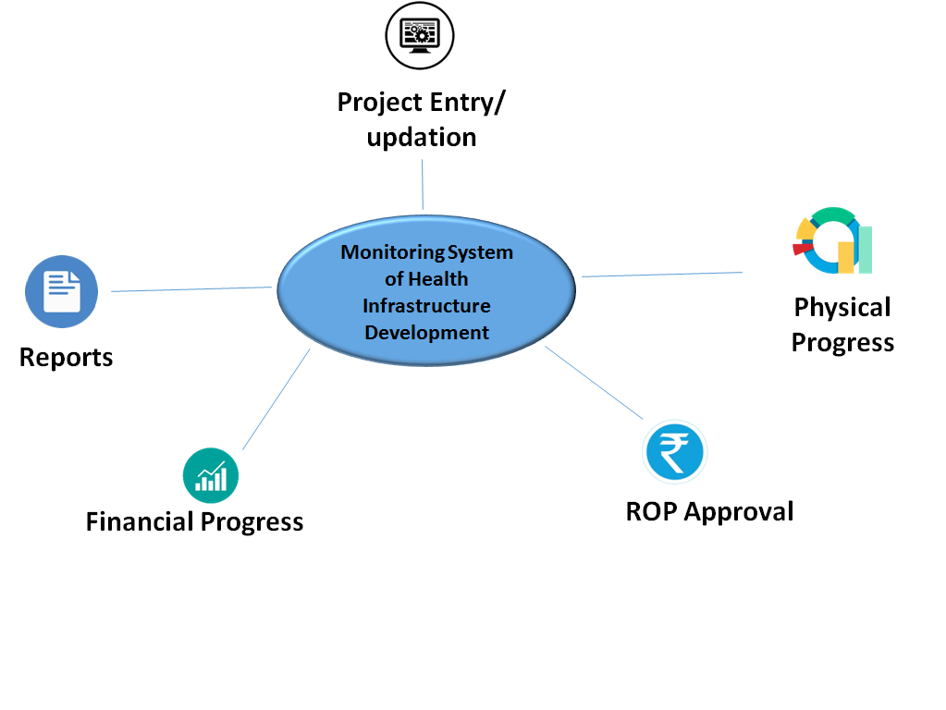
Monitoring System of Health Infrastructure Development
To monitor the physical and financial progress of the civil works going on different Health Institutions
Linked with the Health Institution Master at the time of taking the work
It keeps the record of various works, their approval and sanction amounts, contractor and agency details and status of the works.

Slide 52
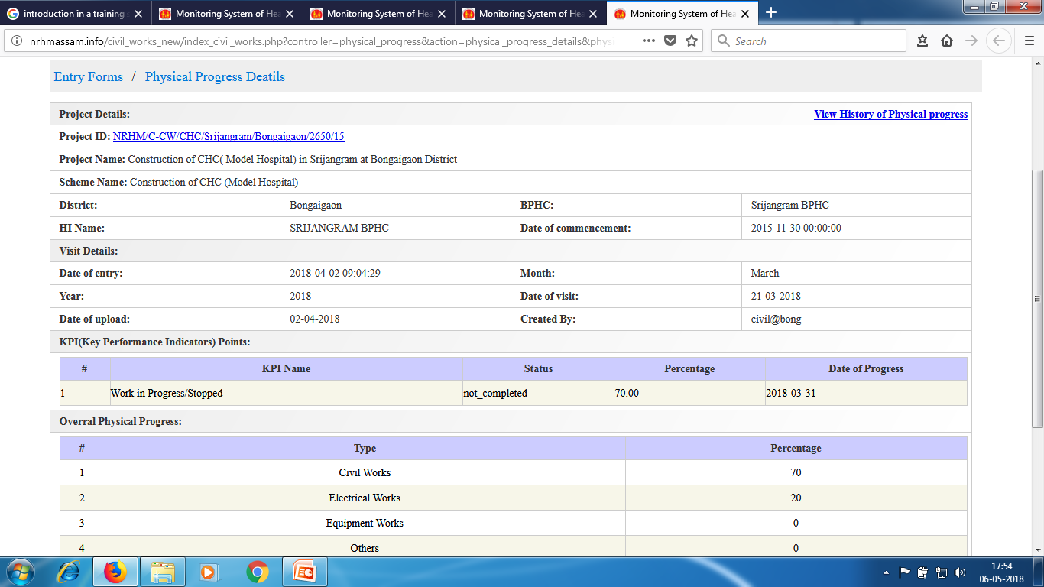
Monitoring System of Health Infrastructure Development
Captures all vital information of each project
Monitoring of each project with photographs

Slide 53
Outcome - Monitoring System of Health Infrastructure Development
Fast track completion of construction activities due to structured and evidence based monitoring of progress.
Identified the stagnant projects, reviewed and take appropriate steps for early completion.
Proper monitoring of physical and financial progress of each projects at all levels.
Increased accountability of Monitoring officers as they have to visit the sites on regular basis and upload progress along with photographs. It has also resulted correct report of physical progress.
Tracking of utilization against RoP approval.

Slide 54
Sustainability and Replicability

Slide 55
Sustainability and Replicability of Swasthya Sewa Dapoon
Cost effective:
No extra fund required.
System developed using in-house capacity
Open Source Technology
Hosted in NHM own server
Customized Application:
Regular customization as per need
Compatibility:
Easy compatibility - NIN integrated
DBT Payment: Utilized services of PFMS for DBT payment.
Women empowerment.
Transparency in the system

Slide 56
Thank You

