Slide 1

Setting up of a Labour Delivery Recovery Rooms –Telangana State

Slide 2
Why this Intervention?
A. Interventions around Birth – 41% impact
Skilled birth attendance, emergency obstetric care, neonatal resuscitation and immediate care at birth
B. Care of Small and Sick newborn – 30% impact
Kangaroo mother care, SNCU, Full supportive care
C. Community Care – 25 to 30% impact
Exclusive Breast feeding, hand washing, home based care, behaviors & practices
India specific analyses based on EN Lancet Paper 3, 2014 by AIIMS, V.K Paul
Notes:
Interventions around Birth – 41% impact (hence focus on intervention around birth)
Skilled birth attendance, emergency obstetric care, neonatal resuscitation and immediate care at birth
Care of Small and Sick newborn – 30% impact
Kangaroo mother care, SNCU, Full supportive care
Community Care – 25 to 30% impact
Exclusive Breast feeding, hand washing, home based care, behaviors & practices

Slide 3
Background
Institutional delivery rate stood at 92% in the state - only 31% in public facilities (NFHS 4). [It crossed 50% now.]
Determination of state to improve quality of care and services in public facilities as per WHO quality standards
Need to introduce Respectful Maternity Care in Public facilities and a safe sensitive environment providing skilled services
First brainstorming between state officials and UNICEF in Dec 2016
Decision - “Standardization of LRs” using LDR concepts to be taken up on war-footing across all high load delivery points using MoHFW guidelines.

Slide 4
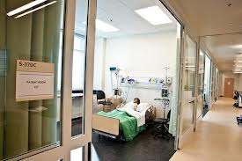
What is LDR (Labour - Delivery - Recovery)
A birthing unit that is
Standardized
Provides privacy and comfort
Eliminates the need to shift mother in different stages of labour
Includes all the support areas
Catering to a mother exclusively
during labour and immediate postpartum.

Slide 5
Process adopted in Standardization
Consultation meetings with the partners, academic institutions and technical experts – Jan 2017
MoHFW checklist adapted for conducting assessment to suit local need – Feb 2017
Assessors identified from the Health Department/NHM, TSMSIDC (Engineers) & Development Partners. Ten teams constituted - Feb 2017
State level assessment teams oriented to tool - March 2017
Technical Support Unit (5 member) set up at IIHFW – March 2017
Identification of facilities - March 2017
Detailed assessments conducted along with the Heads of facilities, Engineers, Obstetricians etc. – April 2017 onwards

Slide 6
Process adopted in Standardization….
District Collectors were appraised of the process and the progress
Data collected, analysed and collated.
Designs finalized at state by core team and estimates prepared
Follow up actions by respective teams & thematic areas
New case sheets designed taking into account C-Section details and “Robson’s criteria”
Dakshata trainings accelerated

Slide 7
Focus Areas for Assessment
  Space, design and layout
  Equipment and accessories
  Consumables
  Human Resources
  Practices and Protocols

Slide 8
Layout Modification in Standardization of Labour Room
New space created
Spaces modified
Triage
Companion waiting area
Registration area
Newborn care area
KMC ward
Utility/ Service Corridor
Labour delivery & Recovery
Nurse station – 1 in each vital area
Hand was and scrub
Toilets
Maternity wards
Dirty utility
Above all better ambience illumination and clean space inviting /client centric and friendly

Slide 9
Type of facilities included for Standardisation of Birthing Units
Type of Facility | Phase 1 | Phase 2 | Phase 3 | Total
District Hospitals | 1 | 3 | 0 | 4
Tertiary Hospitals | 3 | 0 | 0 | 3
MCH | 4 | 1 | 0 | 5
Community Health Centres | 30 | 46 | 1 | 77
Area Hospitals | 30 | 3 | 0 | 33
Primary Health Centres | 18 | 39 | 126 | 183
Total | 86 | 92 | 127 | 305

Slide 10
Budget and Progress during 3 Phases
Activity | No. of facilities | Budget Sanctioned (In crores) | Progress
Phase-1 assessment | 86 | 3.21 | Standardization completed in 205 facilities till date.
Phase-2 assessment | 92 | 8.78
Phase-3 assessment | 127 | 14.02
Total | 305 | 26.14

Slide 11
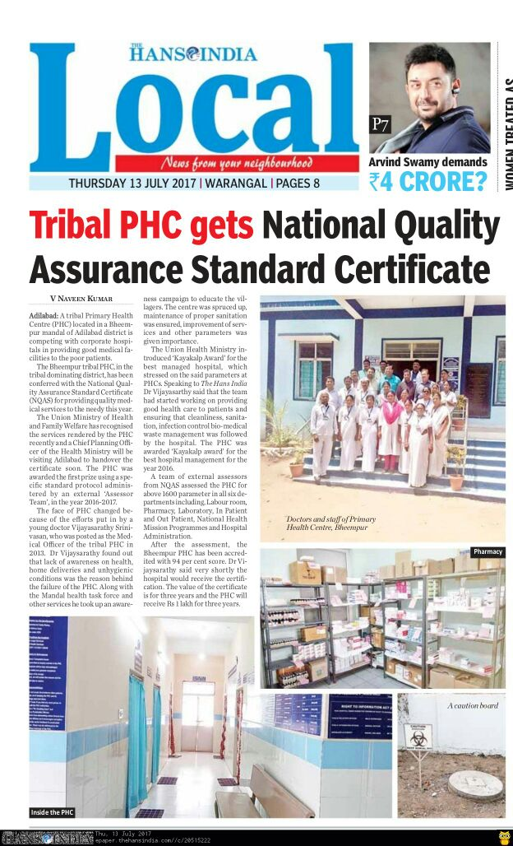
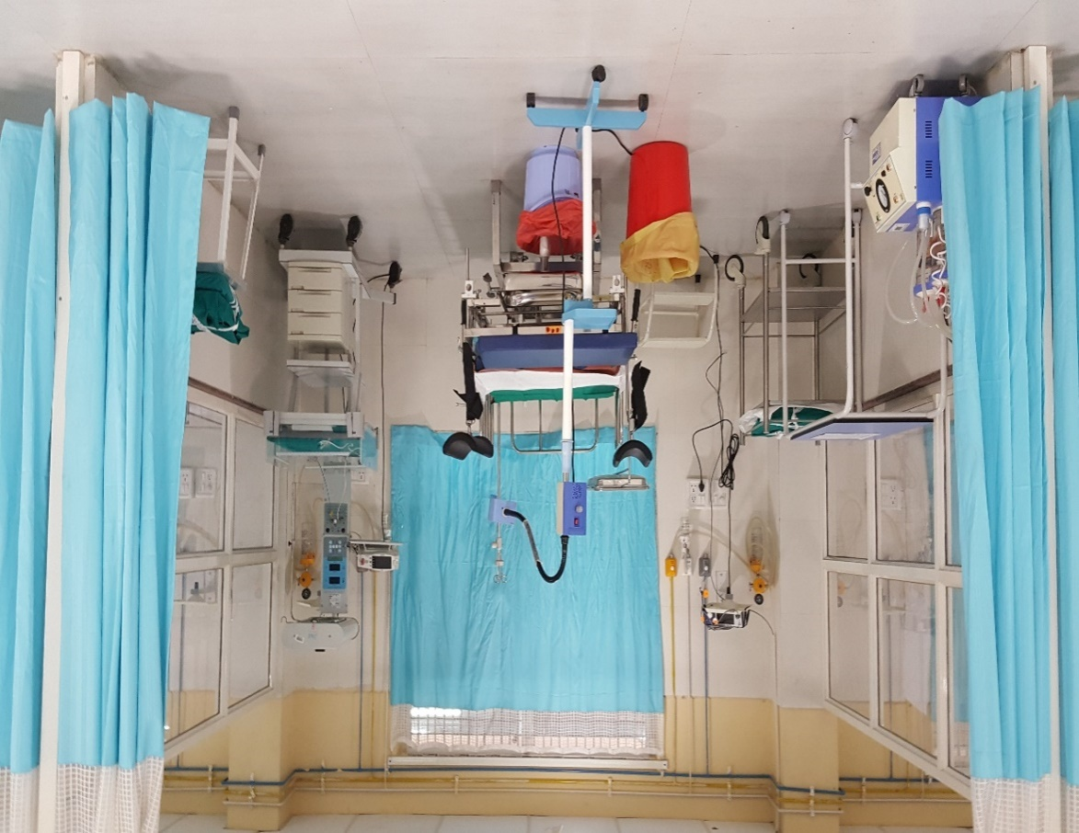
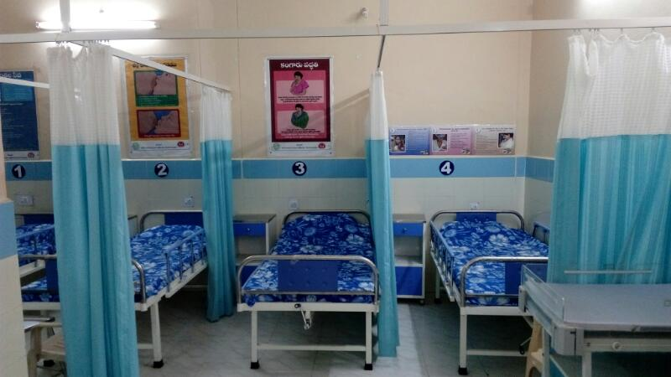
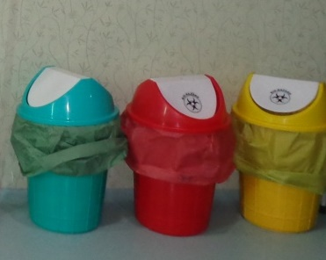
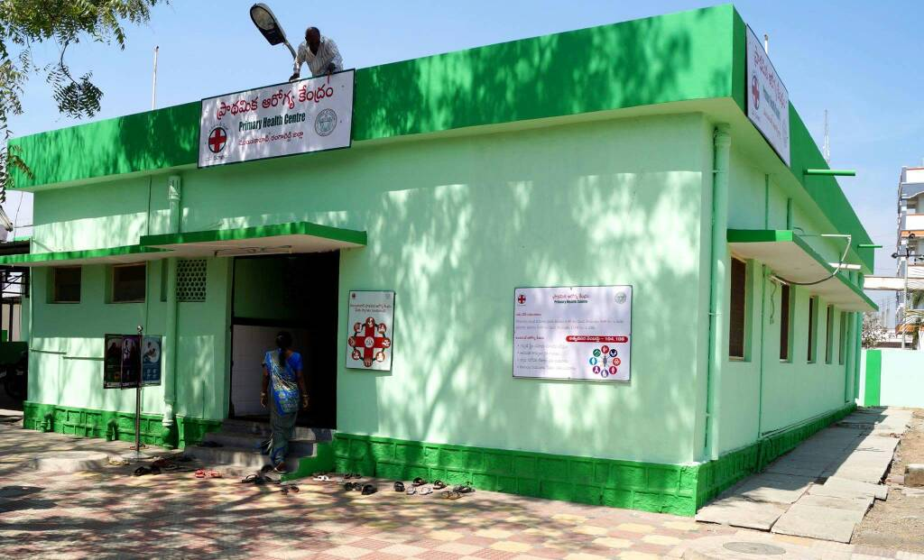
GLIMPSES
Assured service quality
Branding
Clean facilities

Slide 12
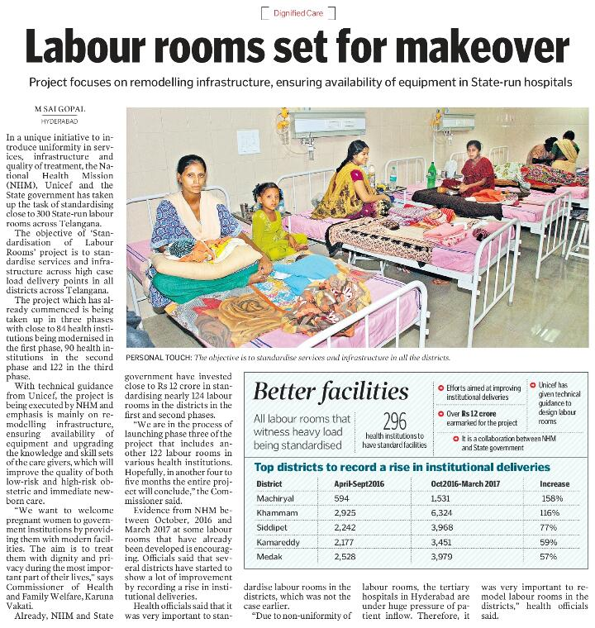
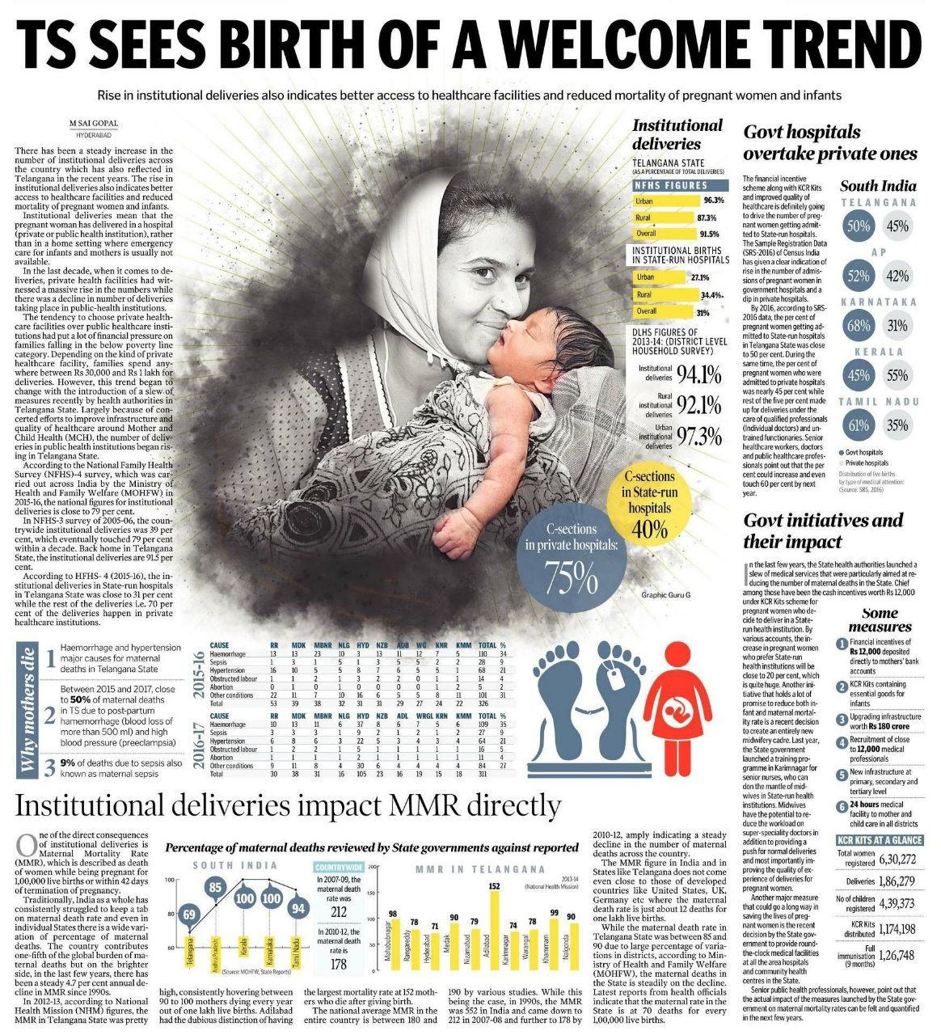
Changing Trends in Media
Increase in institutional deliveries in Public facilities in Telangana: Outcome of a variety of factors like Standardization of Labour Rooms, Focus on skilled human resource, Government schemes like cash incentives and KCR kit, emphasis on quality of humane care.

Slide 13
Way Forward
Saturate Dakshata trainings and regular mentoring visits to ensure correct practices.
Clinical internship planned for providers from low load facilities to avoid attrition of skills.
Digitization of case sheets.
Ensure supply of equipment to all the completed facilities
Address gaps observed during field visits.
High Dependency Units and Obstetric ICUs in tertiary facilities to tackle complications.

Slide 14

Nurse Practitioner Midwifery for Safe Natural Birthing
5th National Summit on “Good & Replicable Practices and Innovations in Public Healthcare Systems”
Kaziranga, Assam, 30th October 2018

Slide 15
Problem Statement
Telangana has 600,000 annual deliveries, of which 92% happen in institutions.
Nearly 50% of the deliveries occur in public facilities, while others are in private sector.
Need to ensure Quality Care (> 40% of deaths happen within the first 24 hours of birth)
Shortage of specialists and other human resources skilled in maternity and newborn care in Public sector
Telangana has the highest C-section rates (58% - NFHS 4). As per the WHO, 70-80% of birth could potentially be natural deliveries
As per one of the cost analyses, roughly 14% of the state health budget is being consumed by costs related to providing C-sections, the vast majority of which may not be required.

Slide 16
C-Sections Rate – Two Extremes

Slide 17
Objective
Objectives
To improve the natural birthing experience, quality of care and reduce C-section rate in the state
To incorporate the core competencies and standards of the International Confederation of Midwives (ICM)
To ensure provision of quality of care as per WHO quality protocols
To manage low risk uncomplicated pregnancies through comprehensive antenatal care and childbirth preparation for mothers

Slide 18
Who is a Professional Midwife?
A highly skilled, healthcare professional accountable for the life of the mother and baby.
Must meet the local INC and global standards of competence and education in Professional Midwifery (18 months additional training after a 3-4 year nursing degree). QUALITY AND STANDARD OF TRAINING IS CRUCIAL.
Works in partnership with women to give the necessary support, care and advice during pregnancy, labour and the post-partum period.
As per the 2014 Lancet Midwifery Series, Midwifery is: “Skilled, knowledgeable, and compassionate care for childbearing women, newborn infants, and families across the continuum throughout pre-pregnancy, pregnancy, birth, post-partum, and the early weeks of life.”

Slide 19
Why Professional Midwifery?
Increase in natural births and decreased risk of unnecessary interventions, including C-sections
Reduction in “Out of Pocket expenses”
Healthier babies, healthier mothers
Improved efficiency of health system - Midwives handle low risk cases, while obstetricians focus on complicated cases.
Equally or more preferred modality for normal deliveries in countries like Sweden, U.K., Sri Lanka, etc.

Slide 20
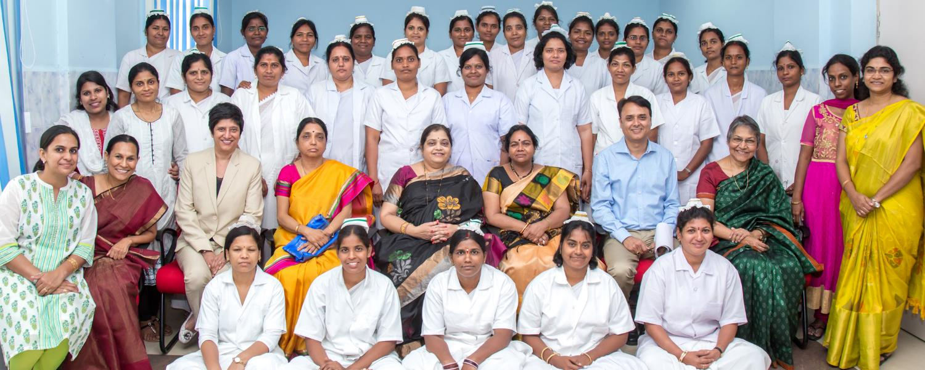
Telangana Experience
Government of Telangana sanctioned 126 positions of Midwives
With NHM’s support, State Government launched midwifery programme in Oct 2017 in collaboration with UNICEF and Fernandez Hospital, Hyderabad
Course duration is 18 months – 12 months theory and clinical mix, followed by 6 months of internship
MCH Hospital, Karimnagar is the training site for the first batch
Notes:
Global Standards -3 years direct entry or 18 months additional training after a 3+ year Nursing degree
India ~6-8 months of maternity care training across the 3-4 years of basic GNM/BSc training
This is just 15% of the 3 years minimum training for direct entry midwifery training and registration
Still, nurses are registered as nurses as well as a midwives after GNM/BSc

Slide 21
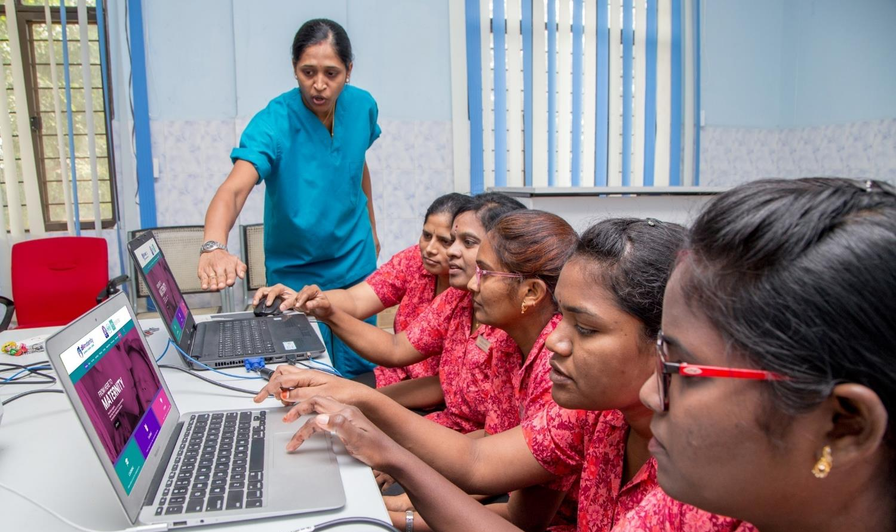
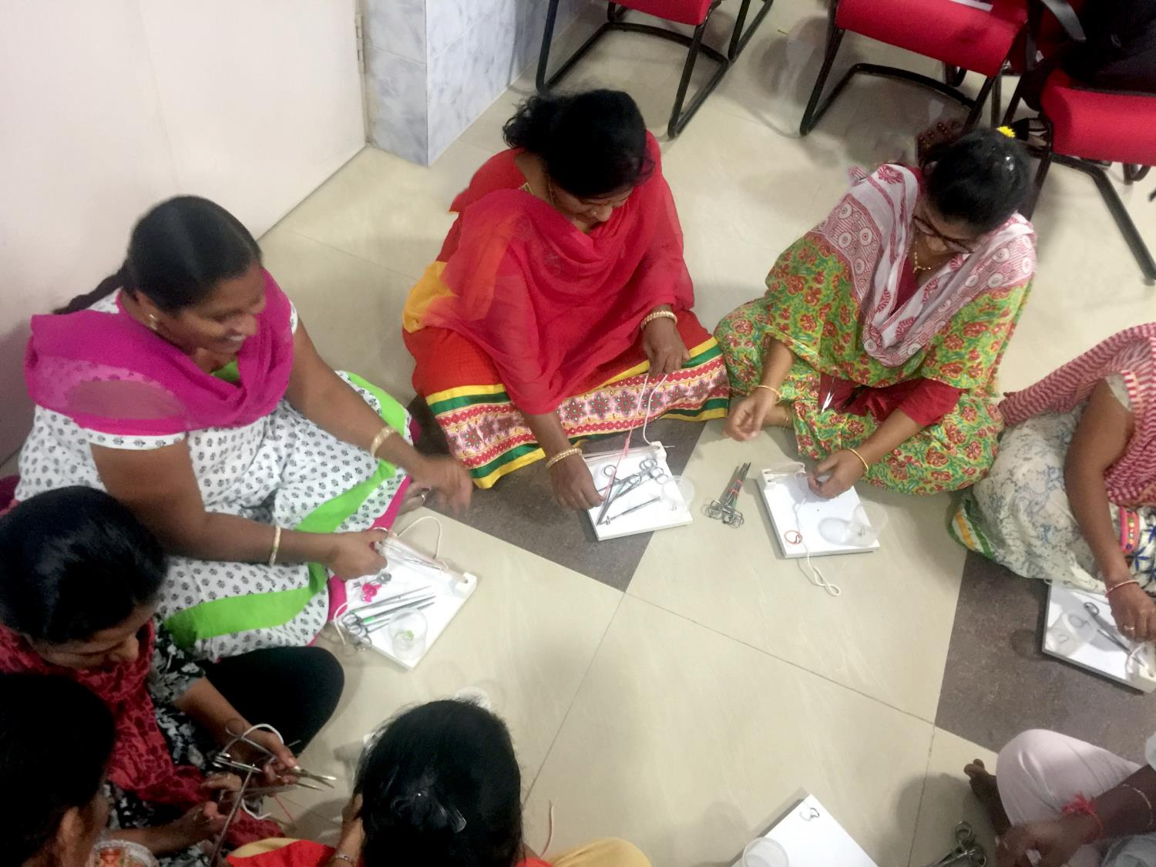
Telangana Experience (contd..)
Thirty students in first batch; identified from existing government staff nurses through a stringent selection process – application, written test, OSCE and aptitude assessment
Course curriculum based on the International Confederation of Midwives (ICM) Standards
Methodology focused on strong skill development – lecture, demonstration, role play, drills, videos, bed side teaching, case scenarios etc.

Slide 22
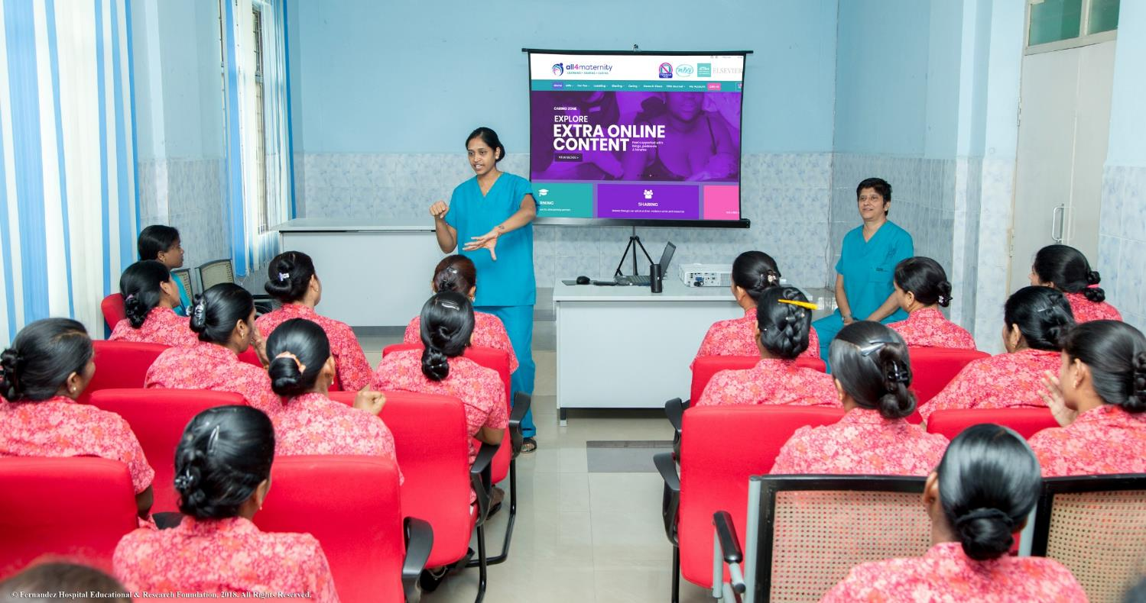
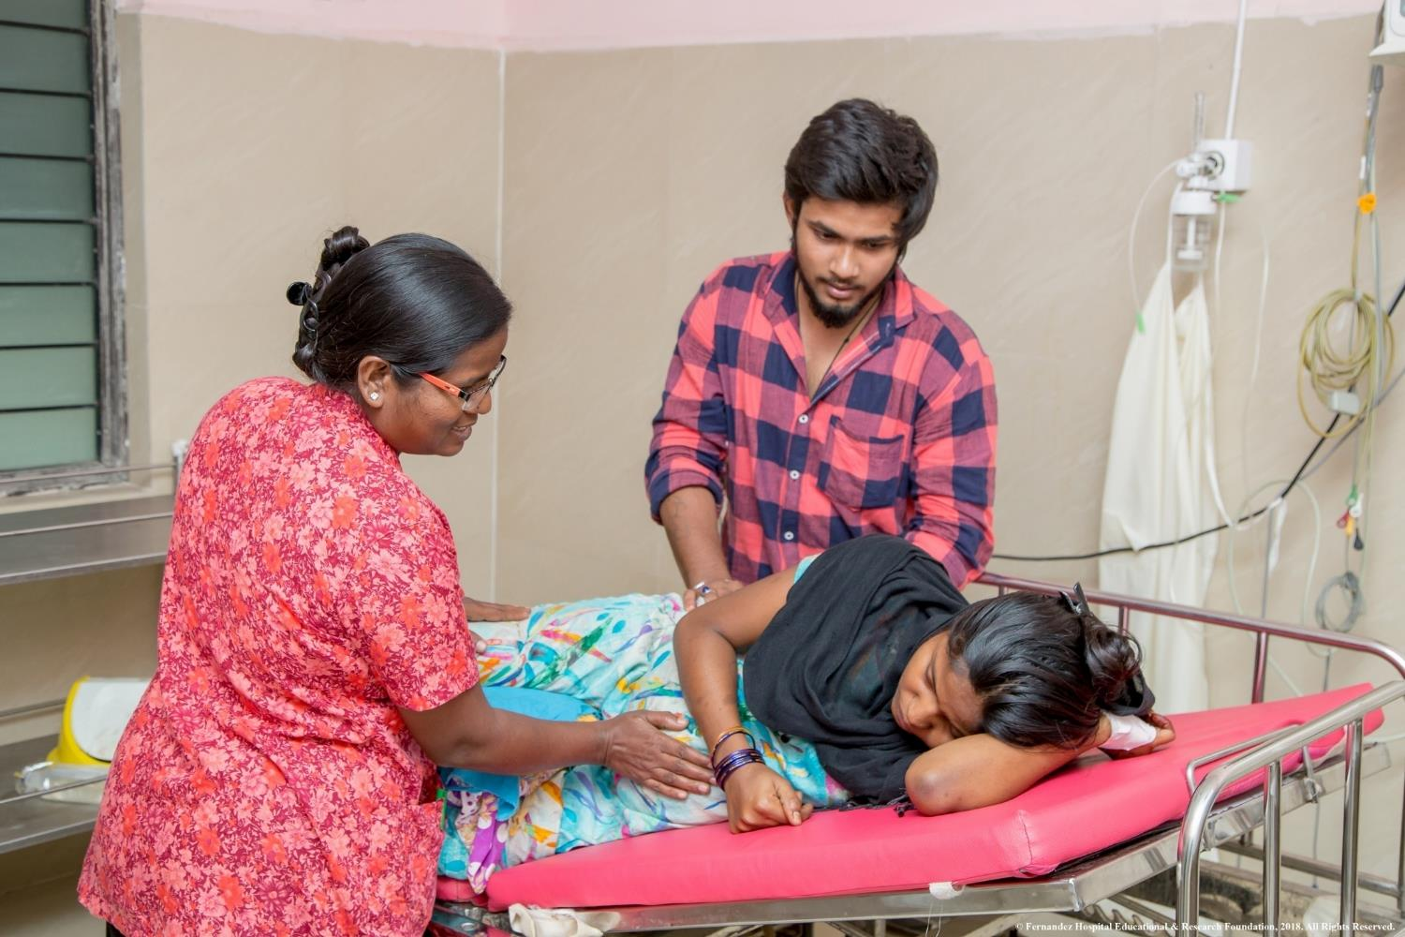
Telangana Experience (contd..)
Training by tutors from Royal College of Midwives, UK and faculty from Fernandez Hospital, Hyderabad
Respectful maternity care and involving families in birthing process are key elements of programme
Post training, candidates to be posted at designated delivery points (CHCs & Area Hospitals) after 18 months of course

Slide 23
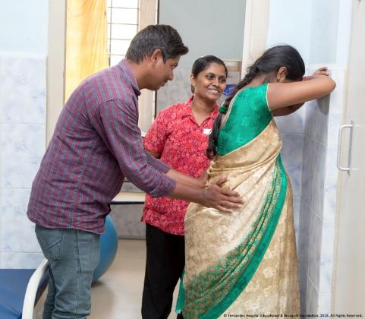
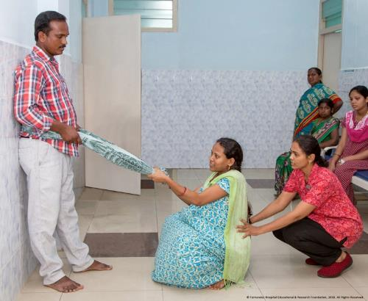
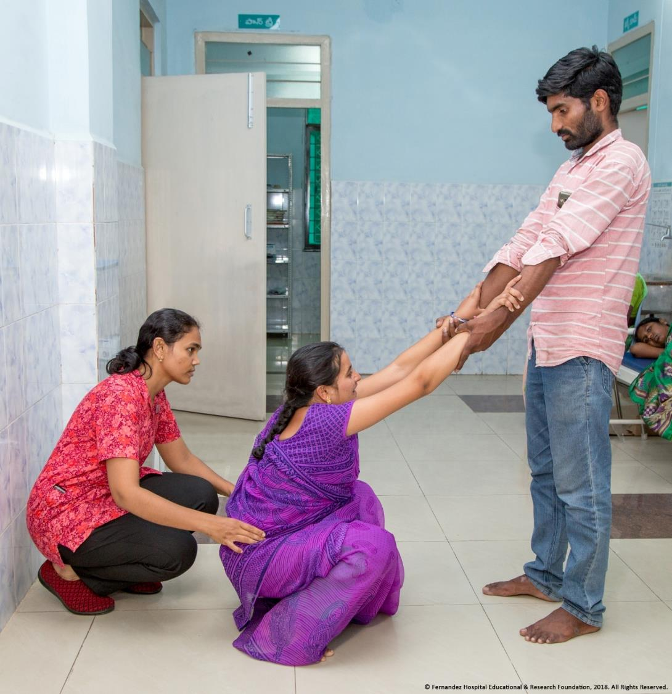
Involving Families ….
Promoting birth companion

Slide 24
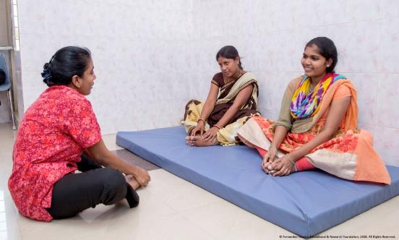
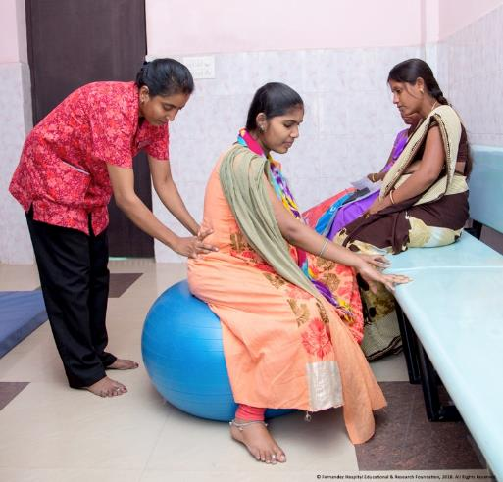
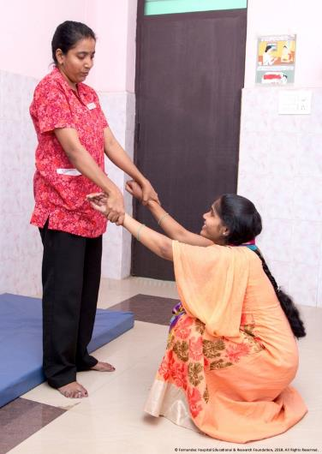
Teaching Pain Relief Exercises
Notes:
Prof. Midwife Trainee Bhavani teaching pain relief Exercises to Moms

Slide 25
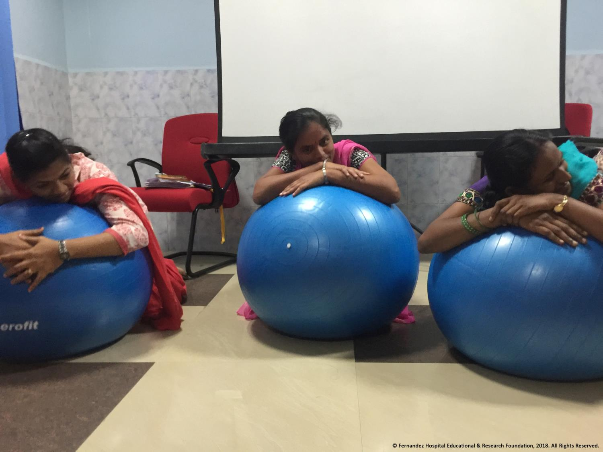
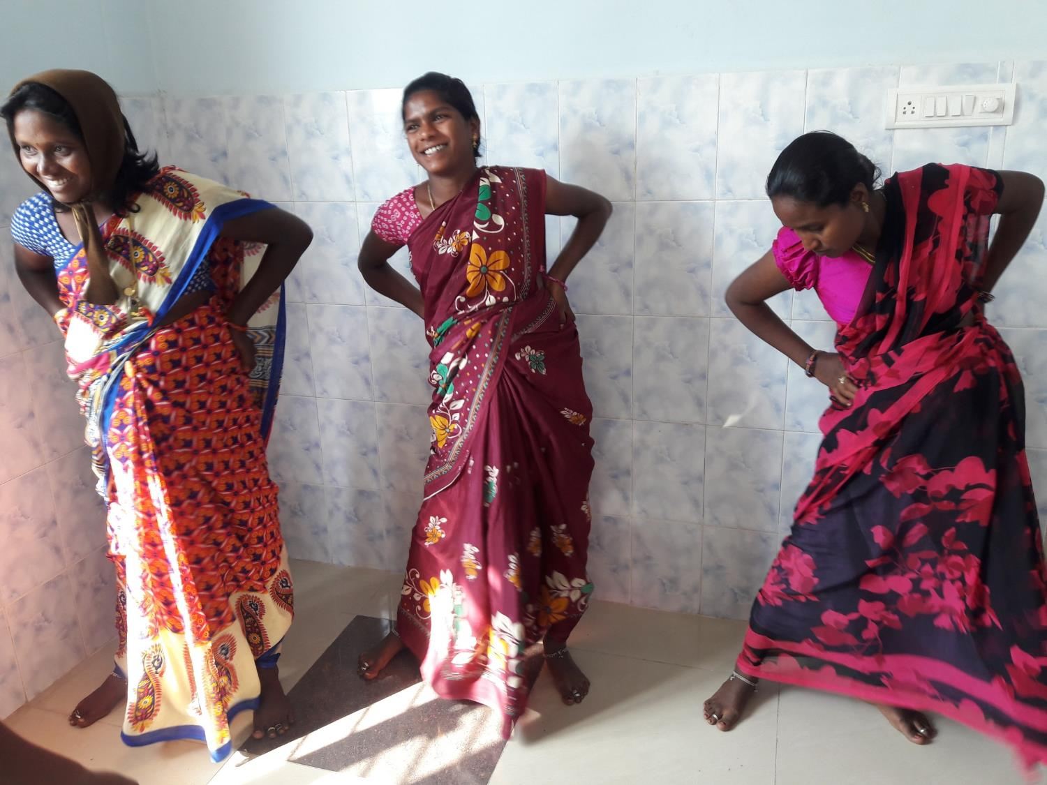
Child Birth Classes

Slide 26
External Evaluation -Preliminary Effects of the Program
Positive Changes in Attitudes/Behaviors
“We were impressed by the changes in attitude in the trainees. While we have not observed all the trainees in action, those who we have observed (at least 20 of the 30), are able to treat the woman with respect. They introduce themselves, ask for consent, give choices to the woman and are empathetic to their situation. This has been a major achievement and the entire credit of this goes to the trainers who taught by practicing these concepts. The trainees observed the trainers and followed in their steps. They now have a role model and a gold standard to follow.“

Slide 27
Changes in Birthing Practices
First six months of intervention showed 10 percent decline in C-Section Rate and similar increase in normal delivery at Karimnagar Hospital.
Notes:
The training started in Nov 17 and the clinical practice started from March 2018. The increase in natural births and decrease in C-Section rate is quite evident.

Slide 28
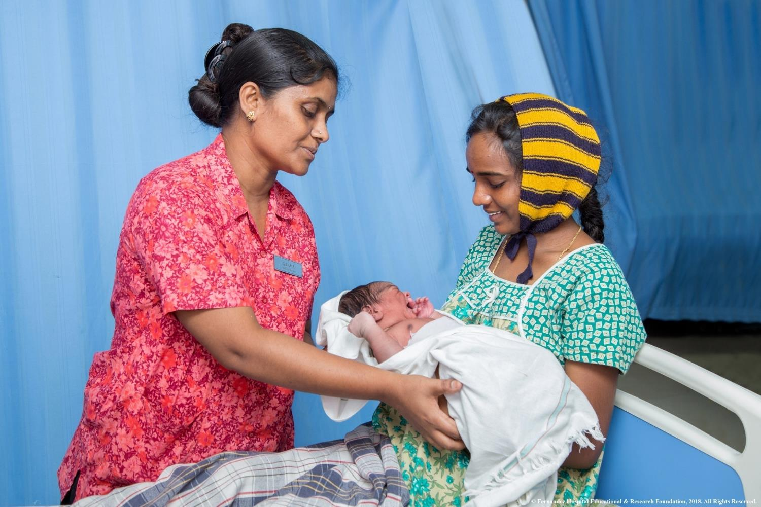
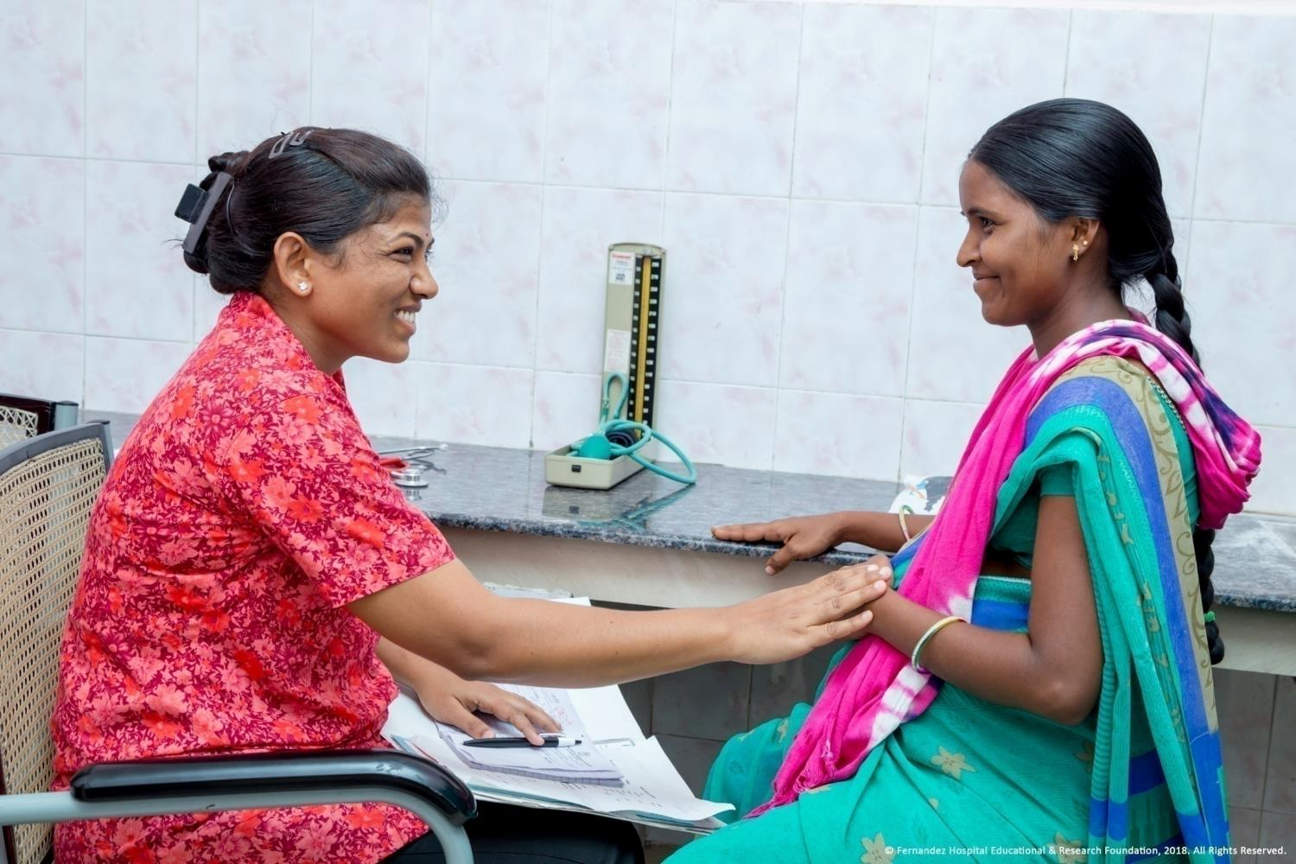
Excerpts
“This is different way of teaching. We are seeing that this is the best way as far as I know. No discrimination. All are treated equally”.
- One of the trainees
“Before I was the kind and honest regarding mother. But I was not bothered about the mother’s feelings. I came to know how important it is to respect the mother’s feelings.”
- One of the trainees

Slide 29
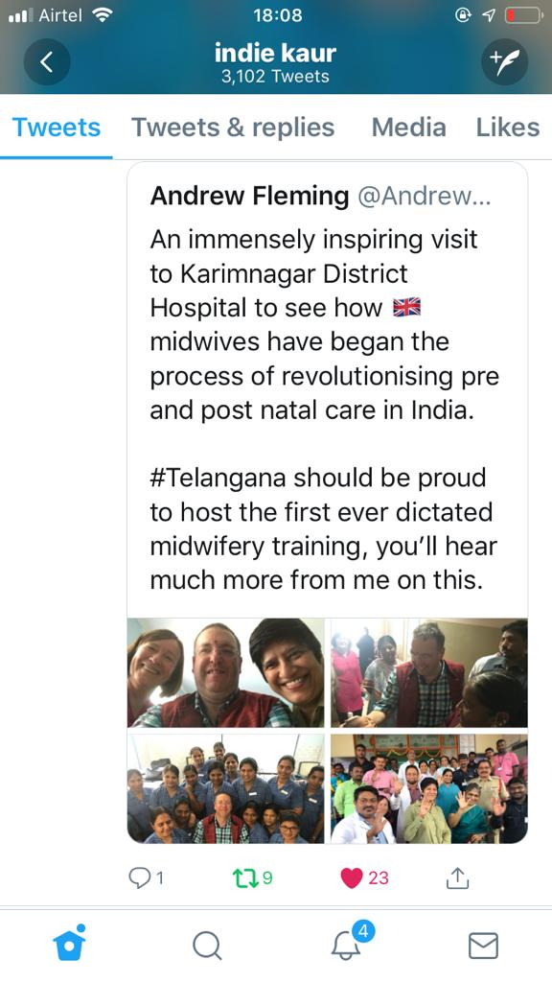
Visit by British Deputy High Commissioner
Notes:
Twitter message of British Deputy High Commissioners on his visit to Karimnagar

Slide 30
Conclusion
Professional Midwifery Course helps develop a cohort of competent, highly skilled professional who ensure respectful maternity care (RMC).
Reduces unnecessary medical interventions including C-Sections – reduces load on health care system thus lowers the cost of the treatment.
Reduction in Maternal and Neonatal, mortality and morbidity.
Decongestion in tertiary care hospitals. Intervention helps bringing quality health services closer to people.
This model warrants nation-wide replication to address the issue of shortage of skilled maternity care providers.

Slide 31
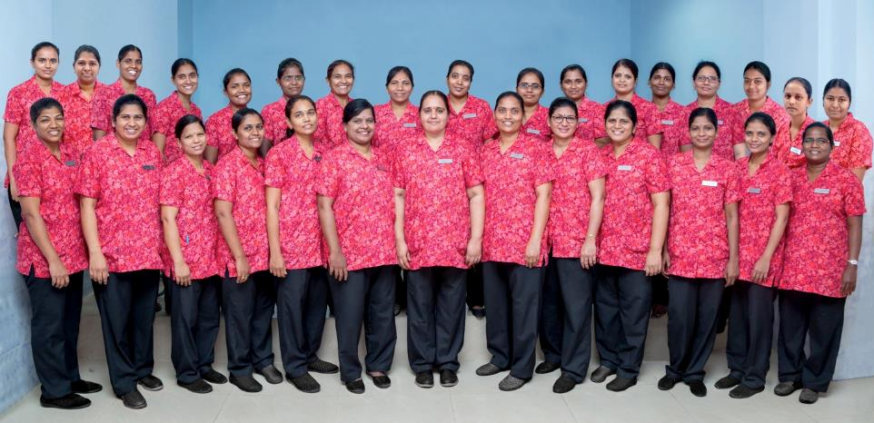




THANK YOU
Although progress is being made to reduce global maternal mortality, a new, broader focus is needed—one that encompasses not only death prevention, but also optimisation of the health status and quality of care for all women.
- Lancet Series
Notes:
Group pic

