Slide 1
STEMI / NSTEMI Programme (An Initiative for Treating Heart Attacks by NHM-TAEI Tamil Nadu)
Dr.Darez Ahamed, IAS
Mission Director – NHM Tamil Nadu

Slide 2
Scheme of presentation
Problem statement
Concept of STEMI/NSTEMI management- Hub and spoke model
Tamilnadu experience in STEMI/NSTEMI
Suggested Template for implementing in states

Slide 3
Heart Attacks
STEMI – ST Elevation Myocardial Infarction
NSTEMI – Non ST Elevation Myocardial Infarction

Slide 4
Problem Statement
Ischemic heart disease is the leading cause of death in India.
Roughly 10 million die per year in India (total deaths)
STEMI incidence is 1.1 per million i.e. 1.34 million STEMI every year
3,50000 to 400,000 STEMI/NSTEMI deaths every year in India (10% mortality) i.e. around 1100 MI deaths per day
Tamil Nadu- 20,000-25,000 STEMI deaths every year i.e 55 STEMI deaths per day in the state.

Slide 5
Global Scenario- CVD
CVDs are the number 1 cause of death globally: more people die annually from CVDs than from any other cause.
An estimated 17.9 million people died from CVDs in 2016, representing 31% of all global deaths. Of these deaths, 85% are due to heart attack and stroke.
Over three quarters of CVD deaths take place in low- and middle-income countries.
Out of the 17 million premature deaths (under the age of 70) due to NCDs in 2015, 82% are in low- and middle-income countries, and 37% are caused by CVDs.
Source: WHO, 2018

Slide 6
Percent of Deaths in 2016 from disease categories in Tamil Nadu (Source : ICMR GBD report 2016)
Non-communicable | 69.2% | Communicable | 17.2% | Injuries | 13.5%
Cardiovascular diseases | 36.1 | Diarrhea, lower respiratory, and other common infectious diseases | 10.6 | Unintentional injuries | 6
Diabetes, urogenital, blood, and endocrine diseases | 12.2 | HIV/AIDS and tuberculosis | 3.8 | Self-harm and interpersonal violence | 4.3
Neoplasms | 7.5 | Neonatal disorders | 1.6 | Transport injuries | 3.2
Chronic respiratory diseases | 6.5 | Neglected tropical diseases and malaria | 0.5
Neurological disorders | 2.3 | Other communicable, maternal, neonatal, and nutritional diseases | 0.4
Digestive diseases | 1.7 | Nutritional deficiencies | 0.2
Cirrhosis and other chronic liver diseases | 1.6 | Maternal disorders | 0.1
Other non-communicable diseases | 0.8
Mental and substance use disorders | 0.4
Musculoskeletal disorders | 0.1

Slide 7
Percent of DALYS in 2016 from disease categories in Tamil Nadu (Source : ICMR GBD report 2016)
Non-communicable | 65.3% | Communicable | 20.4% | Injuries | 14.2%
Cardiovascular diseases | 19.5 | Diarrhoea, lower respiratory, and other common infectious diseases | 7.2 | Unintentional injuries | 5.7
Diabetes, urogenital, blood, and endocrine diseases | 9.5 | Nutritional deficiencies | 4.3 | Self-harm and interpersonal violence | 4.8
Other non-communicable diseases | 7.8 | Neonatal disorders | 4.1 | Transport injuries | 3.7
Mental and substance use disorders | 6.8 | HIV/AIDS and tuberculosis | 3.1
Musculoskeletal disorders | 5.6 | Neglected tropical diseases and malaria | 0.9
Chronic respiratory diseases | 4.9 | Other communicable, maternal, neonatal, and nutritional diseases | 0.6
Neoplasms | 4.7 | Maternal disorders | 0.2
Neurological disorders | 4
Cirrhosis and other chronic liver diseases | 1.3
Digestive diseases | 1.2

Slide 8
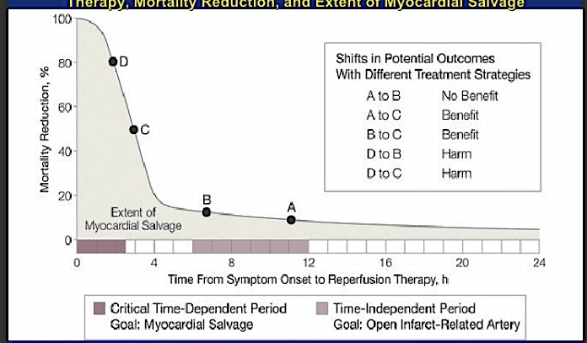
Time is muscle
/ Muscle is life

Slide 9
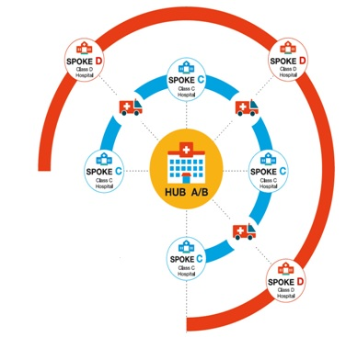
STEMI Programme Components : HUB and Spoke Model : 4 major components
HUB Hospital – having a Cath Lab
A Hospital : has Cath Lab functioning 24x7
B Hospital : has Cath Lab functioning in Office Hours
Spoke Hospital
C Hospital : with ICU setting
D Hospital : ECG facility
108 Ambulance Service – having facility to do an ECG and transmit to a HUB hospital for confirmation of STEMI
Strategic purchasing
CMCHIS
PMJAY
National health Protection Scheme / State Insurance scheme. Drugs and Consumables under NHM for supplementing medicines, stents , consumables etc for STEMI cases

Slide 10
Programme Implementation in Tamil Nadu
Ambulance : STEMI Kit Equipments which Record ECG, Blood Pressure, SPO2 (Saturation of Oxygen) in Ambulance and transmit electronically to Hub / Spoke Hospital
Cath Labs established in 24 Hubs (17 NHM funded & 7 State funded)
Training of Cardiologist, Physicians, staff nurses and Cath Lab technicians in STEMI management protocol
Designation of STEMI Coordinator in each HUB hospital.

Slide 11
Programme Implementation
Provision of STEMI kits and drugs to SPOKE hospitals.
Implementation of STEMI/NSTEMI protocol in HUB with cath lab.
Strengthening of CCUs in spoke hospitals to enable thrombolysis and stabilization.
Linking Chief Ministers Comprehensive Insurance Scheme (CMCHIS) and PMJAY in Government hospitals by using existing Packages.
Putting in place quality checks and creation of registry

Slide 12
Implementing Partners
108 Ambulance Services: Provides emergency Ambulance service
Directorate of Medical Education: Runs Hub Hospitals
Directorate of Medical and Rural Health Services: Runs Spoke Hospitals
Chief Ministers Comprehensive Health Insurance Service (CMCHIS)/PMJAY : Provides insurance support for the program

Slide 13
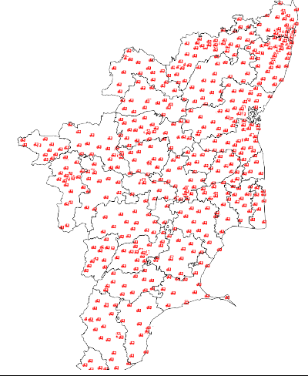
Strengthening 108 Ambulance fleet:NHM
Total Ambulances: 976
BLS Ambulances : 854
ACLS Ambulances: 56
Neonatal Ambulances: 66
No of ambulances
2013: 626
2018: 976

Slide 14
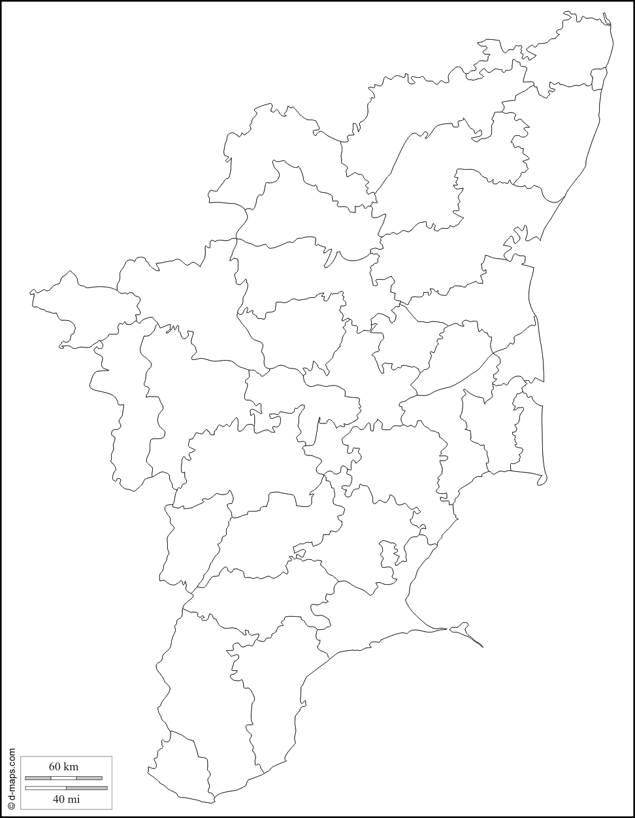
Cath lab network in Tamil Nadu
Phase 1 NHM ROP 2016-2017- 11 catheterisation labs
Phase 2 NHM ROP 2018-2019 - 6 catheterisation labs
Government
cv
Private
cv
cv
cv
cv
125 Cathlabs
cv
cv
cv
2013 - 1:25
2018 - 1:5
cv

Slide 15
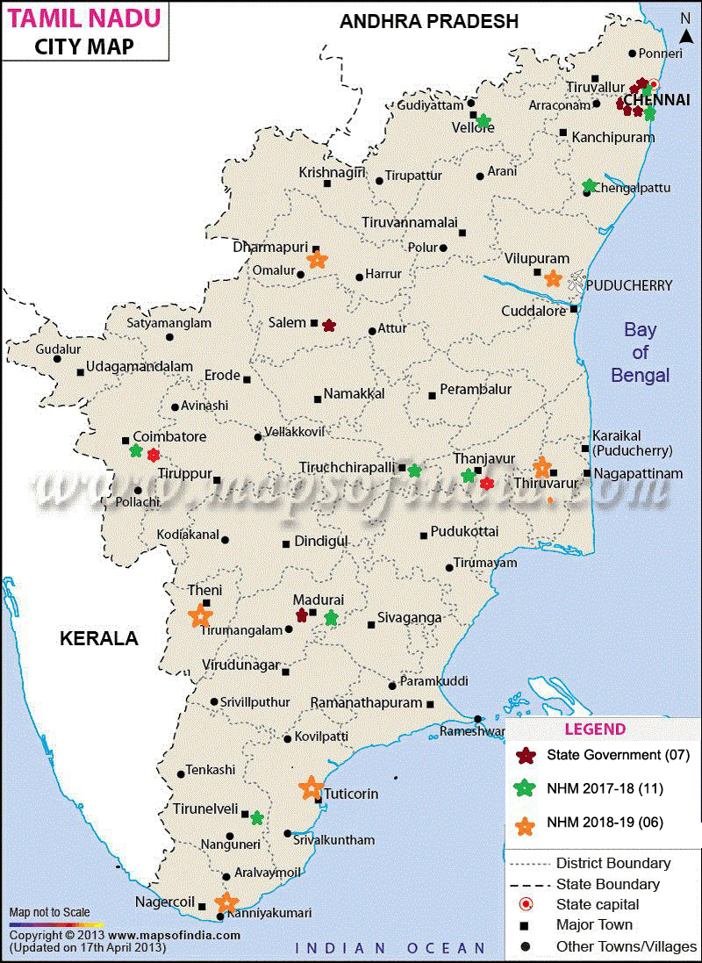
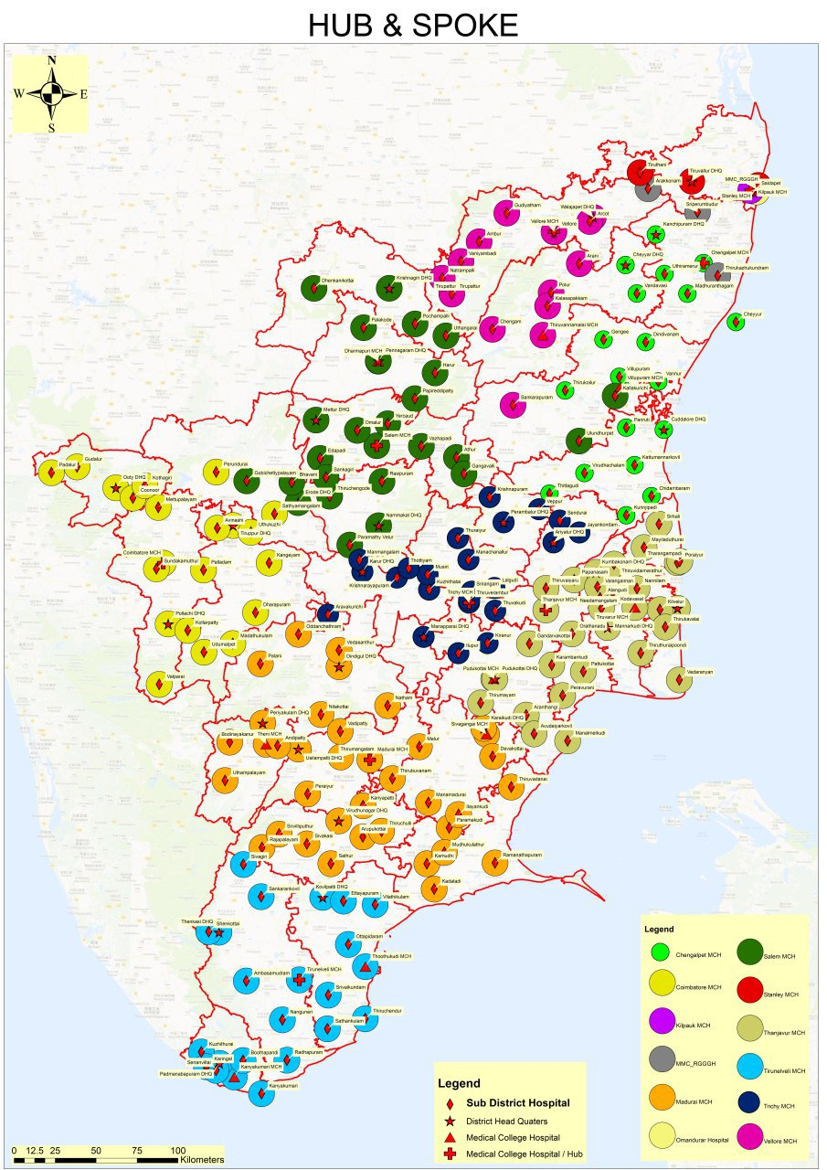

Slide 16
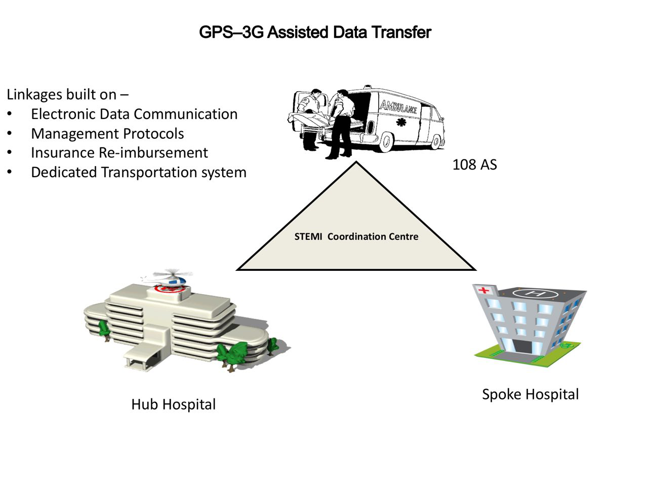
STEMI Kit : Measure, Record, Transmit
ECG
Blood Pressure
Oxygen Saturation

Slide 17
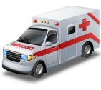
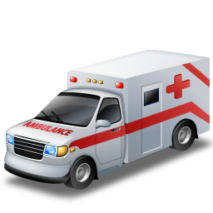
STEMI Cluster
Class C
Class D
Class D
Class A/B Hospital
Class C
Location of patient
Location of closest STEMI hospital
Patient clinical condition
Fibrinolytic contraindications
cardiogenic shock
Class D
Class C

Slide 18
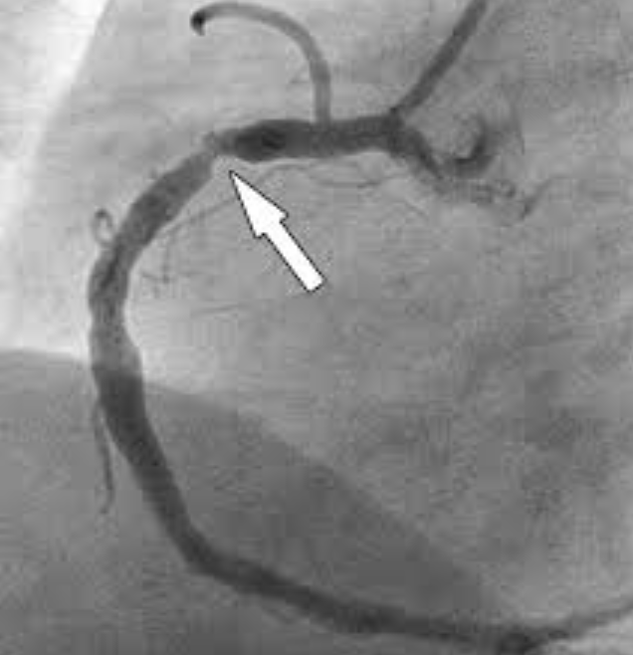
Mode of Reperfusion
Thrombolysis
Primary Percutaneous Intervention
Pharmaco-invasive Strategy
(thrombolysis + invasive )

Slide 19
24 Cath Labs in Tamil Nadu : 24 Hubs
07 Cath Labs Established from State Budget
11 Cath Labs Established by ROP 2017-18
06 Cath Labs Being Established by ROP 2018-19

Slide 20
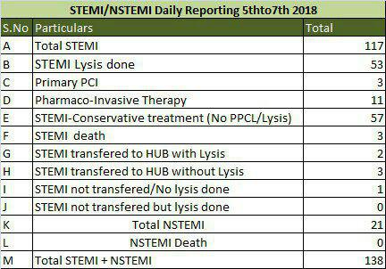
Real Time App Based Report

Slide 21
How to Start STEMI Programme in Your State
Start with a Single Cluster

Slide 22
A STEMI Cluster has:
A Hub : Medical College/DHQ with Cath Lab
For Angioplasty and Thrombolysis / Have STEMI Kits /console
Few Spokes : District and Sub District Hospitals
For Thrombolysis / Have STEMI Kits
Ambulances with STEMI Kits
Each of these have
Non Recurrent Expenses
Recurrent Expenses

Slide 23
STEMI Kits in Ambulances
To Transmit in Real Time
Patient ID and brief clinical history
ECG
Blood Pressure
Oxygen Saturation
Cost approximately 1 Lakh
1 per Ambulance
Can be Included in PIP
Console in HUB Hospitals for Cardiologist / Physician to take decisions

Slide 24
Thrombolysis
Cost of Consumables : Streptokinase (1000rs) vs rTPA (15000-20000rs) covered under PMJAY
Human Resources
MBBS Doctor Trained in STEMI Protocol
STEMI nurse trained in STEMI protocol
108 Amby technician trained in STEMI protocol
Training can be Included in PIP

Slide 25
Angioplasty
Non Recurrent Expense :
Procurement of Cath Lab (Approximately 3 to 4 Crores)
Can be Included in PIP
Recurrent Expense :
Consumables
Human Resources
Cardiologist
Staff Nurses
Technicians

Slide 26
Human Resources
Qualification
Training

Slide 27
Protocols
Standard Protocols may be followed or Minor Modifications may be made

Slide 28
Funds
NHM
PMJAY
State Funds

Slide 29
The infrastructure, Manpower, Equipment, Drugs and Consumable cost for one unit of HUB and Spoke(1 HUB, 6 Spokes –the lysed patient can be transported upto 100 kms only and travel time has to be limited to 2 to 3 hours only in an ambulance) has been worked out as under:
1. HUB Requirements: (24/7 Cath Lab)
Components | Details | Non Recurring/ Recurring | Source of Funding | Quantity | Per unit cost | Total
Infrastructure | Cath lab | Non Recurring | Already Funded by NHM | 1 | 3,50,00,000 | 3,50,00,000
 | Fully equipped CCU | Non Recurring | Already Funded by NHM | 1 | 30,00,000 | 30,00,000
Manpower | Cardiologist | Recurring | NHM/State Government fund | 2 | 1,50,000 | 36,00,000
 | Cardiologist | Recurring | NHM/State Government fund | 6 | 1,00,000 | 72,00,000
 | Scrub nurse | Recurring | To be Funded by NHM (outsourcing) | 8 | 15,000 | 14,40,000
 | Cath lab technicians | Recurring | To be Funded by NHM (outsourcing) | 6 | 12,000 | 8,64,000
 | Ward boys | Recurring | To be Funded by NHM (outsourcing) | 6 | 6,000 | 4,32,000

Slide 30
Equipments | STEMI kit | Non Recurring | To be Funded by NHM | 1 | 1,00,000 | 1,00,000
Medications | Stent & consumables ( Puncture needle, Arterial sheath, diagnostic catheter (for right & left), Guide wires (0.032”), Guide cather’s, PTCA wire, Coronary stent, NC Balloon, “Y-Connector”, Inflation device, pressure tube | Recurring | Drugs and diagnostics under NHM/National Health protection scheme/ State insurance | 1200 cases** per annum requiring a procedure 3600 cases require angiogram | 30,000 ­ | 360,00,000 -
 |  |  |  |  | Grand Total | 876,36,000
*Can also be ploughed back under National Health Protection Scheme/State Insurance Scheme
and under drugs and consumables of NHM.
** It is estimated that at least 16 cases can be taken up in a day out of which 4 cases require
Primary PCI / Pharmaco invasive PCI in a 24/7 facility

Slide 31
Spoke Requirements – Costing
Components | Details | Non Recurring/ Recurring | Source of Funding | Quantity | Per unit cost | Total for 1 Spoke | Total for 6 Spoke
Infrastructure
 | Well equipped ICU | Non Recurring | Already Funded by NHM | 1 | 30,00,000 | 30,00,000 | 180,00,000
Manpower
 | MO | Recurring | State Government fund | 2 | 60,000 | 14,40,000 | 86,40,000
 | Nursing Team | Recurring | To be Funded by NHM (outsourcing) | 4 | 15,000 | 7,20,000 | 43,20,000
 | Paramedical Team | Recurring | To be Funded by NHM (outsourcing) | 4 | 12,000 | 5,76,000 | 34,56,000
Equipments
 | STEMI kit | Non Recurring | To be Funded by NHM | 1 | 1,00,000 | 1,00,000 | 6,00,000
Medications | Thrombolysis - rTPA | Recurring | Drugs and diagnostics under NHM/National Health protection scheme/ State insurance | 1200 | 20,000 | 2,40,00,000 | 14,40,00,000
 |  |  |  |  | Grand Total | 2,98,36,000 | 17,90,16,000
*Can be ploughed back under National Health Protection scheme, State Health insurance
scheme and Drugs and diagnostics under NHM

Slide 32
108 Ambulance Service
Components | Details | Non Recurring/ Recurring | Source of Funding | Quantity | Per unit cost | Total
Capex & Opex
 | Ambulances | Non Recurring | Already Funded by NHM | 30 | 15,00,000 | 4,50,00,000
 | Operation Cost | Recurring | Already Funded by NHM / State | 30 | 1,50,000 | 45,00,000
Equipments
 | STEMI kit | Non Recurring | To be Funded by NHM | 30 | 1,00,000 | 30,00,000
 |  |  |  |  | Grand Total | 5,25,00,000

Slide 33
4. Strategic purchase- -24*7 Cath Lab/hub - National
Health protection scheme/state insurance scheme
Components | Details | Source of Funding | Quantity | Per unit cost | Total for 1 Hospital | Total for 1 HUB & 6 Spokes
Medications at HUB Hospital | PCI/ pharmaco-invasive Stent & consumables | Funded under NHPS/ State insurance and to be ploughed back into the system and hence a revenue for the Government Hospital | 1200 cases** per annum requiring a procedure 3600 cases require angiogram | 30,000 - | 360,00,000 - | 360,00,000
Medications at Spoke Hospital | Thrombolysis - rTPA | Funded under NHPS/ State insurance and to be ploughed back into the system and hence a revenue for the Government Hospital | 1200 | 20,000 | 2,40,00,000 | 14,40,00,000
 |  |  |  | Grand Total |  | 18,00,00,000

Slide 34
Cost estimate for a STEMI Cluster with 24/7 Cath lab (1 HUB + 6 Spokes + 30 Ambulances)
Sl. No. | Component | Already Funded by NHM | NHM/National health protection scheme /State Health insurance scheme | NHM/State Government fund | To be Funded by NHM | Total
1 | HUB –MCH/ District Head Quarter Hospital | 380.00 | 360.0 | 108.00 | 28.36 | 876.36
2 | Spoke – DH/Sub-district Hospital | 180.00 | 1440.00 | 86.40 | 83.76 | 1790.16
3 | 108 Ambulance Service | 459.00 |  | 36.00 | 30.00 | 525
 | Total | 1019 | 1800 | 230.4 | 142.12 | 3191.52
4 | Strategic Purchase – National Health Protection scheme/ State Insurance scheme/ |  |  |  |  | 1800.00
5 | Additional Budget Required to be provided by NHM |  |  |  |  | 372.52
** It is estimated that at least 16 cases can be taken up in a day out of which 4 cases require Primary PCI / Pharmaco invasive PCI in a 24/7 facility

Slide 35
Cost estimate for a STEMI Cluster with 24/7 Cath lab (1 HUB + 6 Spokes + 30 Ambulances) Recurring & non recurring
Components | Recurring | Non-Recurring | Total
HUB – District Head Quarter Hospital | 4,95,36,000 | 3,81,00,000 | 8,76,36,000
Spoke – Sub-district Hospital | 16,04,16,000 | 1,86,00,000 | 17,90,16,000
108 Ambulance Service | 45,00,000 | 4,80,00,000 | 5,25,00,000
Grand Total | 21,44,52,000 | 10,47,00,000 | 31,91,52,000
Amount in Lakhs | 2144.52 | 1047.00 | 3191.52

Slide 36
Take Home Message
Non Communicable Diseases are Increasing
Heart Attack is a Common Problem
Heart Attack has High Mortality
It is Easy to Address this Challenge

Slide 37
For copy of protocol please mail your request to rchpcni@tn.nic.in
Contact no MD NHM TN (9443358888)
THANK YOU

