Slide 1
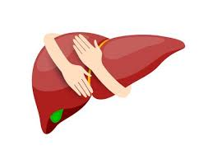
ROLE OF PEER SUPPORT STAFF IN IMPLEMENTATION AND EXPANSION OF NVHCP DURING COVID
Dr. Gagandeep Singh Grover
State Programme Officer NVHCP/IDSP/MRHRU
Department of Health & Family Welfare
Punjab

Slide 2
Introduction
The Mukh Mantri Punjab Hepatitis C Relief Fund (MMPHCRF)
launched in June 2016,
Free treatment of Hepatitis-C at 25 treatment centres (22 DHs and 3 GMCs)
1 Model treatment centre at PGI Chandigarh.
The existing staff of medical specialists, lab technicians, pharmacists, and data entry operators to provide free screening and treatment for Hepatitis C.
Drugs for HCV, Baseline tests and Viral load tests free for all Patients
National programme (NVHCP) was adopted by Punjab in Sep-2018.

Slide 3
Cascade Report
(June-2016 till Dec-2020) at 22 DH, 3 GMC , 13 ART, 11 OST, 1 SDH and 9 Central Prisons
Notes:
All Facilities/ District including DH/GMC, ART, OST and CJ

Slide 4
Peer Support
Under NVHCP Peer support staff was outsourced at each Treatment Center (TC) for effective and dedicated outreach to patients.
The Peer supports are either old Hepatitis-C patients or someone from their own family have been a Hepatitis-C/ HIV/ Hepatitis B patient.
Thus, they understand the challenges related to the disease and counsel the patients effectively.

Slide 5
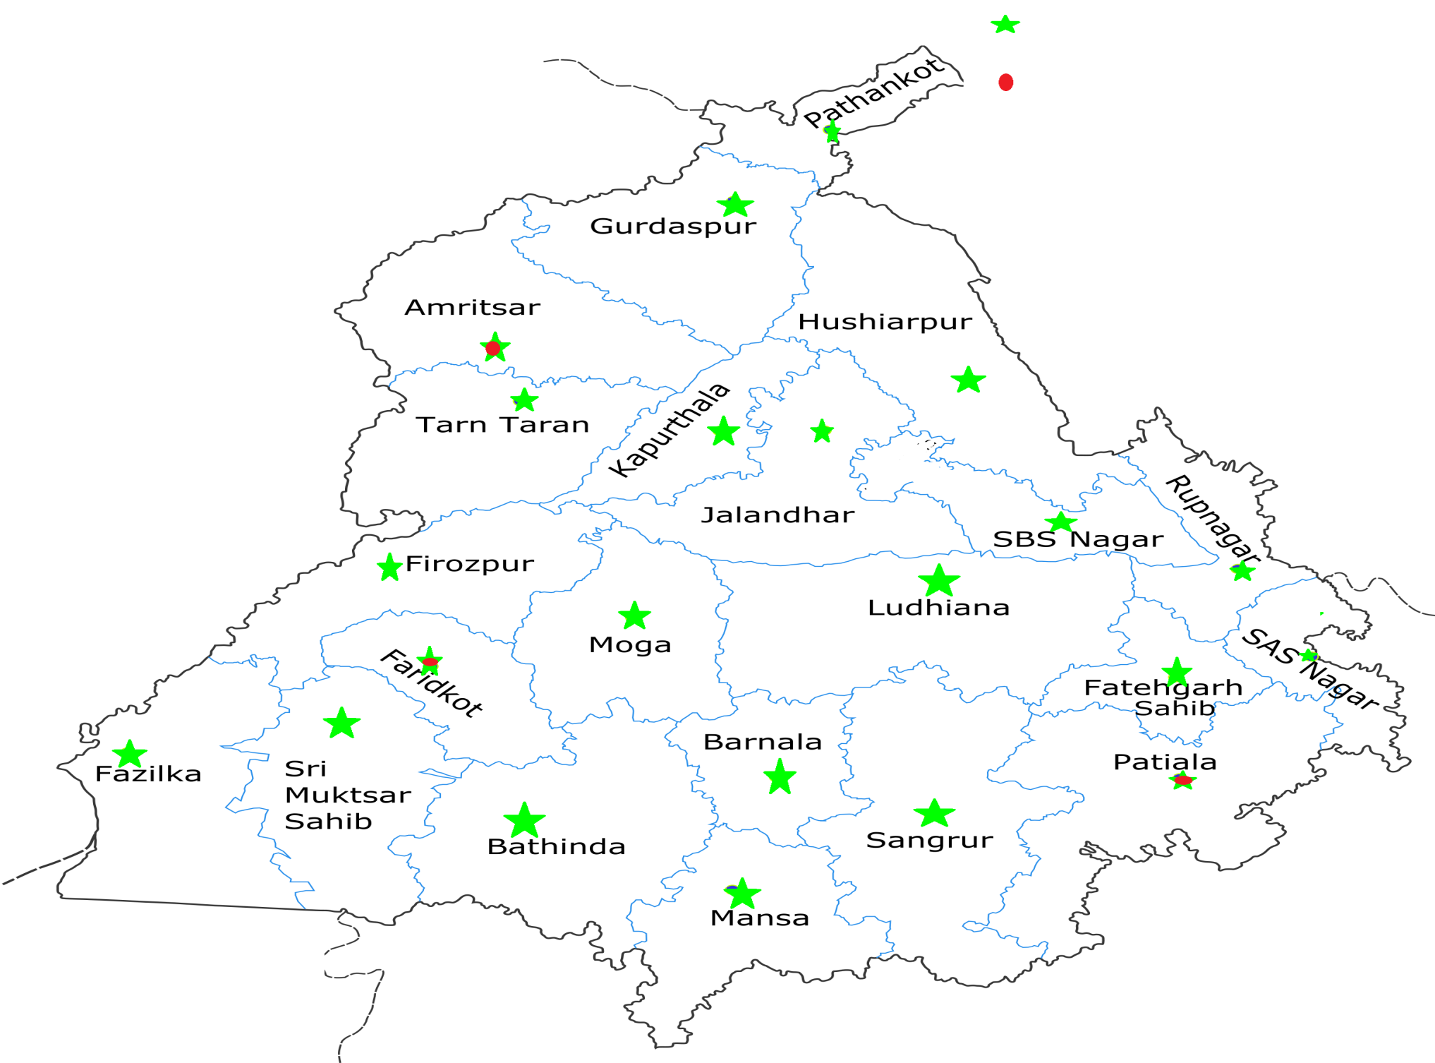
Duty Stations
22 District Hospitals
3 GMCs
PGI, Chandigarh
(MTC)
The 25 Treatment centres and 1 Model Treatment center from where Hepatitis-C care started

Slide 6
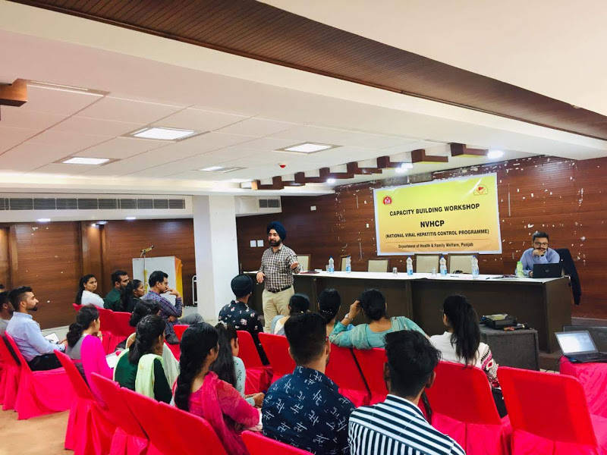
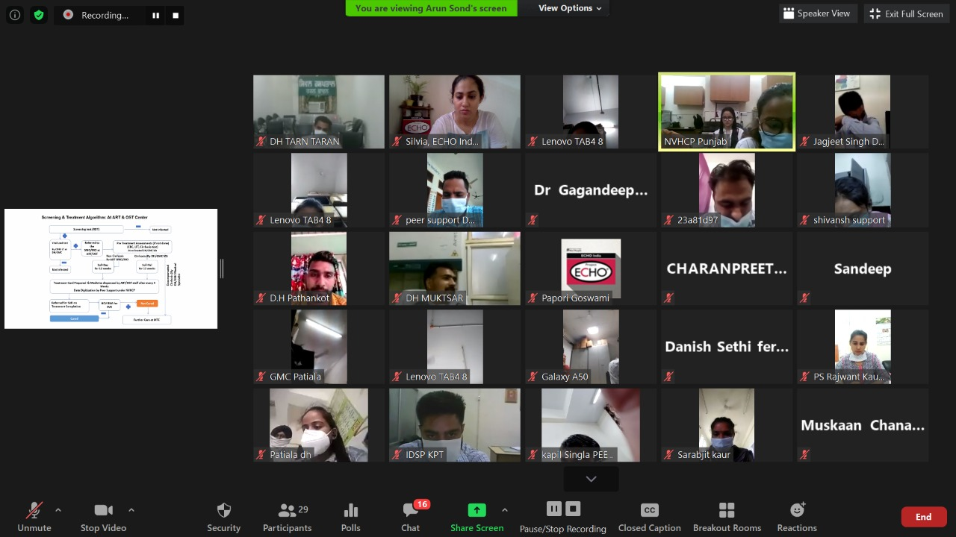
Capacity Building
First Peer Support Capacity Building Workshop held in Nov-2019
Virtual Capacity Building workshop during COVID
First Capacity building workshop for Peer Supports was held in Nov-2019
Being impacted by COVID situation the Review meeting was held virtually in July-2020 and in Dec-2020 as well.

Slide 7
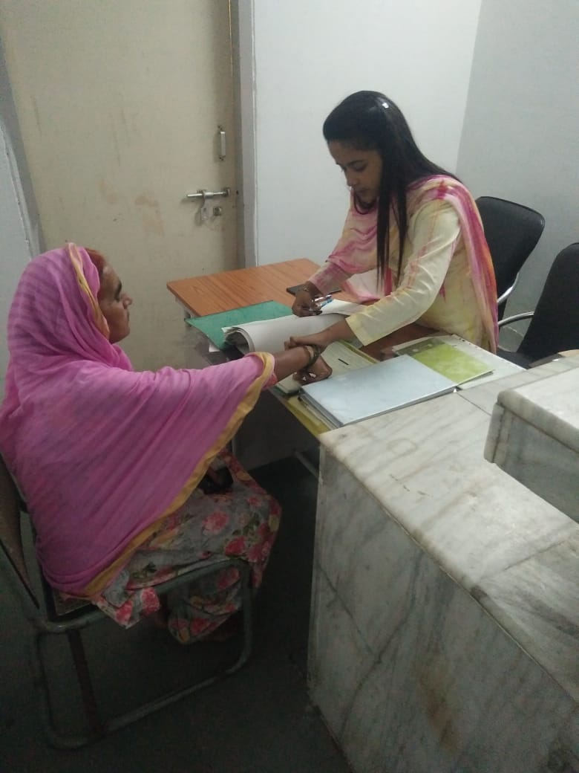
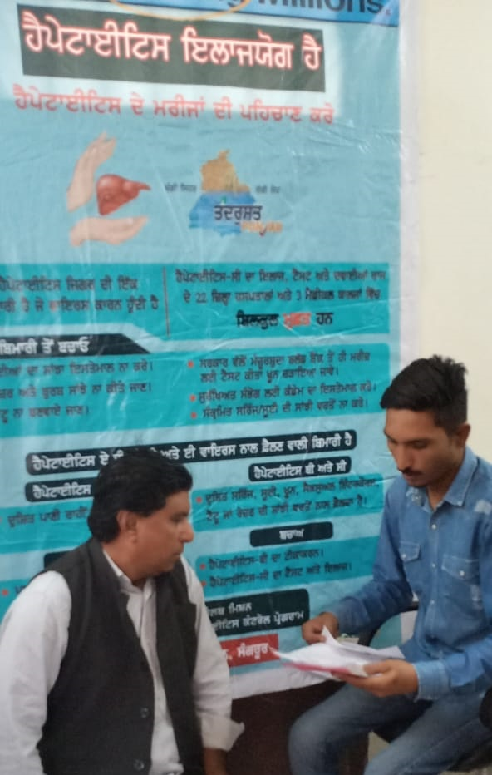
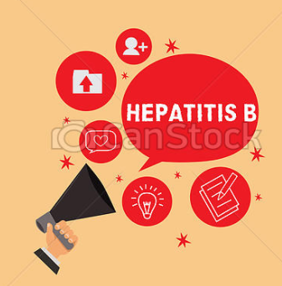
Key Roles of Peer Support
Hepatitis-C
Counselling of patients
Guiding and assisting patients for screening, viral load and baseline tests
Tracking for follow-up of patients
Assisting the Pharmacist in record keeping and handling
Monthly reporting to State
Data digitization on the tabs provided to each Peer support under NVHCP
Reporting and data digitization of Co-located ART and OST centres
Tracking of Prison released Hepatitis-C patients for further care
Hepatitis-B
Data management of Hepatitis-B screening

Slide 8
Impact of COVID situation on HCV
Average 1200 patients of HCV were initiated on treatment per month before COVID situation. Due to lockdown the count declined to only 250.

Slide 9
Designation of ART and OST centres as Treatment sites during COVID
The active screening program was envisaged in 2017 and further launched in October 2018, to initiate Anti-HCV screening for PLHIVs at 13 ART centres and IVDUs at 11 OST sites.
To facilitate effective outreach to patients, the 13 ART centres and co-located 11 OST centres were designated as Treatment centres for HCV in June-2020.
Under COVID situation it helped ensuring that positive patients get Treatment at the respective sites only at the earliest.
Online portal entries/ Digitization of data/ calling and counselling of patients are done by the Peer Support appointed under NVHCP at the Co-located District Hospitals or Government Medical Colleges on routine basis.

Slide 10
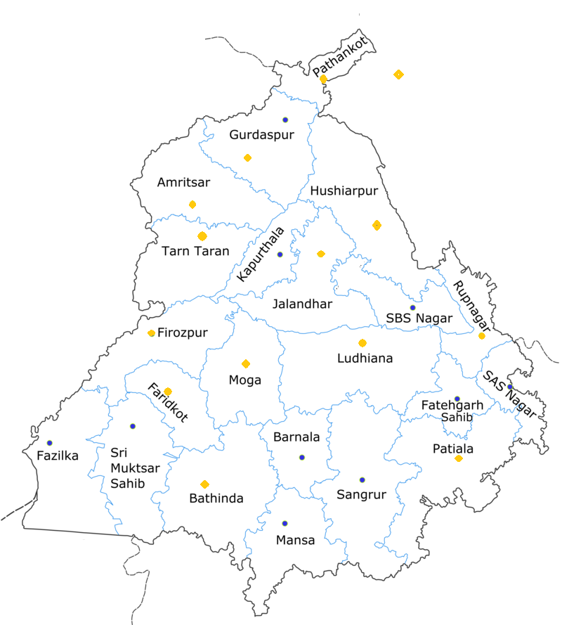
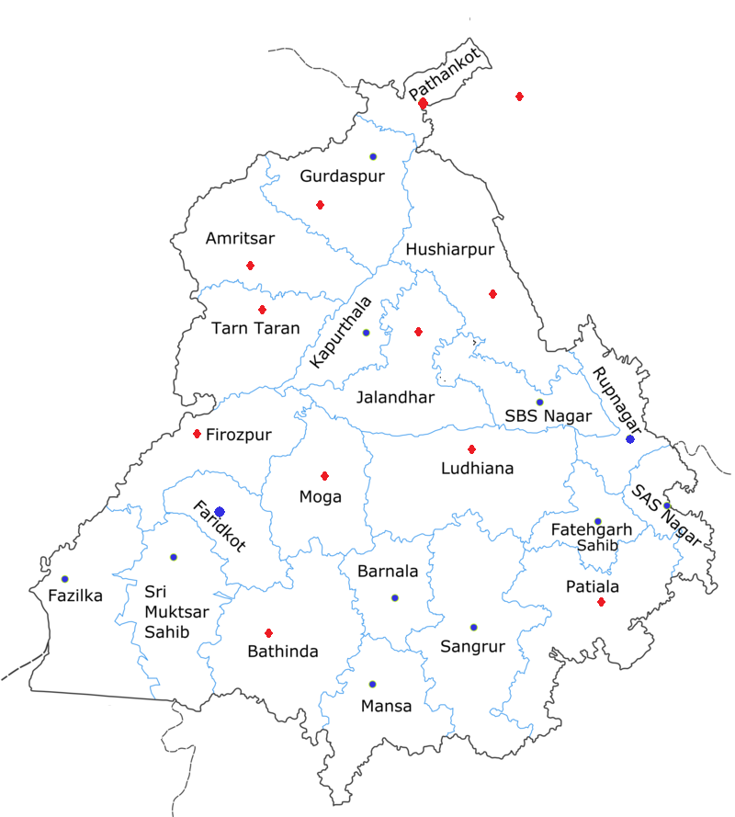
Designated ART and OST centers
13 ART centres
By developing simplified data and patient flows screening protocol was developed to scale-up HCV testing to PLHIVs at 13 ART centres and IDUs at co-located 11 OST centres.
Designated as Treatment sites in June-2020
Screening at ART centres started in October-2018 & at OST centres in September 2019.
Till date, more than 26,823 patients have been screened at ART centres and more than 3459 patients screened at OST centre.
11 OST centres

Slide 11
Role of Peer Support during COVID situation
All the 26 peer supports and data entry operator of MTC were given the task of calling patients to ensure the patient follow ups
Peer supports at TCs and MTC called the HCV patients for adherence to treatment.
Co-morbid patients were also counselled for COVID-19 precautions.
The patients who had missed their follow ups (or defaulted) due to COVID 19 pandemic, were counselled by peer support for further follow ups after lockdown and brought back to treatment
Letter issued by State to allow movement of Hepatitis-C patients during lockdown

Slide 12
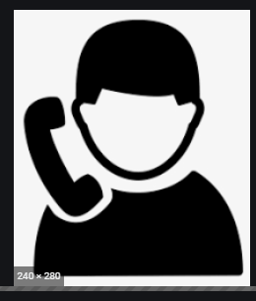
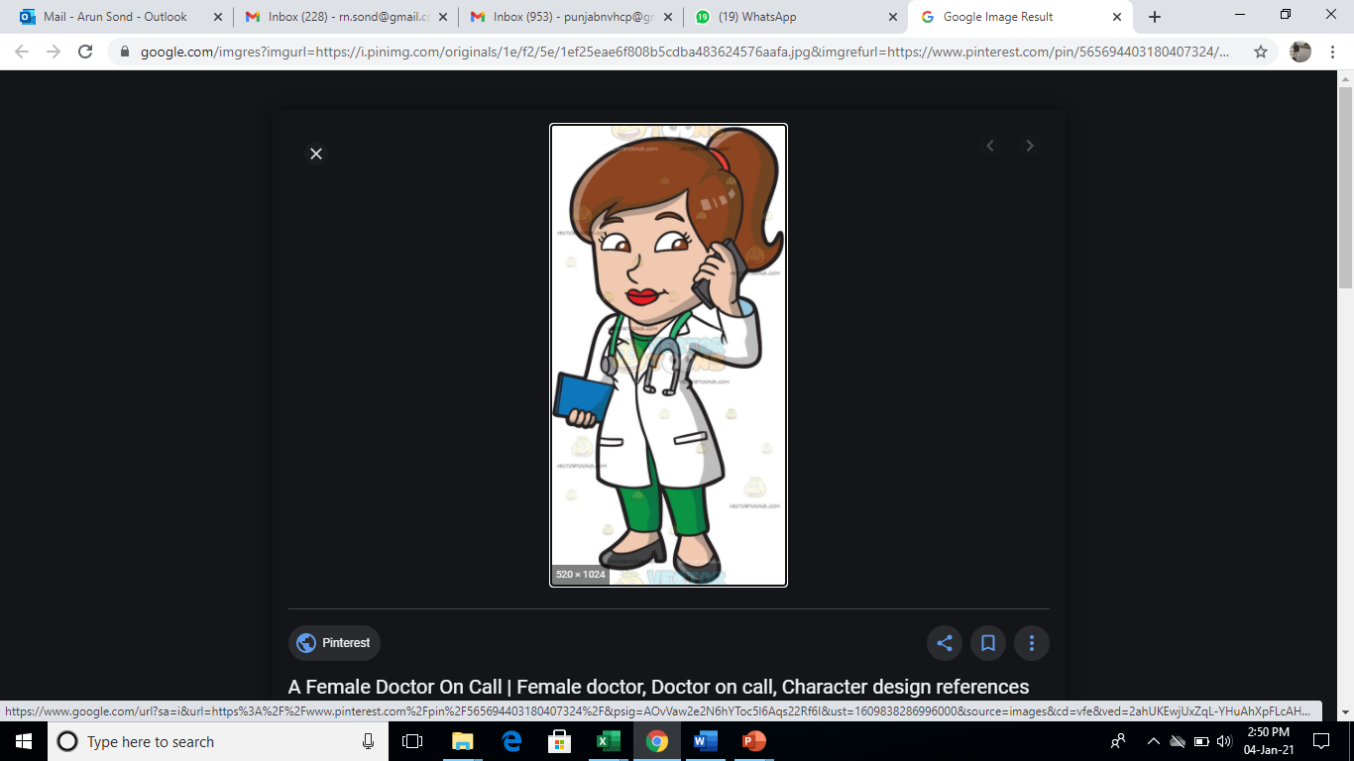
Roles of Peer Support during COVID situation
Appx 6000 patients were called across the state.
The upcoming follow-up patients were called and counselled for importance of the treatment so that they complete their treatment.
Treatment initiation due patients were called and motivated for treatment, and thus treatment initiation increased eventually.
Due to active calling , 650 patients were initiated on Treatment during the COVID lockdown period.
Also the Average Treatment initiation increased to 800 patients per month.

Slide 13
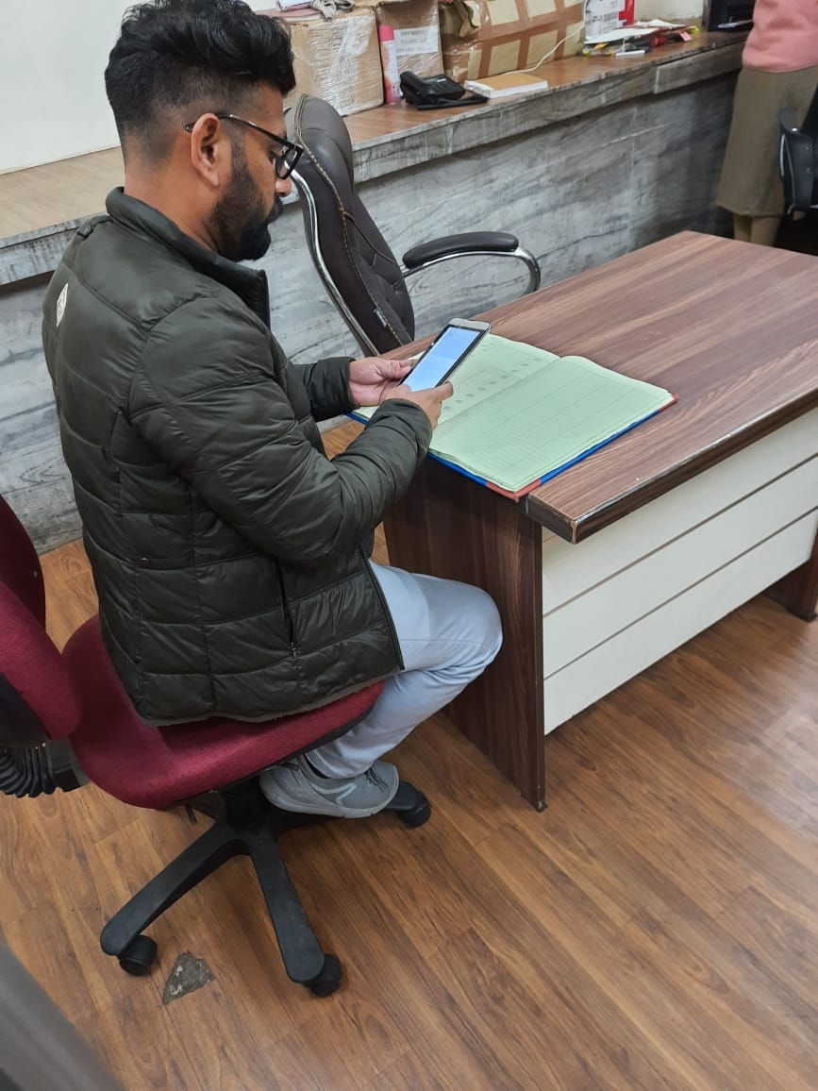
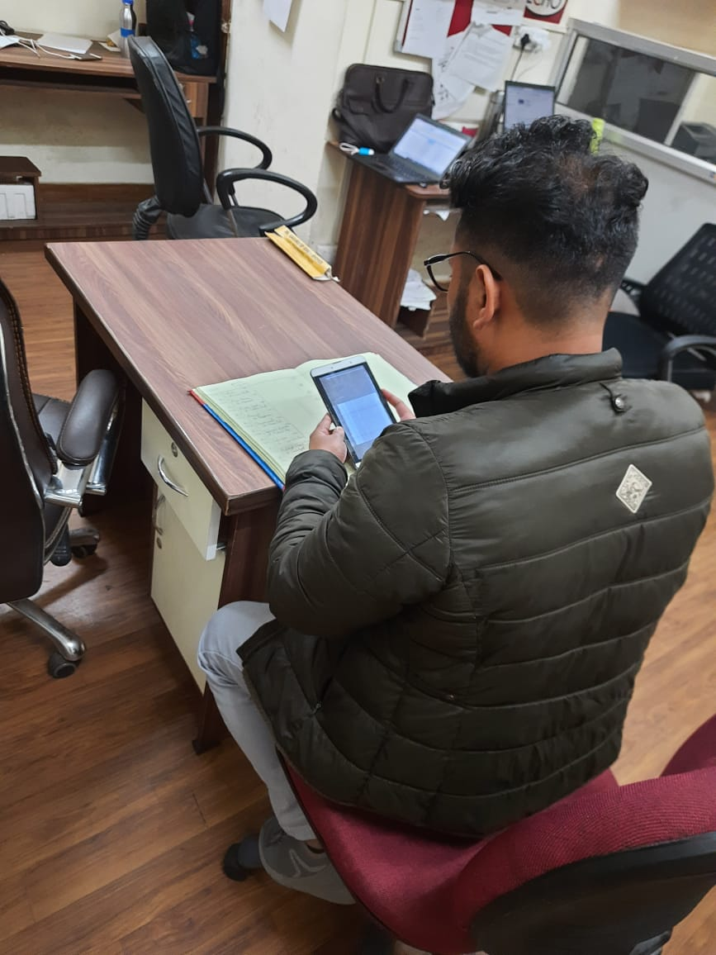
Digitization of Data by Peer Support
Peer Support staff have been issued Tabs
The data of the patient screening and treatment is uploaded on portal of NVHCP (GOI) on the Tab by each Peer support
All the Tabs have calling feature as well for calling the patients

Slide 14
Results
With dedicated Peer support under NVHCP, the State of Punjab was able to
Track the due follow ups during lock down and medicines were provided to patients during lock down thus avoiding default
Appx 650 new patients were initiated on treatment during lock down period
Dedicated staff helped in digitization of data
The co- located 13 ART and 11 OST centres were designated as TCs and Peer support staff have been digitizing data rom these sites as well.
The Peer support plays an important role in treatment adherence, once the patient is out of prison.
The dedicated manpower has helped Punjab expansion rom 25 treatment centres in 2016 to 59 treatment centres and 3 model treatment centres

Slide 15
Results
With active intervention and involvement of Peer Support staff, the enrolment of patients on treatment of HCV has again back on track after Covid lockdown.

Slide 16
THANKS

