Slide 1
Reducing neonatal mortality by addressing the group at the highest risk:
Implementing simple interventions to identify and support the care of preterm and low birth weight babies at state-wide scale in Bihar
Notes:
This innovation is the adaptation of Home Based Newborn Care (HBNC) guideline and ASHA Module 7 for those born preterm-LBW. These guidelines define babies at high risk as fulfilling at least one of three criteria i.e. birth-weight < 2000 gm, gestational age at birth < 37 completed weeks and not feeding well from the day of birth. For ease of communication and clear differentiation from babies who later develop sepsis, the name used for babies fulfilling these criteria in Bihar is ‘weak newborn babies’. Those who are suspected to have sepsis are referred to as ‘sick newborn babies’.
Taking advantage of the relatively high institutional delivery rates in Bihar, this intervention began in 694 public health facilities, other than teaching hospitals, state-wide from September 2016 after a brief pilot in 552 facilities in June 2015.

Slide 2
Area and Population Covered
This intervention has covered all institutional deliveries from 694 public health facilities
The number of births in public health facilities increased from 14.7 Lakh at the beginning of the project to more than 16 Lakh in 2017.
The target group for this particular intervention was all pre-term and/or low-birth weight and/or newborns with Poor Suckling on the day of birth: an estimated 13% of the total live births.
Our intervention started in June 2015 and is at present an ongoing activity within our system.
HMIS data calculated for Jan-Dec cycle – Numerator = Total number of institutional deliveries reported in the reporting month (HMIS : M2-2.2); Denominator = Total ANC registration in the reporting month-(HMIS: M1-1.1)

Slide 3
Rationale
Neonatal deaths account for about 70% of infant deaths. Pre-term and Low-Birth weight is the leading cause of neonatal deaths
The Gadchiroli trials from 1996-2003 showed that steep reduction in pre-term deaths was possible with simple home-based interventions.
Based on these trials, Home Based Newborn Care Protocols and Guidelines were introduced by GoI
Our intervention was inspired by the Gadchiroli model with some adaptations . Unlike Gadchiroli, which had very low % age of Facility Deliveries, well over half the deliveries take place within the public facilities in Bihar. Hence, we needed to supplement the HBNC intervention with facility based care.
Thus, our intervention integrates facility based care (with Post-Natal Counselling by ANMs and Mamtas) and Home Based Care by ASHAs, with referral to SNCUs for indicated cases.
Notes:
Complications of Preterm birth & Low Birth weight are underlying causes of most of the neonatal deaths¹.

Slide 4
Project Description
This intervention identifies preterm-LBW babies by criteria stated in ASHA Module 7 for high risk babies: those who fulfil at least one of three criteria i.e. birth-weight < 2000 gm, gestational age at birth < 37 completed weeks and poor suckling on the day of birth. ( The only modification we have made in these criteria is inclusion of babies with birth weight = 2000gm also)
The name used in this intervention for babies fulfilling these criteria is ‘Weak Newborn Babies’.
After a brief pilot in 40 facilities in 5 districts, intervention began statewide in 552 health facilities in June 2015, and scaled up to another 142 health facilities in state-wide from September 2016.

Slide 5
Roll Out
  State ToT: 78 master trainers from 38 districts were trained on Guideline, Registers, Formats etc. in 1 day.
  Orientation of RCH officers/ACMOs was done for implementation and review of Program.
  District ToT: 1 day workshop for 5 participants from each block i.e. Facility-in Charges, Medical Officers, Labour Room-in-Charges, Block Health Managers and Block Community Mobilisers.
  Block ToT: Orientation of all Labour room nurses, HSC Nurses and all ASHAs of 534 blocks on identification, counselling for extra care, reporting and follow-up (telephonic and home visits).
  HSC Platforms were utilized for continuous orientation of ANMs and ASHAs using Incremental Learning Approach ( ILA)

Slide 6
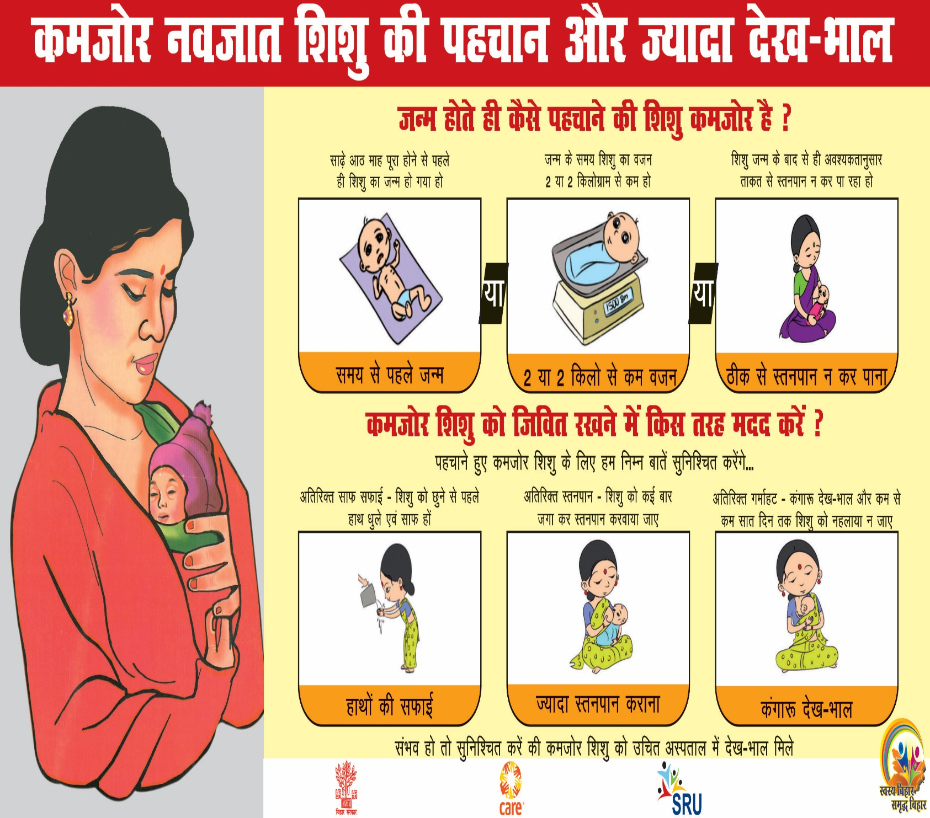
Training Materials for ASHAs & ANMs (ILA content- N2)

Slide 7
Project Description-1
  The intervention consisted of following actions:
  Identification of weak newborn babies born in government facilities by
  1. Correct weighing by digital weighing scale
  2. Estimation of gestational age by an LMP-EDD calendar which included dates of key
  festivals to aid memory
  3. Observation of breast feeding by Mamtas and ANM on the day of birth of the baby.
  Communication to the family that the baby is Weak who needs extra care.
  Initiation of KMC in the hospital and counselling for continuation KMC at home.

Slide 8
Project Description-2
  Pre-discharge counselling of mothers and families for Extra care:
  Extra warmth by Kangaroo Mother Care(KMC) and delayed bathing until 7th day of life
  Frequent breastfeeding in every 1-2 hours
  Cleanliness by hand-washing before handling and dry cord care
  Issuing a ‘Passport’ to the baby, which can facilitate greater attention for extra care at home and follow-up & referral by FLW
  Facility Line-listing was maintained to enable telephonic follow-up with family and ASHA

Slide 9
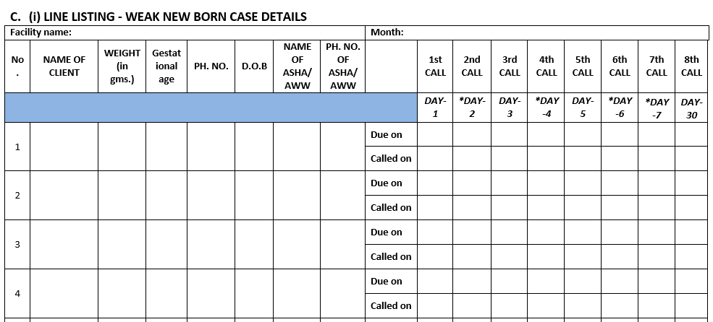
FORMATS
Follow-up checklist for ANM
Pictorial extra care advice for mother

Slide 10
Passport for Weak Newborn Baby for follow-up care
Copy for Hospital Records
Copy to Outreach ANM
Copy for patient

Slide 11
Project Description-3
  Referral of babies to SNCUs who weigh 1800 gm or less or not suckling well.
  Communication about danger signs suggestive of sepsis.
  Notification to the ANM and ASHA of the village of the weak baby. A full line list of weak babies was maintained by the ANM.
  ASHAs to visit the family at least once daily for the first week, and provide support.
  Telephonic follow-up with the family and the ASHA from facility on alternate days in 1st week to ensure that the family is well supported daily by ASHA.
  Confirmation of status of baby on 30th day of life.

Slide 12
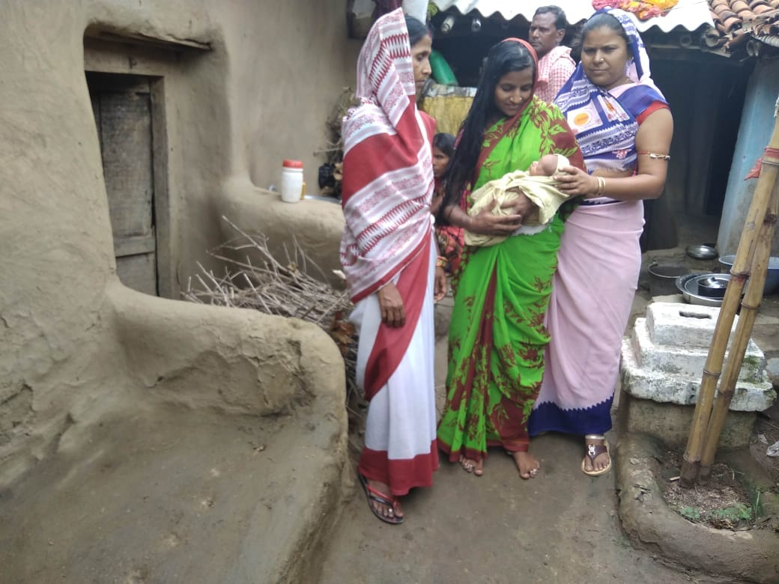
A Weak Newborn Baby is being visited at home by ASHA & AWW.

Slide 13

Evaluation of WNB Intervention (≤ 2000 gm): Study Methodology
Independent evaluation was conducted – at baseline (pre-intervention) and an assessment was done after 30 months following the intervention at statewide scale
For the assessments, 171 facilities were randomly selected from 694 public health facilities. The same facilities were persisted with, in the Baseline and Assessment rounds. The list of facilities assessed was blinded from the implementation team
WNBs who were with birth weight ≤ 2000 gm and born during preceding 1-3 months were selected for assessment: out of 3 criteria, the sole criterion considered was body weight ≤ 2000gm as it was difficult to establish objectivity for identification of pre-terms and poor suckling newborns
Baseline, Pre Intervention, May-2015
1443 WNB families were interviewed
171 facilities
Assessment Round, December 2017
2722 WNB families were interviewed

Slide 14
Identification of WNB¹ newborns has improved but remains lower than benchmark
1 - WNB implies babies with birth weight <= 2000 gms
2- Expected prevalence is from CARE’ Facility Information System (FIS) data for Sep’17 & Oct’17
Source: WNB assessment study

Slide 15
The practice of recording the birth weight as rounded off 2000gm has declined sharply since the onset of intervention

Slide 16
Process Indicators-1
Mother was told that baby was WNB at hospital
Mother/relative was told that baby was WNB at home by FLW
Baseline N=1443 Last Round N= 2722
Baseline N=1443 Last Round N=2722
Identified WNB babies advised for extra care at hospital
Mothers of WNB babies advised for extra care by FLW
Baseline N=1443 Last Round N=2722
Baseline N=1443 Last Round N=2722
Source: WNB assessment study

Slide 17
Process Indicators-2
LBW babies received delayed bathing (48 hrs to 7 days)
KMC² practices **
Baseline N=1402 Last Round N=2686
Baseline N=1305 Last Round N=2520
**Change in indicator value from R3 to R4 is statistically significant (p<0.05)
1 - WNB implies babies with birth weight <= 2000 gms
2 - Duration not measured
Source: WNB assessment study

Slide 18
Practice of delayed bathing was more common among surviving infants
 |  | R1 | R2 | R3 | R4
Delayed Bathing | Those who died within 0-27 Days | 13% | 9% | 13% | 10%
 | Died within 0-2 Days | 1% | 1% | 1% | 0%
 | Died within 3-27 Days | 23% | 18% | 23% | 21%
 | Those who died at or after 28 Days | 51% | 35% | 41% | 39%
 | Alive | 46% | 48% | 46% | 49%

Slide 19
How Mortality is changing???
HMIS data calculated for Jan-Dec cycle – Numerator = Total number of institutional deliveries reported in the reporting month (HMIS : M2-2.2); Denominator = Total ANC registration in the reporting month-(HMIS: M1-1.1)

Slide 20
Neonatal mortality (adjusted for weight)
Source: WNB assessment study

Slide 21
Lesson We Learnt?
Improvement in correct weight recording by Digital Weight Scale; availability of Digital weighing scales improved from 27% in 2015 to 81% in 2017. Challenges remain in identification of pre-terms by LMP
Remarkable increase in identification and tracking of preterm and low birth weight by using simple syndromic definition and training.
Improvement in behavior change practices like KMC and Hand Hygiene, etc. can save thousands of newborns.
A combination of telephonic calls and home visits led to improvement in the good practices and overall survival of these new born.
Guidelines for the care of preterm-LBW babies can be successfully adapted on a state-wide-large-scale for deliveries in public facilities
The implementation of similar interventions in the case of home and private facility births is more challenging.
Notes:
The independent measurement arm of the Bihar TSU evaluated the implementation of the intervention (identification and support to weak babies born in government facilities) through serial large sample surveys in 4 rounds (2015-17). The following changes were noted in key indicators:

Slide 22
Financial investment for implementation
No separate expenses were incurred in the training of staff nurse and ASHAs; they were trained during their routine meetings at facilities.
The annual cost of printing of Line Listing Register (Facility & Community), Monthly Reporting Formats (HSC, Block and District), WNB Passport, was supported by CARE for the year 2016 and 2017.
Incentives for Home visits by ASHAs were met through existing HBNC provisions. The follow up visits by CARE staff were met by CARE project funds.
Telephone calls were made from hospitals.
The total annual cost may be projected at Rs. 22,67,000/-.

Slide 23
THANK YOU !!

