Slide 1
NIKSHAY MITRA – An initiative of National TB Elimination Programme (NTEP) through
PPSA for comprehensive care of TB patients in
private health sector
National TB Elimination Programme,
NHM, Jharkhand

Slide 2
Vision, goal, targets, milestones
Vision:
A world free of TB
Zero TB deaths,
Zero TB disease, and Zero TB suffering
Goal:
End the Global TB epidemic
Notes:
We have to now move towards new era of SDG and from STOP TB Strategy to END TB Strategy.
Everyone with TB should have access to the innovative tools and services they need for rapid diagnosis, treatment and care. This is a matter of social justice, fundamental to our goal of universal health coverage. Given the prevalence of drug-resistant tuberculosis, ensuring high quality and complete care will also benefit global health security.

Slide 3
Transition From RNTCP NTEP:
National Strategic Plan: 2017 – 2025:
VISION: TB-Free India with zero deaths, disease and poverty due to TB
GOAL: To achieve a rapid decline in burden of TB, morbidity and mortality while working towards elimination of TB in India by 2025.
Targets towards TB Elimination by 2025:
 | Baseline | Targets
IMPACT INDICATORS | 2015 | 2020 | 2023 | 2025
1. To reduce estimated TB Incidence rate (per lakh population) | 217 | 142 | 77 | 44
2. To reduce estimated TB prevalence (per lakh population) | 320 | 170 | 90 | 65
3. To reduce estimated mortality due to TB (per lakh population | 32 | 15 | 6 | 3
4. To ensure no family should suffer catastrophic cost due to TB | 35% | 0% | 0% | 0%

Slide 4
Background
Gap in TB Incident TB case Notification against Estimated: 2019
Universal Health Coverage & Social Protection
TB Treatment Coverage | 82% (60 – 120)
TB Patients facing catastrophic cost | No data available
TB case Fatality Ratio | 17% (12 – 24)
Missing nearly 4.0 Lakh incident TB cases!
With qualified health providers other than public health.
Seeking care from unqualified rural health care providers
Left un-detected.
Source: WHO-Global TB Report 2020

Slide 5
Background
India has a robust private health sector that serves as the first point of care for nearly half of all health related problems in the community. The missing TB cases fall somewhere between the public and the private sector.
Studies have shown:
TB diagnosis and treatment practices among private providers vary widely.
Delay in diagnosis and non-adherence to treatment are comparatively more in the private health sector
Ministry of Health & FW, NFHS-3, 2005-06
TB Notification from Private health sector are the indispensable in the national effort to counter the problem of TB in India
Highlights the need to engage the private health sectors through TB notification and manage the TB cases on standards laid down in “Standard of TB Care in India” (STCI)

Slide 7
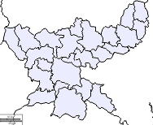
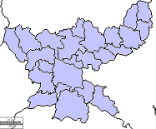
National Analysis– comparing Private and NTEP on treatment in 2019 & 2020
NTEP Notified Patients on TB Treatment: 2019
NTEP Notified Patients on TB Treatment: 2020
43,687 patients on public health
13,007 patients on private health
29,243 patients on public health
15,034 patients on private health
TB Notification in 2020 Vs 2019:
Public Health - Loss of 33.1%
Private Health – Gain of 15.6%

Slide 8
Why is private sector engagement essential?
It brings down:
Increased transmission as a result of delayed diagnosis and treatment;
Excess mortality and morbidity as a result of inappropriate treatment;
Increasing drug resistance as a result of incomplete or incorrect treatment;
Unnecessary impoverishment as a result of the high cost of private care;
Delayed and incomplete introduction of improved TB tools as a result of failure to penetrate private channels.

Slide 9
Patient Provider Support Agency (PPSA):
Planned by NHM (TB) Jharkhand with approval by Govt. of India:
To strengthen private sector engagement and provide quality health care to TB patients managed by them.
Strategic Framework:
To provide an ecosystem that outlines interventions for collaborating with the private sector and earmark resources to support its execution.
Govt of Jharkhand has engaged ALERT INDIA as PPSA in Sep 2019 through open bidding process – in all 24 districts in two phases

Slide 10
PPSA Goal
“All TB patients in the community to have access to early, good quality diagnosis, treatment and adherence support services in a manner that is affordable and acceptable to the patient in time, place and person”

Slide 11
Patient Provider Support Agency (PPSA)
AIM: Support Private Health Sector for quality and free TB Care as an interface agency between Government and Private
PPSA Objectives
Facilitating TB Notification
Free Anti-TB Treatment of NTEP
Social Support for successful treatment outcome
Free TB Diagnosis and Drug Susceptibility Tests from NTEP
Public Health Action like Counselling, HIV, DM testing
Treatment Adherence and Follow Up

Slide 12
MODEL KEYS AND INNOVATION in PPSA: - “NIKSHAY MITRA”
“Nikshay Mitra”:(“Nikshay” – Elimination of TB & “Mitra” – Friend ; “Friend to help in elimination of TB”)
A nodal person identified and assigned by the Private Health Care Facility for a set of TB related activities and are incentivized for his/her activities.
Roles of Nikshay Mitra:
Coordinates with PPSA, Private Health Facilities & Public Health
TB Case Notification – Nikshay & Notification register
Provide health education and counseling
Bank account details collection
Collection of specimen for DST
HIV and Diabetes testing and/or referral
FDC offer to patient & ensures treatment adherence
Tracking adherence, Refill Management
Record Treatment outcome at the end
All Nikshay Entries
Incentivized for each set of activities

Slide 13
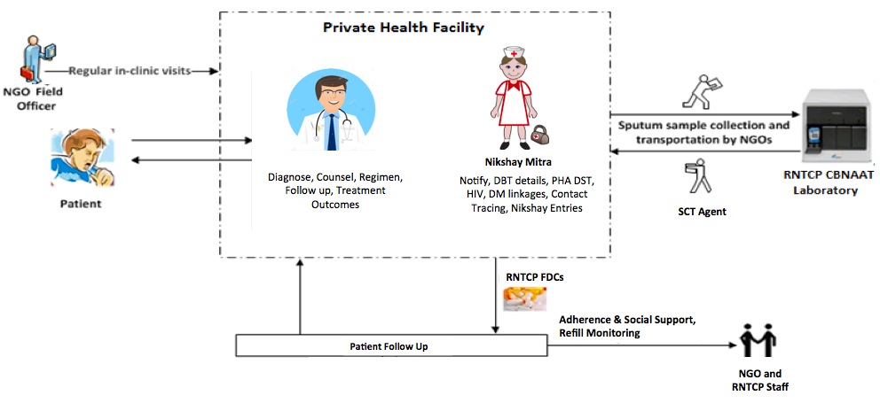
PPSA – Service Delivery Model
NTEP CBNAT
Laboratory
NTEP FDCs
NGO & NTEP staff

Slide 14
Engagement of Nikshay Mitra and Capacity Building
Nikshay-Mitras identified among the existing support staff of registered Private Health Facilities in coordination with doctors/hospital administration
Activity based incentivization to selected and trained Nikshay-Mitras
A district level training imparted to selected Nikshay-Mitras in NTEP guidelines
Hands on training in processes of specimen collection, recording and reporting (TB cards, Notification register, Nikshay portal entries)
Patient counselling and adherence monitoring (Manual & ICT based)
Recording and reporting of Public Health Actions – Comorbidities, Patient’s Bank account seeding for NPY benefits, Follow-ups & Treatment outcomes etc.

Slide 15
Public Health Action: Nikshay-Mitra to support in Coordination with NTEP
Public Health Action
Counselling
DST
Patient Retrieval
DR TB Treatment Linkages
Contact Tracing
HIV/DM Testing

Slide 16
PPSA Activity: Adherence Support through Nikshay-Mitra
Adherence Support
Treatment Supporter
Counselling
Free Medicines
Refill Monitoring
NPY/ Social Support Scheme Linkages
ITC Support: Call Centre/ 99 DOTS/MERM
Human Touch

Slide 17
FDC Supply Chain Management for Private Sector
Nikshay-Mitra advocates on availability of free anti-TB drugs from RNTCP and get requisition form from private providers (PP) for issuing free of cost to their patients.
PPSA submits the indent of FDCs for two months at the start to District Drug Store through DTO.
Upon receipt from DDS, PPSA issue them to the Private Providers through FDC supply agents.
On last day of month, PPSA get utilization from all Private providers and compile for the month.
Depending on the monthly utilization, PPSA raise monthly indent to DDS and replenish the FDCs to private providers in first week of the month.
Patient wise issue record at PP sites maintained by Nikshay-Mitra and and monthly consumption is be submitted on last day of month.

Slide 18
Approximate Per Patient Incentives to Nikshay Mitra
Notification of TB Case in Nikshay: Rs 100/-
Patient DBT Bank Account Details entry in Nikshay: Rs 100/-
Universal DST to private patient and entry in Nikshay: Rs 50/-
HIV & Diabetes testing result entry in Nikshay: Rs 50/-
Adherence Support: Rs 100/-
Treatment Outcome entry in Nikshay: Rs 100/-
Note: All the above incentives to Nikshay-Mitra is borne by PPSA
Rs 300/-
Rs 200/-

Slide 19
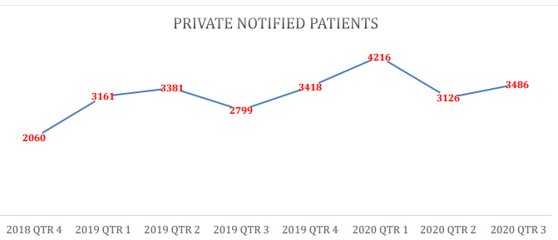
How Engagement of PPSA-Nikshay Mitra improved TB case notification in Private Health Sector?
Positive trend in TB notification observed in Private Health Facilities since involvement of PPSA – Nikshay Mitra on 29th Sept 2019.
Most importantly, PPSA has been able to support NTEP Jharkhand in improving the service delivery to TB patients managed in private sector in Jharkhand substantially.

Slide 20
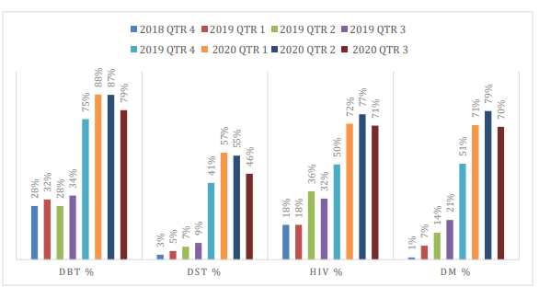
How Engagement of PPSA-Nikshay Mitra improved TB case notification in Private Health Sector?
Improving trend in U-DST among TB patients in Private Health Sector – 46% increase noted in 3rd quarter 2020 compared to 3rd quarter 2019.
Similar trends have been observed in Bank A/C seeding, NPY-DBT, HIV & Diabetes status and treatment adherence.
Improved uptake and utilization of NTEP FDC-drugs in Private sector - Almost 60% of Notified Tb cases in Private sector provided with NTEP drugs (decreased out of pocket expenditure to TB patients)

Slide 21
Summary of lessons and challenges
Overall, there is improved engagement of Private Health Sectors in TB notification and quality of TB care.
Substantial increase in compliance in TB testing, diagnosis, treatment adherence, utilization of NTEP FDC drugs, follow ups
Major challenges:
Initial challenges in convincing Private Health Care providers in new initiative as per Standard of TB Care in India (STCI) guidelines
Coordination and Orientation of Nikshay-Mitras
Migration of patients from Private to public, Public to private, Private to Private & Inter-district transfers
Frequent changes of mobile numbers/ wrong numbers/ network issues
Poor Health seeking behavior of patients, acceptance of NTEP FDC drugs
Sample collection & transport, linkages with CBNAAT labs, HIV testing etc
Treatment outcomes to TB patients with poor follow-up reporting and tests
Almost year long Covid-19 pandemic – Closure of facilities, frequent lockdowns & poor compliance.

Slide 22
Conclusion & Policy Implementation:
Potential for scale of implementation of PPSA-Nikshay Mitra envisaged in the NSP 2017-25 to provide universal TB care in India
The learnings during the course of implementation and the encouraging trend so far, provide an opportunity for other states for its implementation
Partners involved in implementation Alert India - a Mumbai based NGO, is the PPSA partner implementing this project in both the clusters and has completed its first year. Based on the satisfactory implementation and performance the project period has been extended for one more year

Slide 23
Thank you
“Lets Join Hands to END TB”

