Slide 1
NAYI DISHA KENDRA HIMACHAL PRADESH
National Health Mission,
Himachal Pradesh

Slide 2
Rationale
Population of HP 68,64,602 (Census 2011)
About 27% youth in Himachal Pradesh are involved in Drug Abuse.¹
Youth constitute about one-third of the total population.
1. https://abhipedia.abhimanu.com/Article/State/NDUyNAEEQQVVEEQQVV/Drug-Menace-in-Himachal-Pradesh-Himachal-Pradesh-State(Accessed on 2020 October 12)

Slide 3
Services offered at Nayi Disha Kendra
Clinical
Counseling
De-addiction
Referral
NUTRITION
INJURIES AND VIOLENCE
SEXUAL AND REPRODUCTIVE HEALTH
NON COMMUNICABLE DISEASES
SUBSTANCE ABUSE
MENTAL HEALTH

Slide 4
99 NAYI DISHA KENDRA
S.No | Name of District | Nayi Disha Kendra established
1 | Bilaspur | 5
2 | Chamba | 8
3 | Hamirpur | 6
4 | Kangra | 19
5 | Kinnaur | 3
6 | Kullu | 6
7 | Lahaul & Spiti | 1
8 | Mandi | 16
9 | Shimla | 16
10 | Sirmaur | 6
11 | Solan | 6
12 | Una | 7
13 | Total | 99

Slide 5
Unique features in Nayi Disha Kendra
Nayi Disha Kendra
Training on RKSK, De-addiction, Mental Health
IEC
Online reporting
Liason with District Mental Health Teams
Mental Health Helpline/ 104 Helpline
Services- Clinical, Counselling, referral + De-addiction
NGO Involvement
Team- MO, Paramedic staff, Counsellor

Slide 6
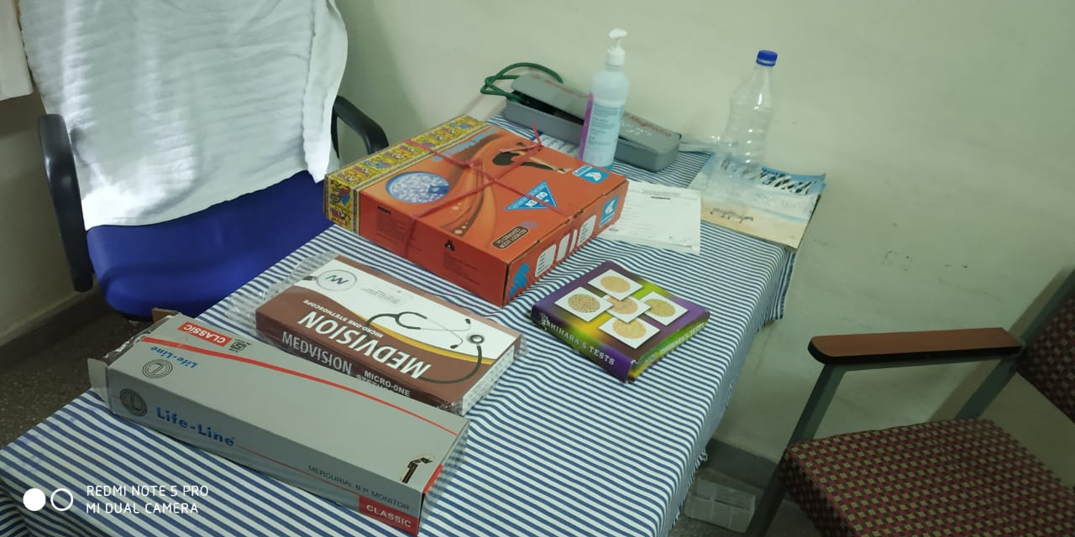
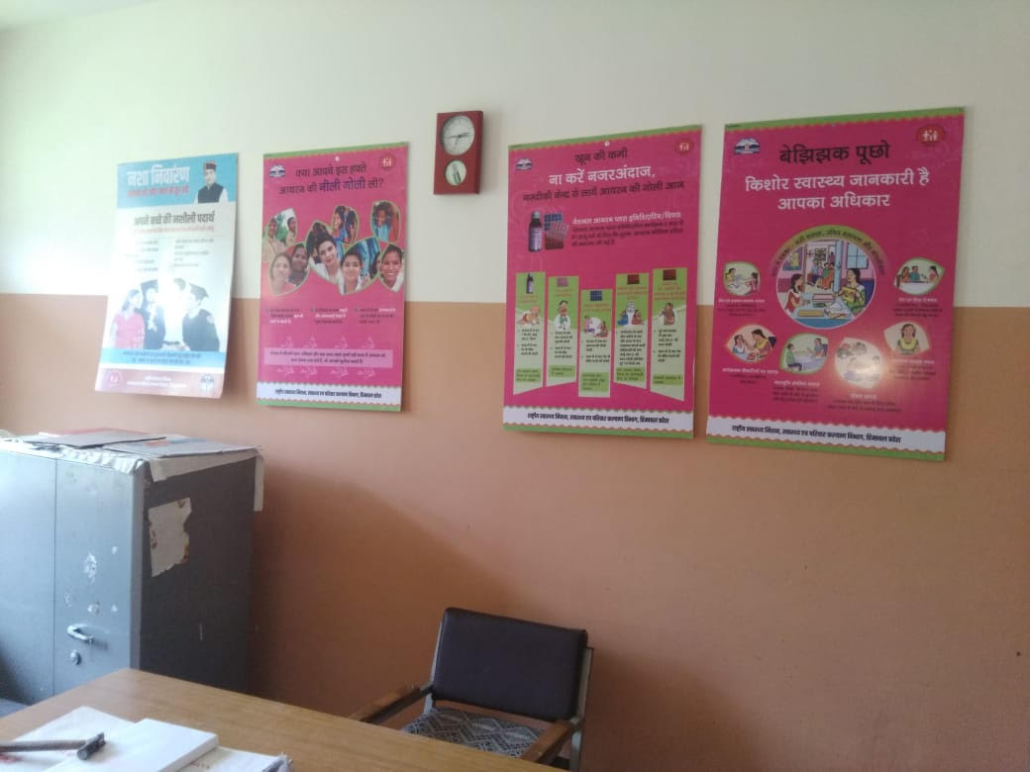
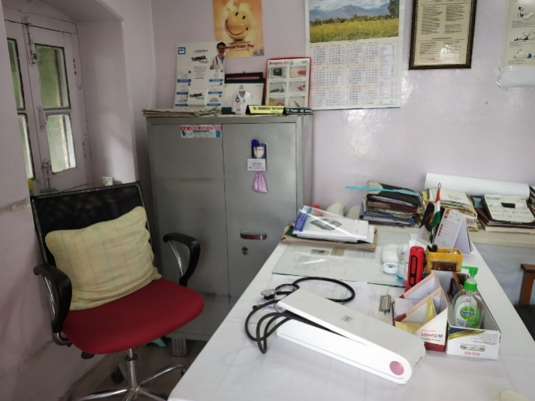
Nayi Disha Kendra
ZH Mandi
Reporting formats at Nayi Disha Kendra
CH Junga
CH Dalhousie

Slide 7
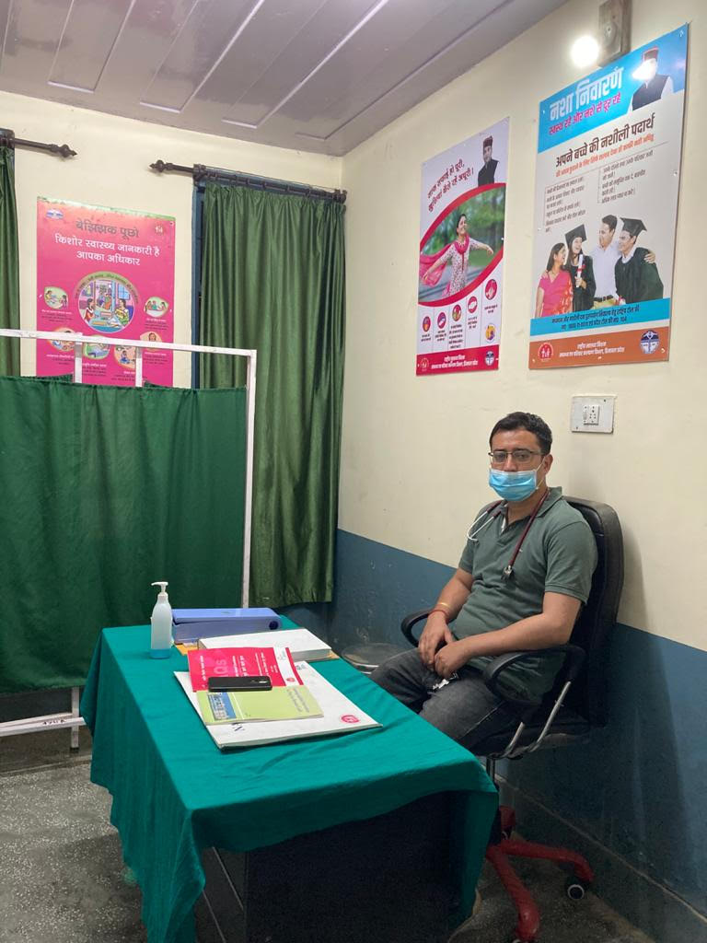
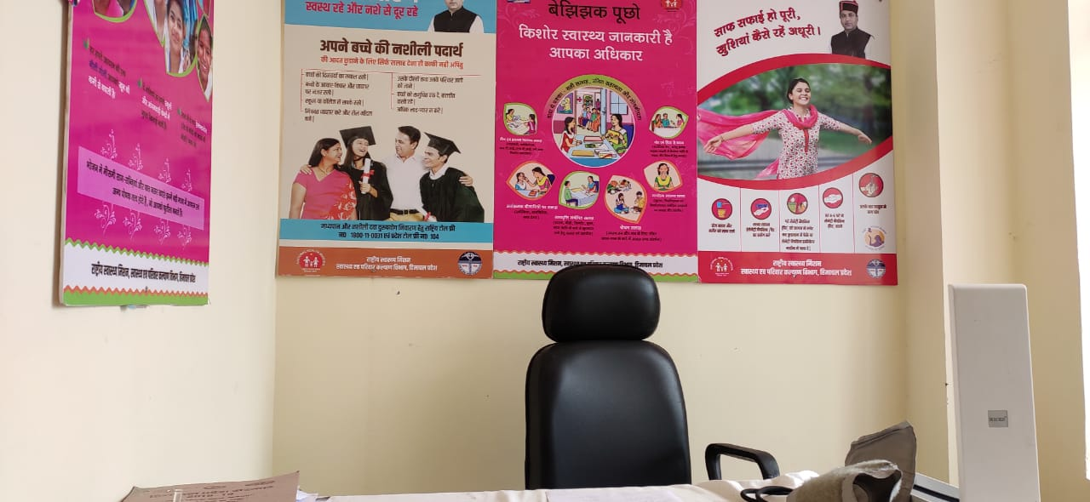
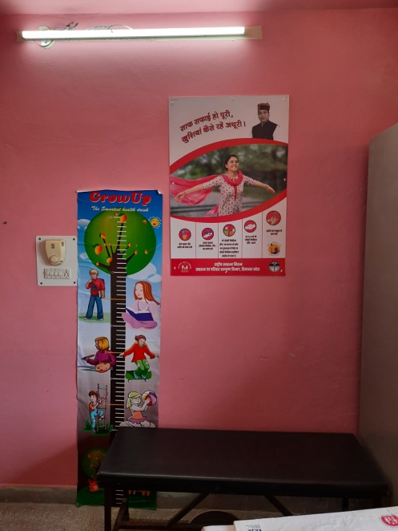
Nayi Disha Kendra

Slide 8
Capacity Building Strategy
3-4 health care providers (Medical Officers/ FHW/ Staff Nurse/ Lab Technician/ Pharmacist/ Counselors etc.) trained from each NDK on mental health and RKSK.
Training on treatment for de-addiction was imparted to Medical Officers in Nayi Disha Kendra and on counselling to Counselors.
Training of Psychiatrist was also done on De-addiction so that Medical Officers can consult them whenever they require.
In addition training on mental health and de-addiction was also imparted to 104 Helpline Counselors.
Training for online reporting of the RKSK format was given through online mode to 256 participants including District Programme Officers, Medical Officers, Paramedic Staff, Block Programme Managers and MIS Coordinators

Slide 9
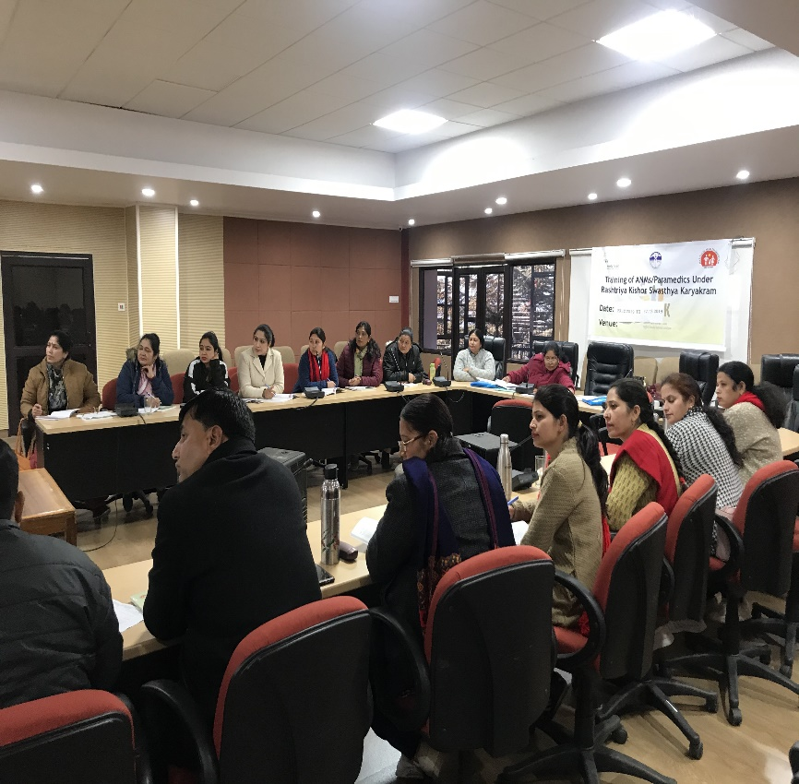
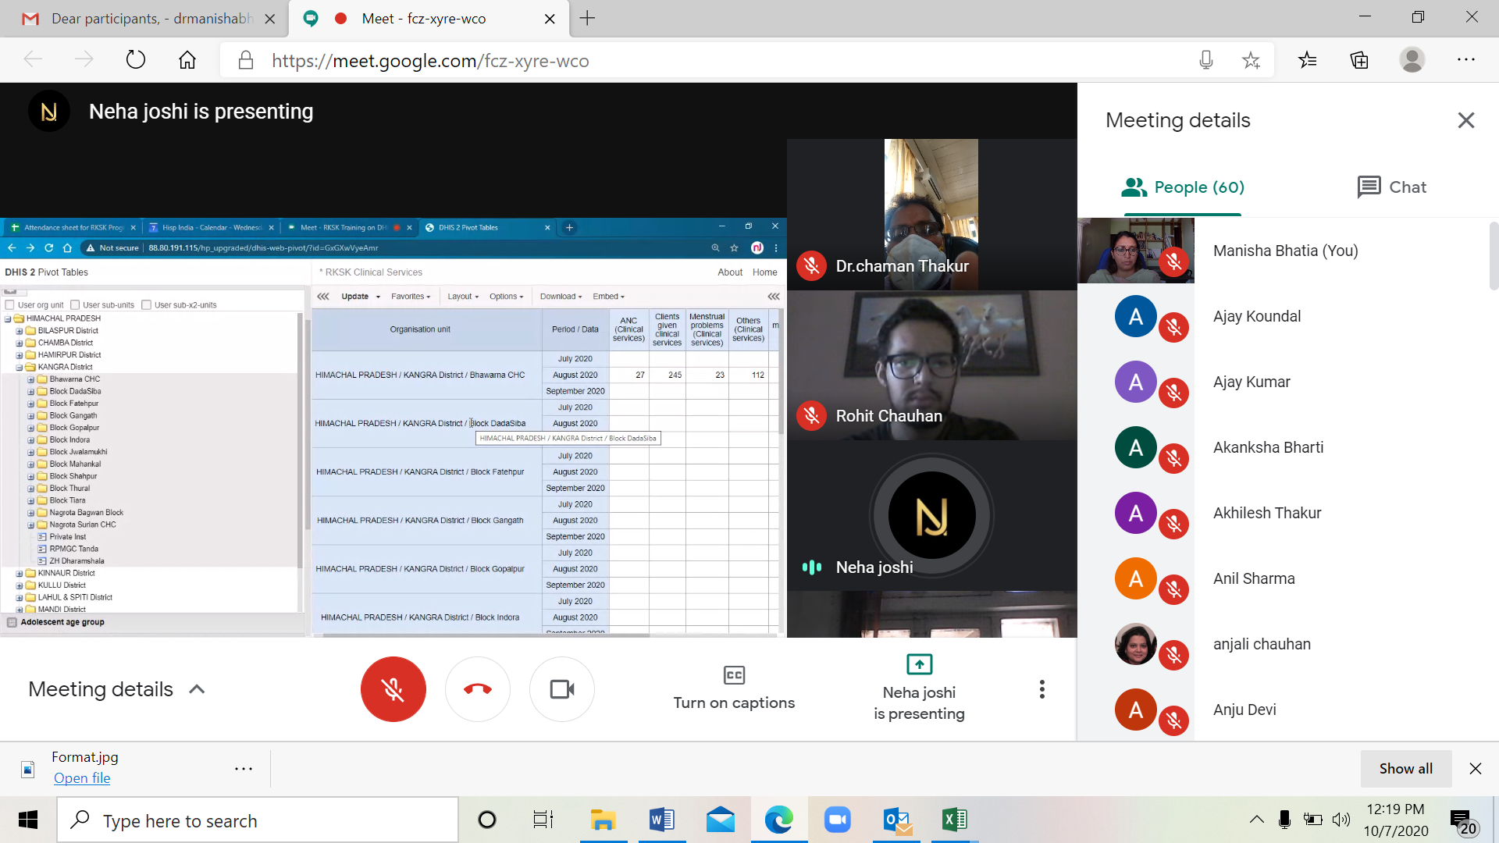
Capacity Building
Training of Paramedic staff
Online Training of MOs on De-addiction
Online Training of staff on online reporting

Slide 10
Minimum Human Resource
No new HR has been recruited. Existing Human resource like Medical Officers/ FHW/ Staff Nurse/ Lab Technician/ Pharmacist/ Counselors etc. after due training provides the services.

Slide 11
Beneficiaries availed services
As capacity building of various staff category was done in the month of December, 2019, hence services on de-addiction started in the month of January, 2020.
Beneficiaries availed services from Jan to Dec, 2020
S.No | Total Adolescents registered | Adolescents counselled for de-addiction
1 | 22066 | 754

Slide 12
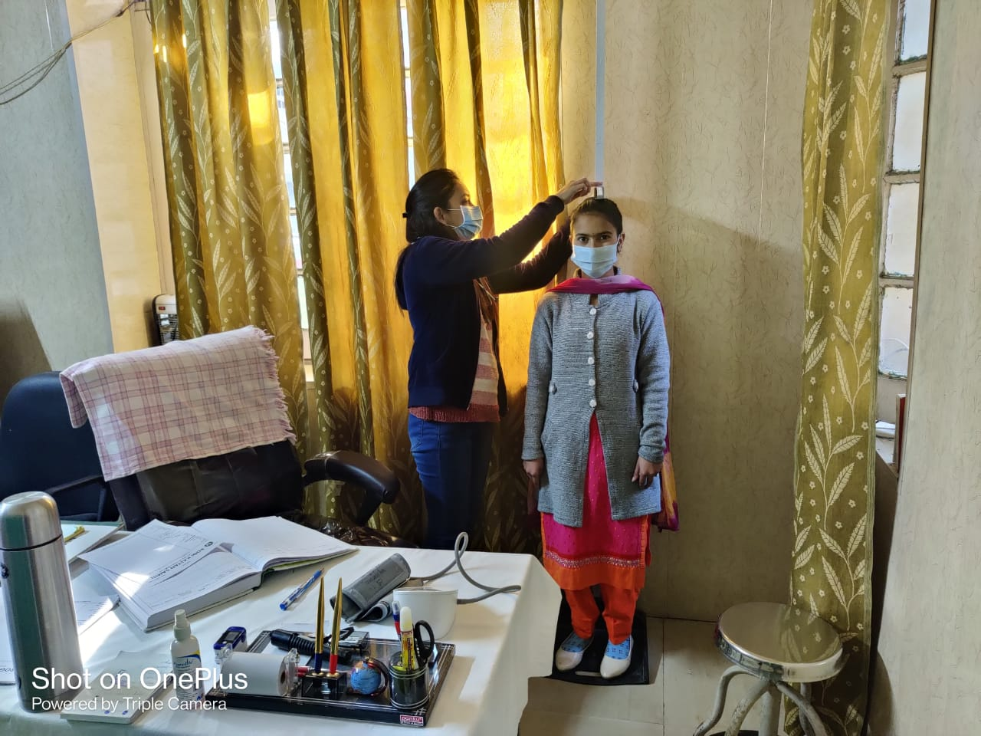
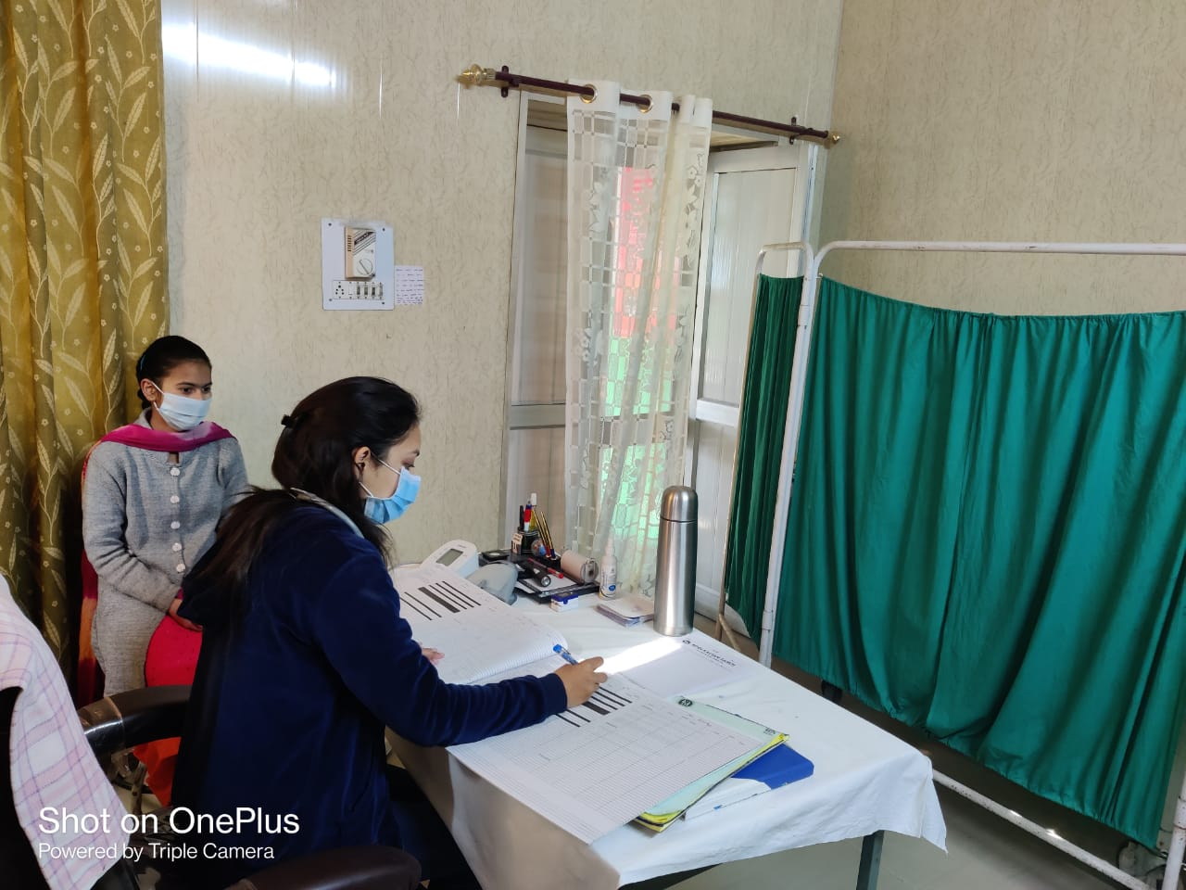
Beneficiaries at Nayi Disha Kendra

Slide 13
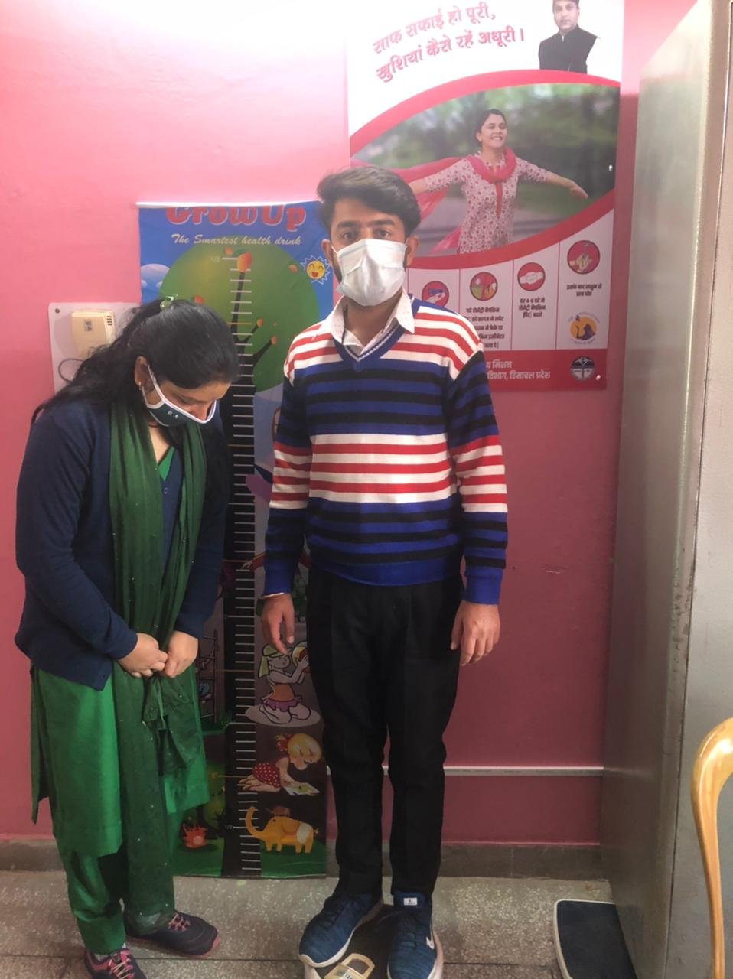
Beneficiaries at Nayi Disha Kendra

Slide 14
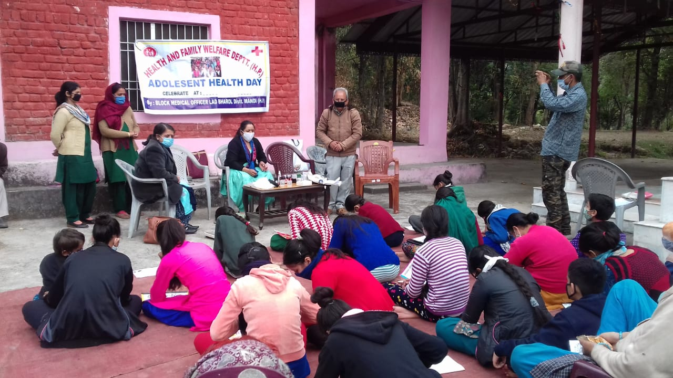
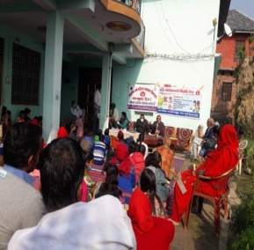
Sensitization of Adolescents in AHD for De-addiction services at Nayi Disha Kendra

Slide 15
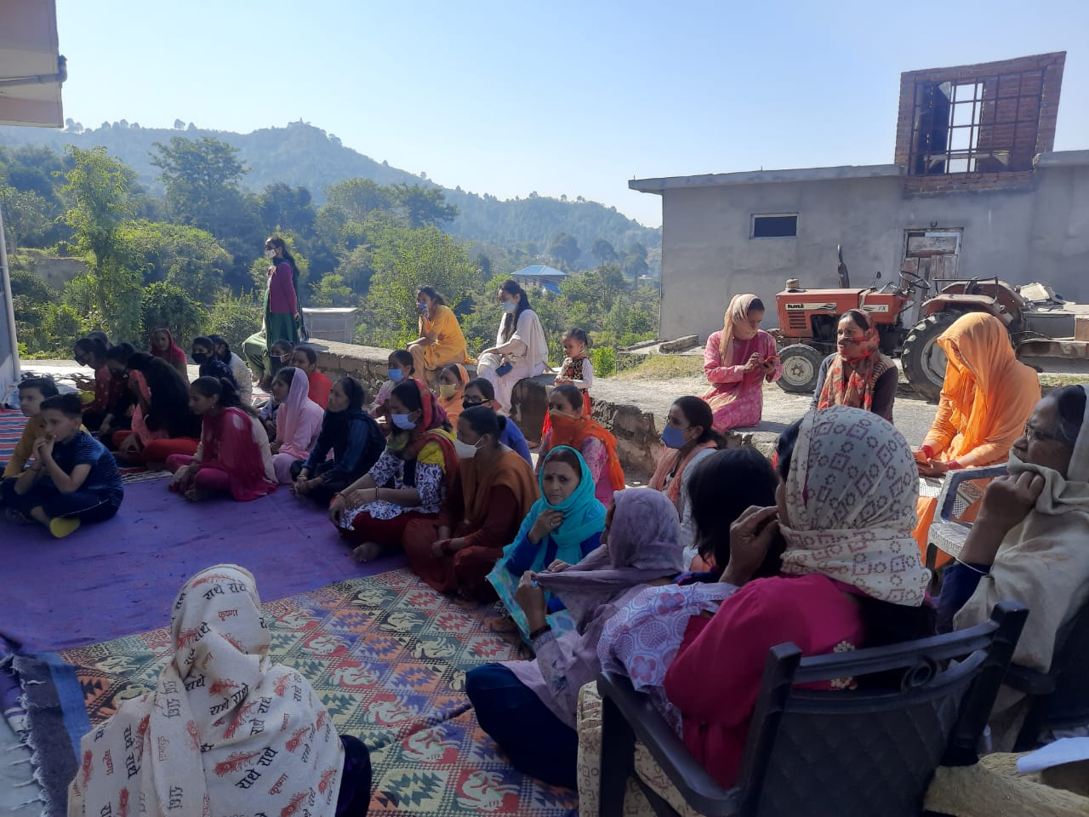
Sensitization of parents for De-addiction services at Nayi Disha Kendra

Slide 16
Convergence with other departments
Various platforms of other departments are being used for wide spread publicity of services being provided at Nayi Disha Kendra such as
Kishori Diwas, Poshan Maah, Anemia Mukt Bharat – ICDS
Har Ghar Pathshala- Education
Gram Sabha- Panchayati Raj

Slide 17
Partners Involved For Implementation
“MAMTA HIMC” a NGO with known name in Adolescent Health engaged and MoU signed.
MAMTA HIMC is facilitating and strengthening the implementation of RKSK in the state as Technical partner.
Coordination is being done by MAMTA in establishment, assessment and supportive supervision of the Nayi Disha Kendra.
Based upon supportive supervision, gaps were shared with health officials after which time to time corrective actions were taken by the department.
MAMTA has facilitated the RKSK training and De-addiction training of Psychiatrist, Medical Officers, Paramedics and Counselors along with the training of online reporting of RKSK.
MAMTA has also developed counseling material.

Slide 18
Challenges
Adolescent Health is the least priority of Medical Colleges.
Trained manpower is dynamic and hence repeated training is required at the facility level.
Performance in such facilities is individual driven. Performance depends upon the self-motivation of the staff.
State has only 22 Adolescent Health Counselors. Rest 77 Nayi Disha Kendras do not have AH Counselors. A team including paramedic staff has been trained to provide various services at NDK.

Slide 19
Way Forward
Initially Nayi Disha Kendras were started at the tertiary and secondary level of facility having adequate infrastructure. Once these facilities become popular then in next phase Health and Wellness Centers would be covered to provide services to adolescents.
Multi Drug Screening Kit shall be provided at Nayi Disha Kendra. These kits helps in detection of six drugs namely Marijuana, Cocaine, Opiate, Amphetamine, Benzodiazepines, Methylnedioxymethamphetamine.
Recruitment of Counselors shall be done.

Slide 20
Thank You

