Slide 3
Making of a Hub
The Madhya Pradesh story

Slide 4
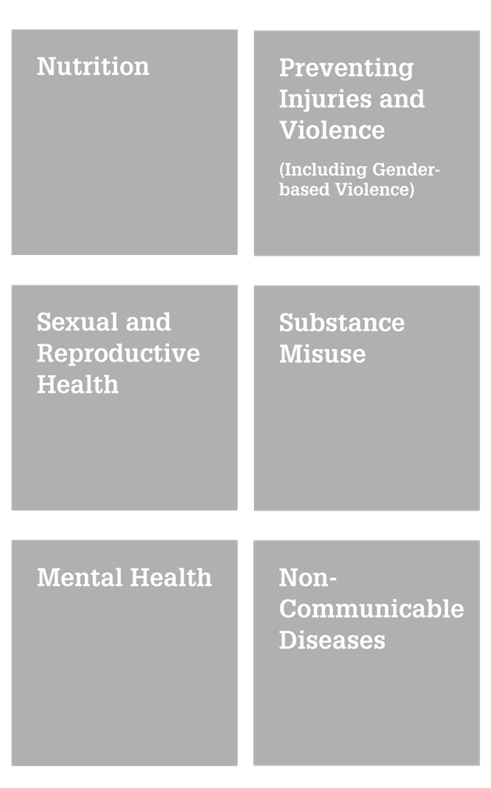
RKSK launch
World’s first ever national adolescent health programme launched in India. The year was 2014. Madhya Pradesh launched the programme in the state immediately after.
KEY COMPONENTS
Adolescent peer-educators in every village
Counsellors operating from block level
Larger eco system engaged through dialogue
Comprehensive adolescent health beyond RH and LSE
Preventive approach very new to public health practitioners
Operations Guideline developed by GOI needed customization

Slide 5
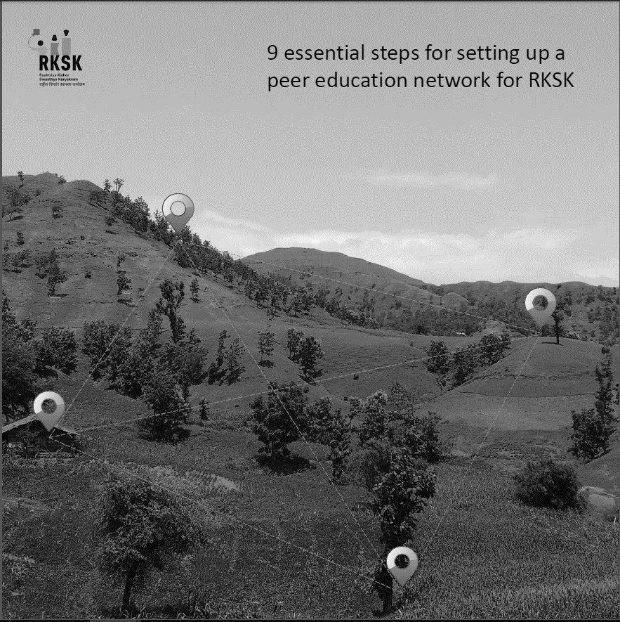
MP Model
With technical support from UNFPA in the state, the programme implementation was studied in Barwani District, in 2015. Several solutions were recommend. These solutions were tested in the field and came to be known as the “MP Model”.
SOLUTIONS INCUBATED IN MP
Repositioned Peer Educations as Saathiyas
Promoted Saathiyas via PFI TV serial
Customised existing helpline for RKSK
Developed app with FAQs on adolescent health
Inducted field NGOS to handhold
Mission report that paved the way for innovations like: Saathiya branding, AH app, helpline and Saathiya TV serial
Launched nationally by GOI in 2017
52 TV episodes obtained free from PFI
Learning helping design all-new 104
Replicated by HQ MIS in 8 countries
Expanded TOR for next 3 years
Name was launched nationally by GOI in 2017
52 TV episodes were obtained free from PFI
The experience is helping design the all-new 104
This has been replicated by HQ in 8 countries

Slide 6
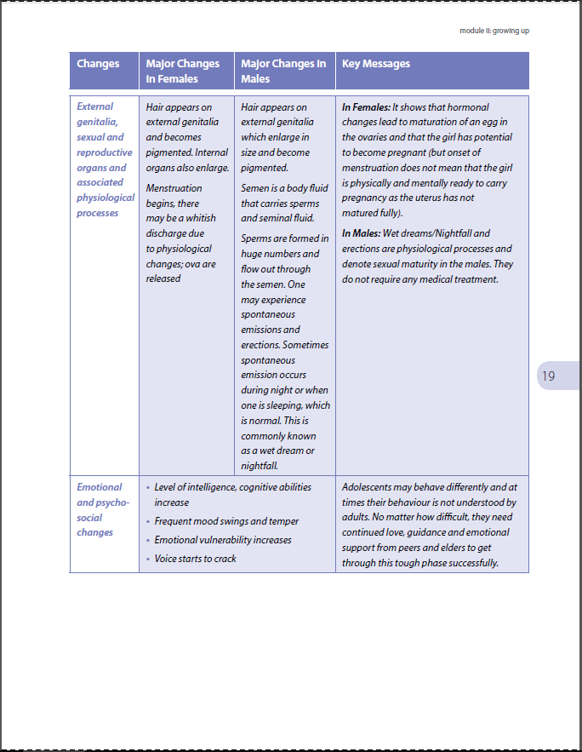
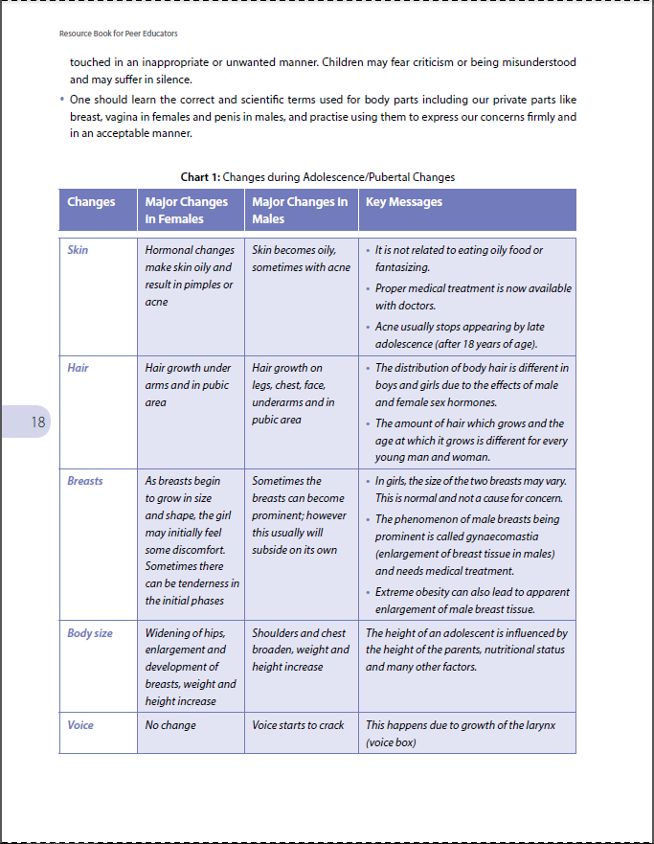
6 big barriers remained
The Saathiya resource material was too school-like to motivate adolescents to attend monthly peer meets
With no cash incentive and an 18-year age limit as many as 15% Saathiyas dropped out every year
The quarterly AHDs were not easy to organize for the Saathiyas, in spite of Rs.2500 provided per event
With a counsellor requiring a day on average to cover a village, each village could be visited only once in 54 weeks
The 6-day classroom training for counsellors was neither sufficient, nor cost-effective to ensure quality
The manual reporting systems was making M&E of RKSK activities delayed and
inaccurate
Thick book with text-heavy info did not appeal to adolescents

Slide 7
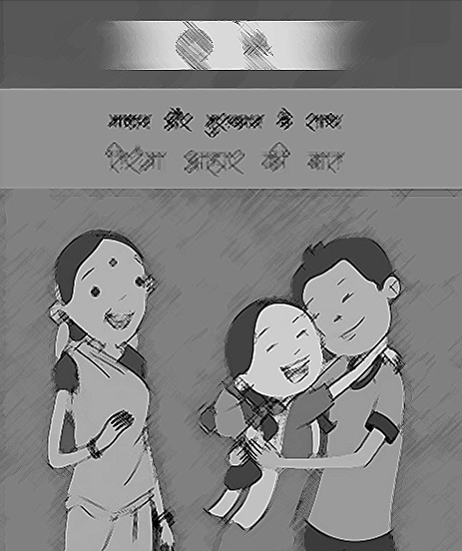
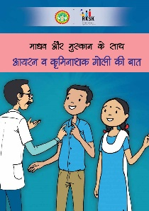
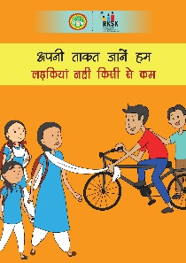
INNOVATION ONE
Comics and Animatics
Resource book converted into simple a series of comics and animatics. The stories in every comic is ‘department neutral’, so Health, Education, Skills and Women & Child Departments are all using the material.
6 animations in pipeline for soft skills.
24 comics on 24 topics for 24 months.

Slide 8
INNOVATION TWO
AGREEMENT
Incentives and shadow peers
Government of Madhya Pradesh
As effective incentives for Saathiyas, inter-departmental collaborations have been initiated.
For school-going Saathiyas, talks are on with the Education Department to provide credit points for time spent on promoting adolescent health.
For out-of-school Saathiyas, it is proposed that the Skills Mission provides vocational training.
And to ensure new Saathiyas are ready to take over from those who turn 18, two younger ‘shadow PEs’ are being inducted in every village to learn on the job.
Agreements in pipeline with Department of Health,
with Department of Education and Skills Mission

Slide 9
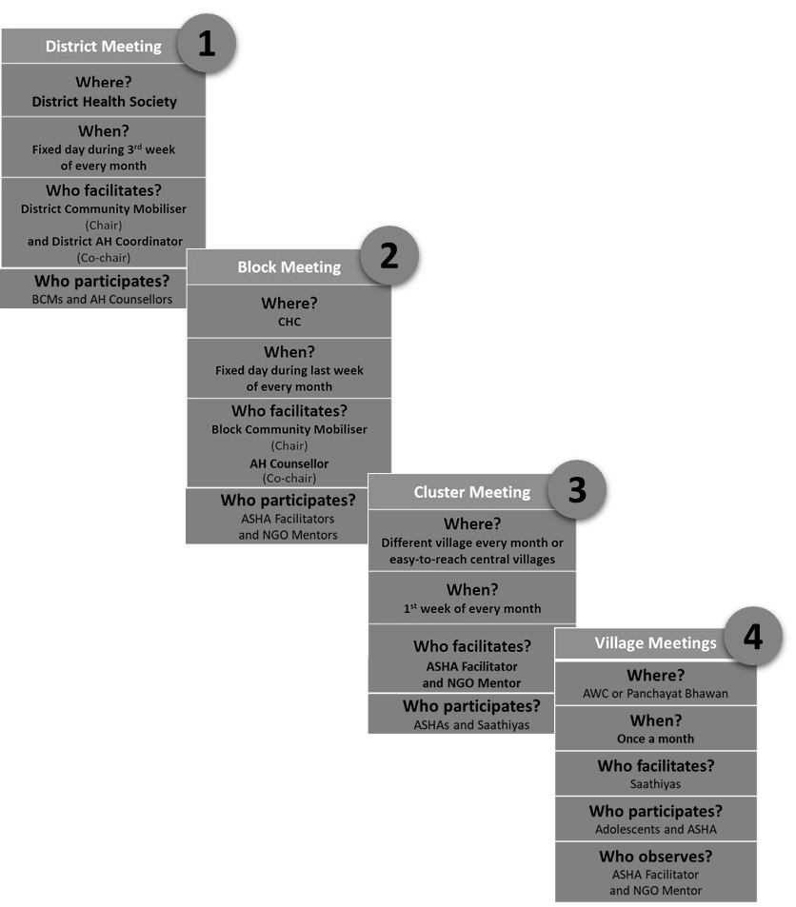
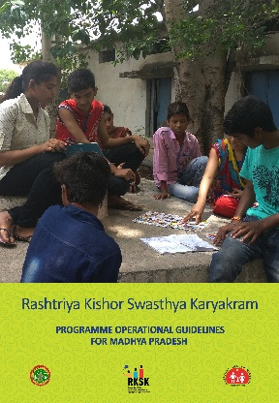
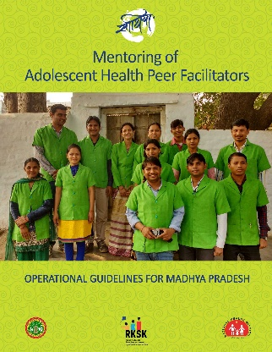
INNOVATION THREE
Mentoring chain
Connecting the state to the villages is a relay of monthly meetings.
A convergence with the ASHA Department ensures sustained engagement with ASHA Facilitators.
One comic is distributed per month, sent down the mentoring chain in time for the peer meeting.
The counsellors are now handling walk-in cases, covering schools in and around the AFHC, and visiting villages on call.
Revised programme guidelines for MP
Mentoring chain guidelines ➔ for MP
A unique convergence between
the Adolescent Health and AHSA Departments
is the hallmark of this mentoring chain

Slide 10
INNOVATION FOUR
Counsellor E-training
In order to make fresh and follow-up training by well-known experts possible, one of India’s best training courses has been packaged into an online curriculum.
Other departments have also opted for this online service.
Over 201 people have enrolled for the online training course and most of them are just a few modules away from becoming certified health counsellors.

Slide 11
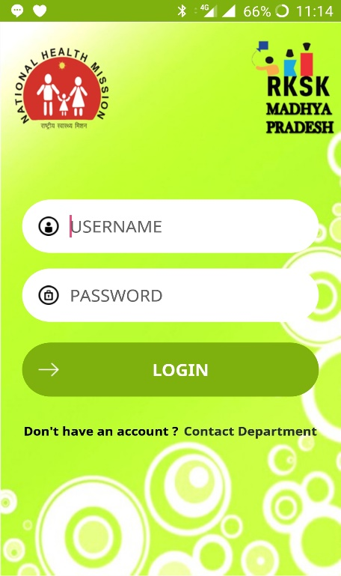
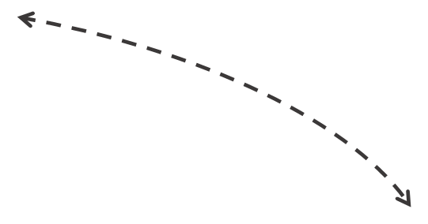
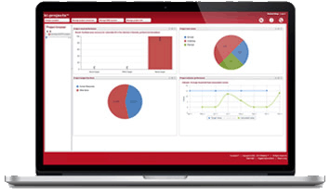
INNOVATION FIVE
MIS application
UNFPA has developed an online reporting system exclusively for RKSK that will help access, analyze and share data on implementation in the field.
With the RKSK programme in MP already spanning 4111 villages, and set to expand to many more in the next phase, such paperless monitoring will make a huge difference.
NGOs and ASHAs in the field will send real-time updates using their mobile phones.

Slide 12
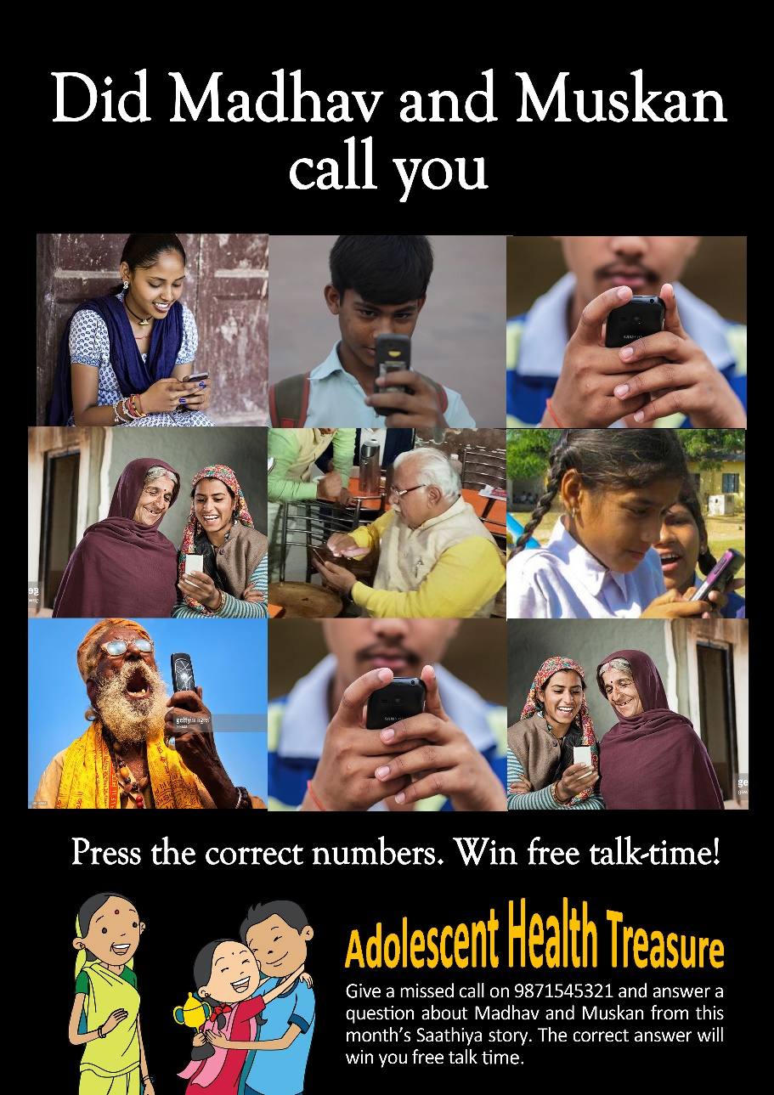
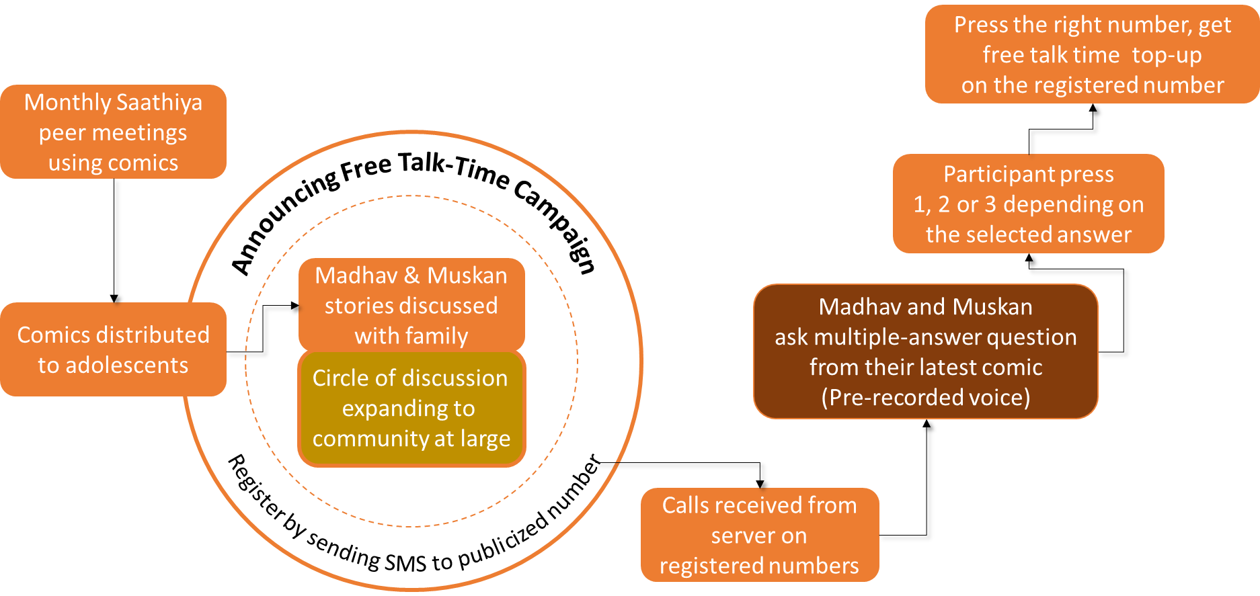
INNOVATION SIX
Community support
Buy-in of parents and local influencers on adolescents discussing topics like reproductive health, substance misuse, GBV, etc. is essential. The Adolescent Health Days (AHDs) are now being organized better, thanks to the mentoring chain and involvement of ASHA Facilitators.
As the next big innovation, funds are being sought to launch a missed call campaign that would serve the purpose of AHDs even better, at a fraction of the cost.
Posters offering free talk-time top-up
to people who answer AH questions correctly

Slide 13
India’s innovations hub for adolescent health programming

