Slide 1
Mainstreaming Female Sex Workers in NVHCP
West Bengal

Slide 2
Background
Global Perspective:
People living with Chronic Hepatitis B (CHB) : 240 Million
People living with Chronic Hepatitis C (CHC) : 140 Million
National Perspective:
People living with Chronic Hepatitis B : 40 Million
People living with Chronic Hepatitis C : 6-12 Million
Estimated Burden: 9 times more than HIV
Mortality : Next to TB

Slide 3
Burden of major Infectious diseases in India

Slide 4
The Paradox
Chronic Hepatitis B: Aware – Only 10% of people living with
On treatment - Only 16 % of those aware of status
Chronic Hepatitis C: Aware – Only 19% of people living with
On treatment - Only 30 % of those aware of status

Slide 5
The ‘Missing’ numbers
The Most-at-risk: People Who Inject Drugs (PWID)
MSM/TG
FSW
People in closed settings
Truckers/Migrants
Pooled Prevalence for Hep C : 44.7 ; 5.0 ; 4.4
Missing from the Service Domain

Slide 6
Our Approach
Facility based Approach: The routine
Are we getting to the Most-at-Risk ?
Mainstreaming the Marginalised through Community approach

Slide 7
Our AIM
To bring FSWs and other Core Groups into the NVHCP Fold
Target numbers of FSW to be screened (In pilot): 3965

Slide 8
The Construct of Pilot
The Target Community: Female Sex Workers
The Approach: Community ownership
A Synergy : With existing HIV/AIDS project
The Locale : Sexual Health Intervention Projects (SHIP I to V), Kolkata
The Partners : Society for Human Development and Social Action (SHDSA)
and
Durbar Mahila Samanwaya Committee
The Vision: Counsel Screen Confirm Link to Treatment

Slide 9
The Target Areas to be Covered
Sl. No. | Zone | Area covered (Population )
1 | SHDSA SHIP - 1 | Part of Sonagachi (1200)
2 | SHDSA SHIP - 2 | Part of Sonagachi (1173)
3 | SHDSA SHIP - 3 | Rambagan, Sethbagan, Jorabagan (400)
4 | SHDSA SHIP - 4 | Bowbazar (550)
5 | SHDSA SHIP - 5 | Kalighat, Chetla, Khidirpore, Lakahar Math, Tollygunge (642)

Slide 10
The Activities
Meeting with Project Management: State and Local level
Training of Project Staff: Counselors, ORWs, PEs
Community level Group Discussions to develop Community Ownership
Training on Sample collection and Screening
Establishment of Linkage Nodes for confirmatory tests of reactive screening samples at SRL, IPGMER
Supply of logistics
Commencement of Community level Screening of At-risk
Confirmatory tests for those screened positive at SRL, IPGMER
Linkage of positive patients to Treatment Centre
Periodic on site mentoring from Program Division
Weekly reporting

Slide 11
Meeting with Project Management

Slide 12
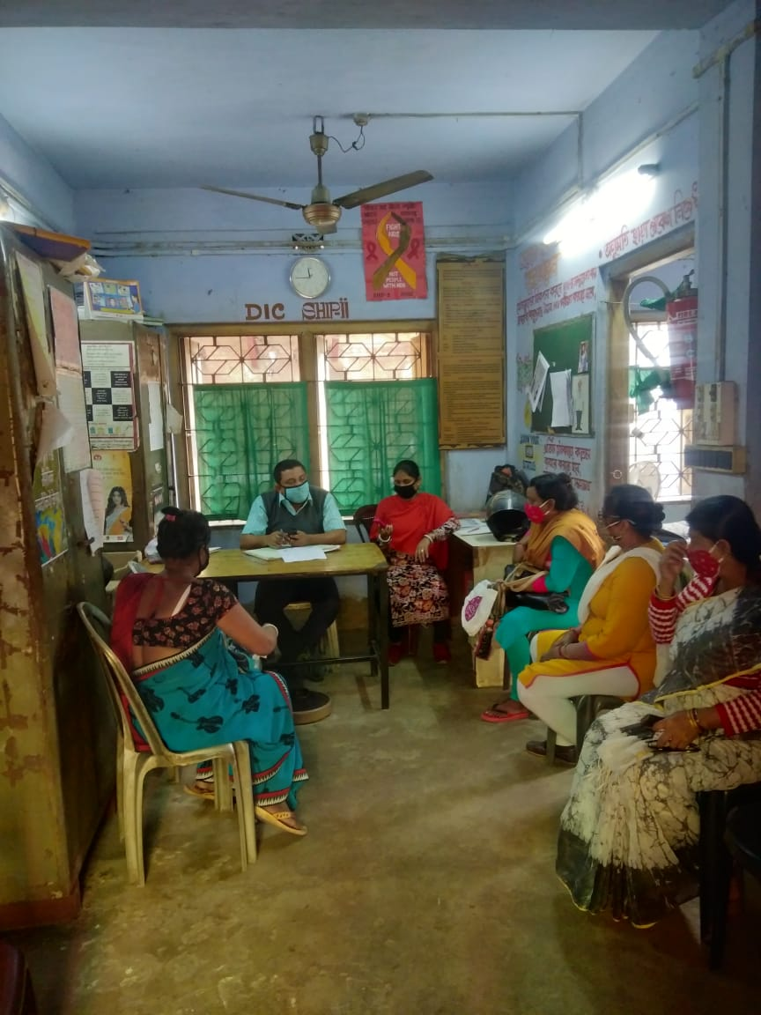
At a Drop-in-Centre
Group Discussion to develop Community Ownership

Slide 13
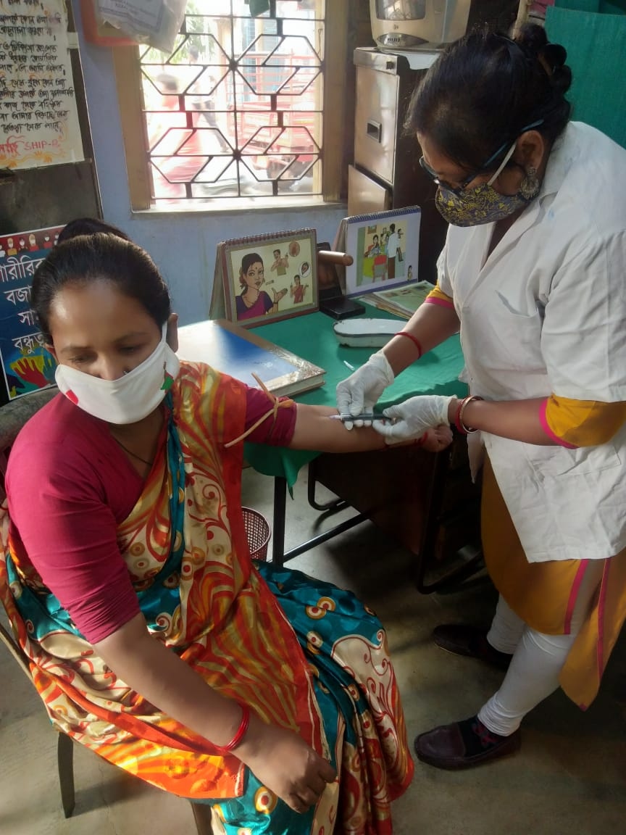
ORW at the Job
Community level Screening of At-risk

Slide 14
The Interim Results
Screening Target: 3965
Coverage: 1970*
Already Successfully Linked to Treatment Centre: 04
*COVID pandemic was a hindrance to effective coverage

Slide 15
Scalability Potentials
Future Success Keys:
Community based outreach: Accessibility of At-Risk marginalized HRGs
Building on existing capacities to combat BBI/STI
Low cost: No HR add-on; only capacity building & logistic support required
Community ownership incentives : Cure for Hep. C, Vaccine for Hep. B
Social Marketing potential: Screening kits for Hep. B&C

Slide 16
Scale up plans
Expand Coverage to include all FSW Intervention projects
Annual Screenings for Hepatitis C
Minimum one time screening for Hepatitis B
Vaccination for all Hepatitis B negatives
Screening of all new entrants
Replication in all other core HRG intervention groups

Slide 17
Thank You

