Slide 1
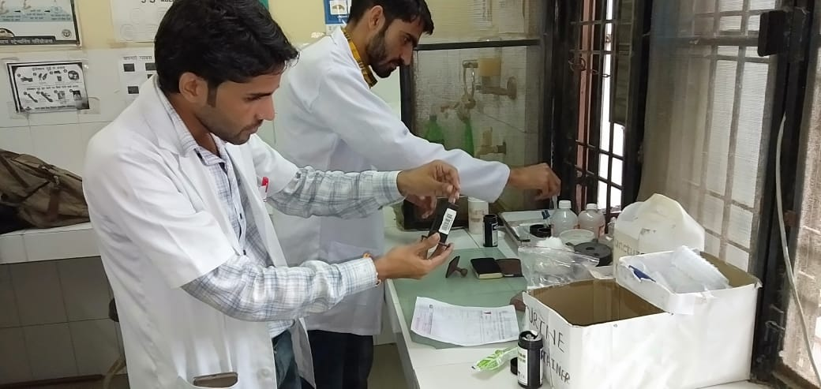
Innovations in rolling out Certificate course in Community Health: Uttar Pradesh
Pankaj Kumar – MD NHM
Dr. Madhu Sharma- GM Planning
Uttar Pradesh

Slide 2
Introduction
01
20573 sub-centres , 2726 PHCs and 592 UPHCs into Health & Wellness Centres by 2022
02
Operationalization requires incremental addition of human resource in the form of Community Health Officers (CHOs)
03
Adopted six‐months Certificate Course in Community Health developed by IGNOU for developing the cadre of CHOs
04
Intake of nursing candidates from open market (GNM/B.Sc.) Course offered at Medical colleges/District Hospitals/Nursing Schools
Notes:
© Copyright PresentationGO.com – The free PowerPoint template library

Slide 3
Conceptual Framework for rolling out Certificate course in Uttar Pradesh
Quality assurance
3
Creating Training eco-system
2
Standardised teaching, learning materials, academic planning tools and mentoring visits
Operationalization of program study centres (PSCs)
PSC level ToTs to develop pool of trainers and
Structured implementation of academic activities
1
Sensitization
Created buzz by engaging all stakeholder through state level orientation meetings
Notes:
© Copyright PresentationGO.com – The free PowerPoint template library

Slide 4
Innovative approaches in rolling out Certificate course
Development of standardized learning resource package
Program Study Centre level ToT
Standardized PPTs, teaching aid, videos etc.
Structured Academic Planning
Orientation of counsellors using Facilitator's Guide book.
MRP, CRP, Academic session schedule etc.
State level orientation workshop
State level stakeholders
PSC I/Cs, faculty and Div.PMs
Mentoring and Quality Assurance support
Support to PSCs, student feedback and knowledge assessment
Notes:
© Copyright PresentationGO.com – The free PowerPoint template library

Slide 5
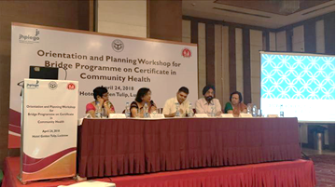
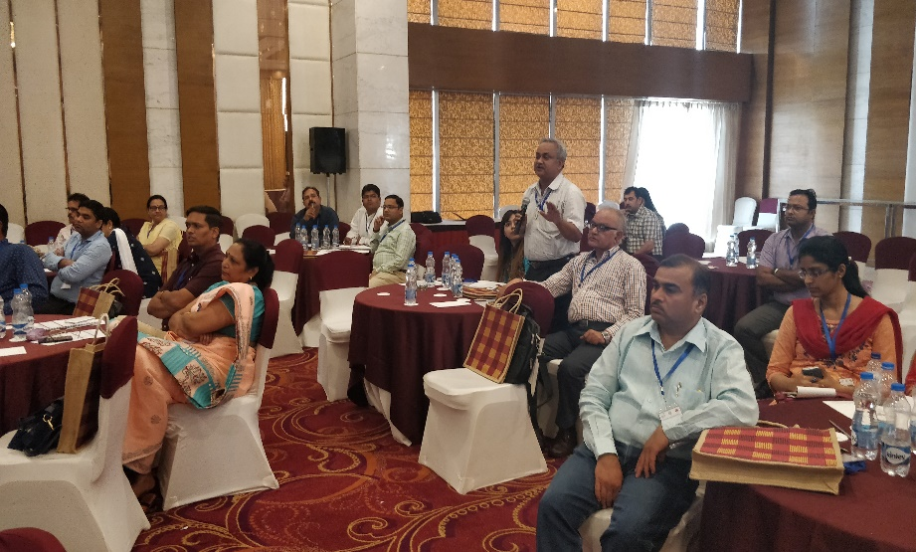
1.State Level Orientation Workshops
Objectives
  Develop understanding about modalities of the certificate course
  Understand the course curriculum
  Roles and responsibilities of major stakeholders
  Administrative and financial provisions under NHM and IGNOU
  Discussion on operational challenges and local solutions devised
Participants
  State level officials from NHM, Directorate of Medical Health
  IGNOU representatives
  Program in-charges & Academic counsellors of identified PSCs
  District level functionaries including DivPMs/ ACMOs/ CMSs/ SICs
  Representatives from development partners – UP TSU & Jhpiego

Slide 6
2. Program Study Centre level ToTs
Overview of HWC & BPCCH Program
Orientation to Modules
(BNS-041,042 & BNSL 043)
Evaluation mechanism of the course
Overview of practical log book
Administrative and financial provisions
Roles and responsibilities of Key stakeholders
Development of operational plans
(Course plan, MRP & CRP)
Mentoring and Quality assurance
Objectives
Sensitization of academic counselors on content of certificate course, evaluation methodology and examination pattern
Orientation of Program In charges and academic counselors on administrative and financial provisions
Delineation of roles and responsibilities among key stakeholders and establishment of effective coordination mechanisms
Participants
  Program in-charges
  Academic counsellors
  IGNOU representative
  District level officials
Topics covered during PSC ToT

Slide 7
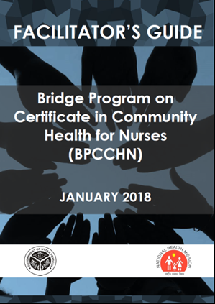
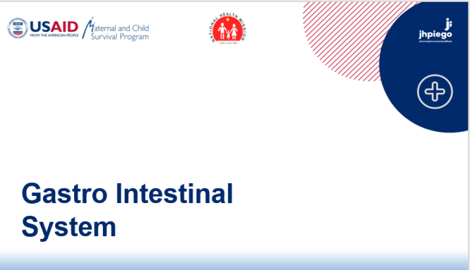

3. Development of standardized learning resource package
Objective: To ensure quality training across all operational PSCs
Package Content
  Facilitator’s Guide- designed for academic counsellors
  Standardized presentations based on IGNOU certificate course curriculum developed to aid academic counsellors in effectively delivering the trainings
  Repository of readily available training aids & reference materials

Slide 8
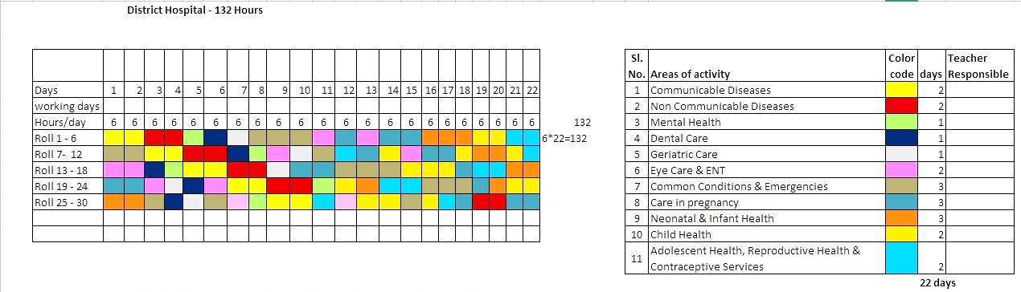
4. Structured Academic Planning
Objective: To ensure time appropriate completion of course in line with IGNOU norms
Planning tools
  Course plan based on availability of counsellors
  Master Rotation Plans (MRP) to plan academic sessions in co-ordination with the academic counsellors
  Clinical Rotation Plans (CRP) to ensure distribution of students in different clinical areas according to practical exposure norms
Clinical Rotation Plan
Course Plan

Slide 9
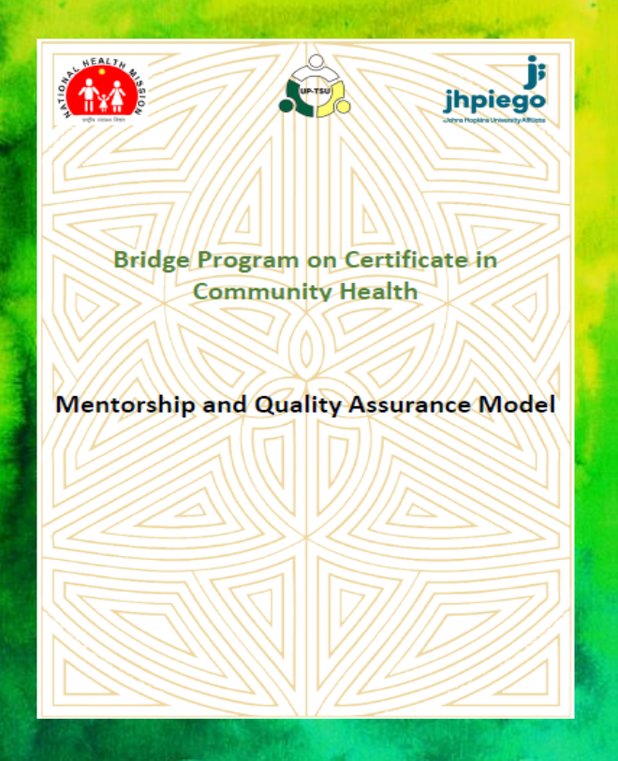
5.Mentoring and Quality Assurance Model
Objectives
  To ensure infrastructural preparedness of PSCs to impart quality teaching
  To establish a structured feedback mechanism for students and academic counsellors
Key Actionable
Day1
Interaction with counsellors for feedback on course/ operational aspects
Day 2
Observe clinical teaching at District Hospital
Review administrative records
Observe classroom teaching
Track fund utilization
Feedback from students
Introductory meeting with PIC
Assess infrastructural preparedness
Debriefing meeting with PIC to provide feedback
Knowledge assessment (3rd & 5th month)
MQA Model

Slide 10
Results
Building and operationalizing training infrastructure – 32 program study centres have been notified and operationalized
Creation of training ecosystem - Resource pool of 339 academic counsellors created
Standardization of teaching practices - 71 standard presentations developed for supporting academic counsellors in conducting structured theory and practical classes
Quality assurance and structured feedback mechanism – instrumental in mid-course corrections and quality assurance of training
Status of Term End Examination- 10 candidates passed (55.5%) against 18 in July 2017 session and 185 candidates passed (85.2%) against 217 in January 2018 session

Slide 11
Geographical Coverage of established Program Study Centers
1
S
H
P
Workload upto Dec-2022
Targeted Program Study Center-52
S
h
a
m
l
i
M
Z
N
B
J
N
1
1
B
G
T
M
R
T
Currently 32 program study centres are functional in 25 districts
1
M
R
D
G
Z
A
H
a
p
u
r
A
m
r
o
h
a
R
M
P
1
P
I
L
S
a
m
b
h
a
l
B
R
L
1
G
B
N
B
L
S
1
Number of PSCs for 2018-19
Category | Targeted (Mar’19) | Notified
DH,DWH & DCH | 27 | 26
Medical College/ Institutes | 4 | 4
College of Nursing | 1 | 1
School of Nursing (GNMTC) | 1 | 1
Total | 33 | 32
2
B
A
D
K
R
I
A
L
G
1
S
H
A
M
T
R
K
a
s
g
a
n
j
1
S
R
W
H
T
R
E
T
A
B
R
C
F
K
B
H
D
O
S
T
P
1
1
B
R
P
1
F
E
R
M
A
I
S
D
N
M
H
G
A
G
R
2
K
N
A
G
N
D
1
1
K
S
N
L
N
O
B
B
K
3
1
B
S
T
S
K
E
T
W
A
U
R
4
F
A
I
N
G
R
P
K
P
D
U
N
N
1
A
B
N
D
O
R
A
m
e
t
h
K
P
N
R
B
L
i
1
J
A
L
S
U
L
M
A
U
1
F
T
P
P
T
G
A
Z
G
B
A
L
J
1
H
M
P
N
P
G
Z
P
J
N
S
K
S
M
1
1
M
H
B
B
N
A
A
H
B
B
D
H
V
R
N
C
K
T
1
C
N
D
M
Z
P
L
L
P
S
B
D

Slide 12
Achievements
Program Study Centres (33 Targeted)
33 PSCs identified
Community Health Officers (Targeted 2000)
Health & Wellness Center (Targeted 2000 HWCs)
253 HWC centres are functional
32 notified by IGNOU
1 is in process
217 candidates had enrolled in Jan 2018 session out of which 185 have qualified
931 enrolled in July 2018 session & are under going training
1163 Candidates will be taken up in Jan 2019 session
First batch of 18 candidates have completed the course & are working as CHO
1000 HWC are under process of establishment & will be functional by December 2018
Notes:
Result for the Januray 20189 batch is awited

Slide 13
Lessons learnt
Investing in capacity building of faculty improves the quality of subsequent trainings
Timely planning is crucial to ensure completion of uninterrupted theory and practical classes
Identification of health facilities (SCs/ PHCs/CHCs) with adequate caseloads is critical for productive clinical postings
Adequate quality assurance and onsite mentoring support are essential for continued learning and competency development

Slide 14
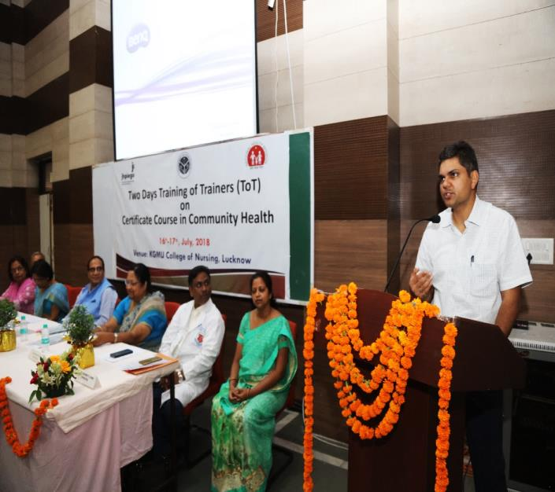
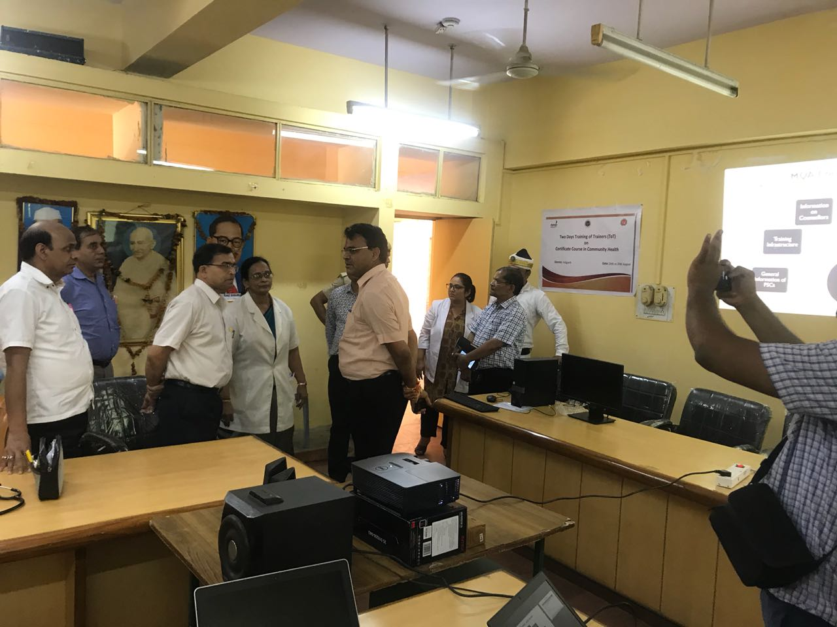
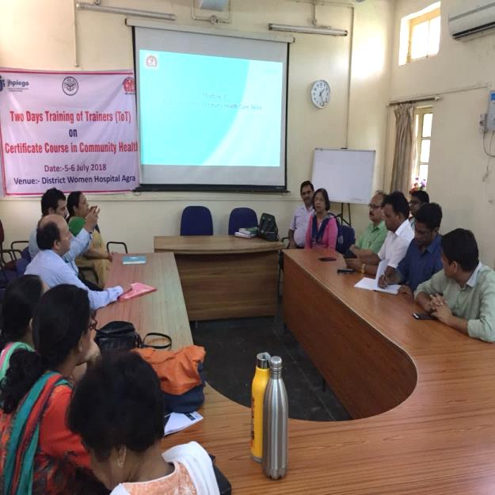
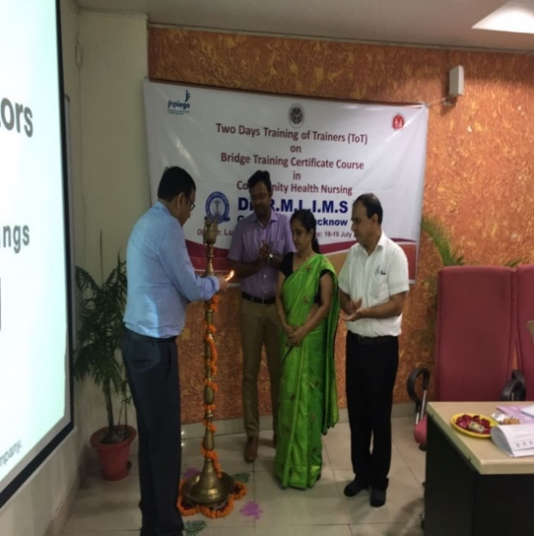
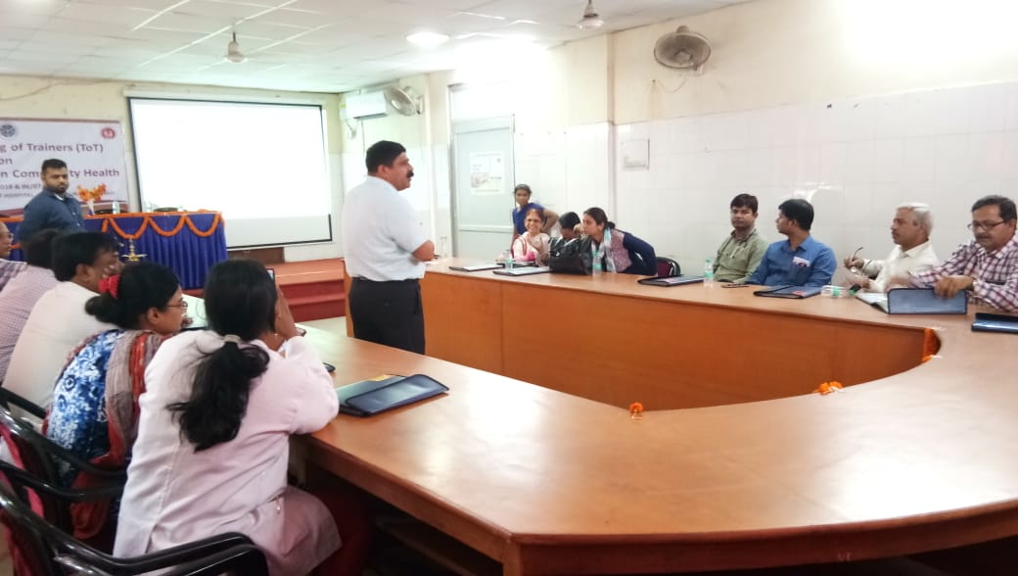
Glimpses of ToTs
Shri Pankaj Kumar, MD NHM at ToT KGMC
DM Aligarh visited During ToT
Dr Madhu sharma GM Planning during ToT
Lamp-lighting at RML Lucknow
Mr. Devesh Tripathi briefing guideline during ToT Varanasi

Slide 15
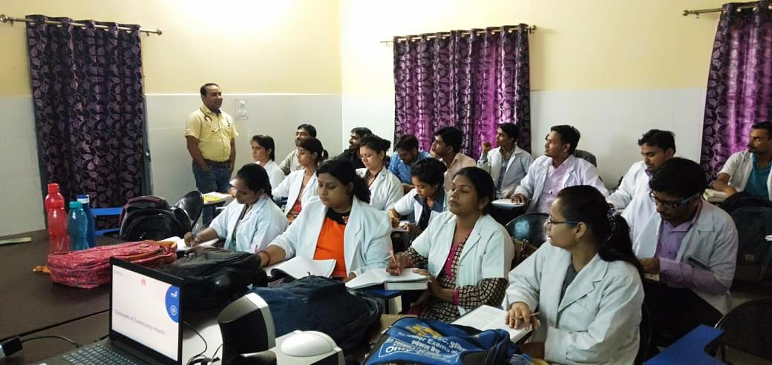
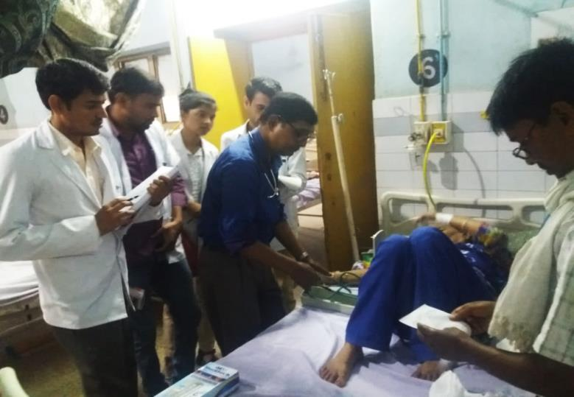
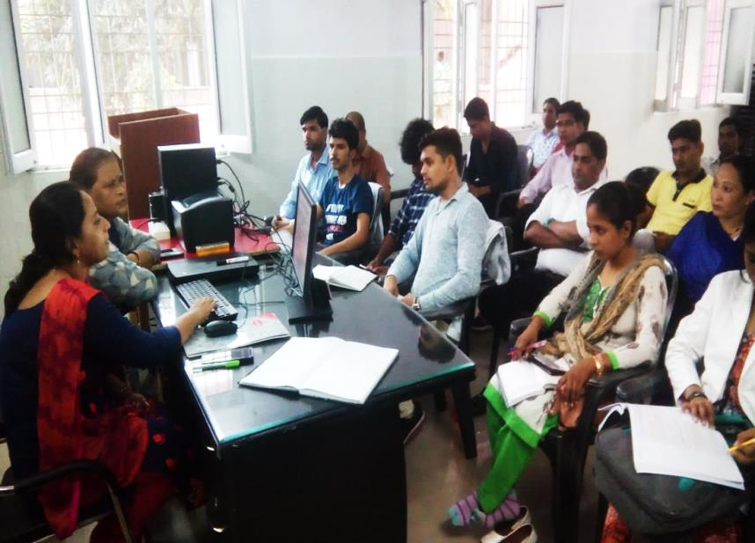
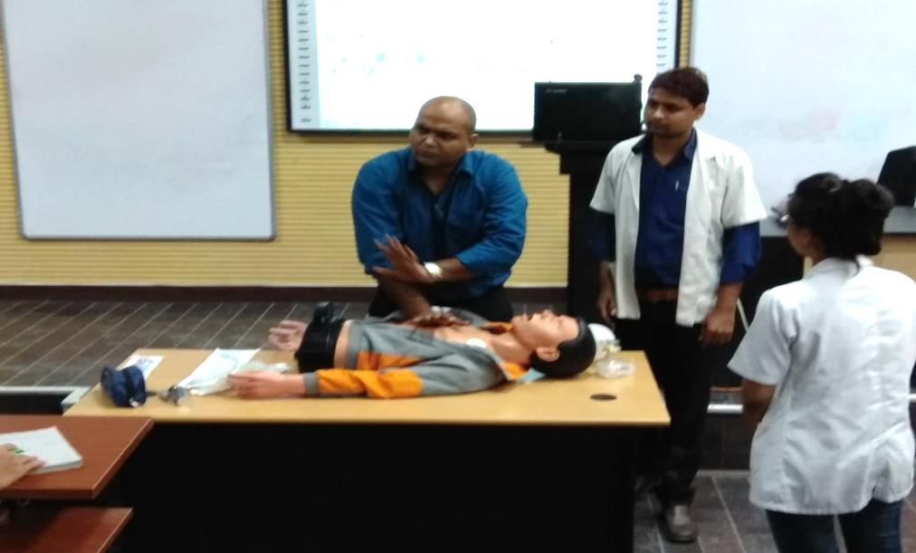
Theory and Practical Sessions at PSCs
Classroom teaching at DWH Aligarh
Clinical postings at DH Baharaich
Sexual Health Education Counseling class at DWH Kheri
Basic Life Support class at RMLIMS Lucknow

Slide 16
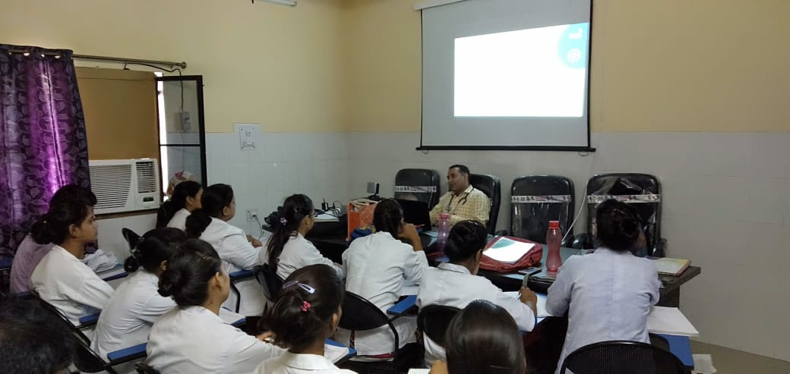
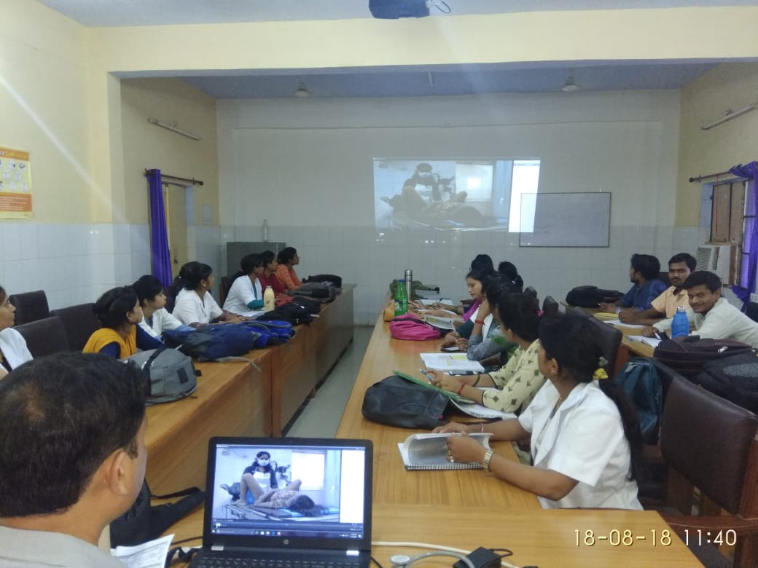
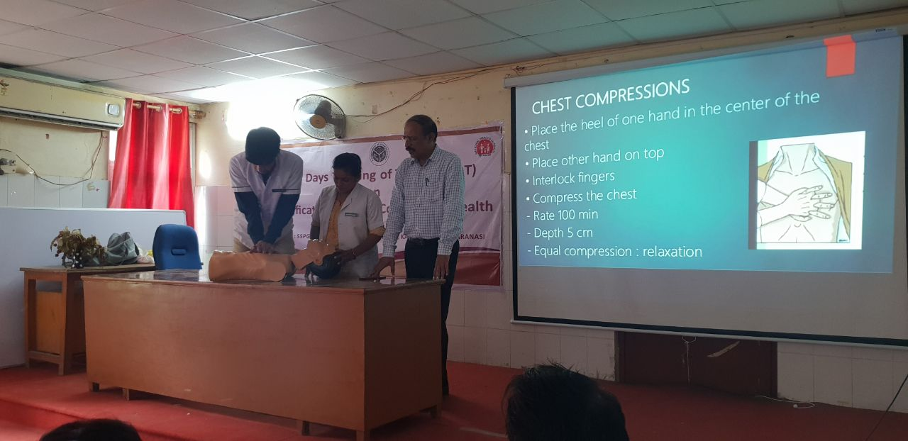
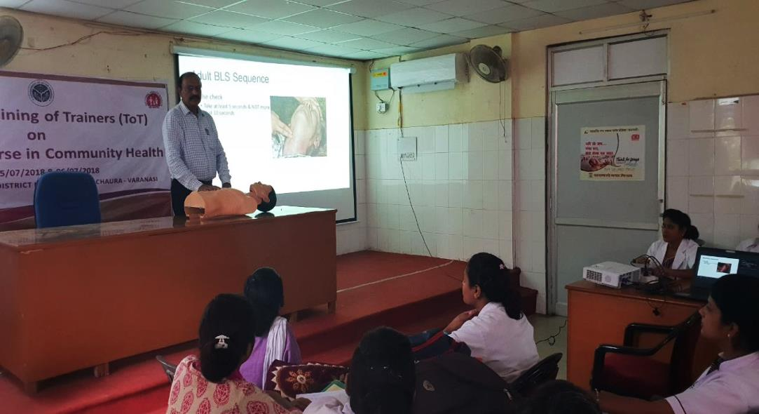
Theory Sessions using LRPs and Skills demonstration.
Theory session using Standard LRPs
Classroom teaching using AV aid at DWH Basti
Skills demonstration at PSC Varanasi

Slide 17
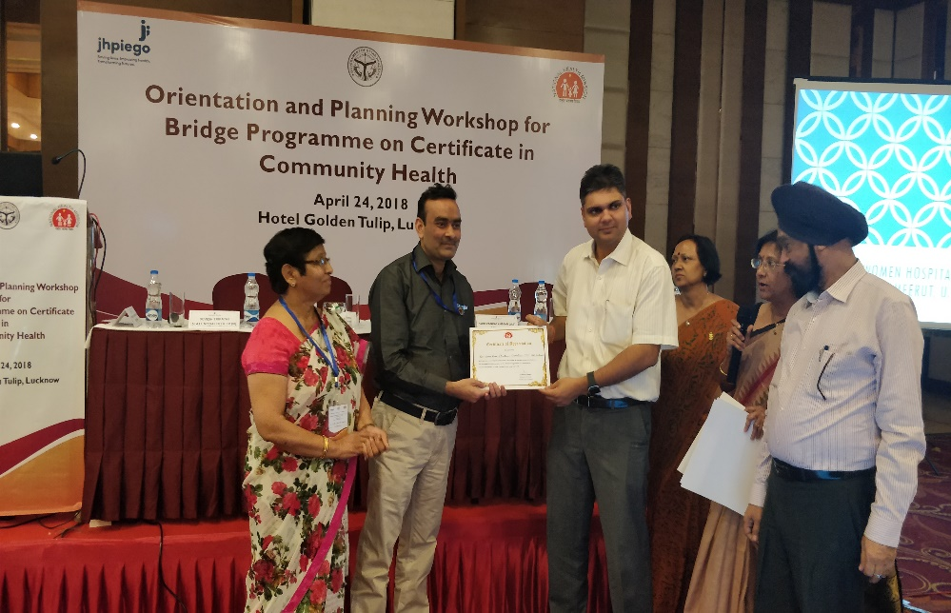
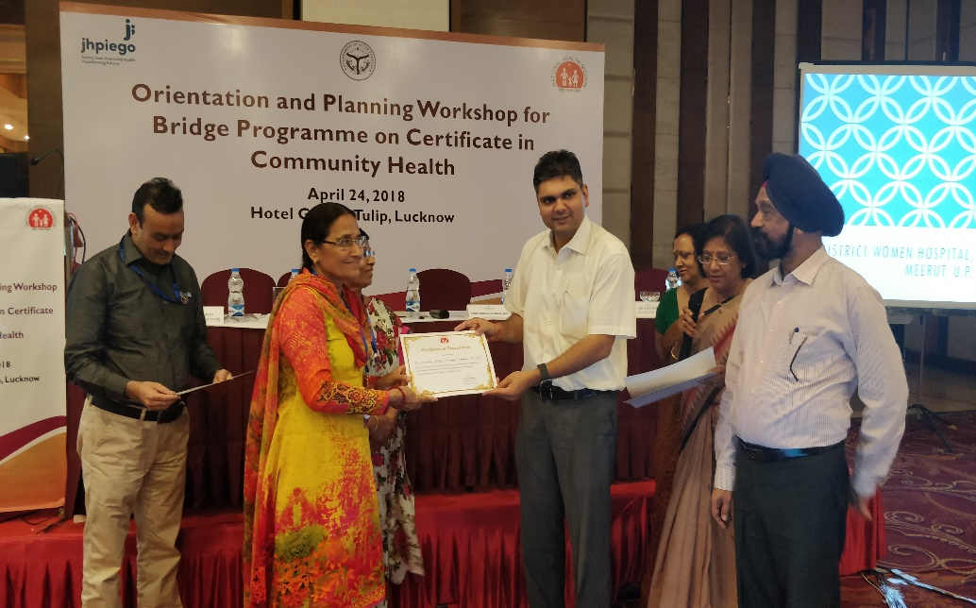
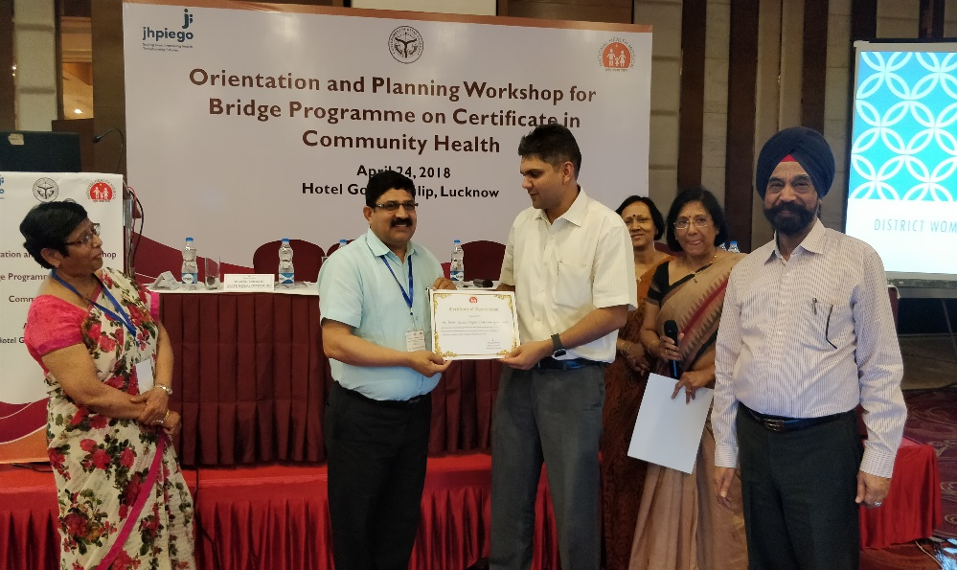
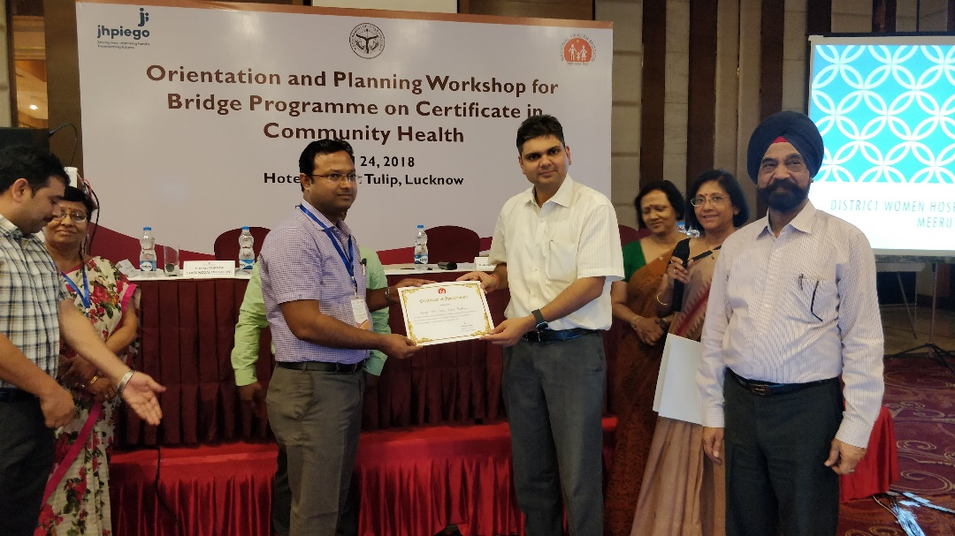
Recognizing efforts of champions

Slide 18
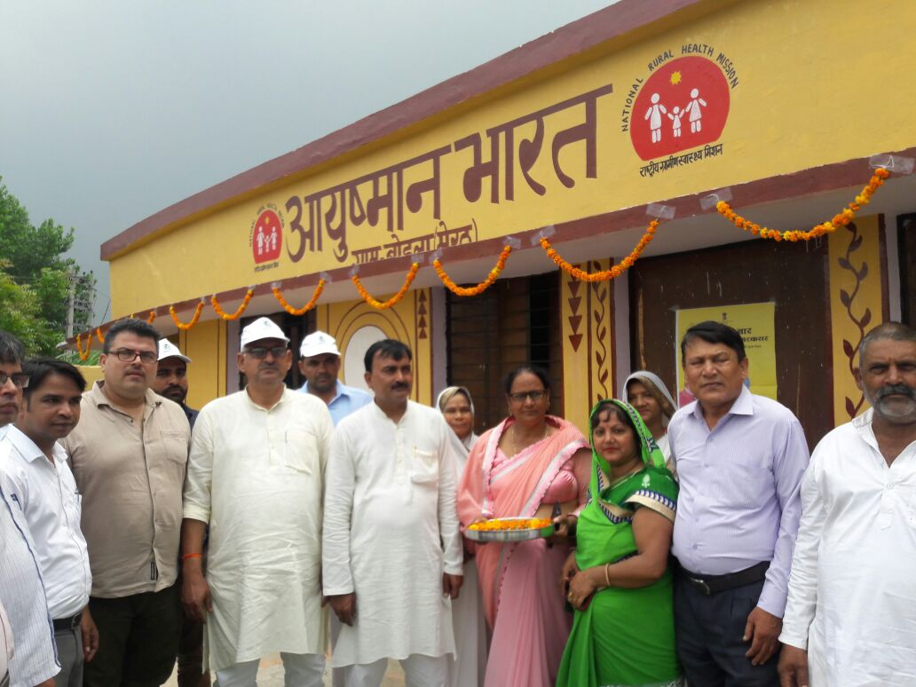
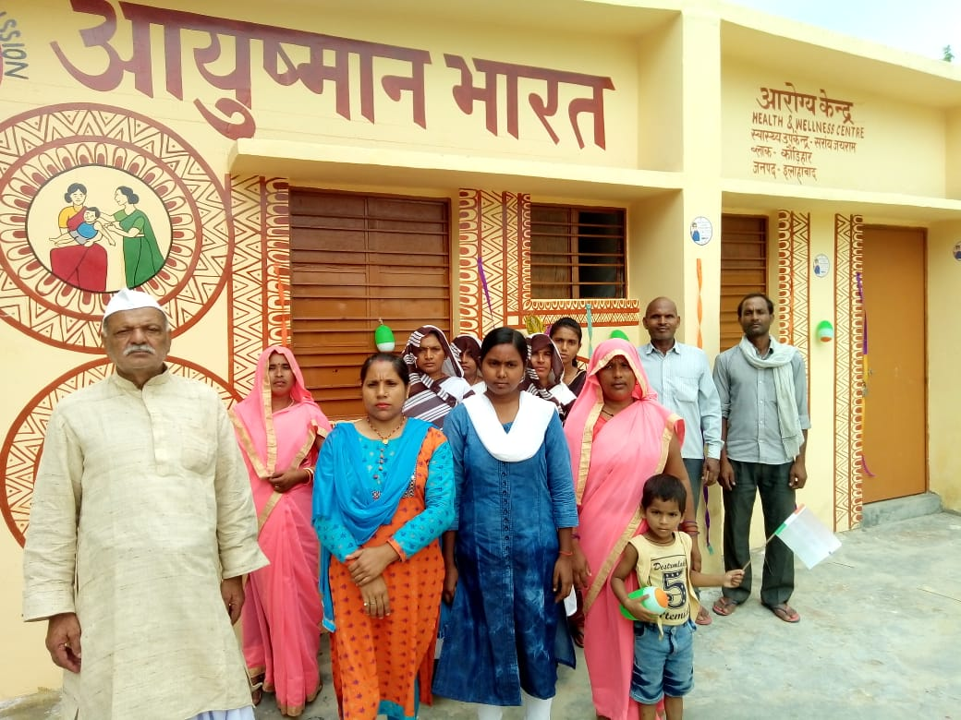
Glimpses of HWC
Sub Centre-Meerut
Sub Centre-Allahabad

Slide 19
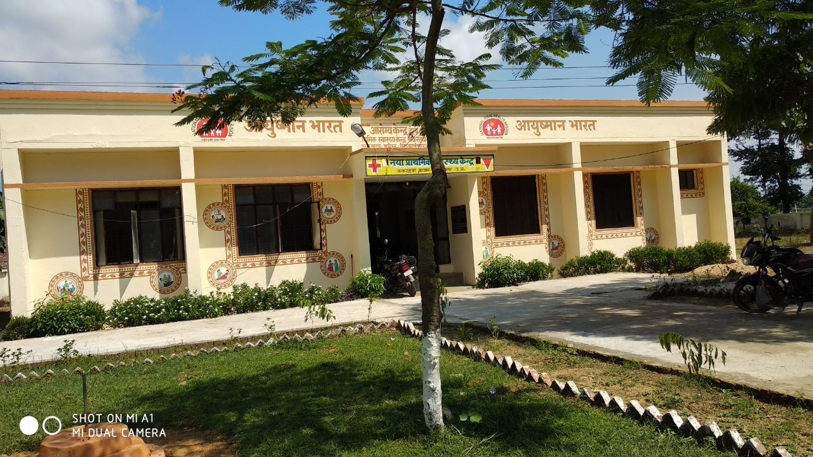
Health and Wellness Centers-New PHC

Slide 20
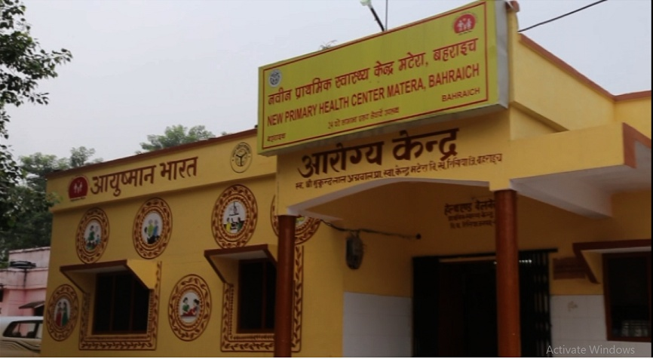
Health and Wellness Centers-New PHC

Slide 21
THANK YOU….

