Slide 1
India Hypertension Control Initiative(IHCI)
Continuum of Care
Maharashtra

Slide 2
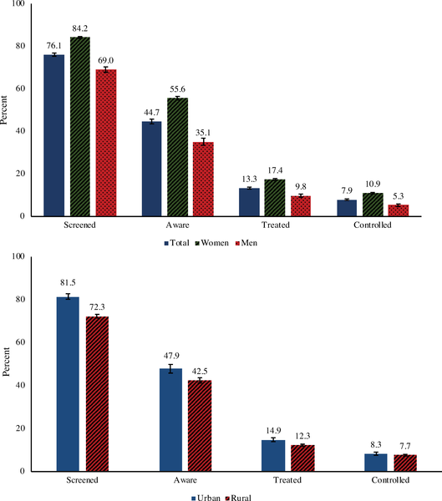
Hypertension control is Key to reducing CVD deaths
Hypertension Prevalence in Maharashtra -24.8% (DLHS 12-14)
Gap to be filled through door-to-door screening
Hypertension is the leading modifiable risk factor for deaths due to Cardiovascular Diseases in India
Risk factors not mutually exclusive.
Source: Institute for Health Metrics and Evaluation, 2015 data
Prenissl J, al. (2019) Hypertension screening, awareness, treatment, and control in India: A nationally representative cross-sectional study
https://doi.org/10.1371/journal.pmed.1002801
Notes:
Left Side Graph) Hypertension control is Key to reducing CVD deaths
Hypertension control is key to reducing CVD deaths
Hypertension is the leading modificable risk factor for CVD.
Deaths due to hypertension are largely preventable.
But unfortunately most with Hypertension in India are not controlled
Hypertension is probably the easiest to treat and effective treatment is available. However data from India shows that only 10-11% patient are controlled with treatment
Right Side Graph - Most People With Hypertension in India do Not Have It Under Control
The Study shows that although 45% are diagnosed with Hypertension, only 13% are started on treatment
The control rate were even lower than 10%

Slide 3





India Hypertension Control Initiative (IHCI) Maharashtra
Aim of IHCI
Increase the blood pressure control from 10% to 30% in the project districts in India by 2022
Strengthen the hypertension treatment component of NPCDCS
IHCI was launch in November 2018 at Wardha , Bhandara , Satara and Sindhudurg districts of Maharashtra
Five Essential components of scalable treatment of hypertension under IHCI
Treatment Protocols
Team-based care &
Task-sharing
Medicines & Equipment
Patient-
Centred Care
Information
Systems
Based on WHO Global HEARTS Technical Package
Notes:
Right side Slide -Essential components of scalable treatment of hypertension under IHCI includes
With this background , India Hypertension Control Initaitve ( IHCI) was started in India with the aim to increase the blood pressure control from 10% to 30% in the project districts by 2022
The project utilizes WHO HEARTS Technical Package to further strengthen Hypertension Treatment component of NPCDCS
The India Hypertension Control initiative was started in four district of Maharashtra in Nov 2018 – Satara , Sindhudurg , Wardha and Bhandara
HCI complements NPCDCS in facilitating management of hypertension and monitoring mechanism
Five Essential component of IHCI are
Standardized Treatment protocol developed in consensus with the experts and IHCI stakeholders
Ensure regular and uninterrupted supply of medicine
Prepare operational guidelines for healthcare workers to enable task sharing
Patient Centered services to reduce barrier to treatment adherence
An robust Information System which allows real-time feedback supported by simple app

Slide 4
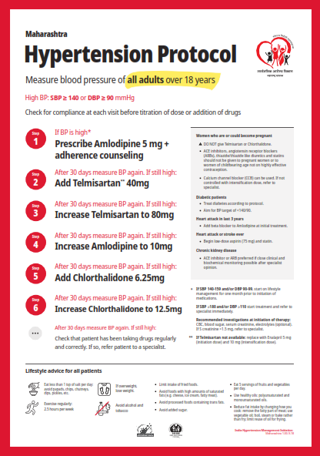
Maharashtra HT Treatment protocol
The Benefits are
Providers- wide acceptability among clinicians
(Evidence based clinical guidelines)
Better outcome in patients
Health System -Improved drug management due to fewer drugs
Approved by expert Consensus in MH for use since Aug 2018
Notes:
Slide 8- Maharashtra HT Treatment protocol
The HT treatment protocol for Maharashtra is state specific and developed by Expert and is implemented in all over of Maharashtra

Slide 5


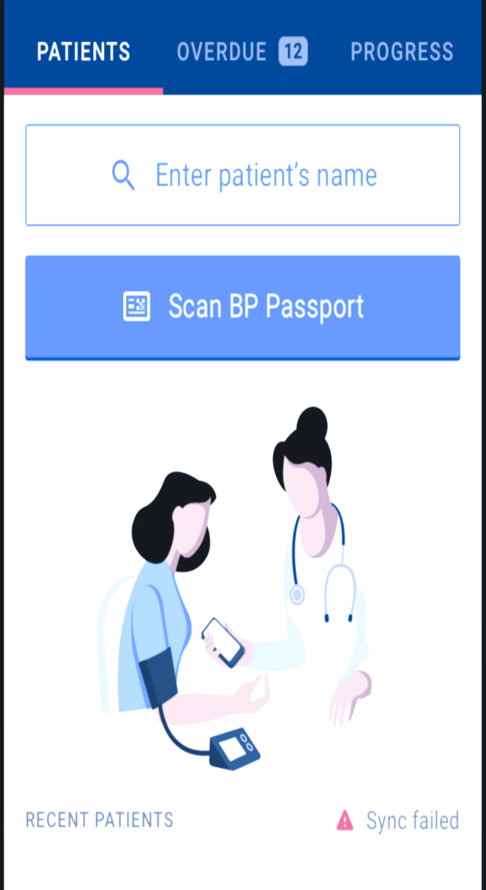

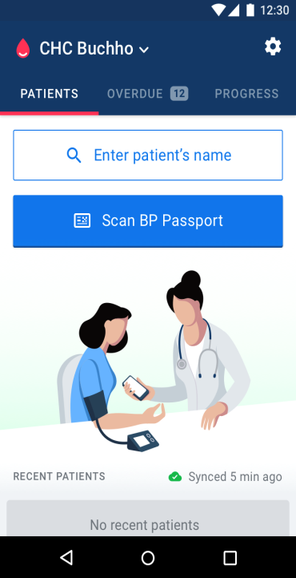
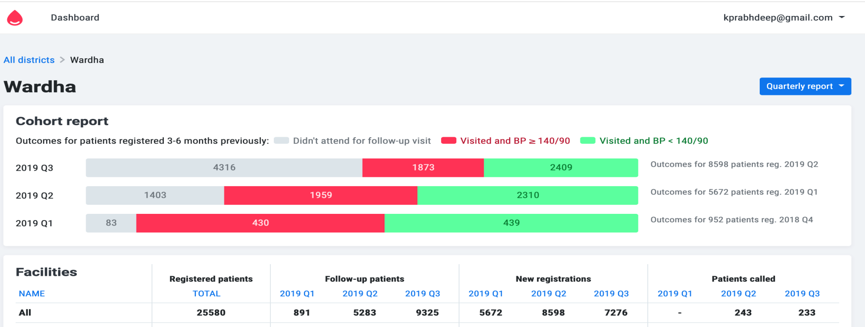
System for monitoring of IHCI activities
Use any modern Android device. Today, most doctors and nurses use their personal device.
App
Enroll new patient under 30 secs
With a scannable BP Passport, a returning patient can be recorded in ~15 sec.
Notes:
Slide 9- System for monitoring of IHCI activities
The data management under IHCI is mediated through The Simple App, which is is an open source android based mobile app for
1) Healthcare workers at NCD Clinic to:
Enroll patients in a hypertension control program
Record patients' BPs and BP medicines
Contact overdue patients for treatment
2) Administrators and Program Managers can use Dashboard which provides of registration and patient BP Control status for health system management
The simple app help in entry of data in Mobile app during registration in less than 30 Sec
With Scannable BP passport which has QR code , the followup paitent data on Blood pressure ,treatment and followup dates can be entered in less than 15 seconds
This makes simple app easy for use
The Wardha District Dashboard for Simple App shows
Number of Hypertension Patient registered and also provides bifurcation of patient controlled , uncontrolled on treatment and missed followup visit.

Slide 6
Status of IHCI Registration in Maharashtra
Name of the district | Estimated Hypertension Patient | Total Registration till Sept 2019 | Proportion (%) of HT Patient registered
Bhandara | 1,36,459. | 32,049 | 23.49%
Wardha | 1,21,834. | 31,642 | 25.97%
Sindhudurg | 1,06,151.00 | 14,807 | 13.95%
Satara | 4,59,303.00 | 26,995 | 5.88%
Total | 8,23,747.00 | 1,05,493 | 12.81%
Notes:
Slide 12 Status of IHCI in Maharashtra as on 30.9.2019
Since its implementation, Maharashtra has enrolled more than 1,05,000 HT patient
Wardha District where Door to Door screening was piloted has enrolled more than 31600 patient

Slide 7
Control rate of IHCI patient in IHCI Implemented district for 3rd Quarter 2019 report
Notes:
The control rate of HT patient as reported in Quarter 3 2019 .
Around 65 patient are visiting the health facilities in Wardha for HT treatment . The control rate can be further improved if major issues of treatment intertia .i.e Treatment escalation if patient BP is not controlled and enuring regularity of treatment

Slide 8
Wardha District Monthly IHCI Registration
Door to Door Screening Project
Notes:
Slide 13 Wardha District Monthly IHCI Registration (As on 30.9.19)
The Door-to-Door screening concept was piloted in Wardha district as registration till February 2019 was low.

Slide 9
Door to Door Screening – improve HT patient registration under IHCI
Objective
To accelerate enrollment of Hypertension patient for treatment by facilitating and providing access to diagnosis and treatment
Expected Outcome –
Increase in awareness about hypertension
Maximum number of HT patient will avail Diagnosis and Treatment services
Target population
1) Individuals with undiagnosed disease
2) Diagnosed but untreated disease
Notes:
Slide 14- Door to Door Screening- Pilot
Objective
To accelerate enrollment of Hypertension patient for treatment by facilitating and providing access to diagnosis and treatment
Expected Outcome –
Increase in awareness about hypertension
Maximum number of HT patient will avail Diagnosis and Treatment services
Target population
1) Individuals with undiagnosed disease
2) Diagnosed but untreated disease
3) Left treatment for non medical reasons ( non Adherence) – Indirect

Slide 10
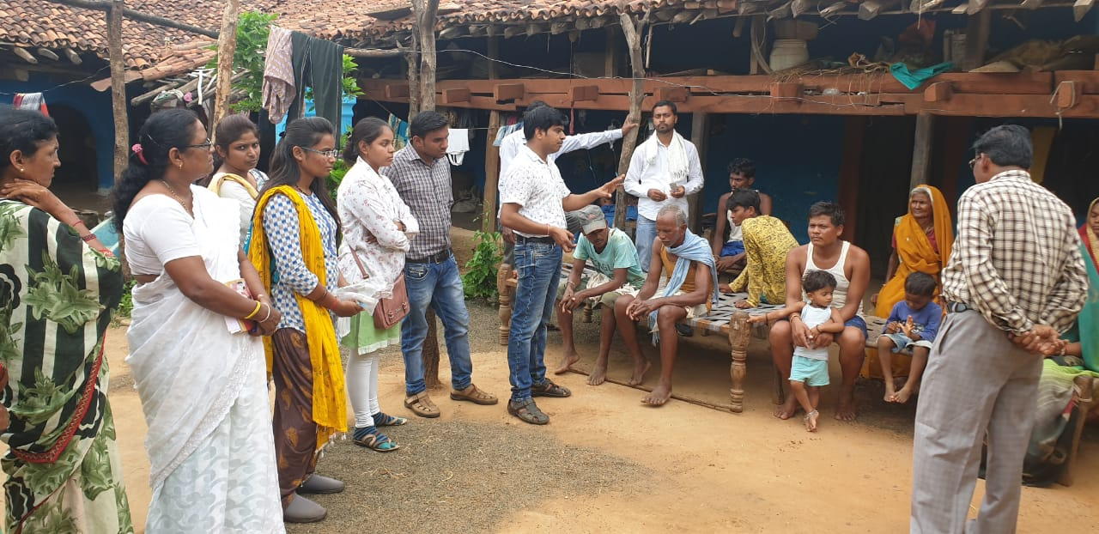
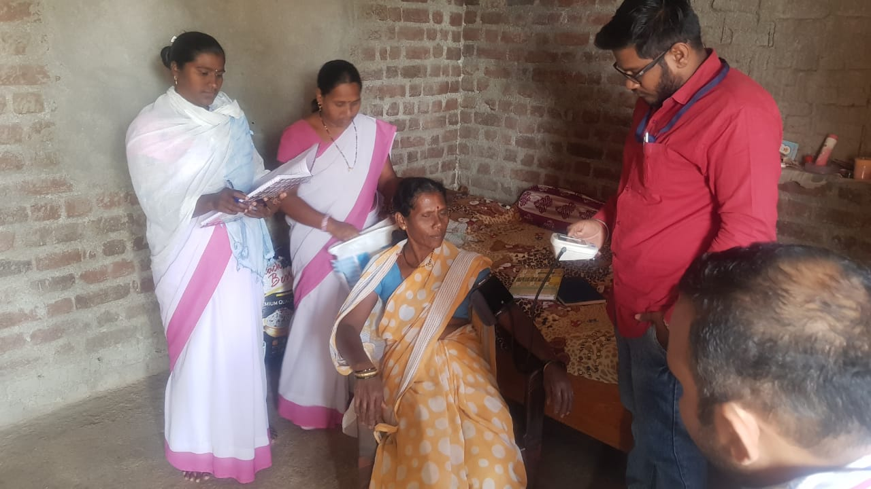
Door to Door counselling of community to access diagnosis and treatment
The HT suspects were motivated to access diagnostic and treatment services prior to activity by door to door visits
Notes:
Door to Door counselling of community to access diagnosis and treatment
The home visits to villagers were carried out prior to diagnosis of Suspects at HWCs
The opportunity was utilised to counsel adults above 30yrs on early diagnosis and prevention of NCDs especially Hypertension , Diabetes and three cancers( Oral , Cervical and Breast).
The ASHA / ANM and MPW utilised their routine visit to conduct such activities and prior sensitisation of Health staff was conducted during monthly meeting at PHC Kharangana Gode .

Slide 11
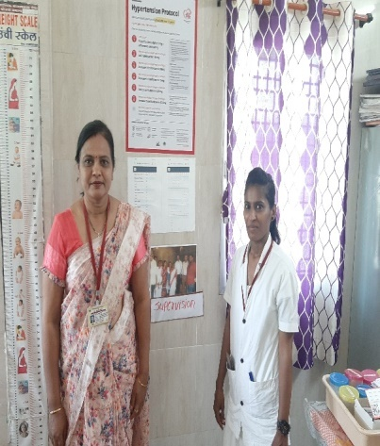
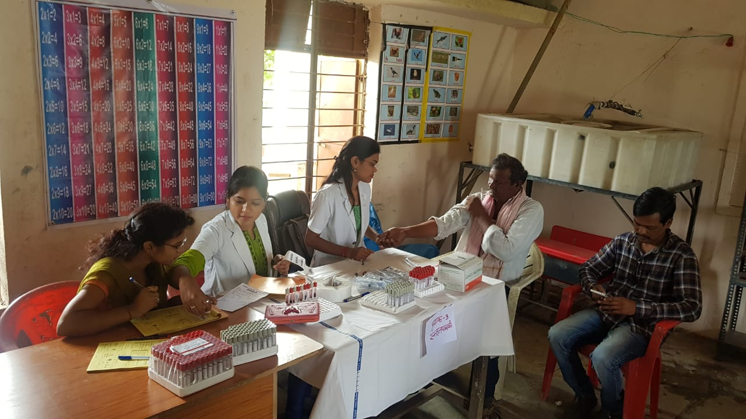
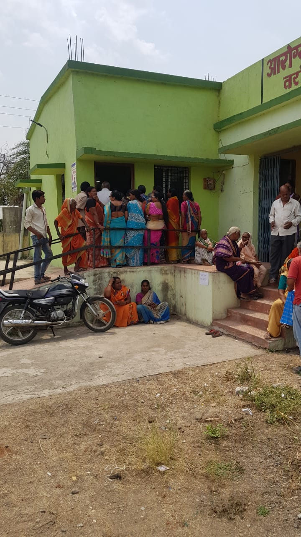
Door to Door Screening- Pilot
The pilot was conducted during March 2019 to May 2019
The initiative was piloted in two sub-centre (( Taroda and Yasamba) of Wardha District covering population of 10,000 approx.
Staff involved in activity were ASHA/ MPW/ANM & MO
Notes:
Slide 15- Door to Door Screening- Pilot
The concept was implemented during March 2019- May 2019
Data for pilot was collected from two sub-centre ( Taroda and Yasamba) of Wardha District (Population Covered 10,000 apprx.)
Staff involved in activity were ASHA/ MPW/ANM & MO

Slide 12
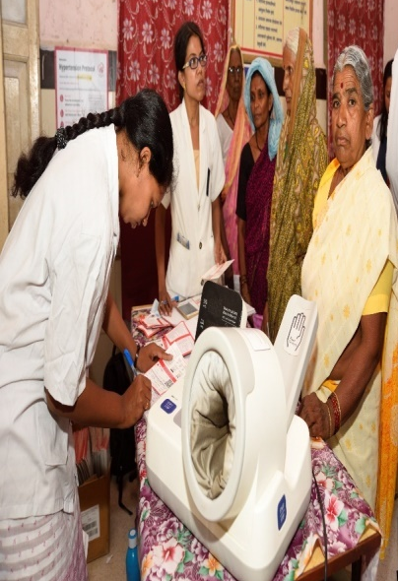
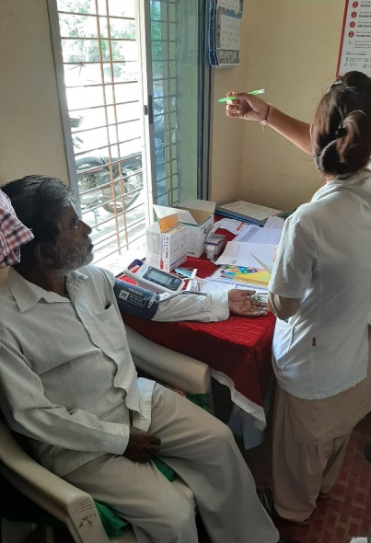
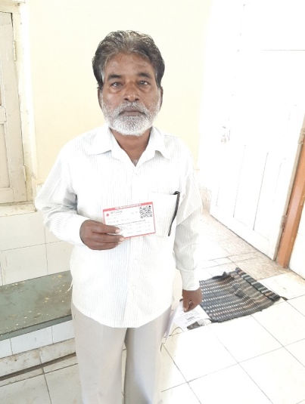
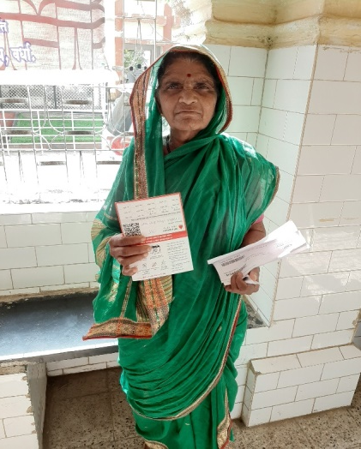
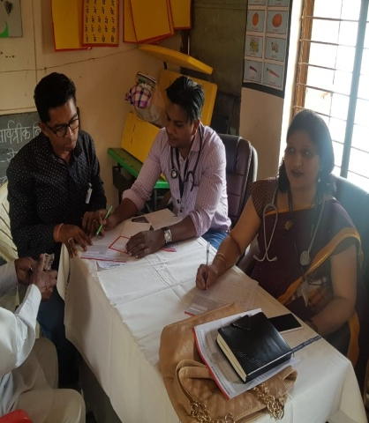
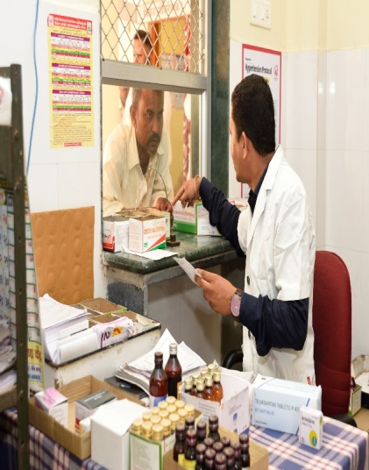
Door to Door Screening- Pilot
4100 individuals above 30yrs screened for Diabetes and Hypertension from two Sub-Centres
970 suspects identified during screening
750 suspects were subjected to Confirmatory Diagnosis
430 Hypertensive and 120 diabetics were diagnosed during the drive
48 patient refused treatment
382 (89%) patient were registered with IHCI
Notes:
Slide 15- Door to Door Screening- Pilot
4100 individual above 30 years in the sub centres areas were screening for hypertension and diabetes
Suspects Identified- 970
Confirmatory Diagnosis of Suspects conducted – 750
Confirmatory Diagnosis- Hypertension - 430 and Diabetes -120
HT Patient bifurcation
48 patient refused treatment
382 Registered for treatment under IHCI (89%)

Slide 13
Sub-Centre Taroda and Yesumba ( Wardha District)
Monthly IHCI Registration
Total patient registered in Pilot HWCs till Sept 2019 (Outcome) | 417
Patient on treatment and controlled | 166 (40%)
Patient on treatment and uncontrolled | 119 (29%)
Patient missed doses | 112 (29%)
Notes:
The Door-to-Door screening concept was piloted in Two subcentres of PHC Kharangana Gode of Wardha district
The registration of HT patient improved after implementation of the model.
The bifurcation of patient registered till Sept 2019 shows BP control among registered patient of 40%

Slide 14
Door to Door Screening-Scalability
Fill-up gap in continuum of care of HT by improving accessibility for diagnosis and treatment of Hypertension
No additional resources (additional funds or equipments) required
The activities can be incorporated into routine activities of health care workers
Expansion planned by 2020
MH is committed to bring maximum hypertension patient on treatment
Notes:
Slide 16- Door to Door Screening-Scalability
The Door to Door screening concept model fills up the gap by tapping more patient to bring them on treatment by Improving accessibility for diagnosis and treatment of Hypertension
No additional resources in term of manpower of resources is required
Also the activities can be incorporated into routine activities of health care workers
Proposed expansion by 2020
MH is committed to bring maximum hypertension patient on treatment

Slide 15
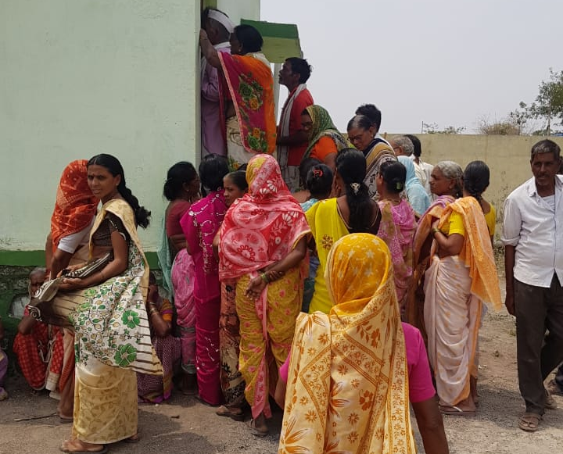
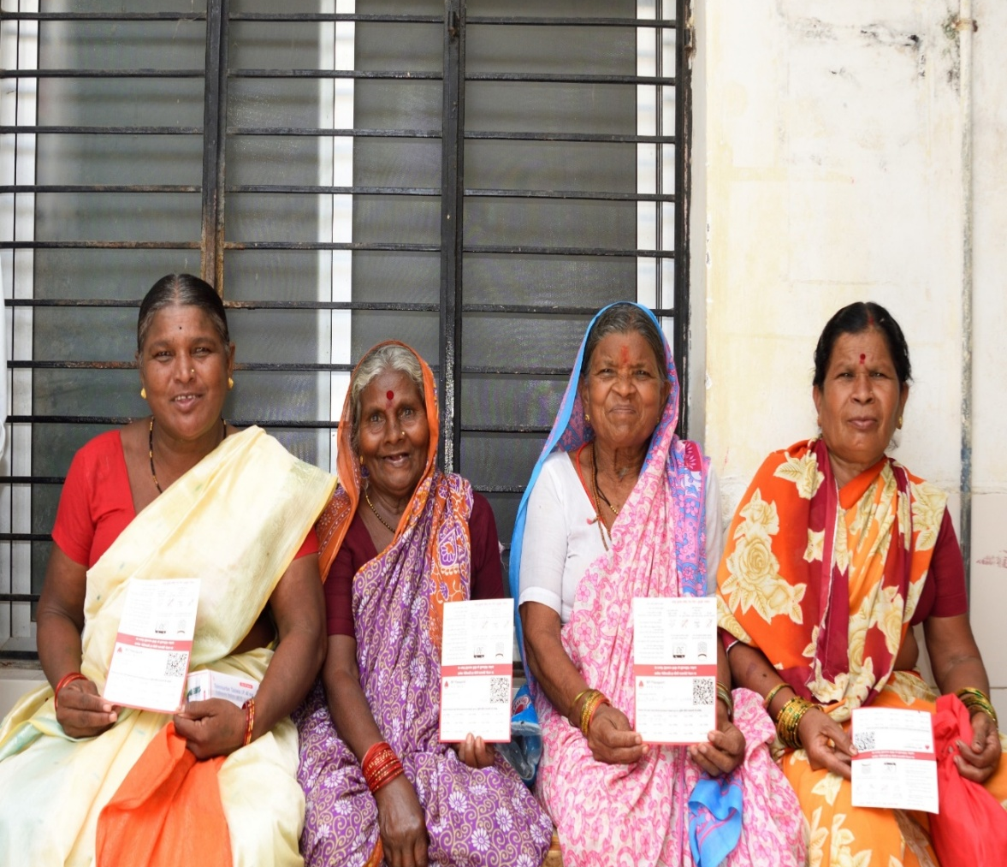
Thank You
Satisfied Clients

