Slide 1
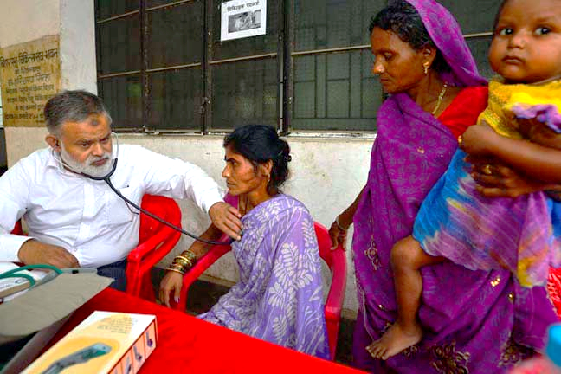
IMPROVING CASE NOTIFICATION AND QUALITY IN PRIVATE SECTOR - PATNA, BIHAR

Slide 2
Why Private Sector?
Nearly 60% of TB patients are treated in the Indian private sector but rarely reported to public health systems
Studies have documented sub-optimal practices in the private sector and non-compliance with the Standards of TB Care in India (STCI)
Challenges to private provider engagement:
Highly fragmented and unregulated private sector (formal and informal providers)
Absence of a technological platform that can absorb large patient volumes and coordinate patient care
Prior models of private provider engagement required private providers to refer to public sector
Bihar exemplifies the socioeconomic challenge of India’s TB epidemic:
Third highest incidence of poverty, with 33.7% of people living below the poverty line
Ranks 15 out of 17 major states in Global Hunger Index (GHI)
Ranks 21 out of 23 key Indian states in the Human Development Index (HDI)
Has a vast private sector to meet patient demand for basic health needs

Slide 3
General household care-seeking behavior: Patna
More than 2/3rd of the population preferred going to private practitioners for their health care needs.
An alarming number (1/5th) of the households mentioned going to pharmacies for general healthcare needs.

Slide 4
Public Private Interface Agency (PPIA)
The Public Private Interface Agency (PPIA) model was piloted in 2014 with technical support from World Health Partners in Patna (Bihar)
PPIA Objectives
Facilitate early and accurate diagnosis of TB in the private sector in urban Patna.
Facilitate notification of cases diagnosed and treated in the private sector.
Ensure appropriate treatment of cases in the private sector as per national Standards for TB Care.
Ensure treatment completion and improved cure rates of TB patients in the private sector.

Slide 5
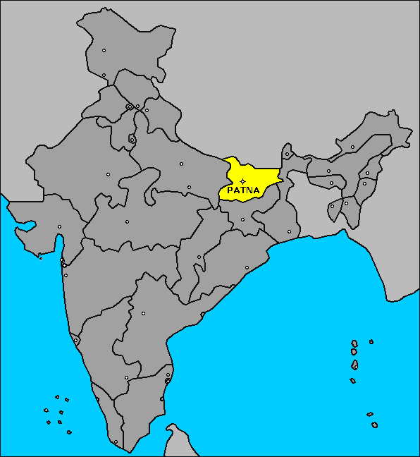
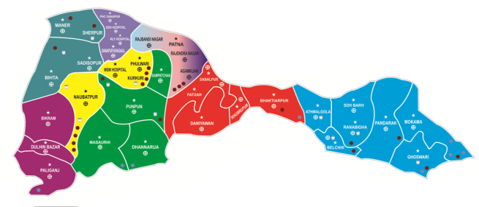
Intervention Area: Patna District Profile
PATNA DISTRICT
Population | Total population | 62,89,193
 | Urban population | 22,50,000 (43%)
Geography | Total Blocks | 23
 | Urban Blocks | 3
Public health facilities | TUs | 10
 | DMCs | 23
Private health facilities | Private doctors (MBBS/+) | 1812
 | AYUSH | 1563
 | Chemists | 1556
 | Laboratories | 641
Key PPIA Stakeholders:
DTO, STO
Indian Medical Association (IMA)
Bihar TB Association
Indian Academy of Pediatricians (IAP)
Patna Drugs and Chemists Association

Slide 6
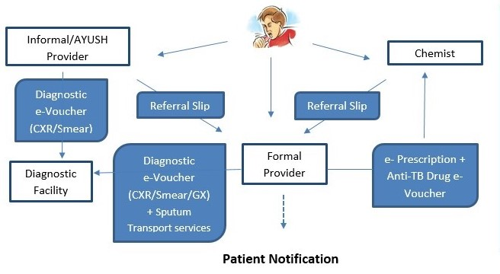
PPIA Model
Provider Field Team Operations:
Provider mapping, identification, & engagement
Provider sensitizations on PPIA model and STCI for TB diagnosis & treatment
Sputum Transportation services
Supply chain management of GoI FDCs
Call Center Operations:
Beneficiary registration via mobile calls
Issuance of diagnostic and treatment e-Vouchers
Patient Notification
e-Voucher validations by diagnostic facilities/chemists
Drug e-Voucher confirmation calls to patients
Patient counseling and adherence
Patient Field Team Operations
Patient Verification of diagnosis & free services received
Patient education and Family DOTS counseling in HH visit (IP phase)
Patient follow-ups and adherence monitoring of at-risk patients
Default retrieval and case management of adverse events

Slide 7
Provider Coverage
PPIA Engaged Network:
597 formal providers
455 informal providers
699 chemists
130 labs
Mapped & Targeted (M&T) : Providers with a TB Case Load
Engaged: Providers with a signed M.o.U agreeing to participate in PPIA
Active: Providers participating in PPIA with at least one activity during reporting period
Formal Provider Engagement & Activity
No. Mapped & Targeted | Cumul . Engaged (% of M&T) | No. Active May 2017 (% of M&T)
850 | 597 (70%) | 402 (47%)

Slide 8
TB Case Notifications
PPIA Patna contributed to 19% of total Patna district notifications in 2016
PPIA Patna contributed to 84% of total state (Bihar) notifications and

Slide 9
Case Notification Rate (CNR)

Slide 10
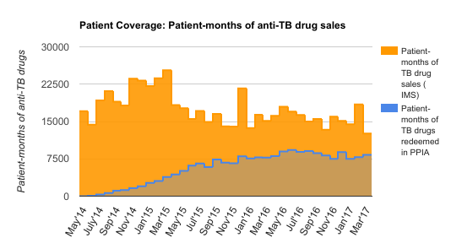
Patient Coverage
Patient-months of anti-TB drugs in the private sector is estimated by a third-party agency IMS.
PPIA estimates the same metric by the number of 30-day (patient-month) e-vouchers validated
PPIA covered 66% of patient-months in the private sector in the last reporting period
 | May'17
Patient-months of Ant-TB drug sales (IMS) | 12568
Patient-months of drug vouchers validated | 8323
% Patient Coverage | 66%

Slide 11
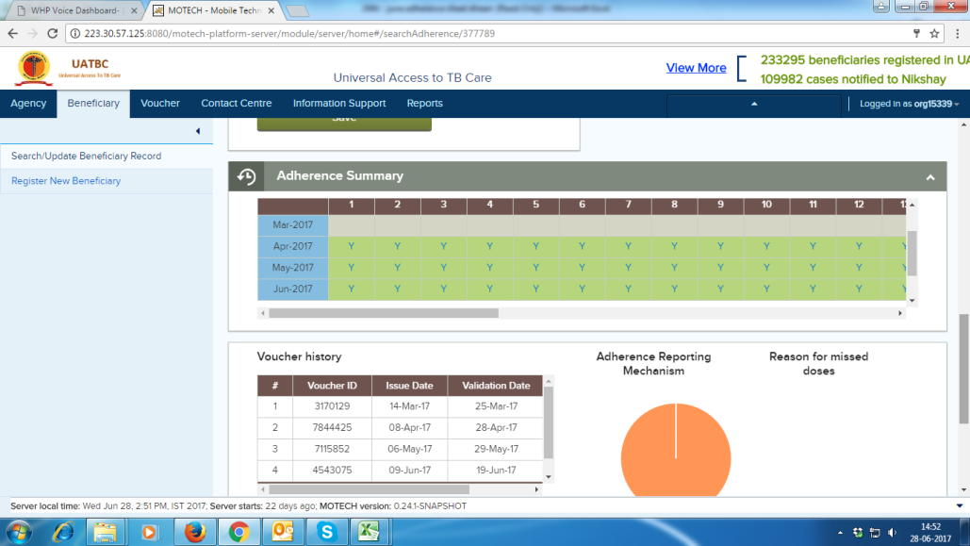
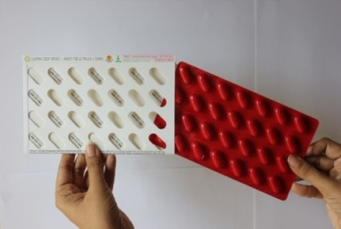
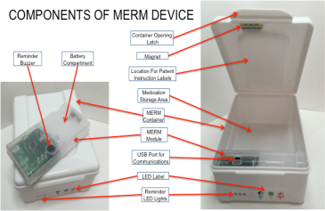
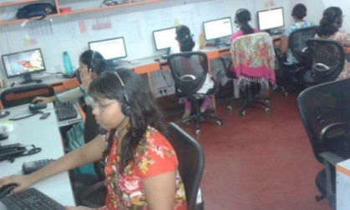
Adherence Mechanisms
Two Measures of adherence: Medication possession and Daily Dosing
1) Medication Possession via drug refill monitoring (e-Vouchers)
“Gap days” generated based on date of issuance and number of days issued
Patient 1 | 01-Mar-17 | 10-Apr-17 | 30-Apr-17
 | 30 | 30 | 30
Daily Dosing via calendar days of doses taken (Call center outgoing patient calls, 99D/MERM)
Adherence score percentage calculated based on doses taken

Slide 12
Treatment Outcomes
75% treatment completion

Slide 13
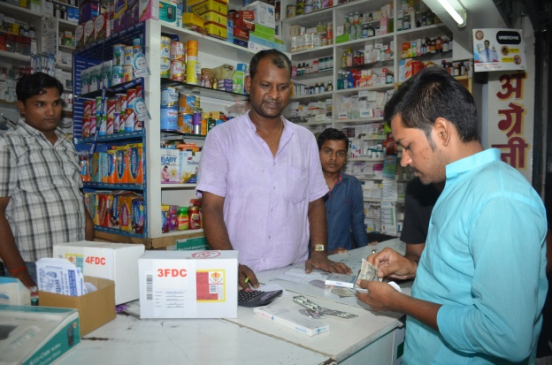
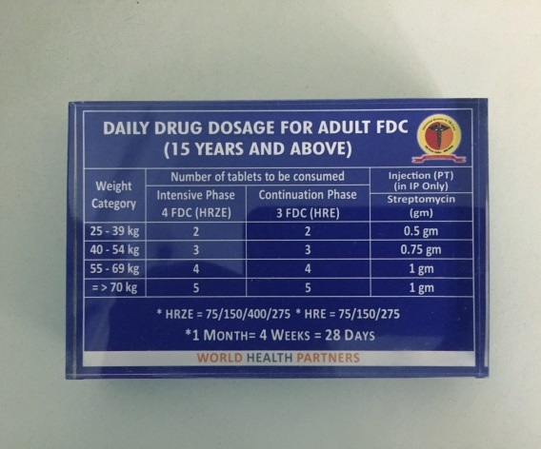
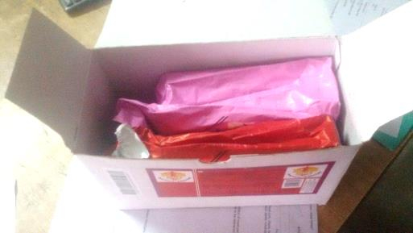
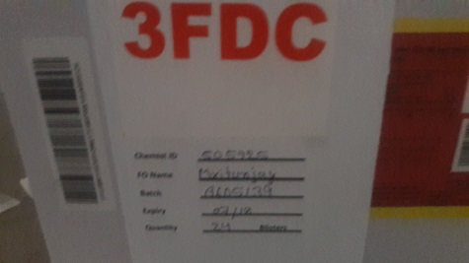
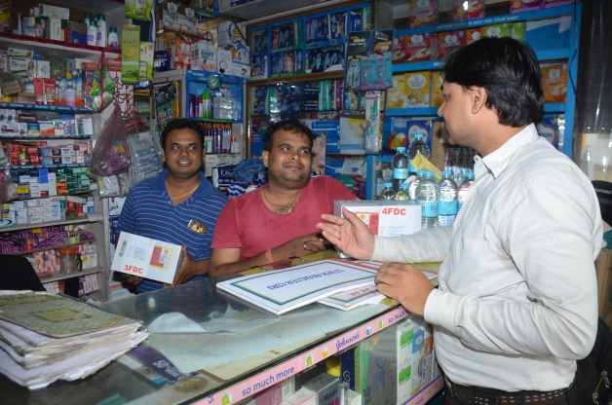
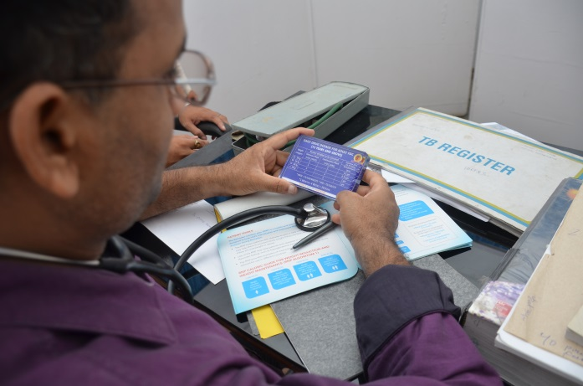
Integration with RNTCP: GoI FDCs
GoI FDCs stored at private chemists and disbursed to patients
Providers trained on STCI protocols (dosage as per weight category for adult/pediatric)

Slide 14
FDC Activity: Providers & Patients
Total No. Patients Initiated on FDCs: 838
62% of Formal providers engaged with FDCs are active
69% of Chemists engaged with FDCs are active
63% of FDC-Engaged Formal providers prescribed FDCs in June’17
57% of FDC-engaged chemists validated FDC-vouchers in June’17
Increasing patient coverage with 14% of notified cases initiated on FDCs (3 month progress)

Slide 15
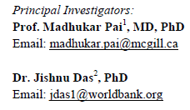
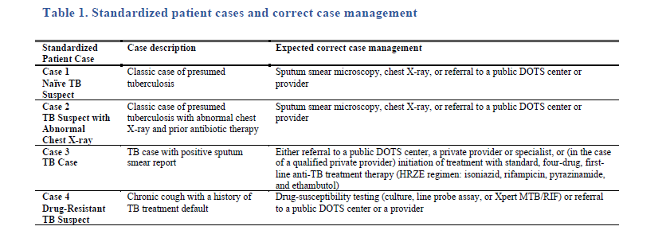
Impact Evaluation: Randomized Controlled Trial (RCT)
Providers randomized to PPIA-engaged (treatment) and non PPIA-engaged groups (control)
“Standardized patients” presented 4 different cases to both groups
Diagnostic and treatment practices were observed between PPIA-engaged providers and non PPIA-engaged providers

Slide 16
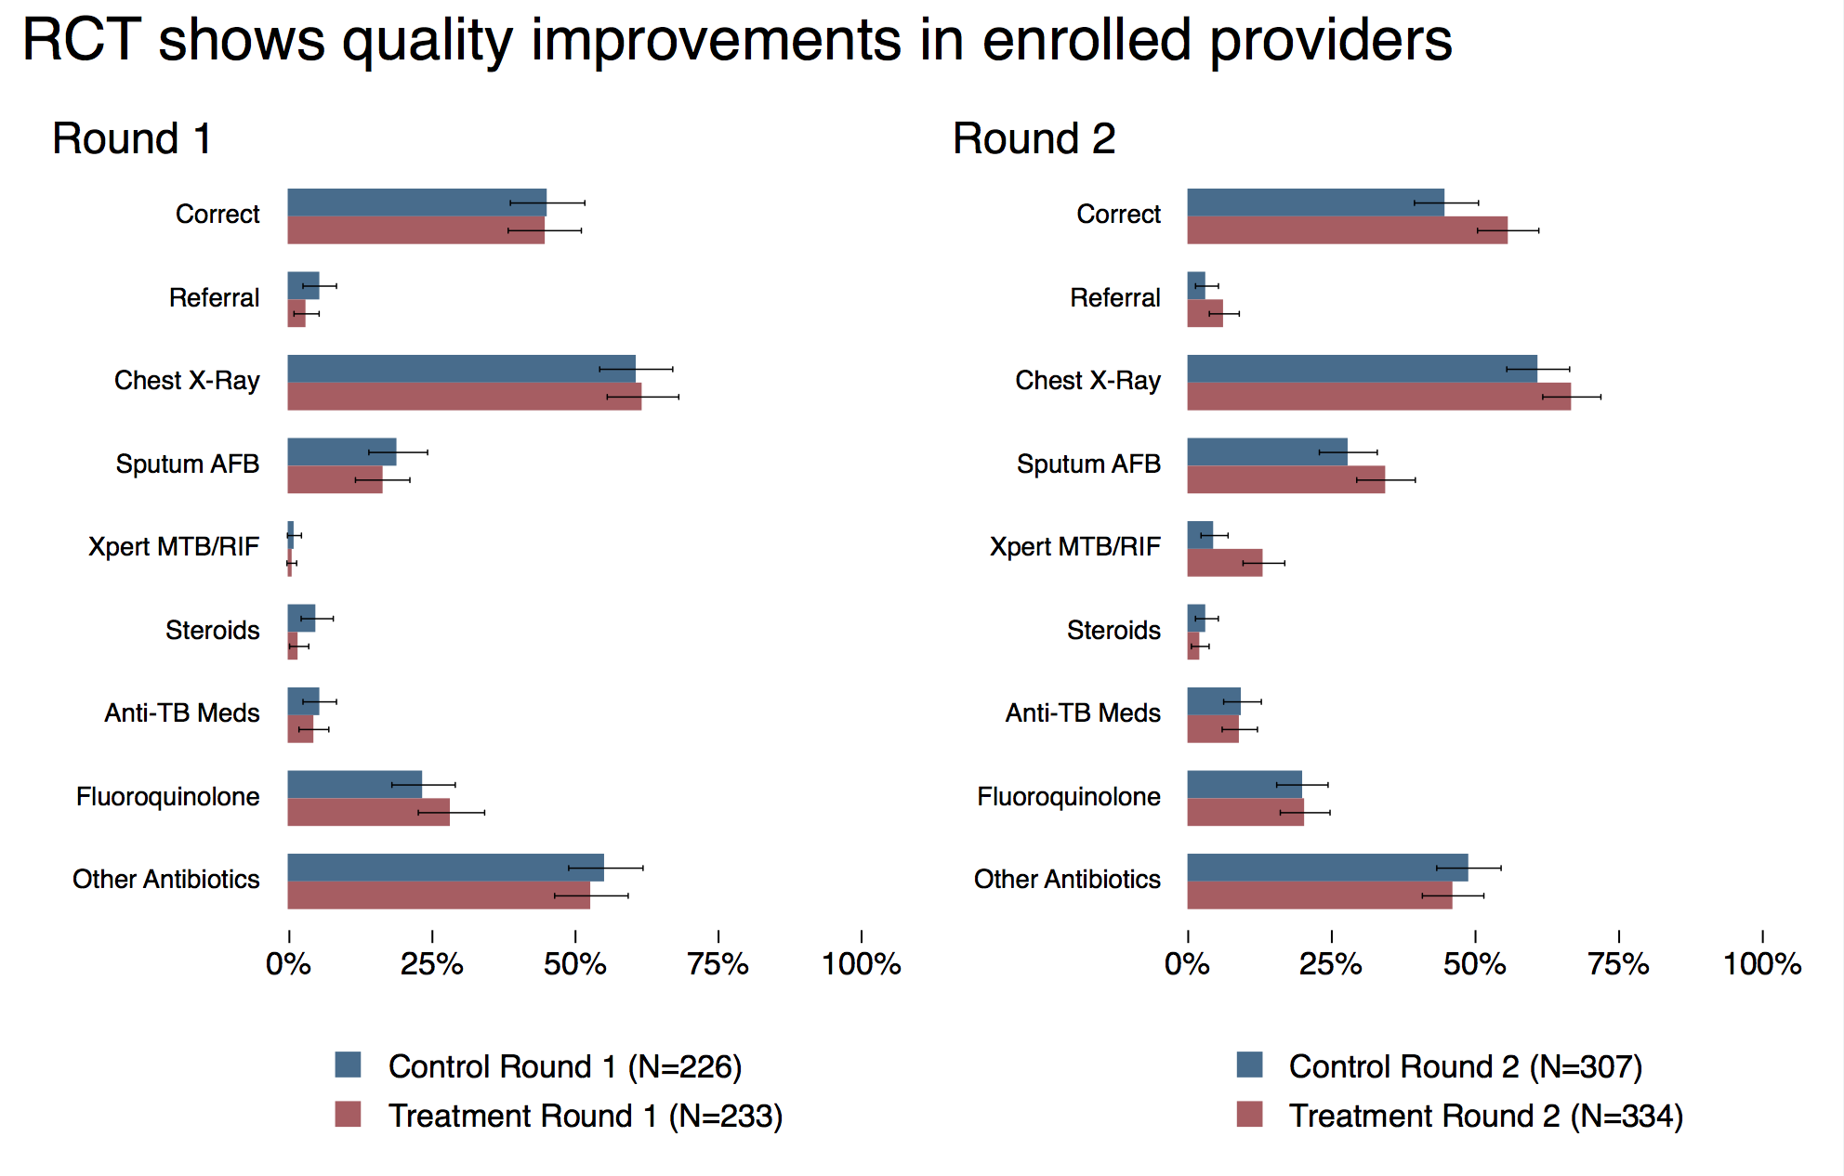
Baseline Round 1: November 2014 – December 2015
Endline Round 2: March 2016 – July 2016
PPIA-engaged (treatment group) performed better than non-PPIA engaged (control groups) with:
Increased correct management rates by at least 22 percentage points from a base of 43%
increased use of chest X-rays by at least 11 percentage points from 62%
Increased use of sputum smear microscopy by at least 19 percentage points from 27%,
Increased use of Xpert MTB/RIF by at least 20 percentage points from 4%.

Slide 17
Thank you

