Slide 1








India Hypertension Management Initiative
Government of Kerala
Dr BIPIN GOPAL
STATE NODAL OFFICER NCD ,KERALA

Slide 2
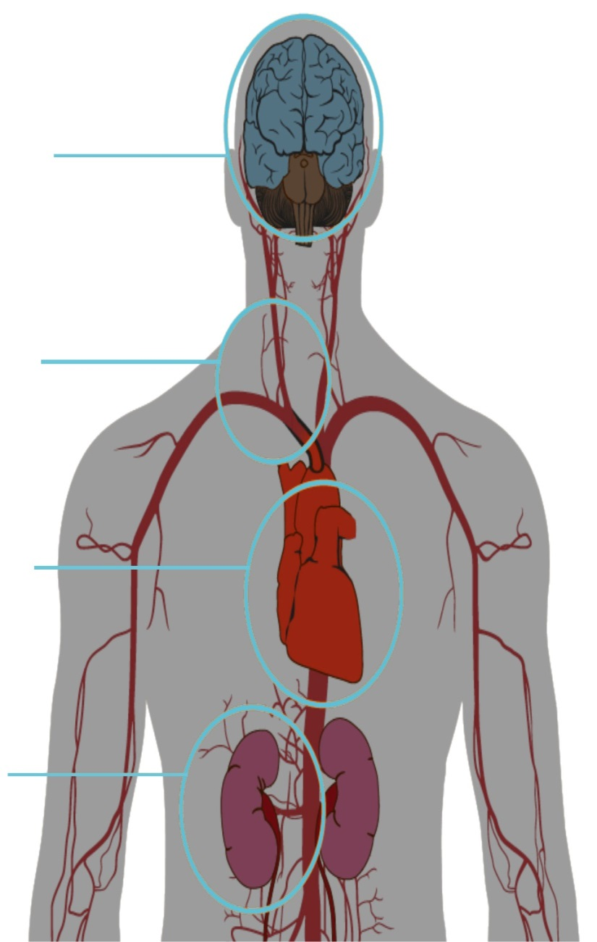
Hypertension is a Silent Killer
Hypertension (high blood pressure) can cause:
Brain
Stroke
Dementia
Arteries
Artery damage and narrowing
Aneurysm
Leg amputation
Heart
Coronary artery disease
Heart attack
Congestive heart failure
Kidneys
Kidney failure
Kidney artery aneurysm
Notes:
High blood pressure, or hypertension, is a leading risk factor for CVD. Raised blood pressure is defined as systolic blood pressure ≥140 mm Hg and/or diastolic blood pressure ≥90 mm Hg among persons aged 18+ years.
HTNN rarely causes symptoms in the early stages and so many people go undiagnosed. Not only does hypertension increase the risk of heart disease, it can also damage your brain, arteries and kidneys. Uncontrolled hypertension can also cause blindness, irregularities of the heartbeat and heart failure.

Slide 3
Burden of CVDs & Hypertension
Global | India | Kerala

Slide 4
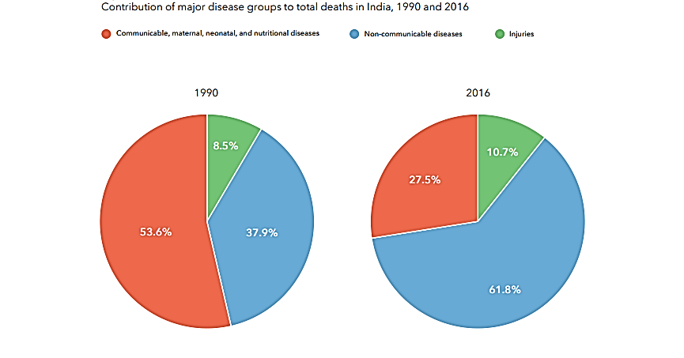
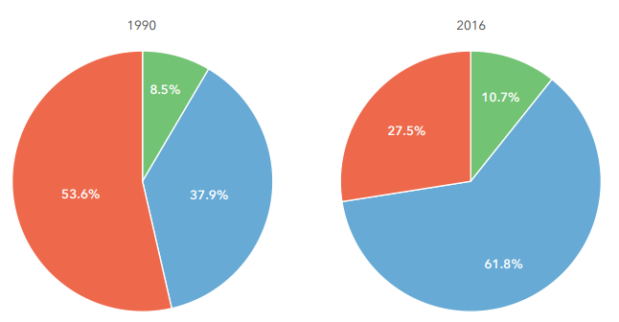
NCDs are major cause of death in India 2016
India, 2016:
Total deaths: 98 lakhs
NCD deaths: 60.5 lakhs
Source: India: Health of the Nation’s States The India State-Level Disease Burden Initiative

Slide 5
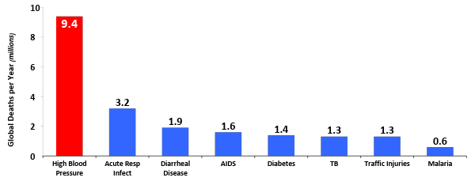
High Blood Pressure is the World’s Leading Killer
High blood pressure kills nearly as many people worldwide
each year as all infectious diseases combined
World Health Organization
World Health Organization, 2010
Notes:
High blood pressure is responsible for almost ten million deaths globally each year
High blood pressure went from being the 4th leading risk factor in 1990 for GBD to the number one risk factor in 2010.

Slide 6
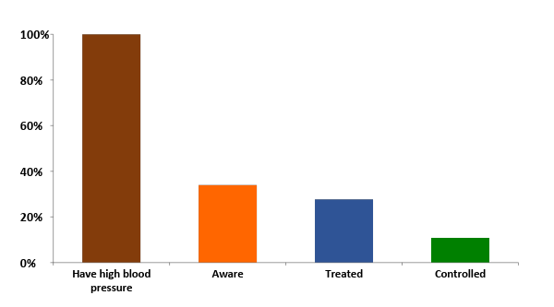
Most with Hypertension in India are NOT controlled
218M
Barely 1 in 10 of the 218 million adults with hypertension
in India have it under control
74M
60M
34%
27%
24M
<11%
Roy A et al. BMJ Open. 2017;7:e015639. Data for Delhi National Capital Region weighted and applied nationally.
Notes:
Despite the heavy burden of illness and death from hypertension, many countries have been slow to respond. Just over half with HTN know they have it and just 1 in 7 globally have it under control. These proportions are significantly higher in LMICs. Yet HTN is probably the easiest to treat and effective treatment is available and can be relatively inexpensive.

Slide 7
National targets for CVDs
National action plan includes specific targets to be achieved by 2025:
  25% relative reduction in overall mortality from CVD
  30% relative reduction in mean population intake of salt/sodium
  25% relative reduction in prevalence of raised blood pressure
  THE SDG GOAL FOR KERALA IS TARGETING TO ACHIEVE THIS BY 2020
Notes:
India: Burden of Hypertension
nearly one third of adults have hypertension
only one fourth of the people with hypertension are aware of their condition
only approximately 10% of those with hypertension have their blood pressure controlled
In order to meet the GOI target of a 25% relative reduction in the prevalence of raised blood pressure:
Approximately 5 crore (48 million) additional people will need to have their blood pressure effectively treated, more than tripling the number controlled (from approximately 2.2 crore to 7 crore).

Slide 8
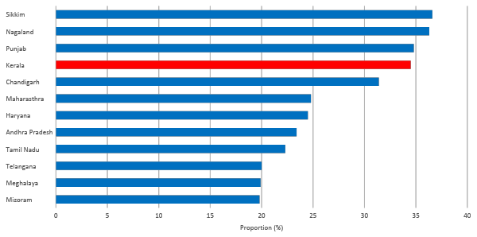
Prevalence of HTN in various Indian states
Source: DLHS- 4 survey 2012-13
Notes:
The District Level Household and Facility Survey (DLHS-4) is a nationwide survey which was conducted during 2012-13.
Showed wide state-state variation in prevalence of hypertension.
In 2016, three of the five leading individual causes of disease burden n India were NCD, with IHD, COPD as the top 2 causes and stroke as the 5th leading cause. (India State-level Disease Burden Initiative)

Slide 9

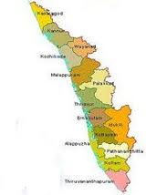
KERALA PROFILE
Particulars | Numbers(Millions)
Population | 33.39
Men | 16.02
Women | 17.37
Population density | 859
Literacy | 93.
IMR | 10
MMR | 46
Life expectancy | 74

Slide 10
KERALA- THE WHEEL OF CHANGE
Highest epidemiological transition zone
Heart Attack Mortality 6 -M
5.3- W
AR
High prevalence of Hypertension
Rampant urbanisation
Stroke death
Men 2.5
Women-1.8
ASR
High prevalence of Diabetes
Over weght obesity
Men 24%
Women 34%
Changing lifestyles
High prevalence of Renal diseases
High incidence of cancer
PURE STUDY/million death study

Slide 11
NCD control program- wheel of motion
NCD CLINICS IN ALL PHC, CHC, SUB CENTRES.
NCD CLINIC IN ALL DH/SDH
SPECIAL CLINCS 6/7 IN FHC
COE IN GH ERANAKULAM
MEDICINES UP TO PHC LEVEL
13300000 PEOPLE SCREENED
NHM-DHS JOINT PROGRAM
SPECIAL PROGRAMS FOR SCHOOLS & WORK PLACES
TOBACCO CESSATION CENTRES IN ALL DISTRICTS
Hba1c analysis in all FHCs

Slide 12
CCU/ Cath lab in DH
Stroke units in DH
State NCD Cell
Diabetic foot clinics
COPD clinics in DH & H&WC
Retinopathy
clinics
44 functional Dialysis units
20 chemo units

Slide 13
DHS- AMCHSS- NCD Survey
One out of Three have hypertension
13 % control rates
One out of Five have Diabetes
16 % control rates

Slide 14
Problem
Non compliance to protocol by doctors
Non compliance to treatment by patients
Non adherence to lifestyle modification
Hospital and medical systems hopping
Quality of medicines
And the solution……..
3 programs adopted by state health department
IHMI, QS and PBS

Slide 15
IHMI
Program Status
INDIA HYPERTENSION MANAGEMENT INITIATIVE
In association with
WHO,ICMR, RESOLVE TO SAVE LIVES
Kerala State

Slide 16
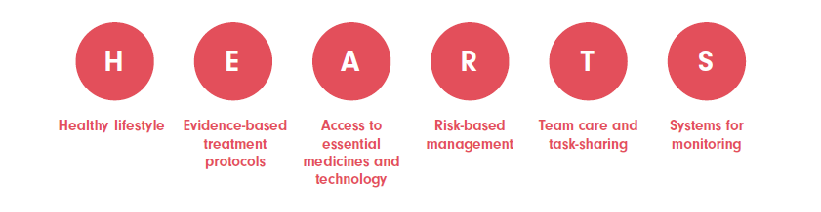
In sync with WHO global HEARTS initiative
Launched by WHO & partners in Sept 2016 to reduce heart attacks and stroke

Slide 17
What is IHMI
4 districts piloted
Development of Standard protocol for management
Appointing CVHOs and STS for IHMI Districts
Trainings and capacity building
Documentation
Screening of all persons above 18 yrs of age &Protocol based management
Regular individual follow up and retrieval of defaulters
Half yearly and yearly evaluation

Slide 18
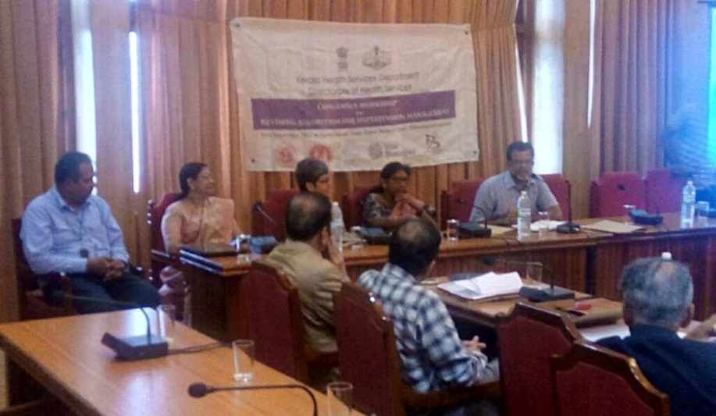
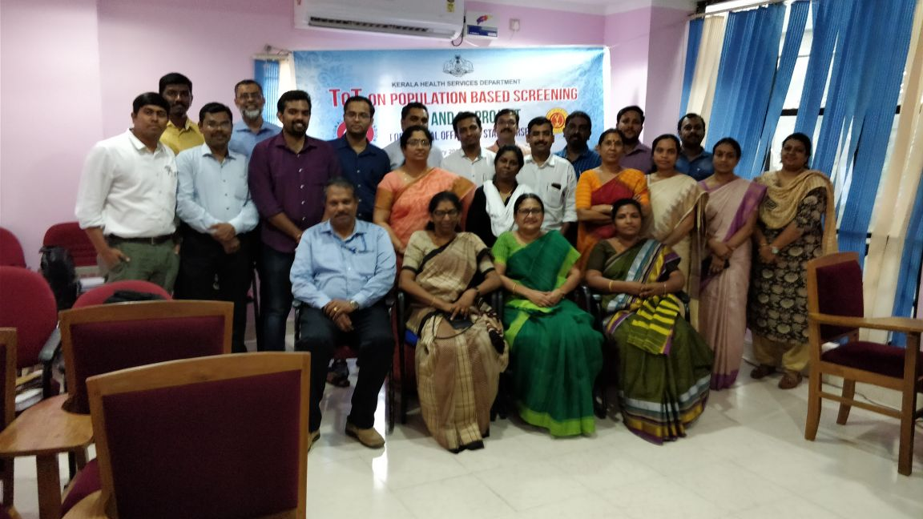
Timeline of Major Events – 1
Sep 2017
Nov 2017
Protocol Development
CVHO & STS in position
Induction training
Feb 2018
Technical Workshop in Delhi
TOT at state level
Notes:
Protocol development
Transition
Induction Training
Launch
Trainings

Slide 19
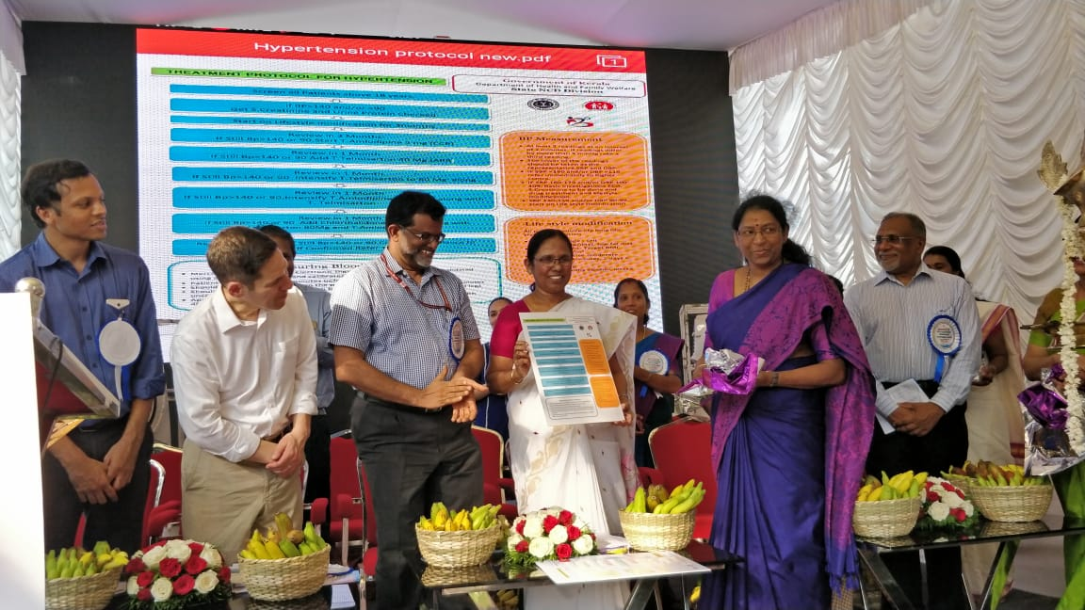
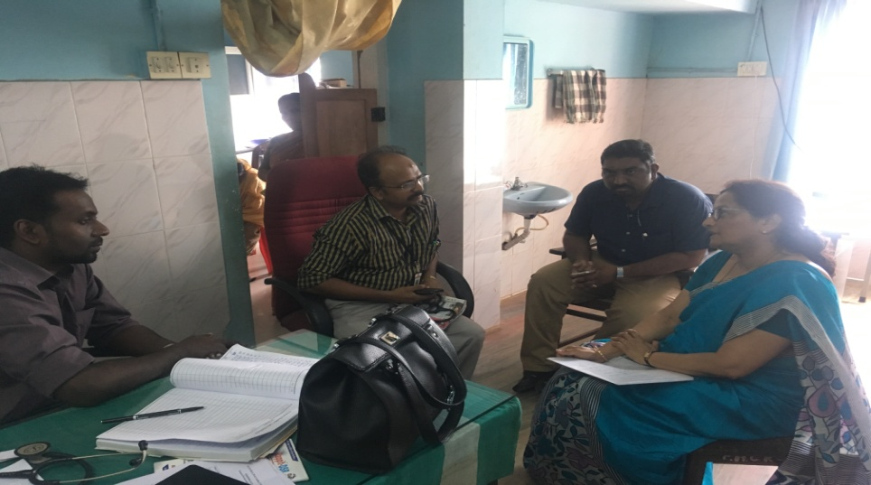
Timeline of Major Events – 2
Program Appraisal
Mar 2018
Apr 2018
Officially launched
Jun 2018
Trainings completed
Notes:
Protocol development
Transition
Induction Training
Launch
Trainings

Slide 20
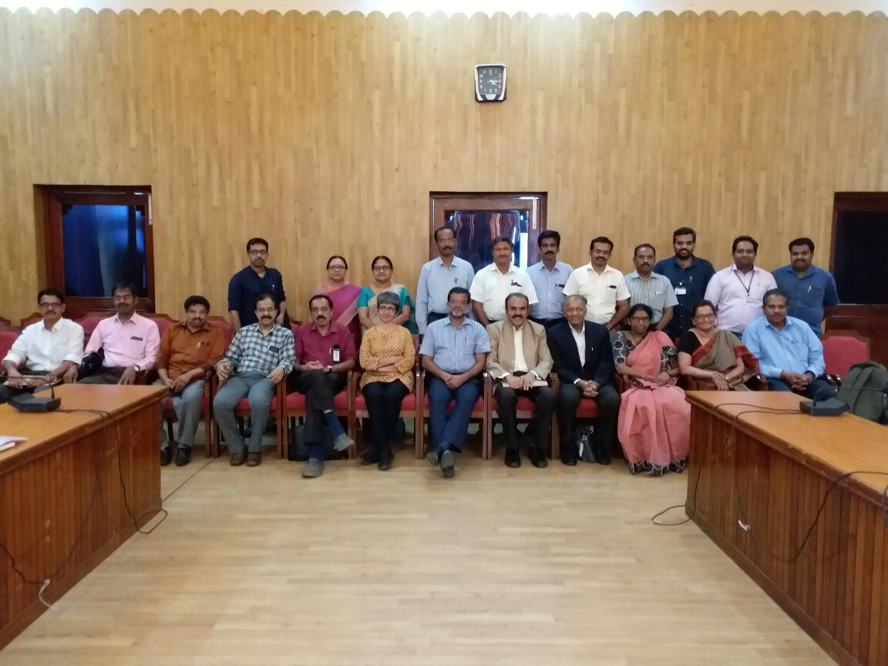

Protocol workshop chaired by ACS kerala, National and state level experts participated

Slide 21
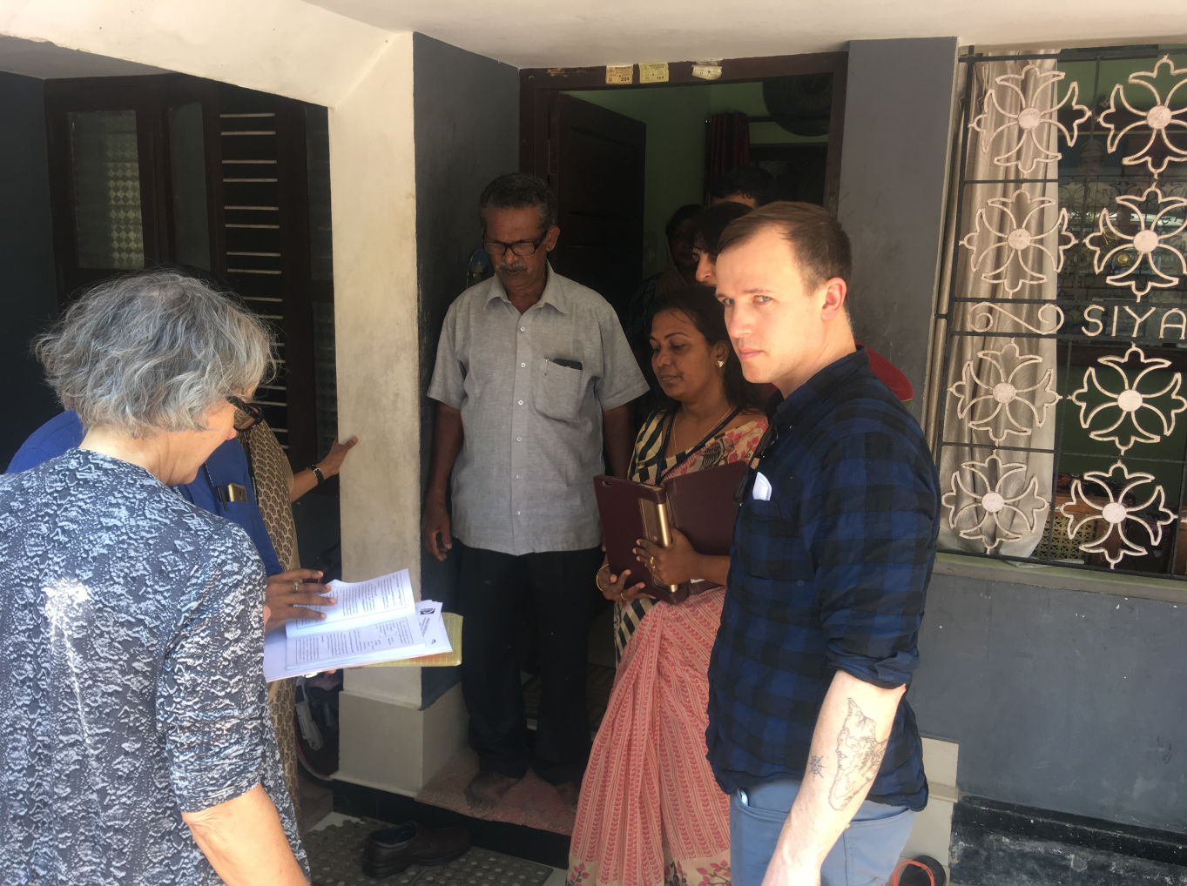
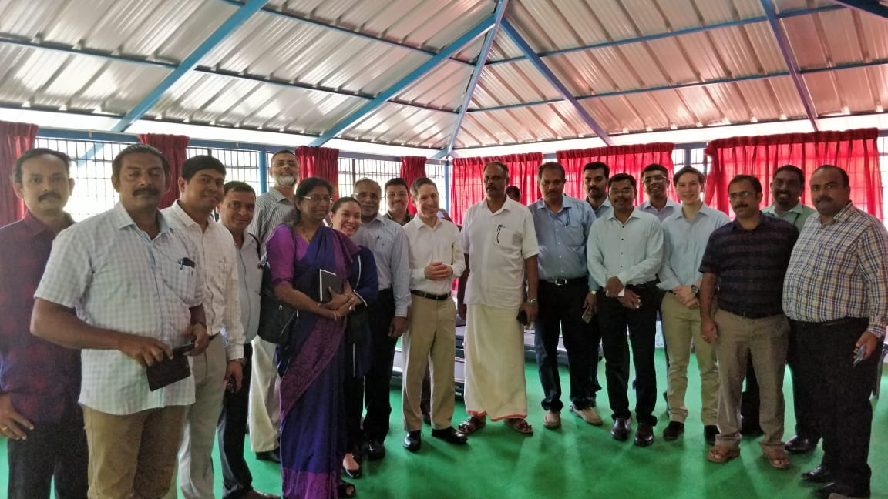
Field visits visit to institutions and houses lead by resolve team

Slide 22
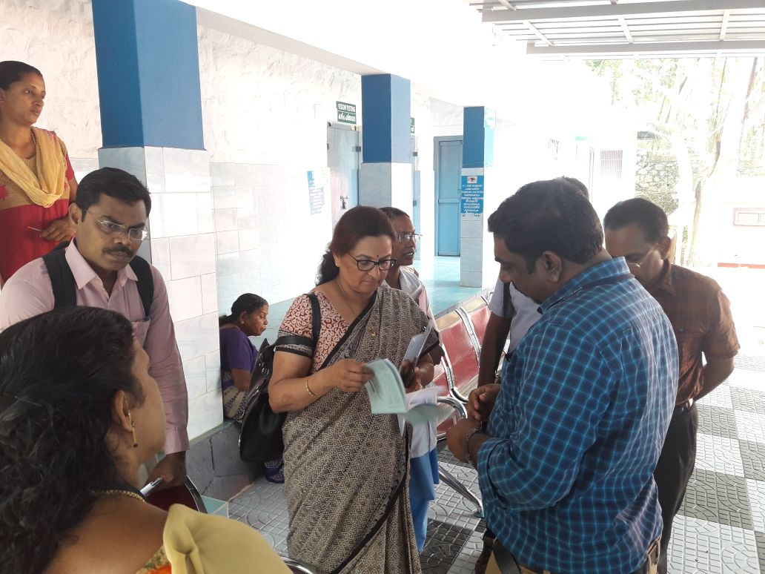
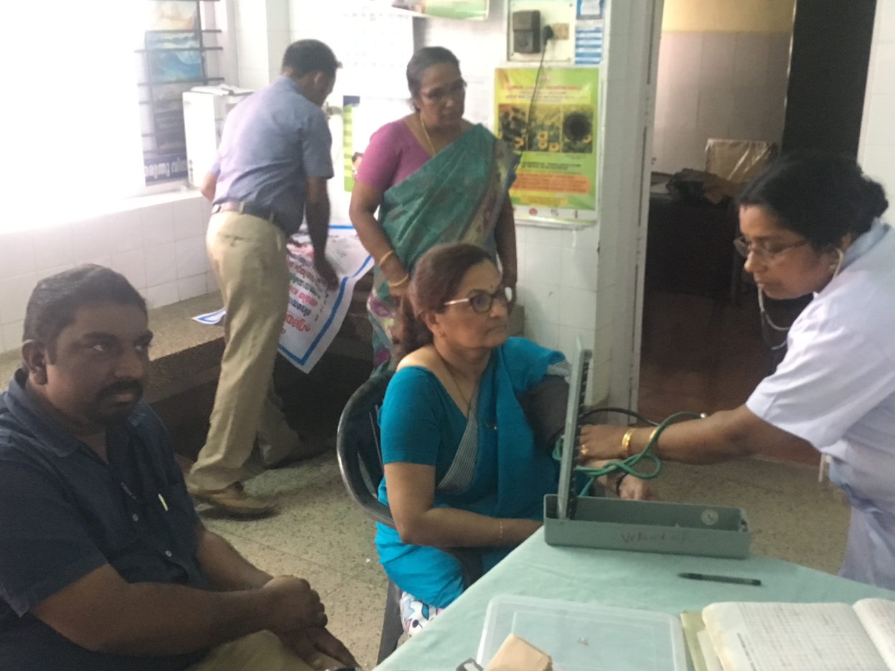
Appraisal visits to assess the preparedness of the districts lead by WHO and ICMR

Slide 23

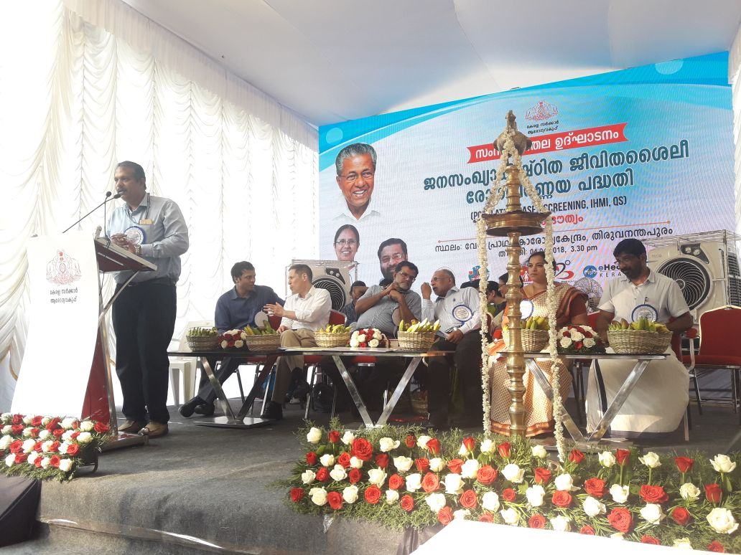
The official launch by Health minister in presence of ACS, DHS, Dr Tom Frieden

Slide 24



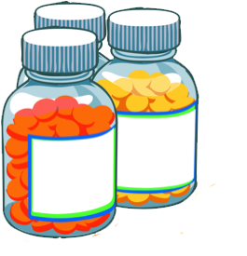
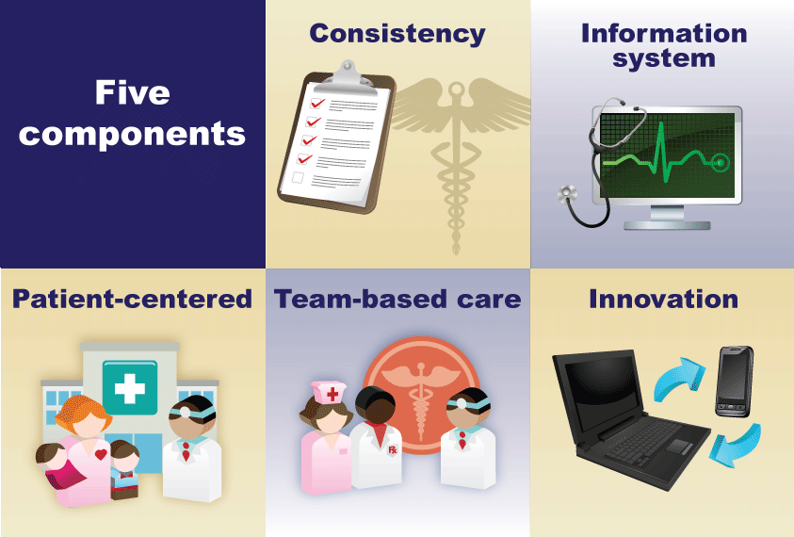
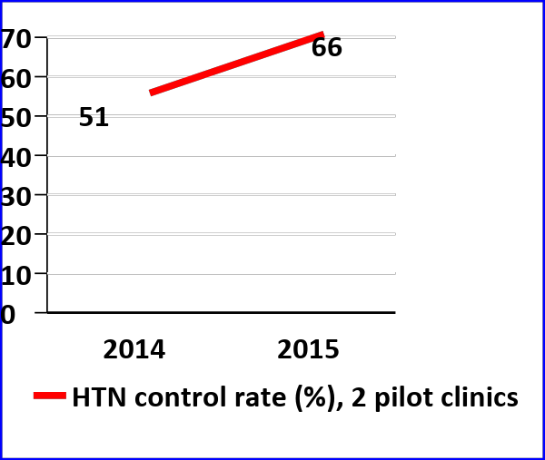
Five Components of WHO HEARTS Technical Package
Protocols
Community-Based Treatment
Medication Supply
Patient-
Centered Care
Information
Systems
14.5% increase
Notes:
Essential components of scalable treatment of hypertension
•Simple, detailed protocols including specific medication dosage and schedule for titration or addition of medications if blood pressure not controlled to establish standard treatment of patients
•Legal and operational procedures in place to enable task sharing so health workers who are accessible to patients can provide and, following physician orders and/or protocols, adjust and intensify medication regimens
•Regular and uninterrupted supply of quality assured medications
•Patient-centered services that reduce the barriers to adherence, including:
reduction (preferably elimination) of costs for medications and medical visits
increasing patient convenience of medical visits and medication refills (e.g. every quarter or every 6 months for stable patients)
use of once-daily treatment regimens
use of fewer tablets, including through combination medications
improving access to blood pressure monitoring including in public places
public education to increase awareness of the importance of control of blood pressure
•An information system which allows real-time feedback on adherence and blood pressure control of individual patients and of different treatment systems to facilitate continuous program improvement
For treatment to succeed the following measures are needed:
Detailed algorithms to ensure quality and titrate-specific medicines
Empower nurses and lay health workers to start and
adjust medications
Track patients and get them back if they lapse
Ensure an uninterrupted, affordable, simple
medication supply so drugs never run out
Make it easy for patients by generating demand and making care free and convenient (e.g., 3-month prescription refills, once-daily dosing, community BP check stations)

Slide 25
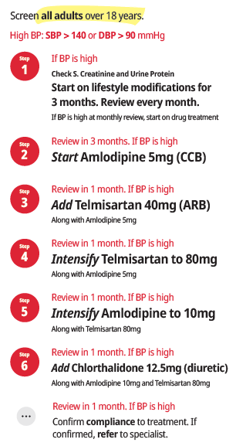

Hypertension
Treatment Protocol
(Kerala)

Slide 26


Department of Health & Family Welfare
TREATMENT PROTOCOL FOR TYPE 2 DIABETES MELLITUS
Screen all individuals above 30 years and if diagnosed
Diagnosed diabetes with symptoms &
1
Advice Life Style Modifications (LSM) & Assess for complications
Start T. Metformin 500mg OD or BD
Monitor FPG/PPPG monthly
FPG ≥ 250 mg/dL at presentation.
Repeat testing once a week and start combination therapy with Tab. Metformin 500 mg BD & Tab Glimepiride 1mg daily , up titrate , monitor weekly and to start Insulin if not getting controlled. Refer if not controlled
2
Review in 1 month, if FPG,PPBG values are high,
Intensify T. Metformin 1000mg BD
Along with LSM
Hypoglycemia
3
Review in 1 month, if FPG,PPBG values are high
Symptoms
Cold sweat, trembling of hands, hunger, palpitation, confusion etc
Treatment
Ingestion of glucose or carbohydrate containing foods. Consume 15 gms of glucose i.e. 1 tablespoon sugar, fruits, next meal & recheck blood glucose after 15 minutes, repeat if hypoglycemia continues
Add T. Glimepiride 1 mg OD
(½ hour before breakfast and reduce to 0.5 mg/day depending if there is hypoglycemia.)
Along with LSM, T.Metformin 1000mg BID. Give hypoglycemia training.
Give hypoglycemia training.
4
Intensify T.Glimepiride 1 mg BD up to 2mg BID
(½ hour before meals)
Along with LSM, T.Metformin 1000 mg/day BID.
If any of the following complications are present, refer to higher centre.
Uncontrolled plasma glucose with symptoms
Visual symptoms
Foot ulcer
Nephropathy/ frothing of
If plasma glucose not under control after second drug and if any complications present,
Refer to District hospital
urine
Painful neuropathy
Infections/sepsis.
5
If there is no complications, Continue LSM, Metformin 1 gm BD, Tab. Glimepiride 2mg BD,
LIFE STYLE MODIFICATIONS
Add T.Pioglitazone 7.5 mg OD
(to a maximum 15 mg once daily)
Avoid in cardiac failure, fluid overload patients
Restrict sugar & sweets
Restrict fried and oily foods
Increase fiber in diet (green leafy vegetables, lentils or peas, whole grains, apple, banana)
Regular consumption of seasonal vegetables
Brisk walking for 30 minutes daily
5 minutes warm up
5 minutes cool down
Avoid Tobacco and Alcohol
6
If plasma glucose not under control after third drug,
Start Insulin
7
If plasma glucose not under control
Refer to District hospital
If patient is under control by any of the above steps, continue same treatments if no complications is identified and follow up shall be done every month with FBG and 2hour PPBG
Base Line Lab Investigations
Urine Albumin Blood Urea Serum Creatinine
Target mg/dL
FPG: 80-130
PPPG: >180
STATE NCD DIVISION

Slide 27
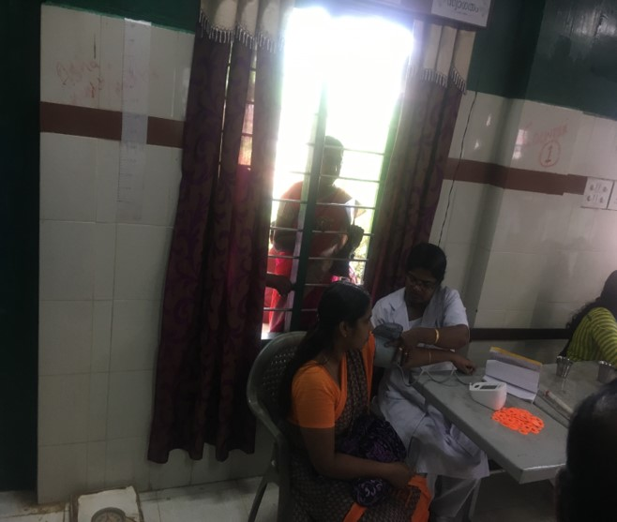
Establishing
NCD Pre-assessment Area
Managed by staff Nurse
BP measurement of all above 18 years of age
Enters the recordings in treatment card
Blood sugar estimation, HbA1c estimation, PFT in FHCs
Patient send to physician after pre check.

Slide 28
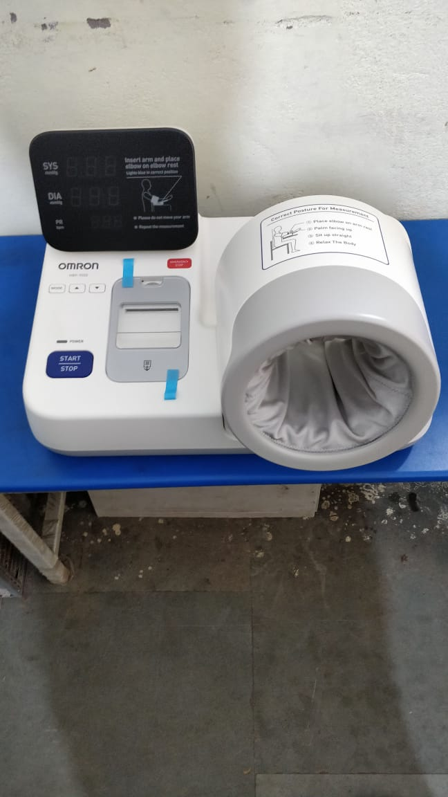
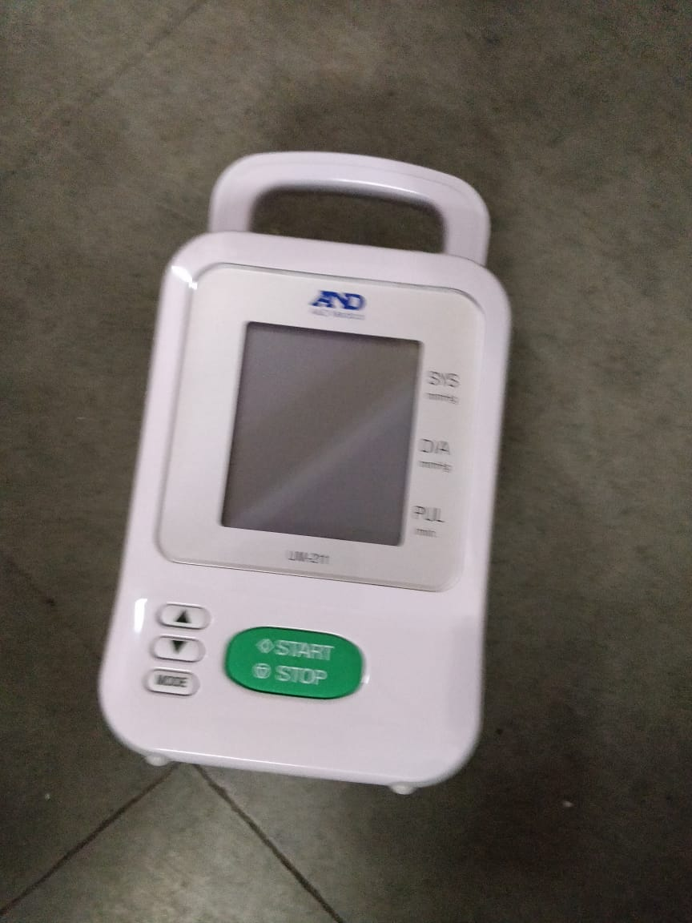
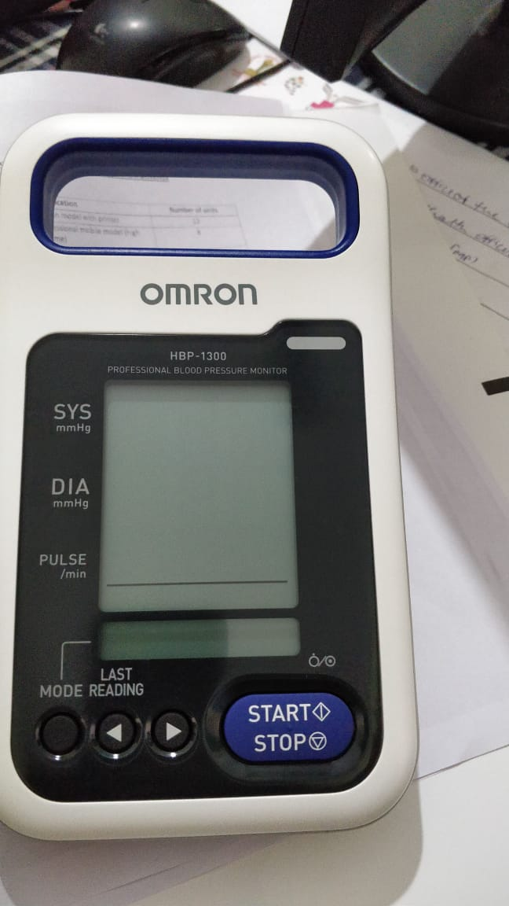
BP apparatus used in pre check area

Slide 29
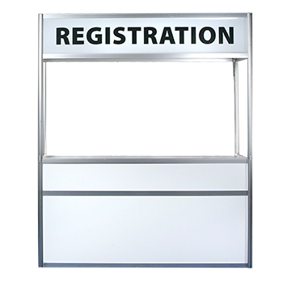



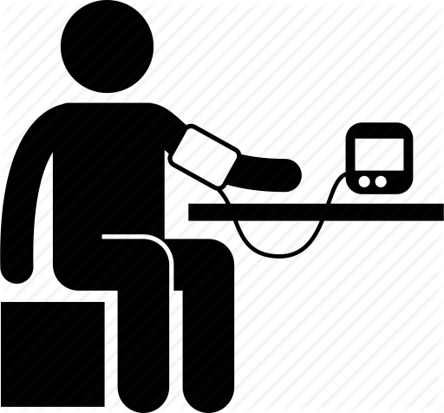
Ideal Patient Flow on all days
All patients above 18 years screened for blood pressure irrespective of their purpose of visit
NCD Pre-assessment Area

Slide 30
Patient flow in FHC

Slide 31
Recording & Reporting System
Treatment Card | HT Facility Register | Patient Passbook

Slide 32
Treatment Card
For Hypertension and Diabetes Mellitus
  All diagnosed patients will be given an unique id number and a treatment card which will be stored in the facility.
  For individual patient monitoring: identifies when was the last visit; when is follow up due; if BP controlled; if patient irregular; what medications

Slide 33
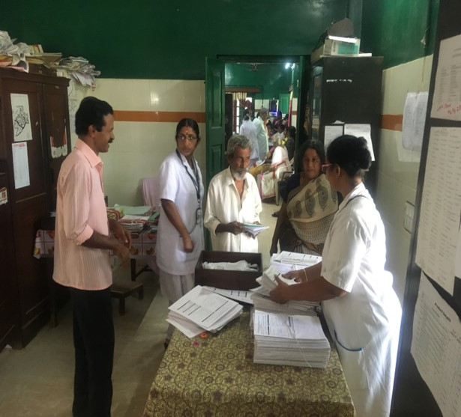
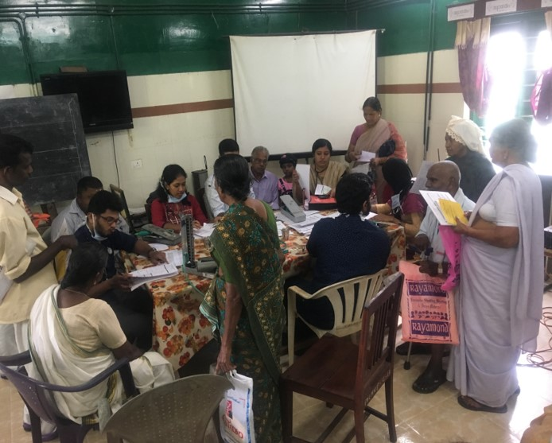
Registration and issue of treatment card

Slide 34
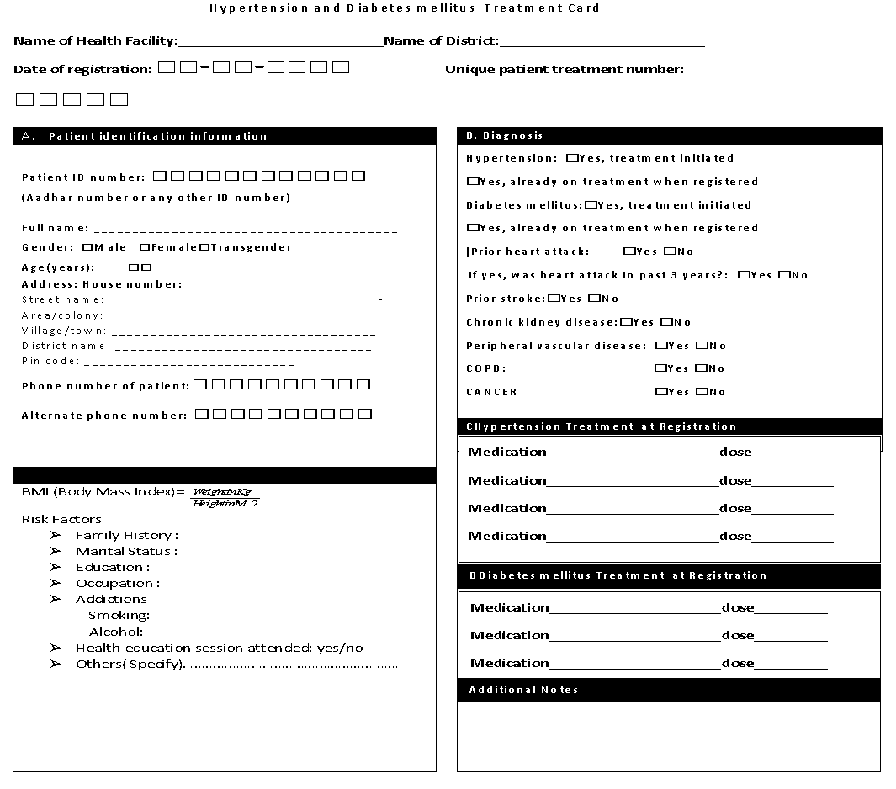
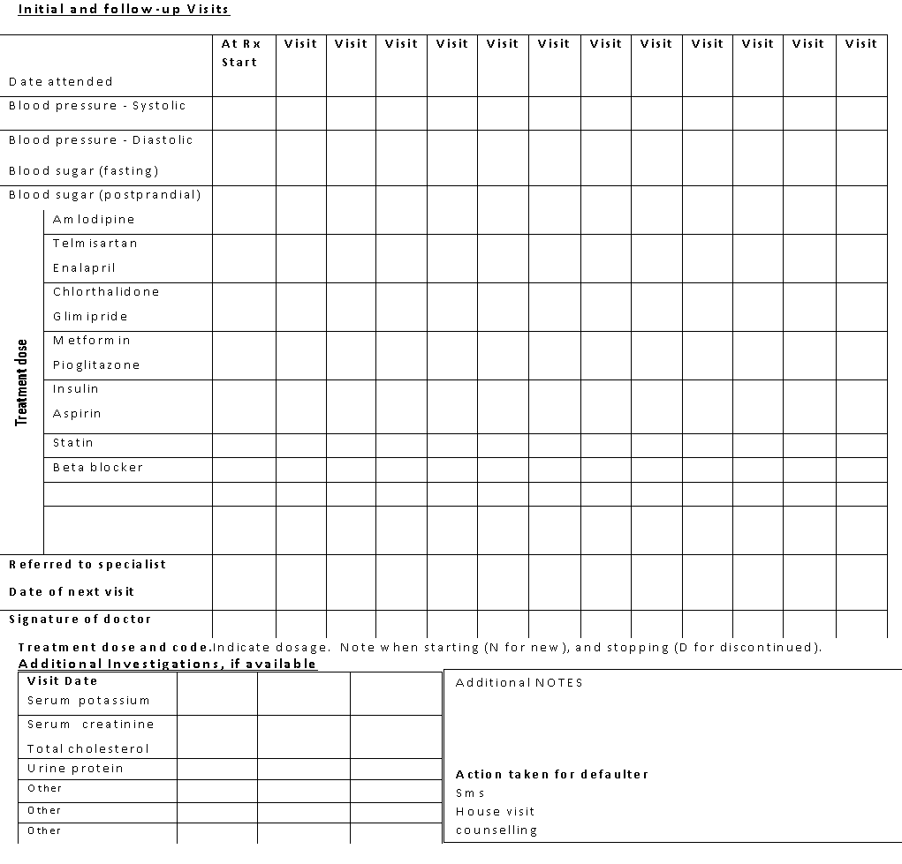

Slide 35
Hypertension Facility Register
Only for Hypertension

Slide 36
Hypertension Facility Register
Each health facility maintains a HTN Register
It is line listing of all patients on treatment in that health facility
Entries are made from the patient treatment cards
  Each health facility designates a staff who will be responsible for maintaining this register
Patient ID information can be filled at the time of starting the treatment card or soon after
After 2 quarters i.e. at the end of 6-9 months, and every year thereafter, update the Register to indicate if the patient’s BP is under control or not by writing Yes/No

Slide 37
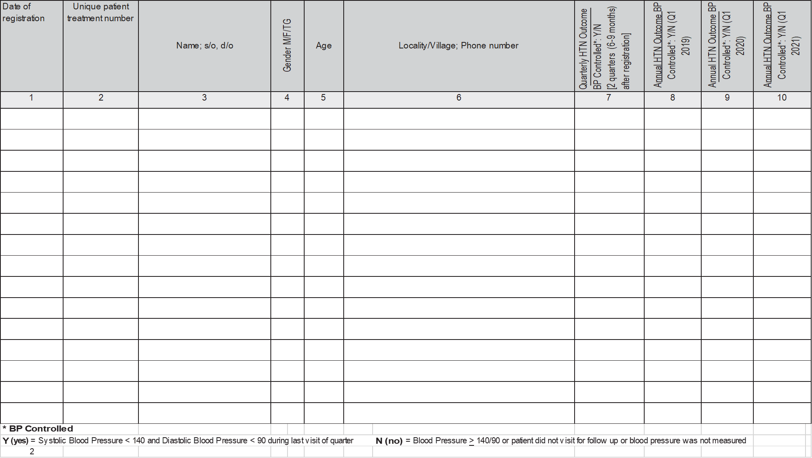
Filled immediately or soon after starting the treatment card
Filled later

Slide 38
Patient Pass Book
For Hypertension & Diabetes Mellitus
Given to Patients

Slide 39
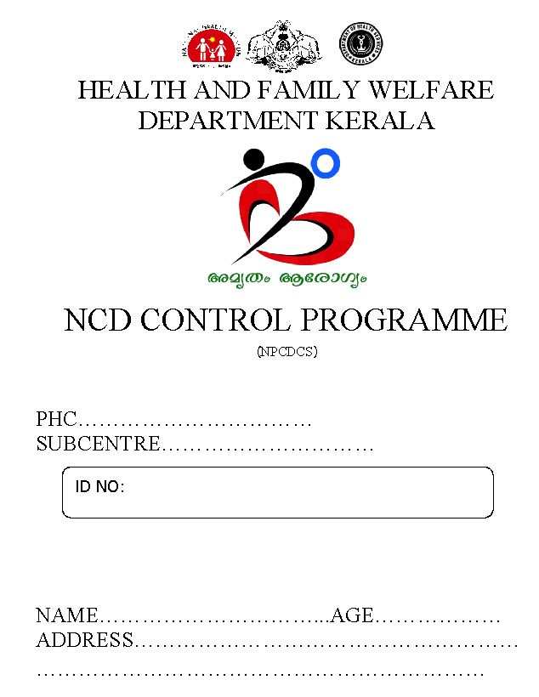
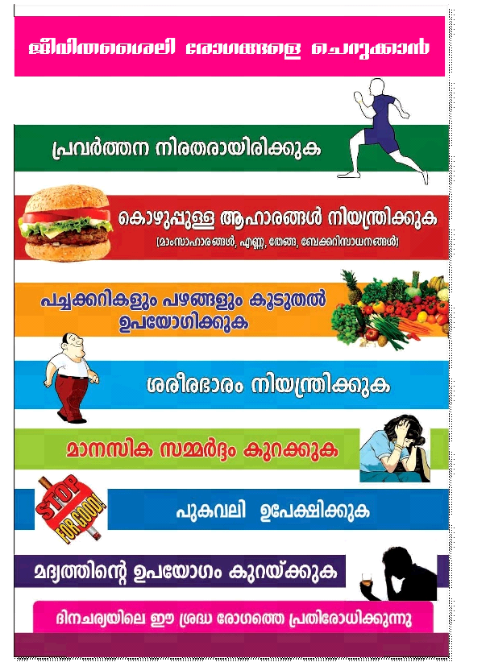

Slide 40
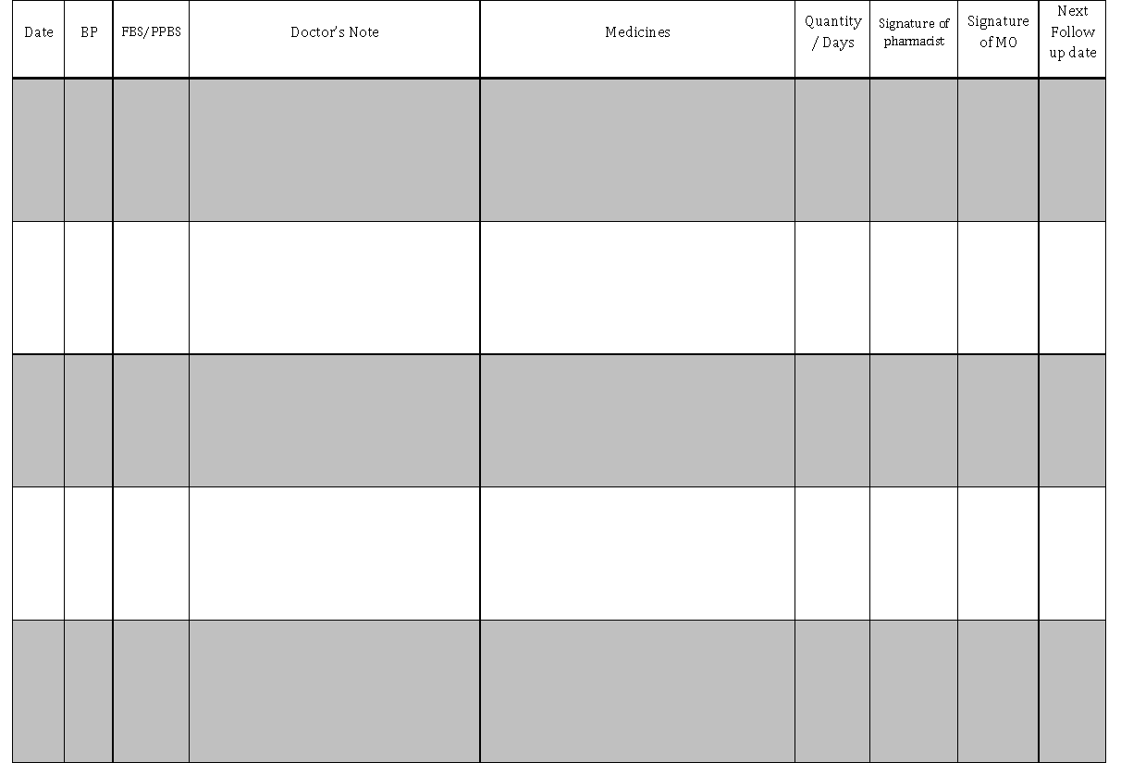

Slide 41
Integration with e health system
All health workers provided tablet PC through ehealth system
NCD module integrated in the ehealth system
Registration and referral could be done online
Back referral from the doctor to the concerned health worker
Alerts to health workers and field workers to track defaulters

Slide 42
Indicator based evaluation
Screening – number screened out of total eligible population
Detection- number of cases detected out of number screened
Treatment-number put on treatment out of number detected
Outcome- number of people attaining control levels out of number treated

Slide 43
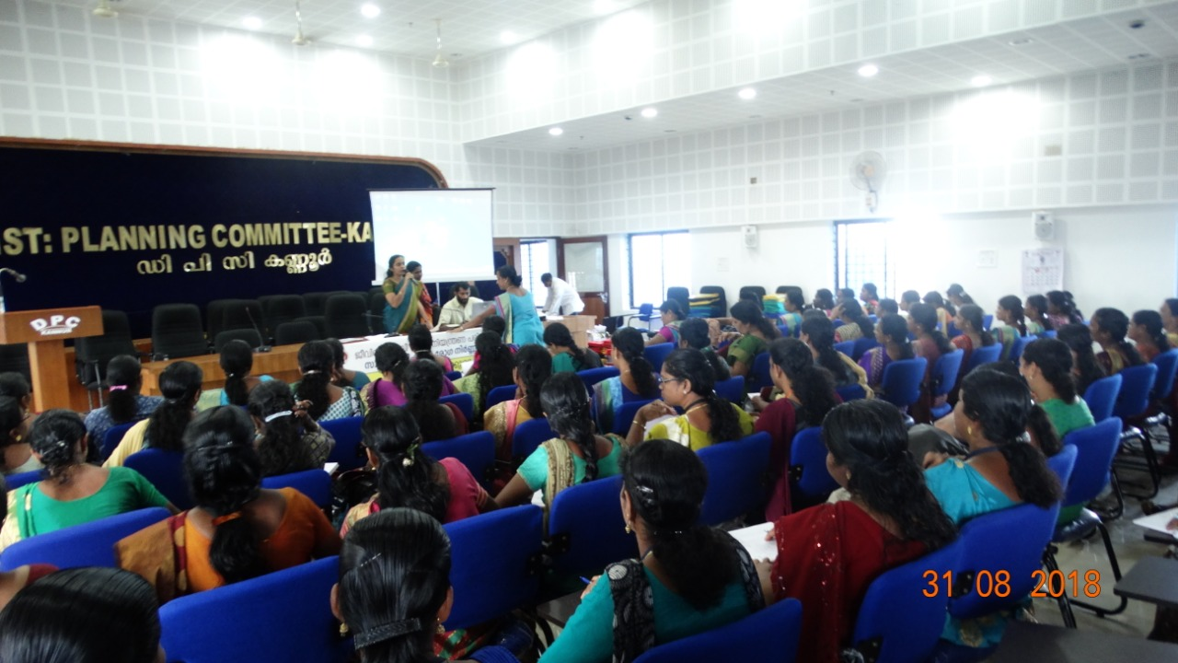
Implementation of Population Based Screening
The same four districts selected for an integrated synergistic activity
Helped in accessing the target population
Patient tracking and referral using ASHA
Default retrieval using ASHA

Slide 44
QUALITY STANDARDS IN HYPERTENSION MANAGEMENT
PILOTED IN 2 DISTRICTS – ALAPPUZHA & ERANAKULAM
IN ASSOCIATION WITH IMPERIAL COLLEGE LONDON
ACTIVITIES SIMILAR TO IHMI
FOCUS ON SERVICE PROVIDERS THAN BENEFICIARIES
TRAINING ON IDEAL BP MEASUREMENT TECHNIQUES FOR ALL HEALTH STAFF
FOLLOW UP

Slide 45
IHMI Implementation Status
96% of institutions in 4 IHMI districts have implemented the program including screening, treatment and follow-up of Diabetes Mellitus
As on 29/9/18

Slide 46
Registration Status
69460 patients registered for HT and DM till Sep 2018
HT | DM | Both
37643 | 9988 | 21829
Updated on 29/9/18

Slide 47
Implementation & Registration – District wise status
District | Total No. of facilities | No. of facilities where IHMI implemented | HT | DM | Both | Total
Trivandrum | 92 | 92 | 6860 | 3454 | 6617 | 16931
Thrissur | 102 | 102 | 10352 | 3652 | 7760 | 21764
Kannur | 97 | 96 | 15293 | 2882 | 7452 | 25627
Wayanad | 36 | 23 | 5138 | DM data not avl. |  | 5138
Total | 327 | 313 | 37643 | 9988 | 21829 | 69460
Updated on 10/10/18

Slide 48
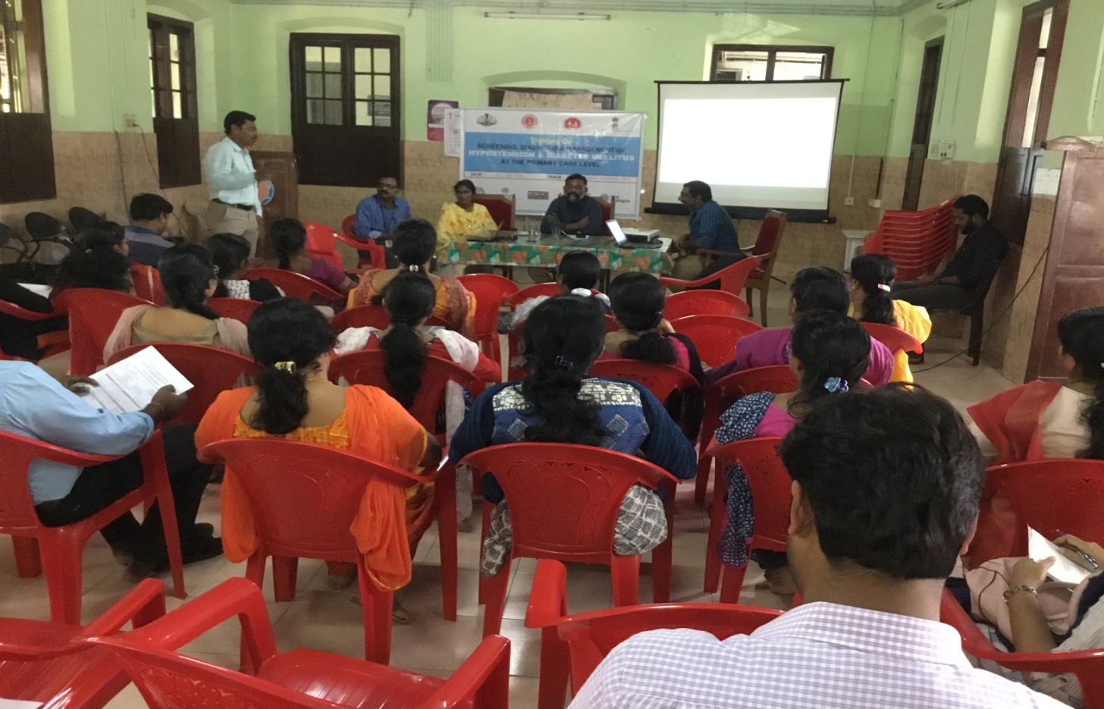
Training
16 state level trainings
( TOT )
64 district level trainings
124 block level trainings
240 institution level trainings
32446 staff given training
91% of staff trained

Slide 49
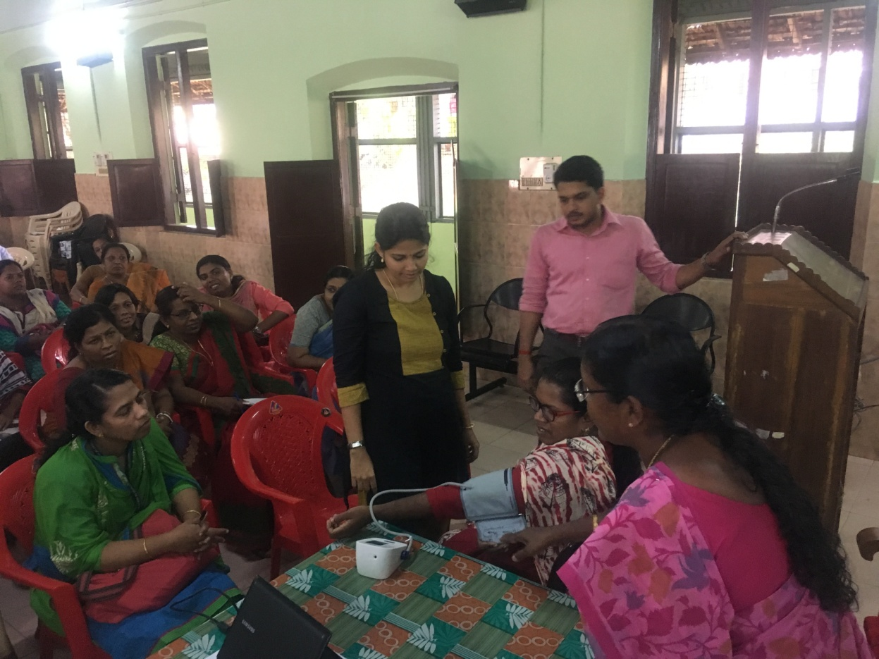
Training Status (%)
District | MO | SN | HS & LHS | HI & LHI | JPHN & JHI | Pharm. | District Avg.
Trivandrum | 91 | 92 | 94 | 96 | 90 | 87 | 91
Thrissur | 98 | 99 | 100 | 91 | 98 | 98 | 98
Kannur | 88 | 77 | - | 81 | 90 | 88 | 85
Wayanad | 87 | 93 | 98 |  |  | 85 | 91
State Avg. | 91 | 90 | 93 |  |  | 90 | 91
Updated on 25/10/18
Notes:
93
96
86

Slide 50

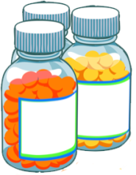
Challenges
Protocols
Adherence to new treatment protocol by Medical officers
Acceptance to protocol based management
Long waiting times during NCD clinics
Coverage in urban areas
Community-Based Treatment
Low participation of male population
Involvement of private sector
Medication
Supply
Drug forecasting for next financial year
Quality of drugs

Slide 51
Way forward
Expand IHMI to Urban PHCs
Involve JHI, JPHN and ASHA workers in defaulter retrieval
Camps, workplace intervention and holiday/evening op to capture more male population
Coalition with professional organizations for more private participation
Complete digitization for decreasing paper work

Slide 52
Expected outcome
decrease the rise in Prevalence of Hypertension
increase control rates to above 50%
create a population based registry for Hypertension and diabetes
decrease OOPE by early detection and prevention of complications

Slide 53
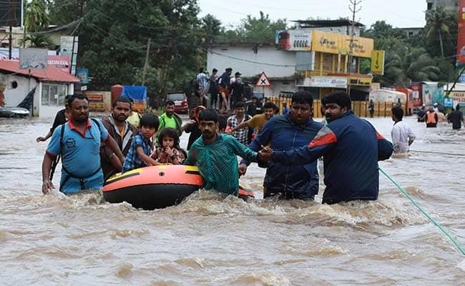

You are under scanner, Once detected , you are booked – and we spare no one

