Slide 1




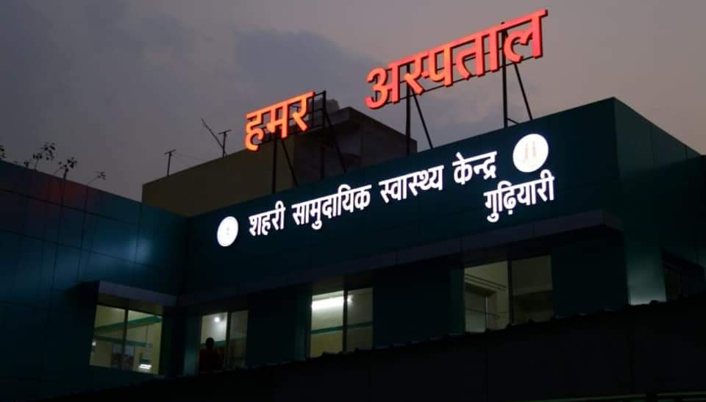
HAMAR ASPATAL
Up-Gradation of Urban Health Centers

Slide 2
Background
Chhattisgarh - 9th largest State, 135.19 lakh sq. km area, over 25.5 million population
Chhattisgarh’s population grew by 22.6% in last decade (Census 2011) but Urban population grew at 41.8%
Total Urban population in the state = 58 lakhs approximately

Slide 3
The Issues
Limited Health Care Facilities to provide primary health services to urban population.
Although District hospital and Medical colleges are providing secondary and tertiary health care services but demand for OPD centric primary health care services still remains partially addressed.
To address the health issues of working class population residing in urban areas – there is also need for OPD beyond normal OPD timings in such areas.

Slide 4
Need
Infrastructure to cater to the needs of as many people as possible & to optimise workflow
Expanded scope of services – to improve the credibility of public health facilities
Improving accessibility of health care by providing free of cost services
Improved Quality of services
Adequate Human resource & their capacity building to be able to provide expanded services
Mechanisms to ensure uninterrupted supply of drugs & diagnostic services

Slide 5
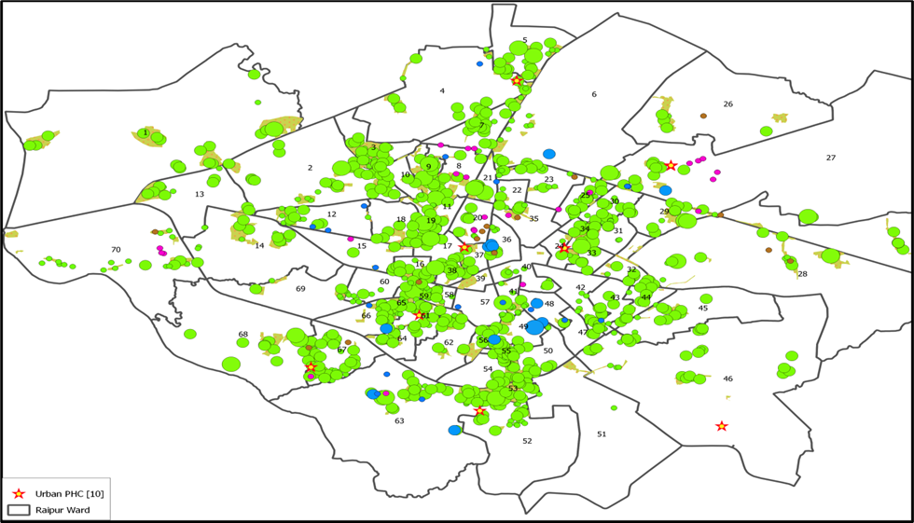
Hamar Aspatal – The Scheme
“Hamar Aspatal” scheme launched to cater the needs of urban Population.
4 Urban health facilities selected in pilot stage.
Facilities chosen based on the Vulnerability mapping by Health department covering majority of the urban population.

Slide 6
1. Infrastructure Upgradation
Renovation & Refurbishment of existing infrastructure
Structural & functional integration
Process Re-engineering to optimise work flow
Prioritization of services as per the patient need

Slide 7
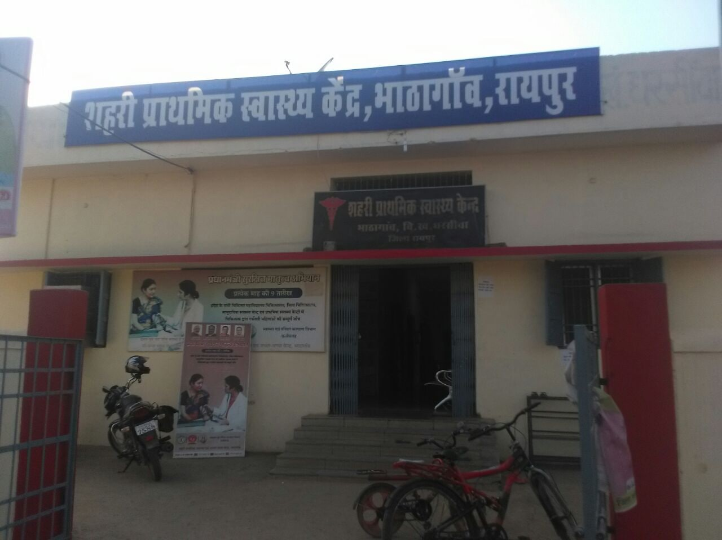
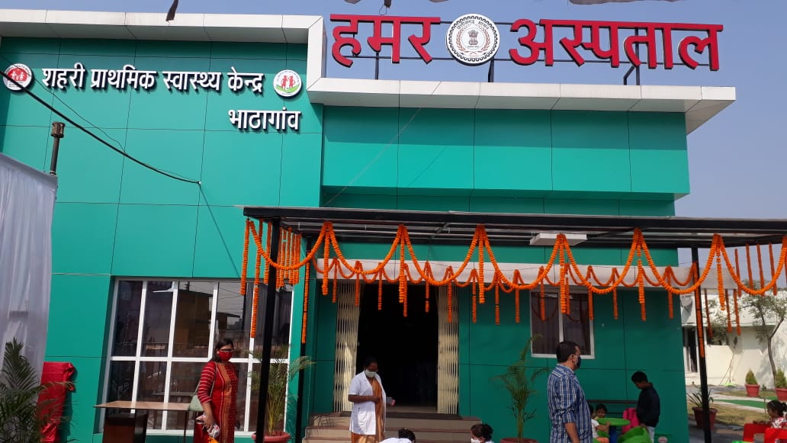
Glimpses (UPHC-Bhatagaon)
Before
After

Slide 8
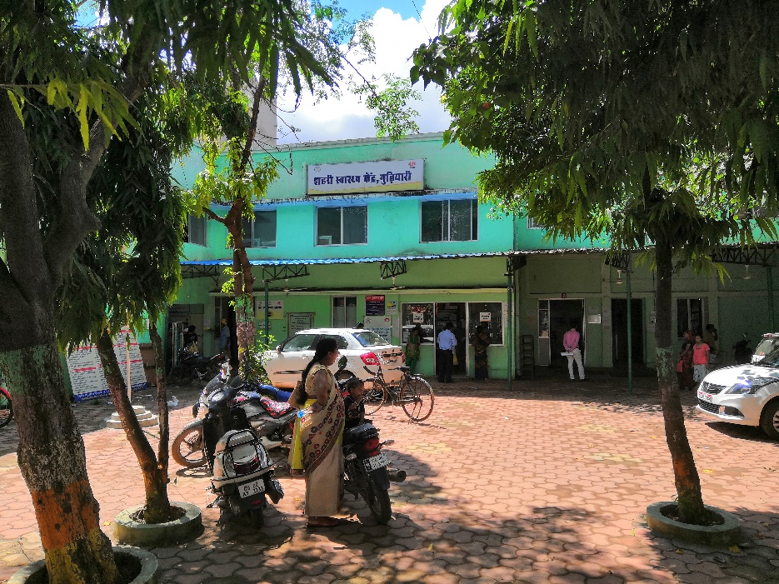
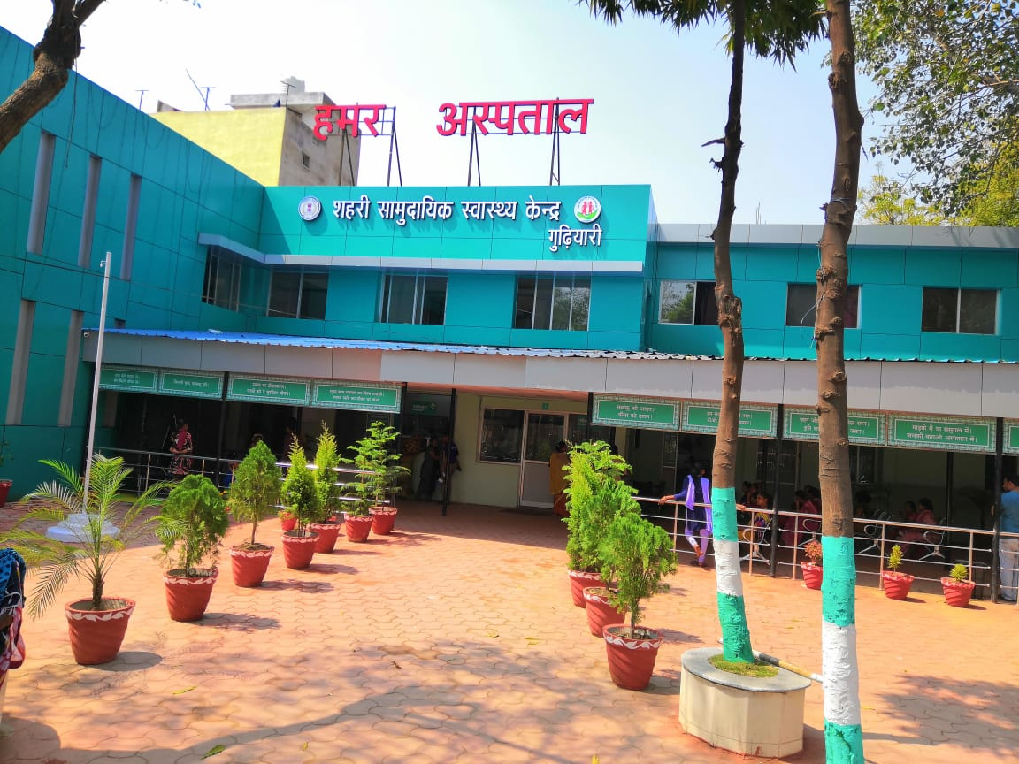
Glimpses (UCHC-Gudhiyari)
Before
After

Slide 9
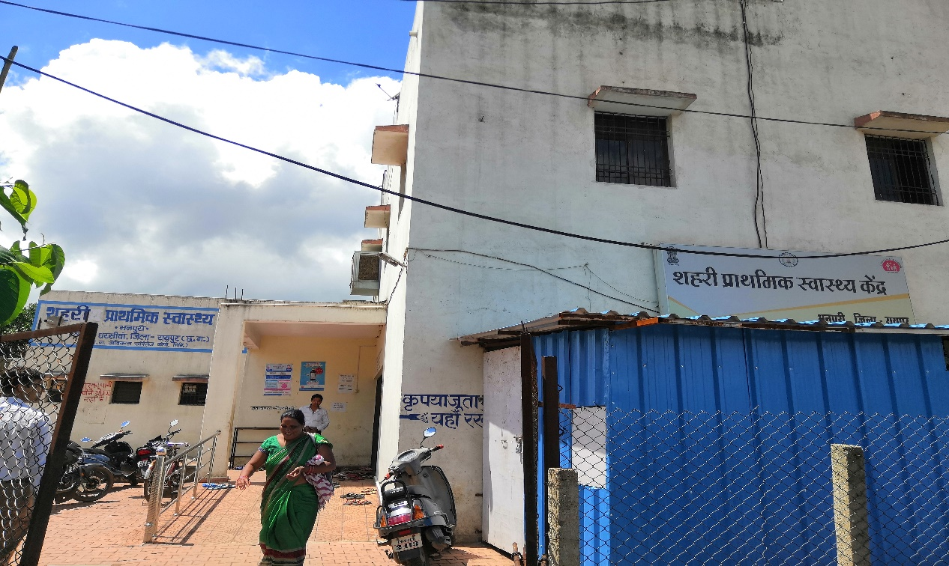
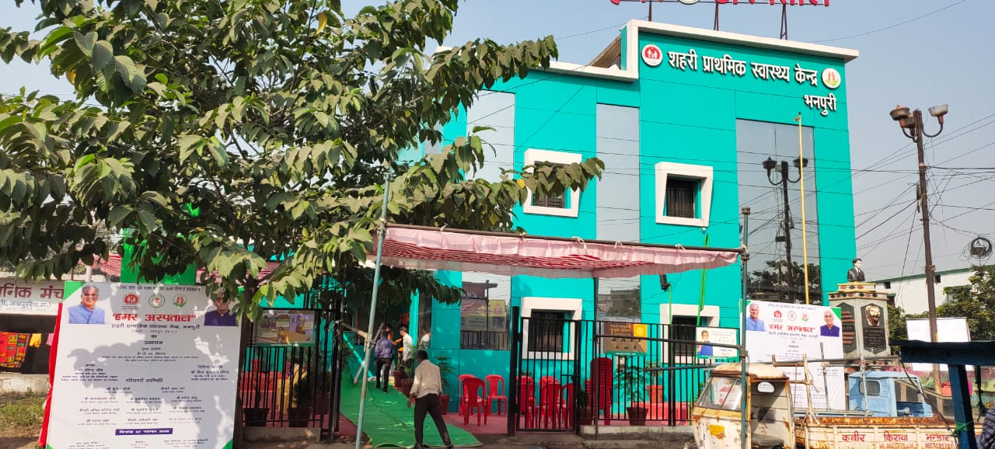
Glimpses (UPHC-Bhanpuri)
Before
After

Slide 10
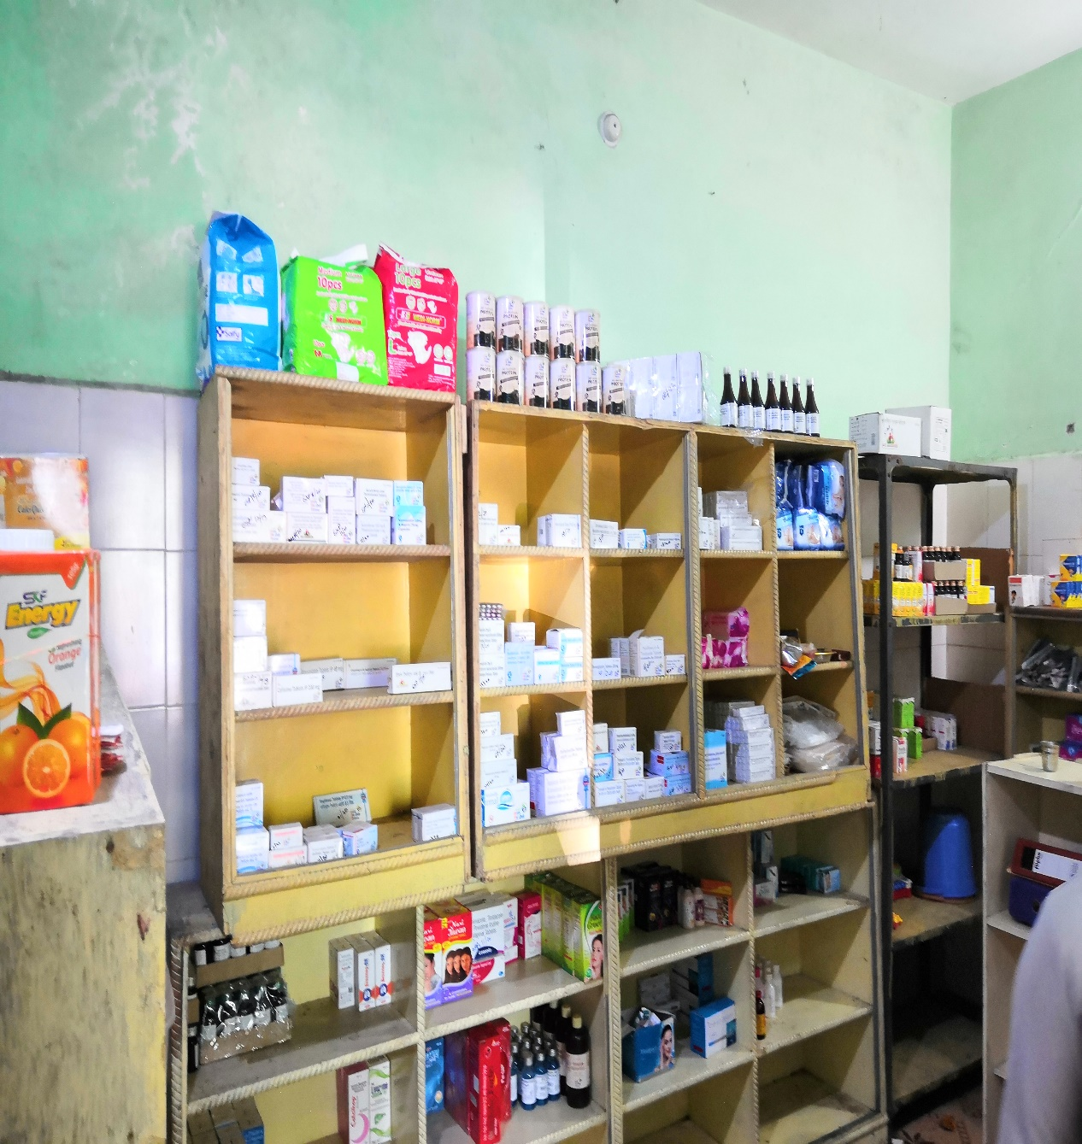
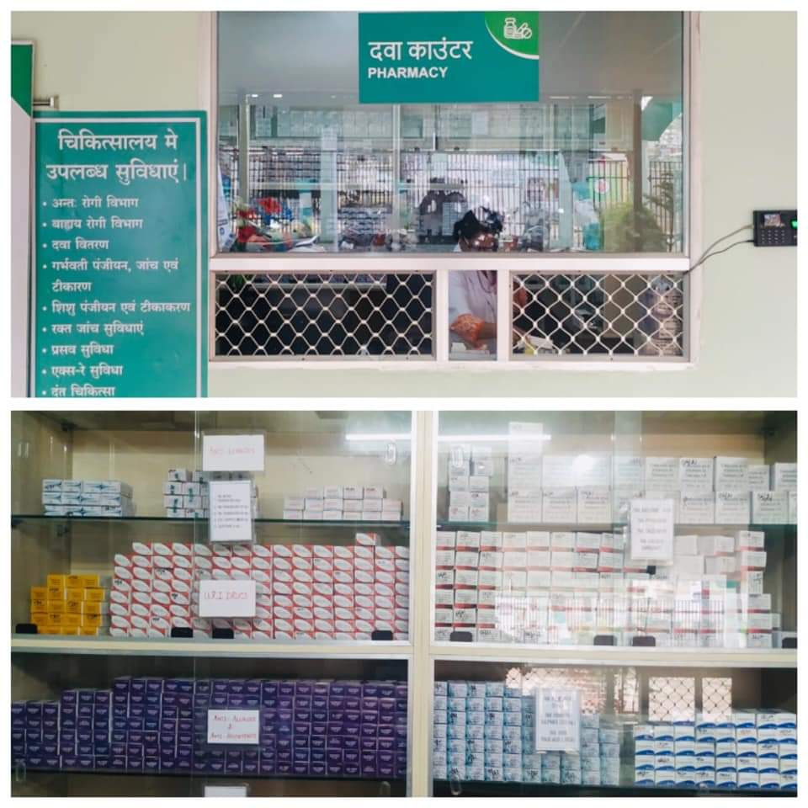
Drug
Dispensing
Before
After

Slide 11
Structural & functional integration

Slide 12
2. Expanded scope of services
S.No | Services | Urban Health Facility
 | Services | Before Intervention | After Intervention
1 | OPD Timing | 9 AM to 1 PM | 8 AM to 2 PM 2 PM to 8 PM
2 | Medicine availability | 121 | 154
3 | Diagnostic Services | 22 | 42
4 | X-Ray | No | Yes
5 | Dental Services | No | Yes
6 | USG services | No | Yes
7 | Ophthalmic services | No | Yes
8 | Physiotherapy | No | Yes

Slide 13
3. Improved Quality of services
Standard Operation Procedures (SOPs) developed.
Introduce E-Hospital & Digital Token System for paperless environment.
Pharmacy & Lab has been redesigned for quality services
System of Internal audit, Peer review & Patient feedback adopted.
Assured minimum 10 ancillary services in all facilities to make them more patient friendly.

Slide 14
10 Minimum Assured Services in all facilities
  Drinking Water
  Clean Linen, Clean Premises & Clean toilets
  Uninterrupted Electricity Supply
  Proper Seating arrangement for patients and attendants
  Sheds for patient waiting outside
  6. Wheel-chairs and ramps for differently abled
  7. Signage’s to aid patient and attendants
  8. Display of minimum essential services, drugs & diagnostics available in every centres
  9. Patient help desk at “Hamar Asptal”
  10. Level-wise uniform branding of all health centres

Slide 15
4. Human Resource & Capacity Building
S.N. | Category of Staff | Before Intervention | After Intervention
1. | Medical officer | 2 | 4
2. | Staff Nurse | 3 | 6
3. | Lab Technician | 1 | 2
4. | Pharmacist | 1 | 2
5. | Clark/ DEO | 1 | 2
6. | Physiotherapist | No Provision | 1
7. | Ophthalmic assistant | No Provision | 1
8. | Radiographer | No Provision | 1
Continuous Capacity Building of staff through various additional training modules on E Hospital, Soft skill, Behavior change & Patient- Provider Relationship.

Slide 16
5. Mechanisms to ensure uninterrupted supplies
Online inventory management system introduced for drugs & consumables.
Timely replenishment of JDS untied funds to meet contingencies.
Rate contract for frequently used items.
Link the online inventory management system linked with E-Hospital for better procurement.

Slide 17
6. Resource Mobilization
Convergence of Resources from CMHDF ( Chief Minister Hospital Development Fund), DMF (District Mineral Fund), NHM, NUHM, Development partners, CBO ( Community Based Organization) and Urban Development Department.
Technical Support extended by Development Partner.

Slide 18
Snapshots of Facilities

Slide 19
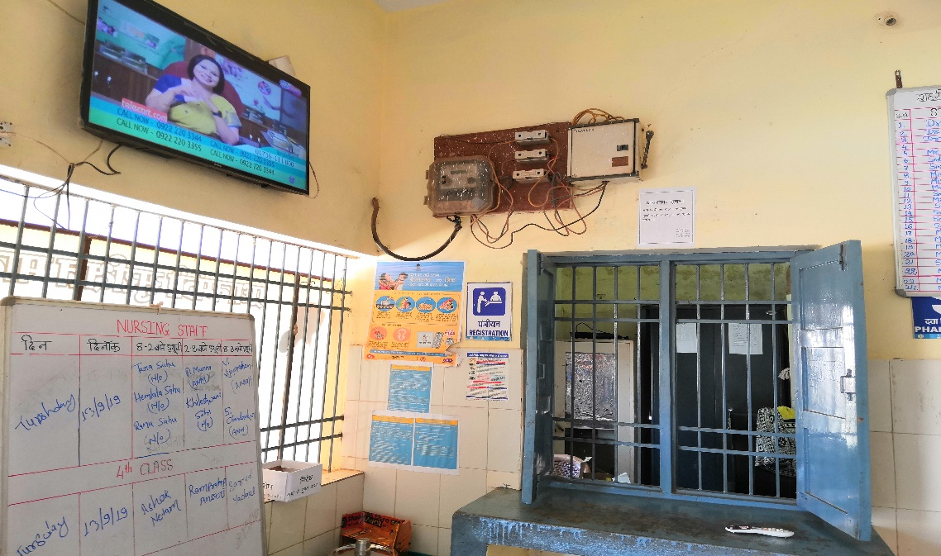
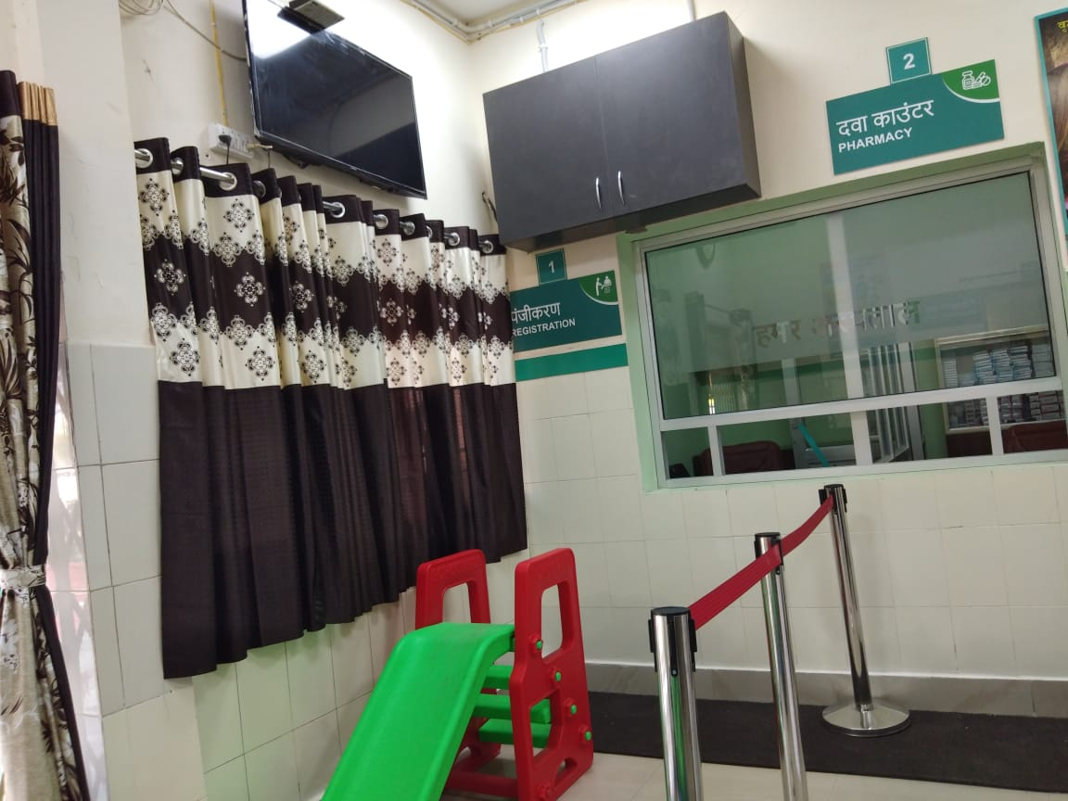
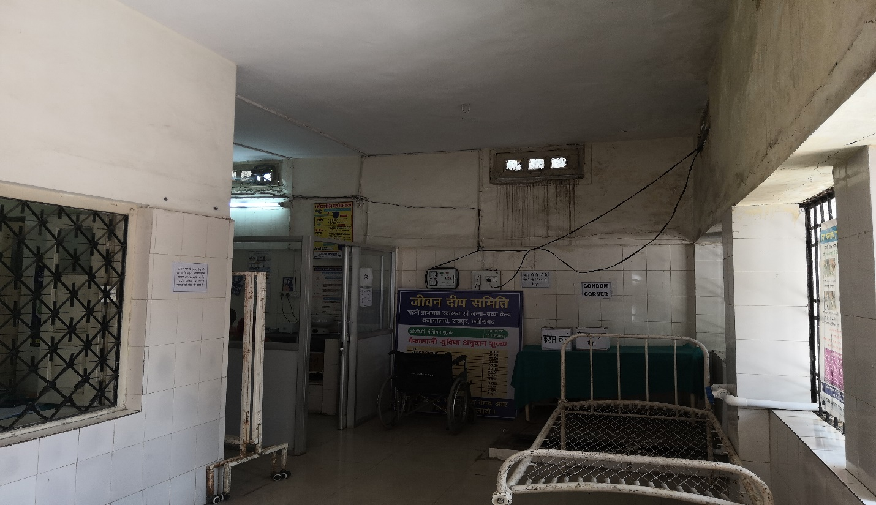
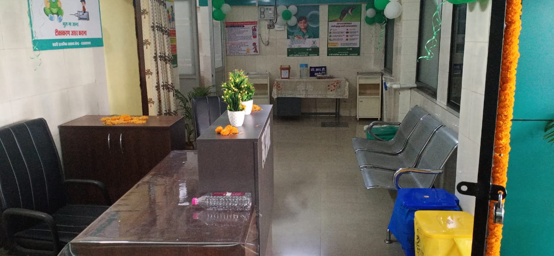
Registration
Before
After
After
Waiting
area

Slide 20
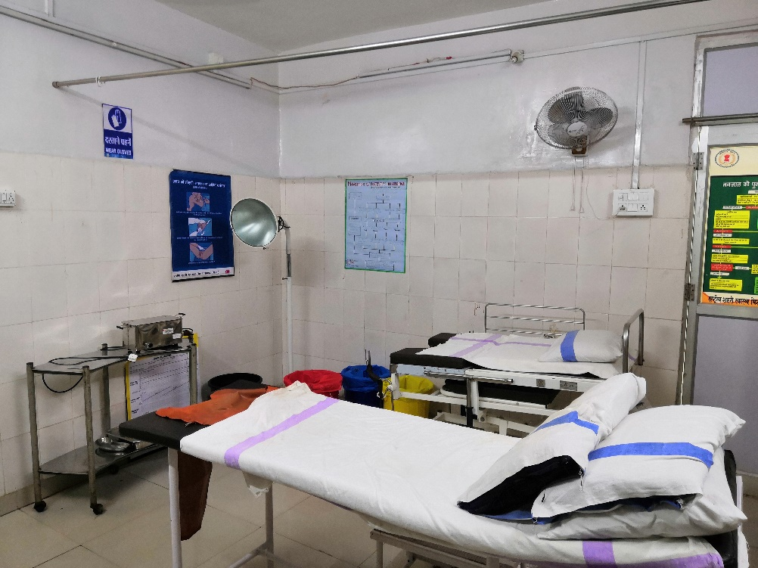
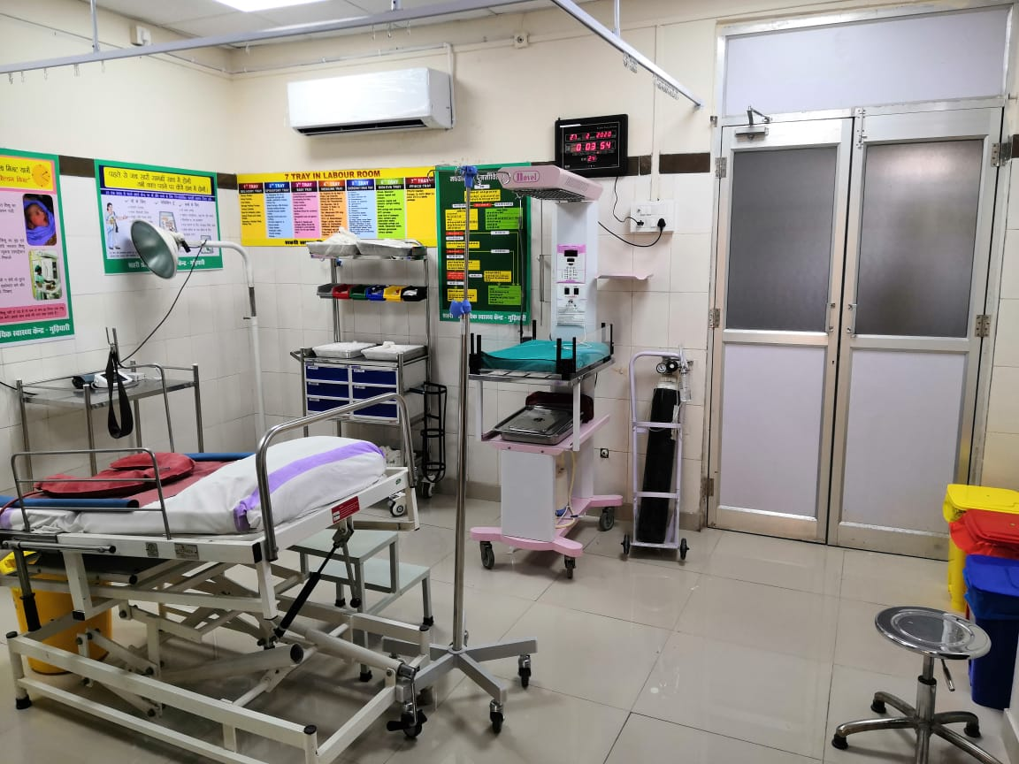
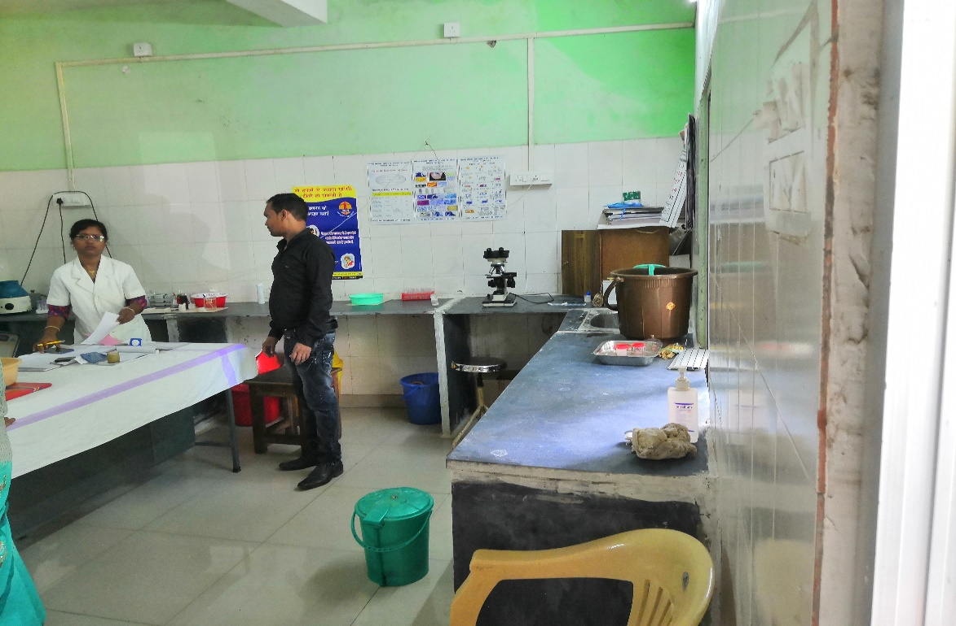
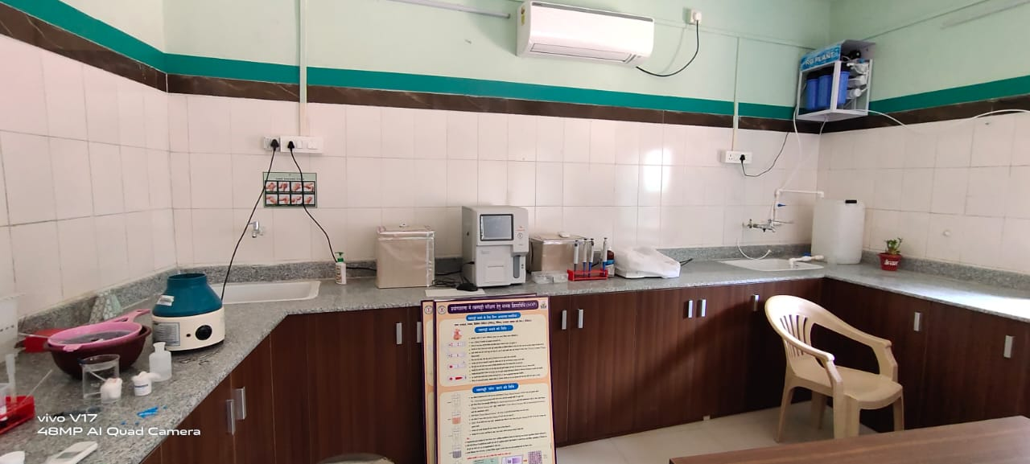
Labor
Room
Before
After
Laboratory

Slide 21
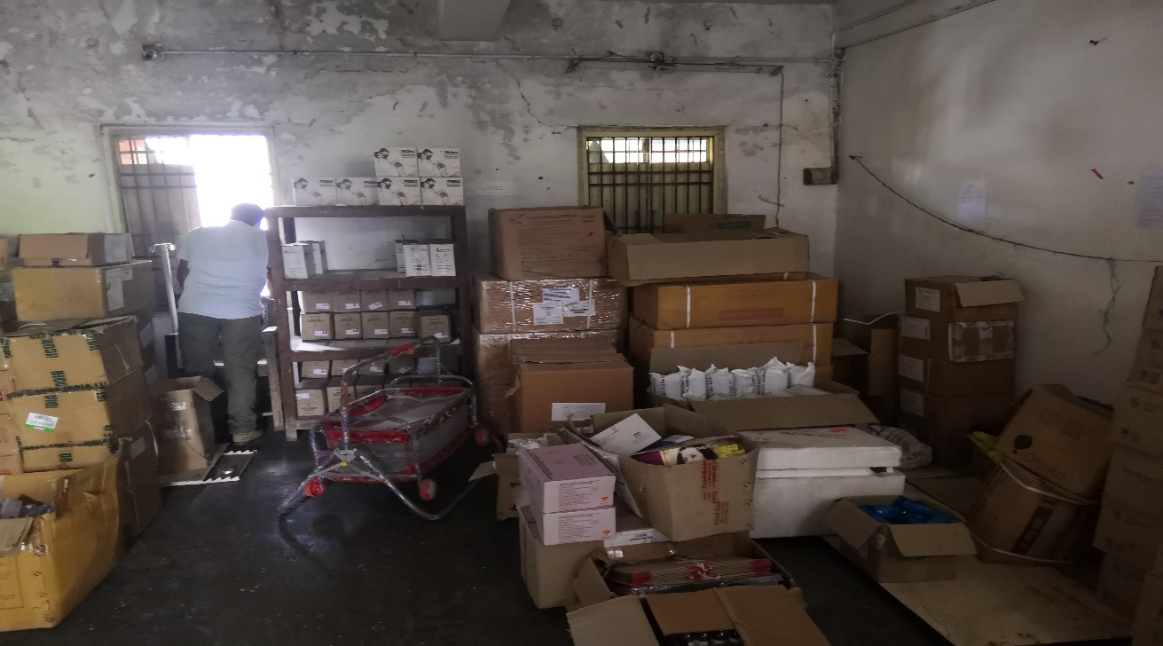
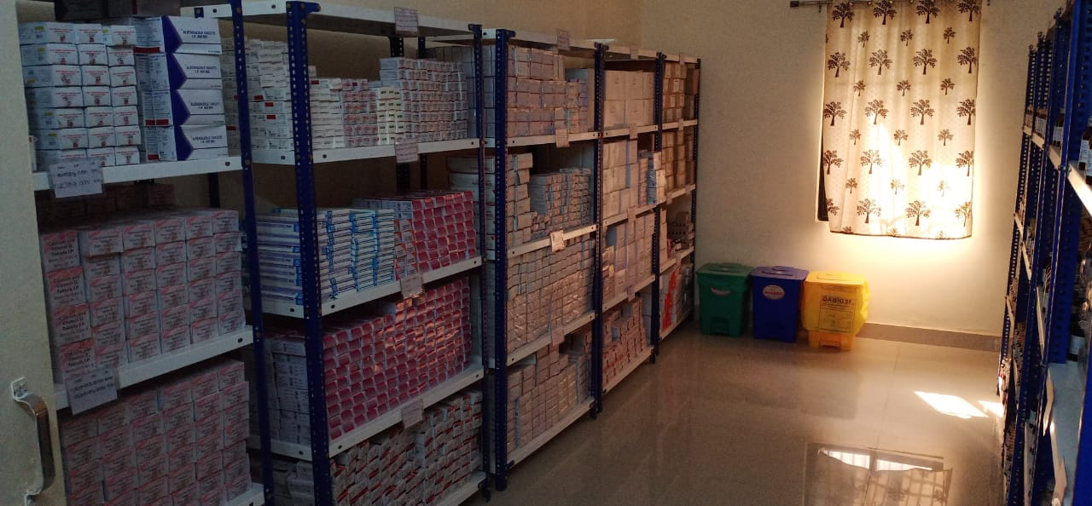
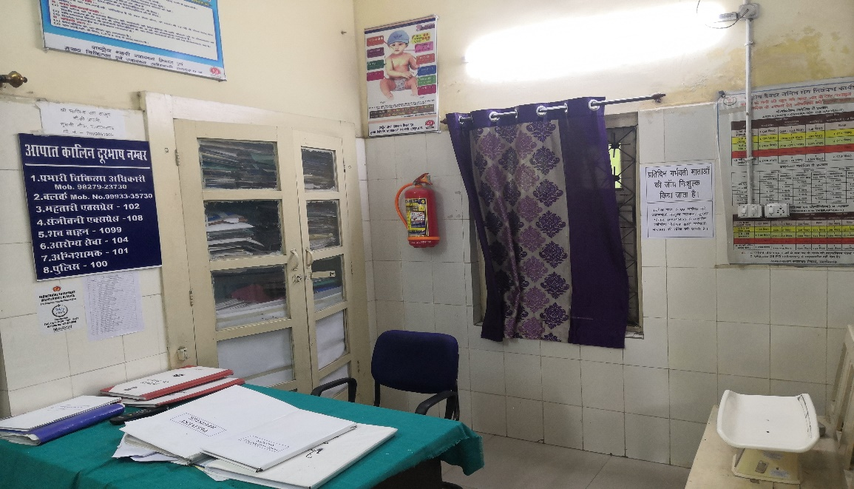
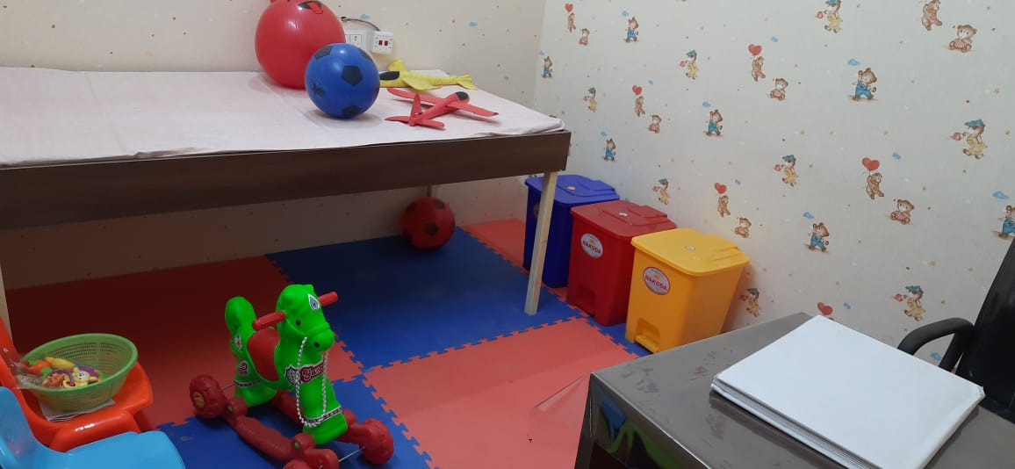
Drug Store
Before
Immunization
After

Slide 22
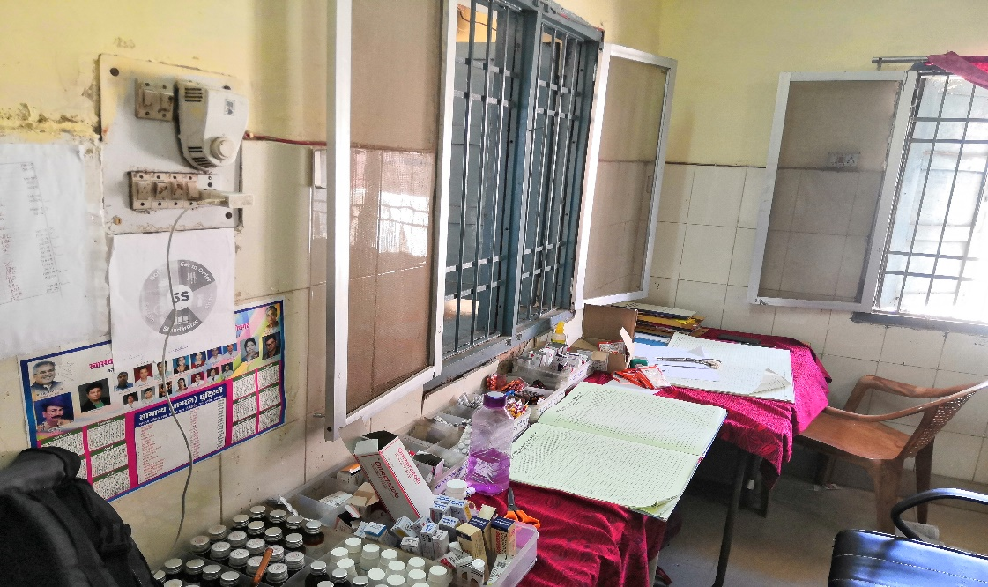
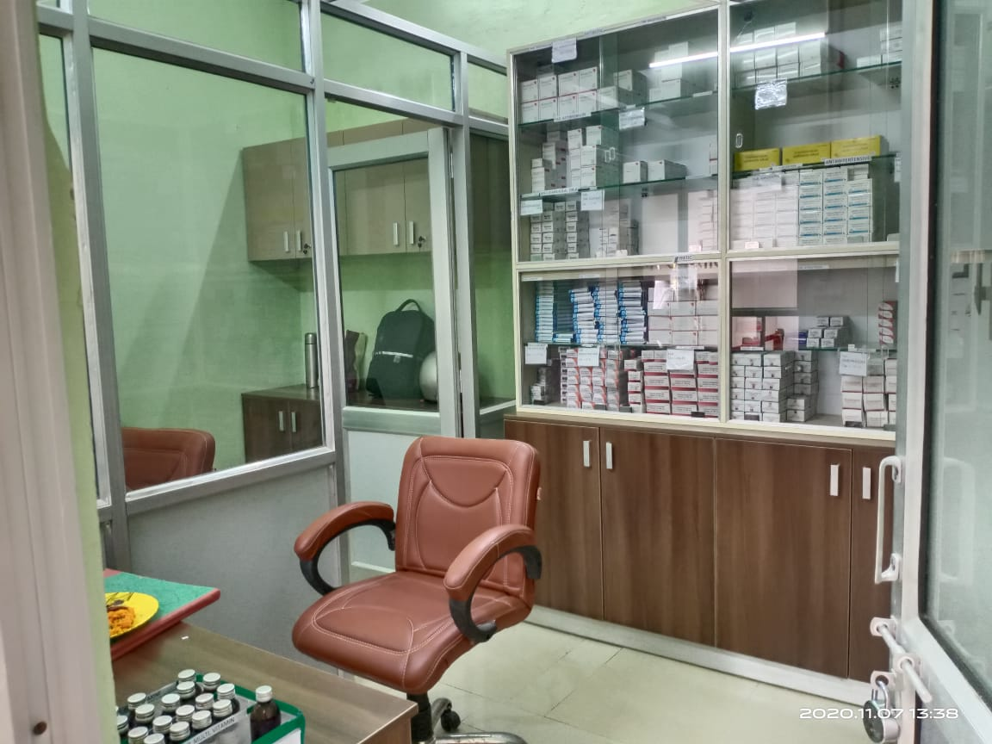
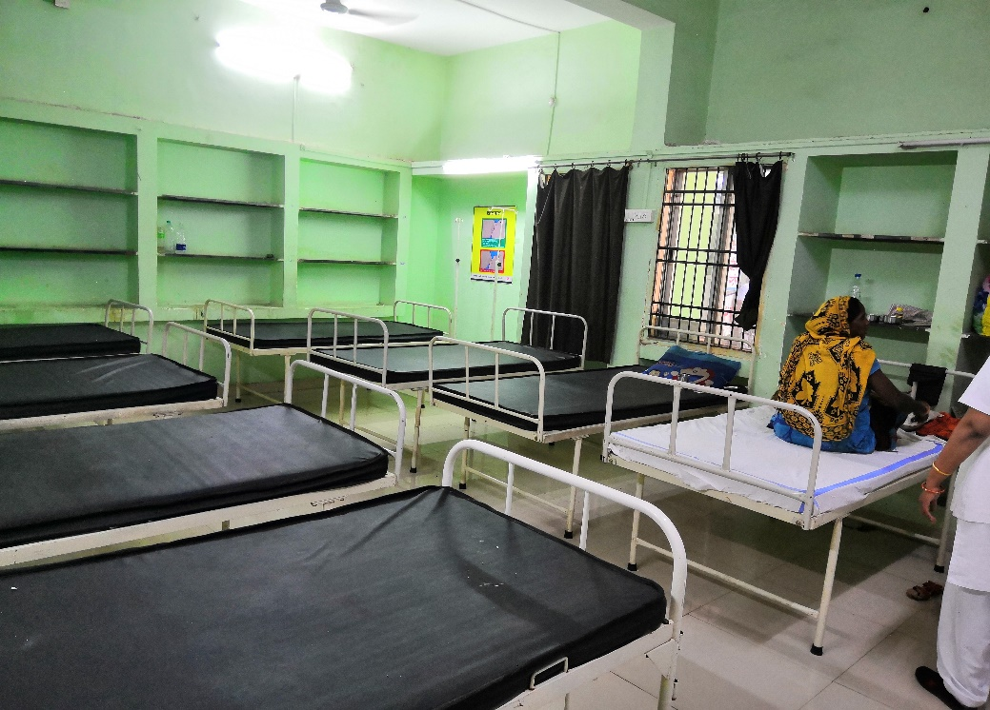
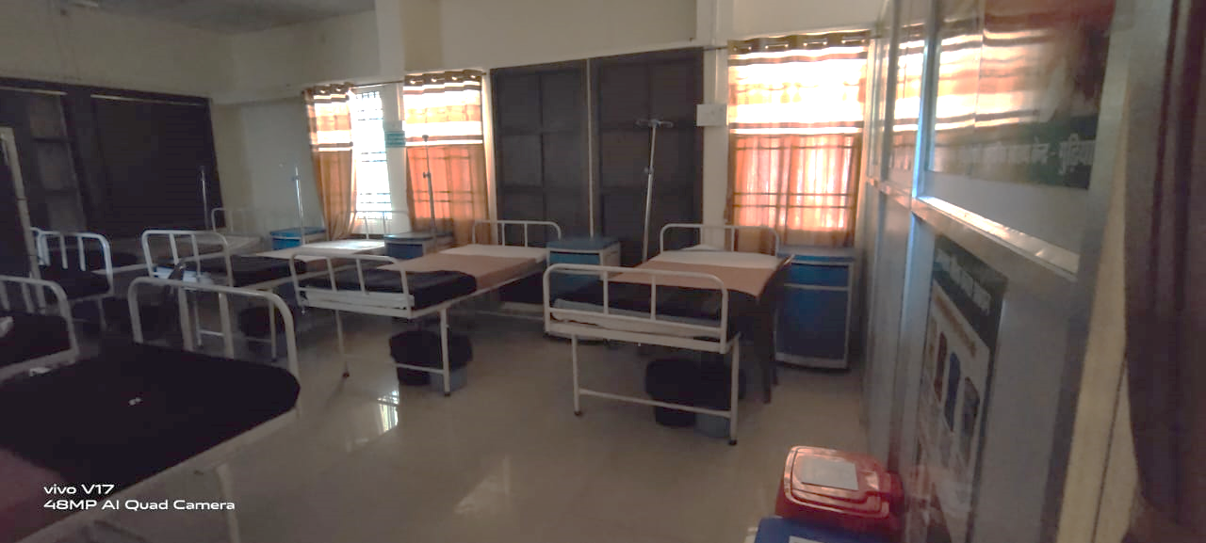
Drug
Dispensing
After
Before
IPD

Slide 23
THANK YOU

