Slide 1
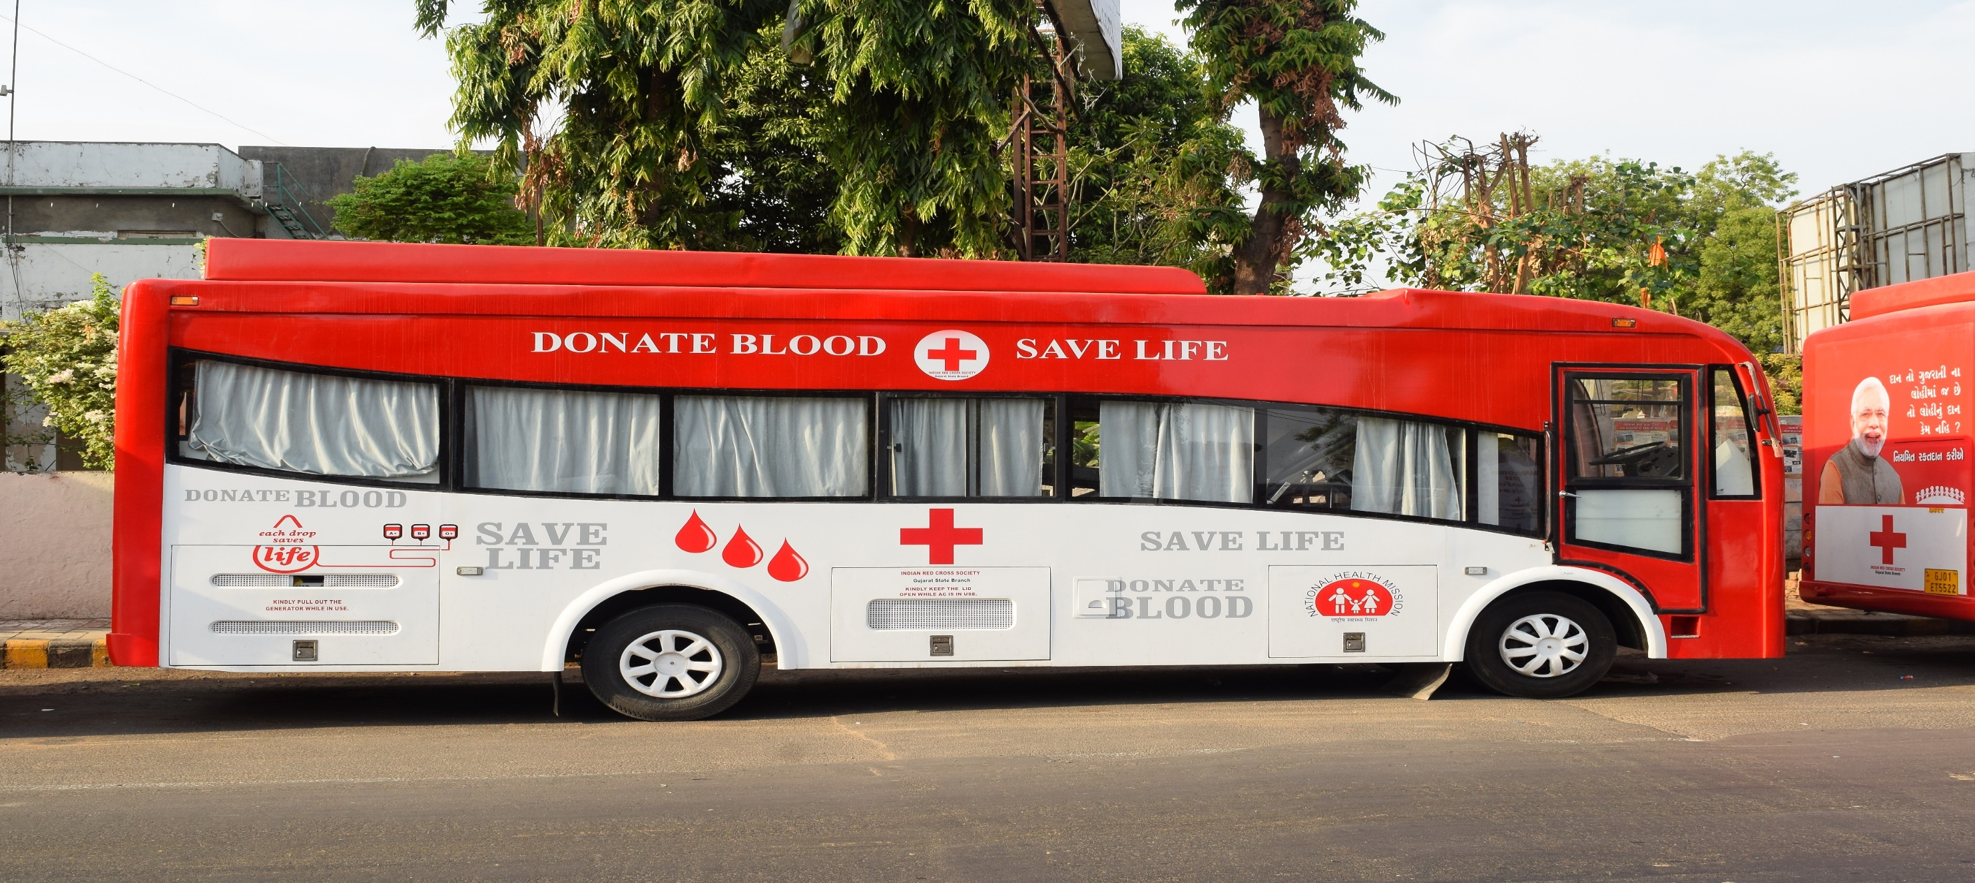
BLOOD COLLECTION MOBILE VANS
Supported by
NATIONAL HEALTH MISSION
Government of India & Government of Gujarat
DR. GAURAV DAHIYA IAS
MISSION DIRECTOR
NATIONAL HEALTH MISSION, GUJARAT

Slide 2
Mission & Vision
Gujrat state Government and Indian Red Cross Society,
is Committed
to ensure availability and accessibility of safe and adequate blood and blood products in the Gujarat.

Slide 3
Background Note
Access to blood in rural areas of India is very difficult due to continued neglect of the blood banking services.
Due to high level of illiteracy, poverty and superstition, very few people are ready to donate blood in rural India.
The potential of augmenting blood through voluntary blood donation camps has not been fully exploited by states, which is only 40%of total collected units
Requirement in some of the states is 2% of the population due to Medical tourism in the states. To facilitate voluntary blood donation, support under NHM is being provided for strengthening blood services including for blood Mobile-blood collection and transportation vans with dedicated manpower to augment availability of blood through Voluntary blood donation.

Slide 4
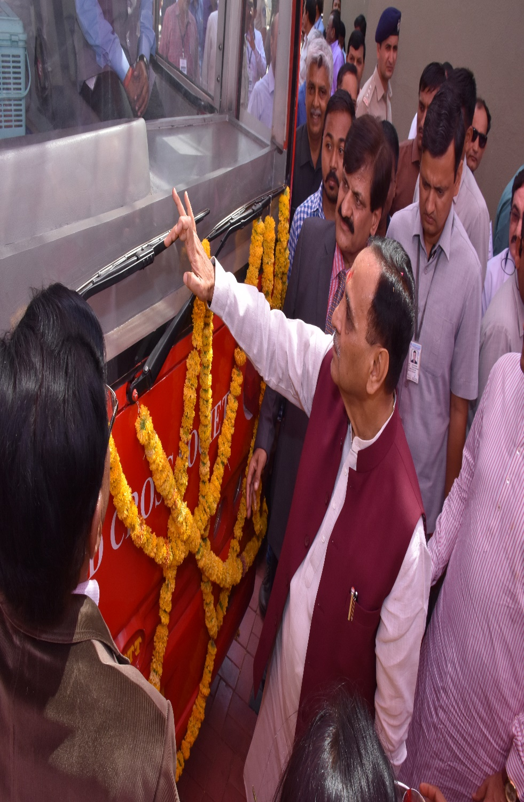
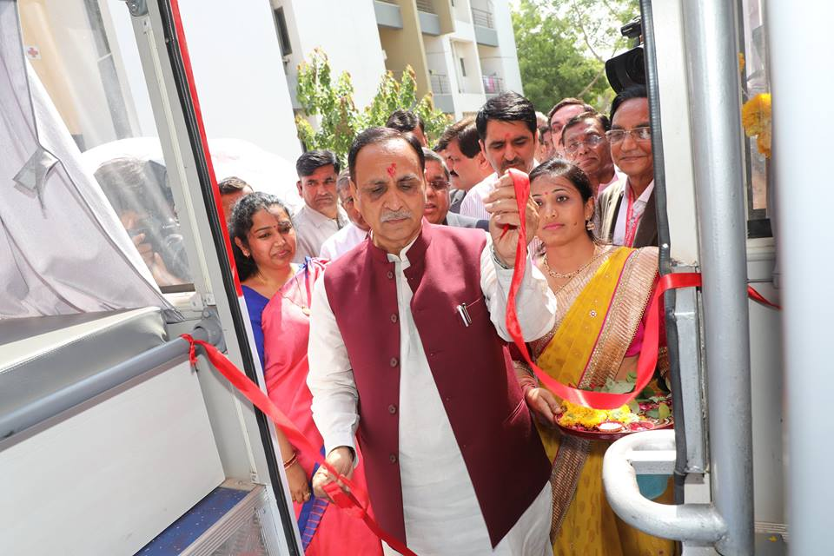
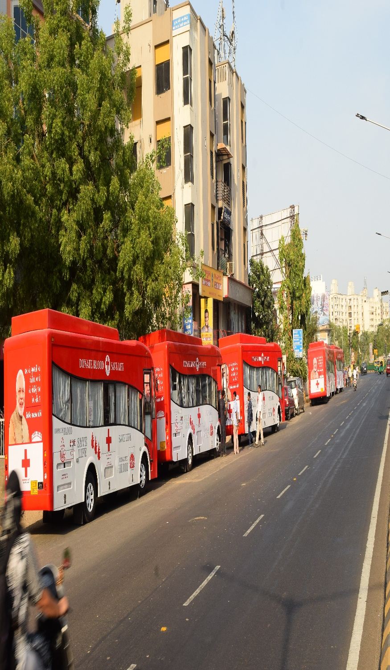
Hon’ble Chief Minister of Gujarat Shri Vijay Rupani has inaugurated and flag offed mobile vans

Slide 5
Support for the BLOOD SERVICES through IRCS
16 Blood Banks run by different District and Taluka Branches of Red Cross.
Last year’s (2017-18) total collection was : 159755
Voluntary blood collections : 94.92%
No. of Blood donation camps organized : 3024
No. of units collected through camps : 107390
% of blood units collected through camps : 67.22 %
No. of units collected through mobile vans : 44197
No. of units issued to patients : 213877
No. of units provided free of charge to thalassemic : 12809
No. of units provided to the needy poor patients : 7776
Total units provided at free of charges : 20585 (13%)
No. of units provided at subsidized charges : All blood banks charging Rs. 600 to Rs. 1100 instead of Rs. 1450 (NBTC guidelines) . Blood for thalassemia, sickle and other blood disorders its free and without replacement

Slide 6
Performance of blood banks improved due to mobile vans
Sr. No. | Year | Total Blood Collection | % of Voluntary Blood Donation | NO. of Camp organized | Units collected through camps | % of camp through collection | No. of units issued to patients
01 | 2016-17 | 152700 | 92.95 | 2124 | 102325 | 64.24 | 209821
02 | 2017-18 | 159755 | 94.92 | 3024 | 107390 | 67.22 | 213877
03 | 2018-19 (April to Sept.) | 78922 | 95.91 | 1339 | 56174 | 71.20 | 101263
No. of outdoor blood donation camps increased.
No. of blood units collected through camps increased.
% of camps through collection against total collected increased which is higher than state and national average.

Slide 7
Impact on blood services due to mobile vans
voluntary blood donation increased.
Awareness on voluntary blood donation increased due to promotion on VBD as well as grouping camps through mobile vans.
It makes easy to organise smaller camps in rural areas too.
The availability and accessibility of safe blood ensured due to mobile vans.
It has ensured availability and accessibility in tribal areas liked Dahod, Godhra, Navsari, Tapi, Bharuch and Narmada etc.
Ensured availability and accessibility of safe blood at blood storage centres at FRUs.
It become helpful to reduce maternal mortality due to availability and accessibility of blood.
Ensured availability of safe blood where no Govt. Blood Bank in the districts like Dahod, Tapi, Navsari, Bharuch, Narmada, Anand, Kheda and Amreli.
It will became helpful to organized camps in all the social and religious events, i.e. birthday to Besana.

Slide 8
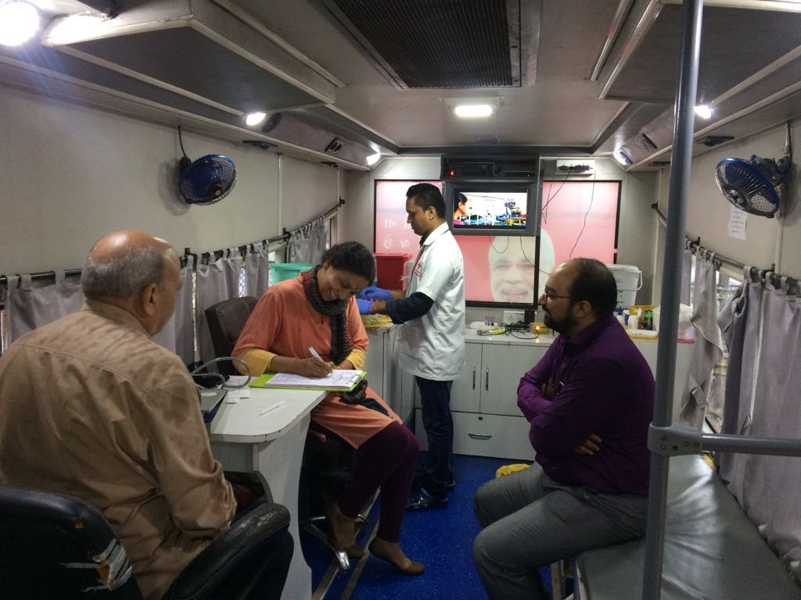
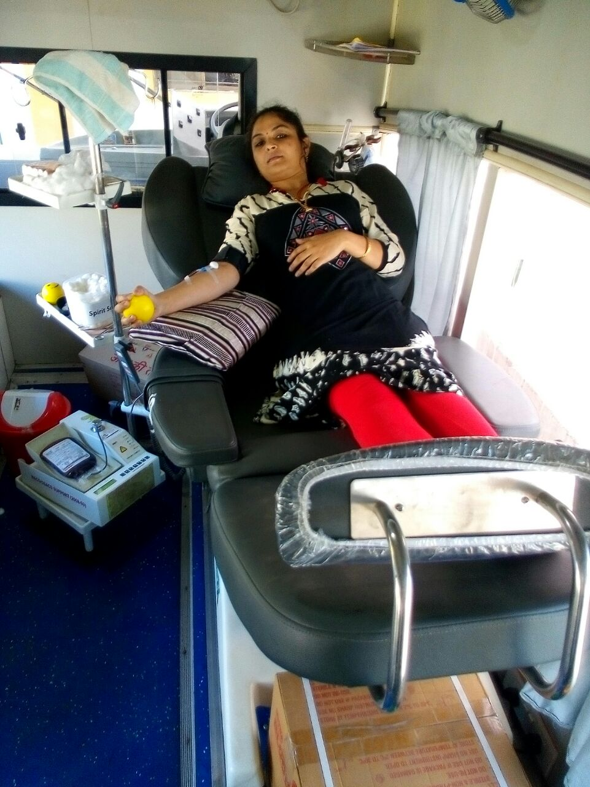
Dr. Jayanti S. Ravi, IAS
Principal Secretary, (PH & FW) and
Commissioner (H, MS, ME & R) is filling donor form in a camp organized on her birthday.
College youths motivating to donate blood in mobile van

Slide 9
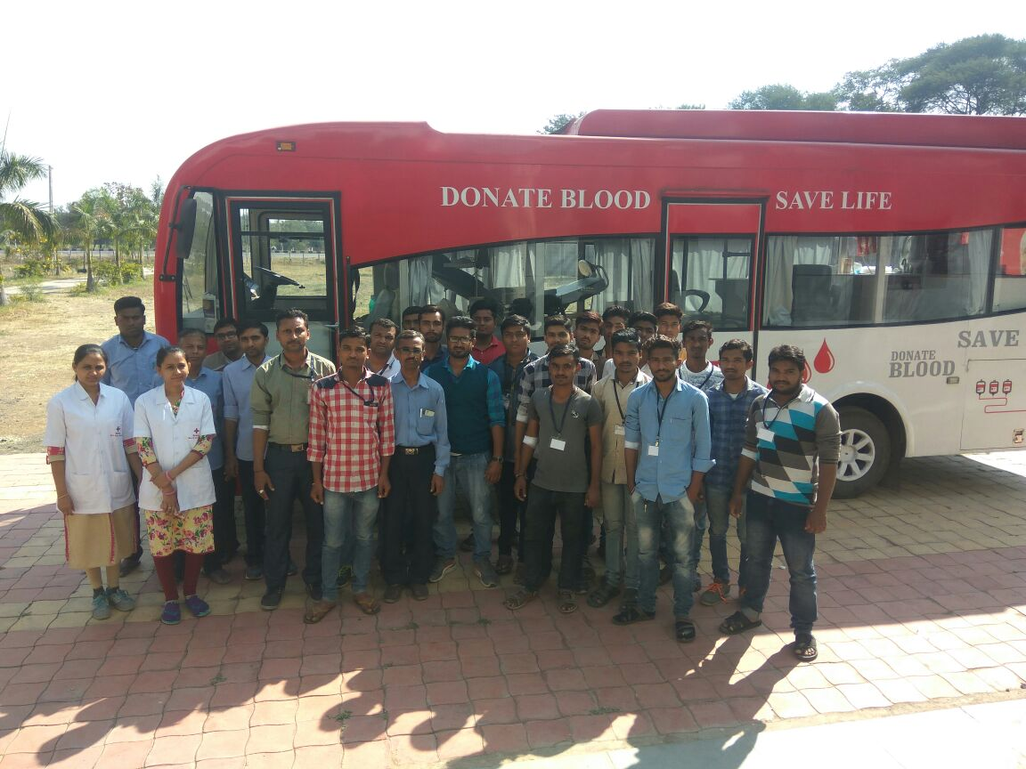
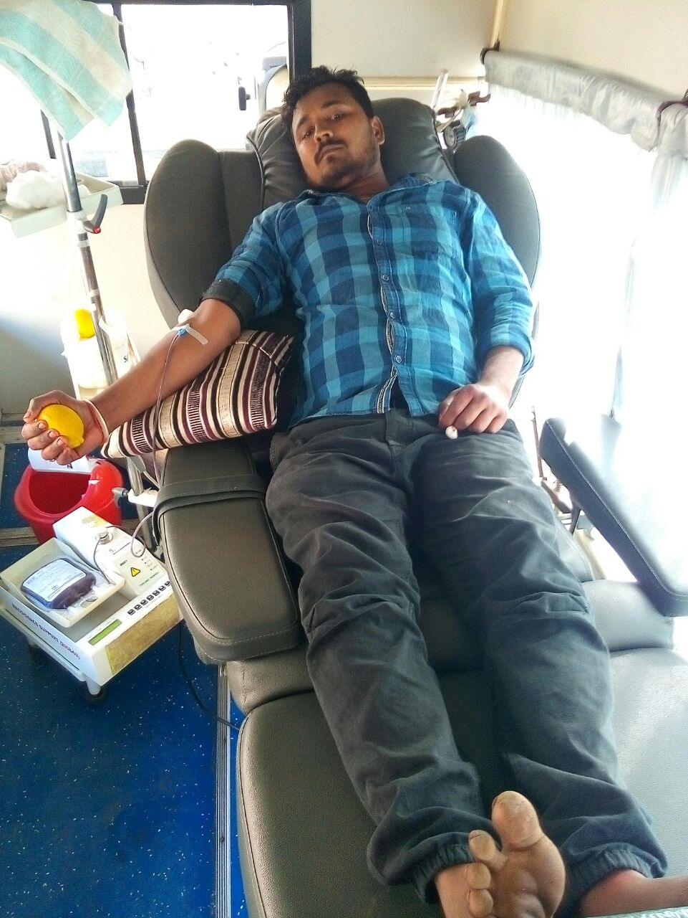
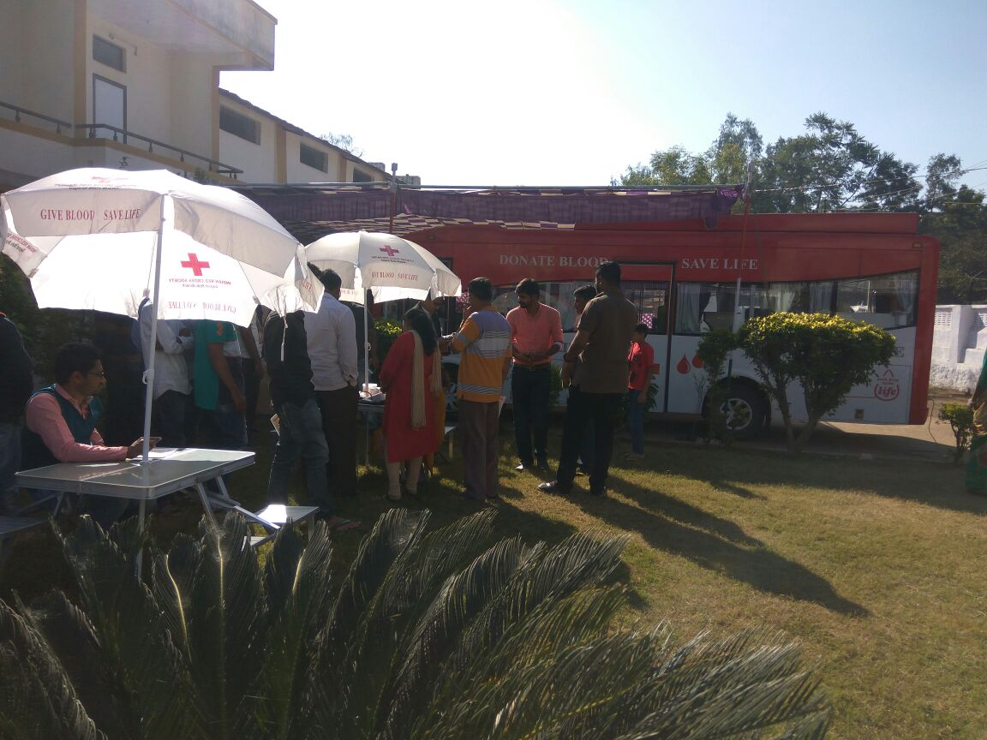
Mobile van becomes attraction for villagers and hence, voluntary blood donation as well as awareness on blood donation has been increasing in rural areas.

Slide 10
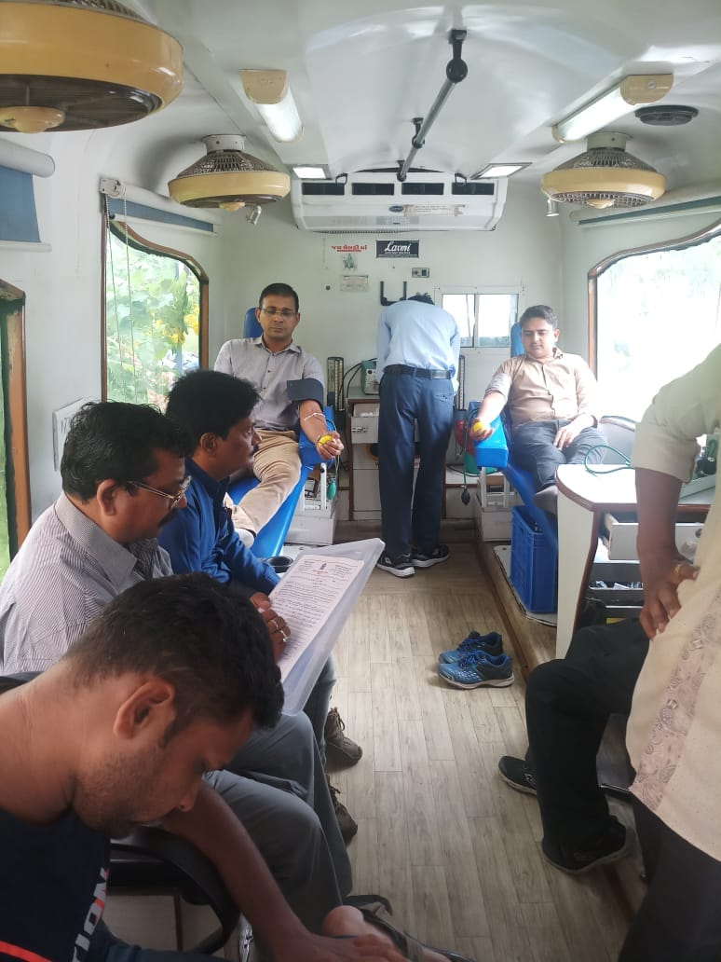
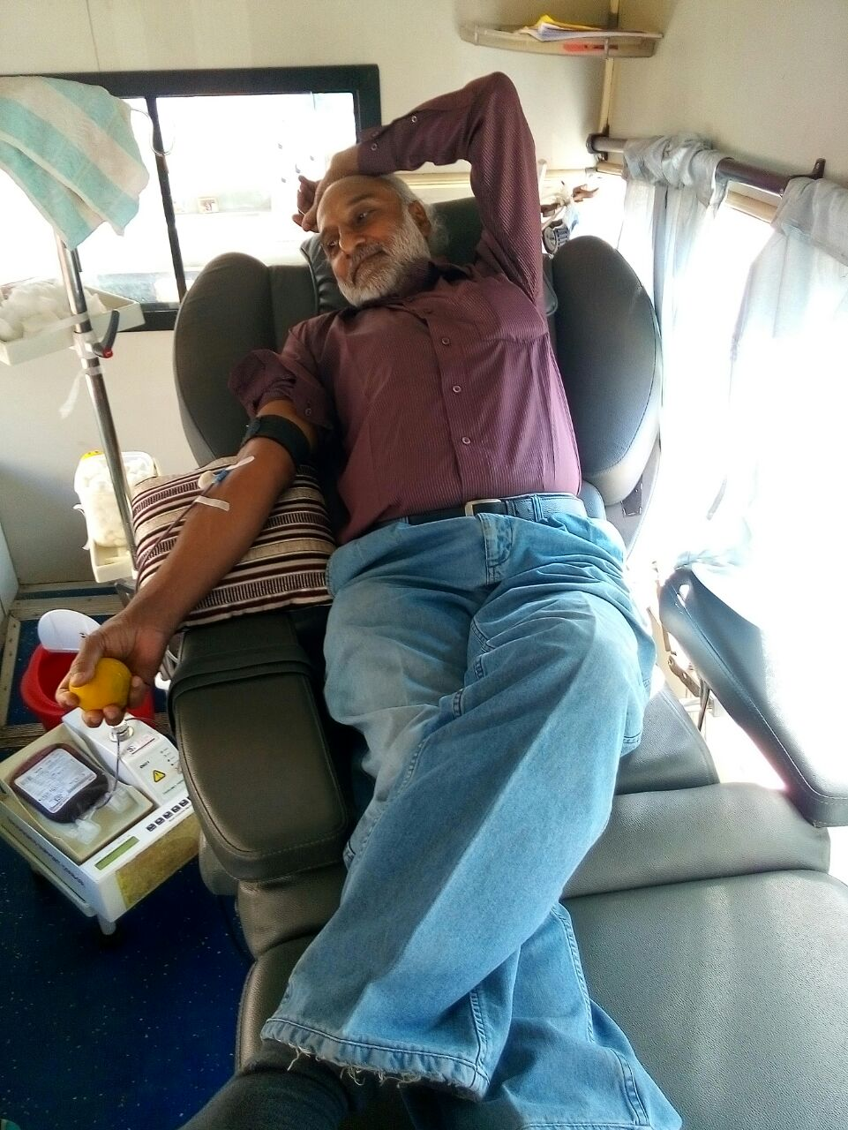
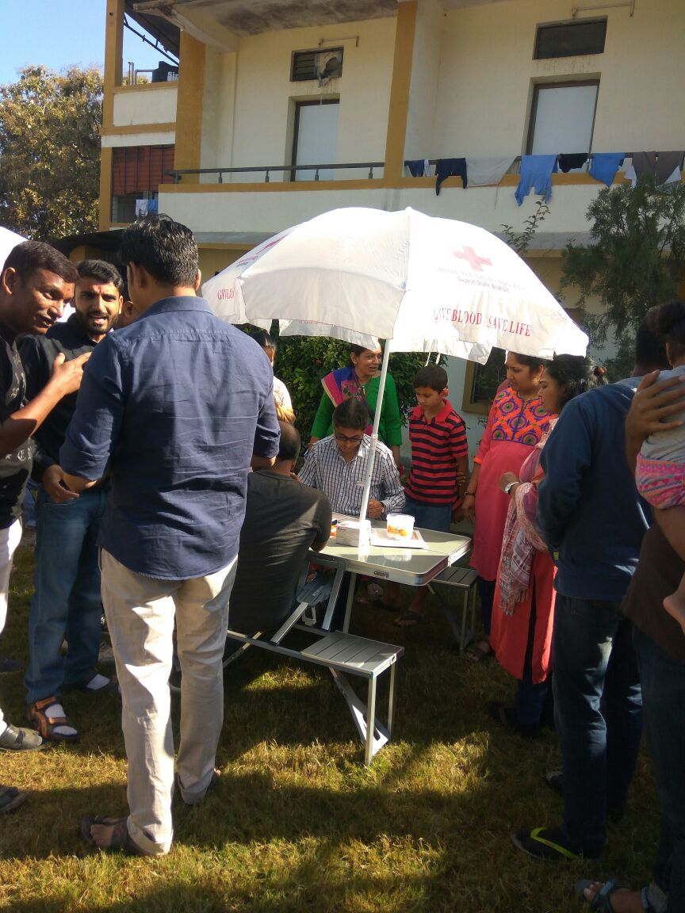
Blood donation camp organized at workplace where employees could donate blood in a pleasant atmosphere like blood bank due to mobile van

Slide 11
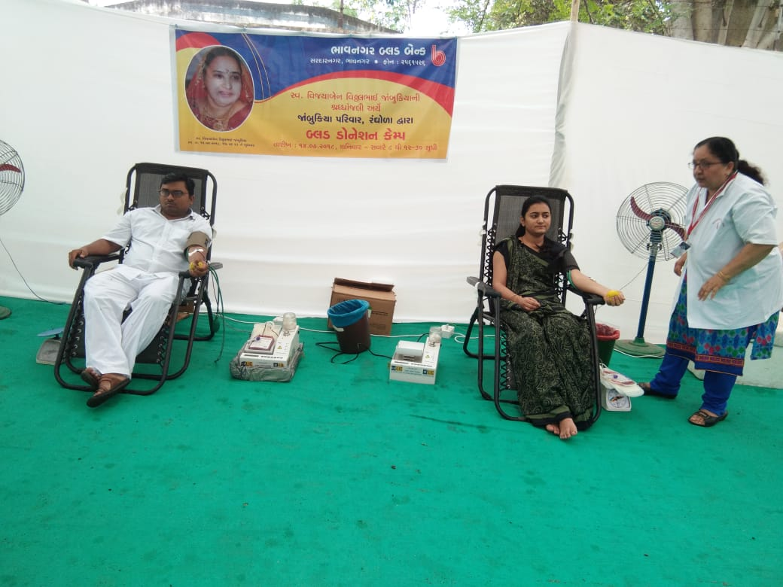
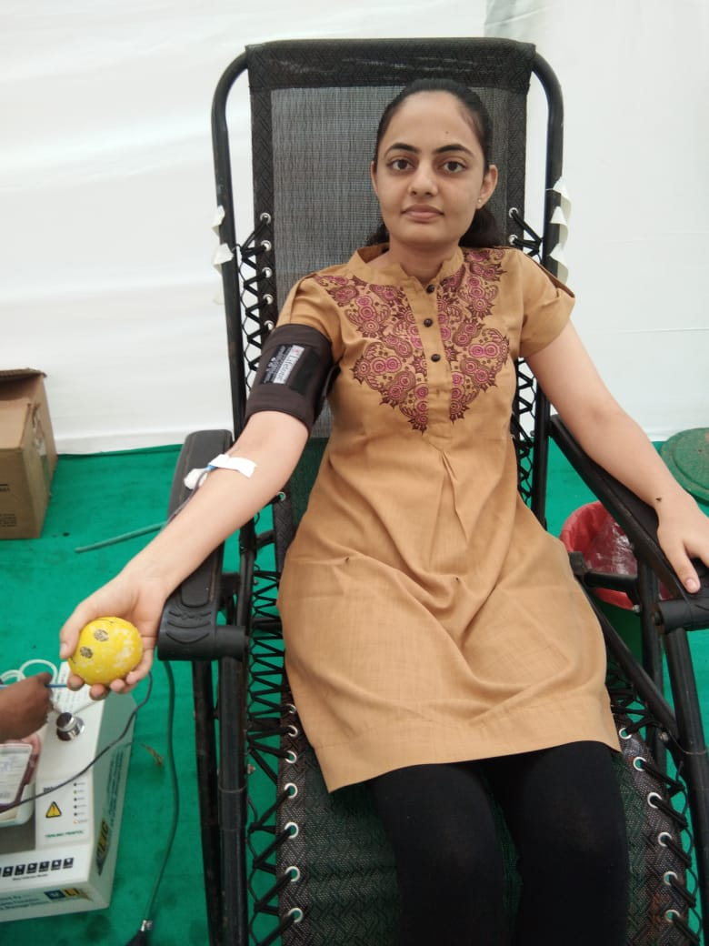
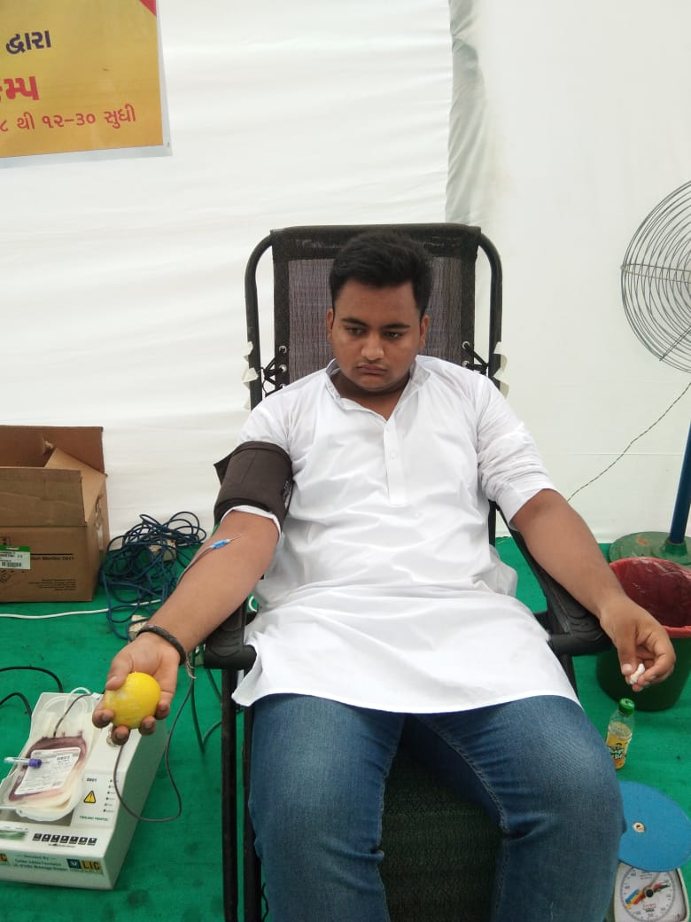
Blood donation camp organized in a “Besana”(Prayers on demises of relative) in a small village

Slide 12
THANK YOU

