Slide 1
W e s t B e n g a l USSD Implementation

Slide 2
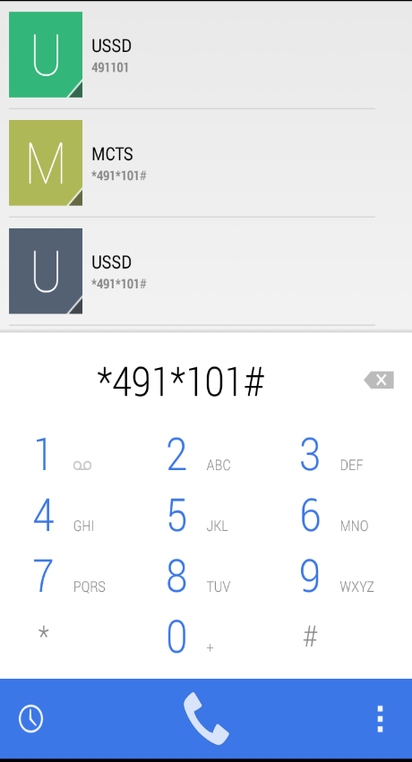
Unstructured Supplementary Service Data (USSD)
USSD is a Global System for Mobile (GSM) technology that is used to send text through an application program.
Technology
GSM technology is used to send text between a mobile user & apps in the network
Length of USSD messages are up to 160 alphanumeric characters for English and &about 70 characters in local language
Similar to SMS, but USSD transactions occur during the session only
The connection remains open, allowing a two-way exchange of a sequence of data
Enables session based communication between application server at the network side and the mobile user
The messages sent over USSD are not defined by any standardization body

Slide 3
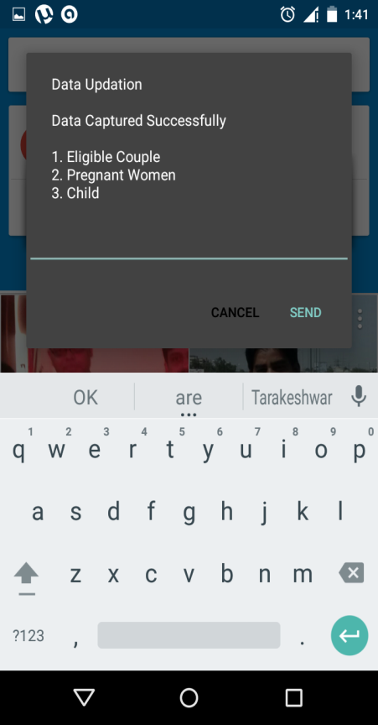
Benefits
Reduces time lag
Improves data quality & ownership
Timely updates of delivered services
Generation & distribution of updated work plans
Better monitoring & micro planning

Slide 4
Key Features
This is a Toll free service, i.e. there are no charges for this service
Works currently only on AIRTEL/ IDEA / TATA / BSNL / VODAFONE GSM SIM (Prepaid or Postpaid)
30 seconds for sending each response; session time 3 minutes
If response is not received in 30 seconds the USSD session is disconnected
Currently supports HINDI & ENGLISH - depends on Mobile Phone’s language support capability.

Slide 5
Roles & Responsibilities
ANM
ASHA
Verify the work plan / services due list.
Providing services in time to beneficiaries as per due list / work plan
Maintaining of MCTS / Integrated RCH register.
Updating service delivery records by using USSD.
Identification of beneficiary.
Facilitating ANM in providing of due services to beneficiary in time.
Motivate beneficiary to availing due services in time.
District / Block Officials
Timely delivery of work plan to ANM.
Universal registration & data updation.
Training ANMs and guiding them on real time data updates.
Addressing challenges
Verification to ensure registration & updating of services delivered

Slide 6
The scenario before…
Data reached Block office once a month in hard copy
Poor internet connectivity resulted in huge entry backlog
Entry of data at Block Level only by DEOs
The work plan generated by the MCTS system was outdated

Slide 7
Steps to the Rollout
Reward for best performing ANM
Rolled out all over the State
Real time hand holding
Daily
Progress Monitoring at each level
Launch across the State in pulse mode
Articulation of specific roles & responsibilities
Organizing hands-on-training for ANMs

Slide 8
Works currently on AIRTEL / TATA (GSM) / BSNL / Idea / Vodafone SIM (Prepaid or Post Paid) – ANMs had varying service providers
ANM with BSNL connections had problems in updating services
Most of the ANMs were unable to use mobile phones for USSD
Key challenges

Slide 9
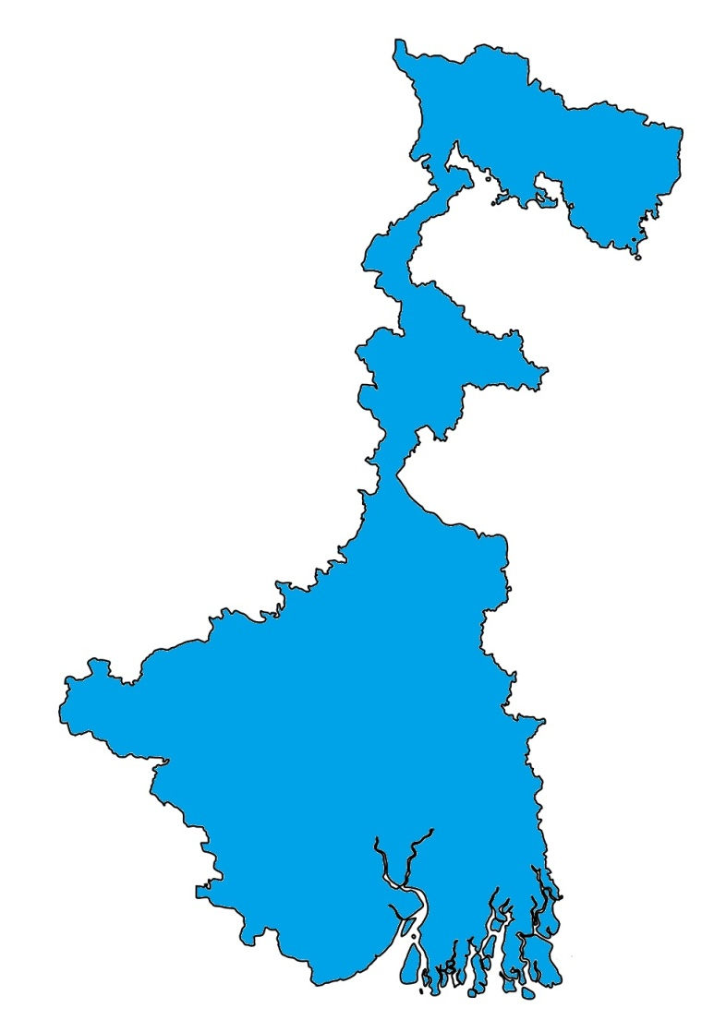
Coverage
Launched : Sept, 2014
Rural population covered : 6.21 Cr.
Districts covered : 26
SubCentres covered : 10368
ANM Registered : 18,775
ANM Subscribed : 18,364
ANM Locked : 16,361

Slide 10
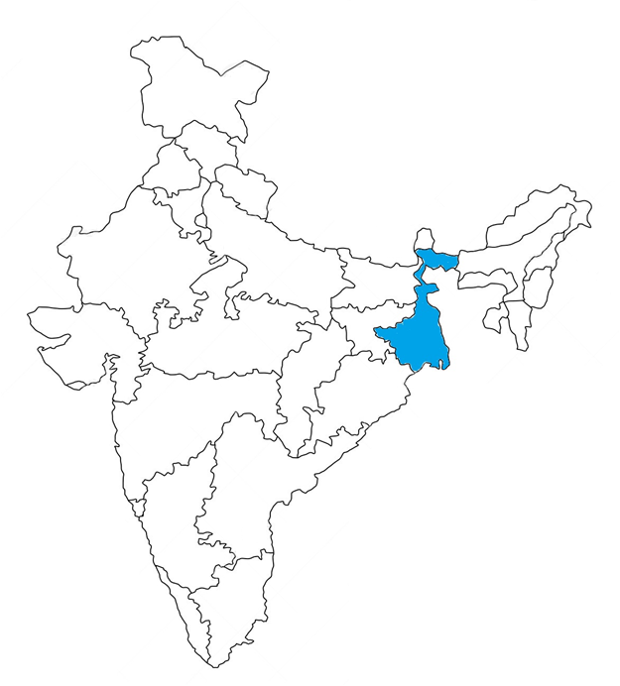
Achievements in West Bengal
PW Services updated
19,67,297
(76.4%)
Child Services updated
35,77,179
(69.0%)
The % of service update is against the total services updated across the country

Slide 11
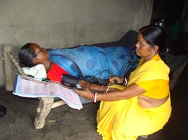
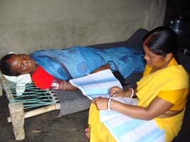
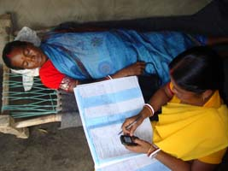
SHIBANI MURMU, an ANM of Purulia District using USSD after 4th ANC at home

Slide 12
Way forward..
Use of USSD by 100% of ANMs
Generation & use of real time work-plans & due lists
Monitoring, supervision & follow up of all MCH services using only MCTS data by Sept, 2015

Slide 14
A documentary on MCTS:USSD
Documentary on MCTS_USSD_MQ.mp4
Documentary on MCTS_USSD_BQ.mp4

