Slide 1
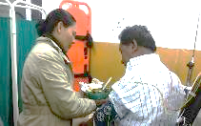
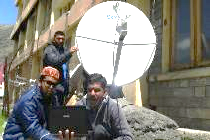
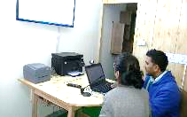
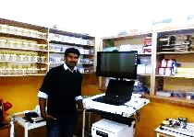
National Summit on Best Practices in National Health Mission
SHIMLA
3rd July 2015
Himachal Pradesh
Tele Medicine Project
A Public Private Partnership Innovation

Slide 2
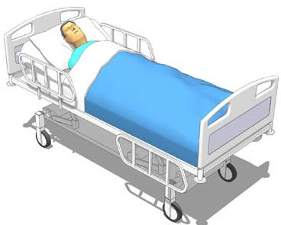
On 26th of May 2015, Mohit was brought to Regional Hospital Keylong with acute chest pain.
He was about to be referred to Kullu Zonal Hospital as is the case with most of the patients with acute chest pain.
However, the Chief Medical Officer, thought of consulting Tele Emergency Doctors before referring Mohit to Kullu. Set up of the Tele Emergency room was completed just a day before arrival of the patient. In Less than 10 minutes, emergency interventionist was available over the Tele-emergency system. He suggested the emergency nurse to connect the patient to remote diagnostic kit to monitor patients vitals in real time. After initial assessment of Circulation Airway Breathing, ECG, CBG, he was diagnosed with unstable angina. Pre Medications were administered as advised by the interventionist, to stabilize the patient.
After overnight monitoring, Mohit moved back home and was advised to take a specialist consultation with a cardiologist. Due to tele-presence of Emergency Interventionist and basic life support medicines Mohit, didn’t travel all the way to Kullu as a referral patient saving precious time and exchequers money. Most importantly, 26th May, renewed his faith in the district’s hospital.
Mohit Singh (name changed for patient privacy), a resident of Sansha village of Lahul Block in Lahul and Spiti District. He is 49. He is the sole breadwinner in his family.
Notes:
CBG- capillary blood glucose, Asprin & Sublingual Nitrate

Slide 3
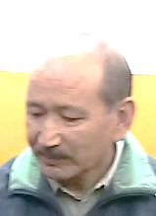
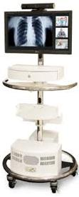
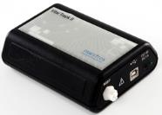
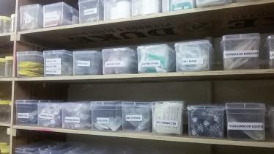
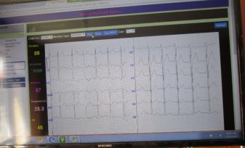
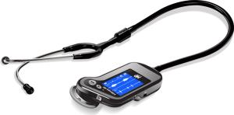
What saved the day for Mohit?
Availability of tele emergency interventionist in 10 minutes of request being made.
Quick decision making by the CMO
Availability of Life Support Medicines in the Hospital
Continuous monitoring of patient vitals from emergency interventionists at remote end
This is Tele Medicine 2.0 : Enabling Remote Healthcare much beyond CMEs and Tele-Consultations.

Slide 4
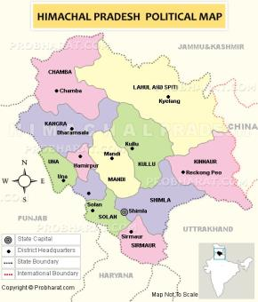
The State of Himachal Pradesh- The High Altitude Regions
The word Himachal means the land of the snows. The rural part of the State is an untouched natural beauty comprising of forests, rivers, valleys, hills and is rich in natural resources.
Key Indicators | Himachal Pradesh | India
Total Population | 6.8 mn | 1210.8 mn
Density of Population | 123 | 385
Rural Population | 90% (least urbanized state in India) | 65%
Literacy Rate | 82.80% | 74.04%
Per capita income | INR 83899/- | INR 68748/-
Ranks 3rd among Indian states in terms of HDI after Kerala and Delhi and above Goa & Punjab
The Total Fertility Rate of the State is 1.7. The Infant Mortality Rate is 35.(2.4 and 40 in case of pan India figures)
However due to geographical remoteness access to specialty healthcare facilities is limited to a certain pockets of the state.
Human Development Index
Delhi
Kerala
Himachal Pradesh
Goa
Source: NRHM India, Census of India, Economic Survey-HP, UNDP, Business Standard
Notes:
Total Population and Literacy, TFR and IMR: http://nrhm.gov.in/nrhm-in-state/state-wise-information/himachal-pradesh.html
Density HP: http://censusindia.gov.in/2011census/censusinfodashboard/stock/profiles/en/IND002_Himachal%20Pradesh.pdf
Density India: http://censusindia.gov.in/2011-prov-results/data_files/india/Final_PPT_2011chapter7.pdf
Per Capita HP: Economic Survey 2013-14 Himachal Pradesh, Page2
Per Capita India: http://www.business-standard.com/article/economy-policy/india-s-per-capita-income-rises-to-rs-5-729-per-month-113020700995_1.html
Rural Population: http://censusindia.gov.in/2011census/censusinfodashboard/stock/profiles/en/IND002_Himachal%20Pradesh.pdf
HDI: http://www.undp.org/content/dam/india/docs/inequality_adjusted_human_development_index_for_indias_state1.pdf

Slide 5
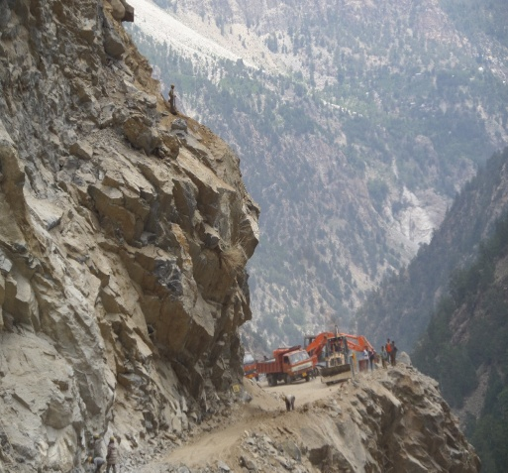
Genesis of the Himachal Pradesh- Tele Health Services
The District of Lahaul and Spiti faces harshest winters, with temperatures dropping up to minus 40⁰ Celsius.
Is terrestrially inaccessible for more than 6 months in a year.
Movement within the district is virtually impossible for these months due to excessive snow and road blockages.
Availability of doctors who can adapt to such climate, transport of medicines and other life support items are also challenge.

Slide 6
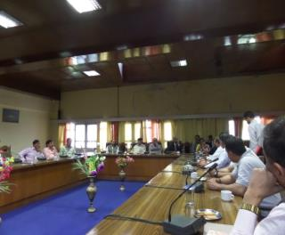
The Conceptualizing the HP-THS Program
Find Solutions with in the Government Health Systems
Enable Telemedicine between Government Health Systems
Mobilize Specialist Doctors and post them during Winter
Innovate & Think out of the Box- Public Private Partnership
Create a Delivery Assurance based PPP framework
Possible Turnkey Solution end to end on Program Management approach
Evolving Technology and Requirement of Specialist in Telemedicine systems
Provide Funding and Incentives for Government Doctors
Government to pay for service delivered and failure of non delivery results in penalties
Stakeholders
Options Available to the State:
National Health Mission- GoI
National Health Mission- GoHP
Apollo Hospitals -Telemedicine

Slide 7
Need Assessment Study and Findings
A feasibility study undertaken by a joint team of ATHS and GoHP before signing MoU
Very low population density in all three districts.
The population is migratory in nature, seeking better quality of life. The younger generation are looking for employment opportunities in metros
People commute 50-120 Kms to access primary care services.
For secondary health care services patients need to travel up to 300 Kms
108 Ambulance services are available in the 3 identified Districts and the Government has provisioned additional ambulance support to transport patients to higher health care facilities within the State during emergencies
CHC at Kaza and Keylong has on an average 150 to 250 outpatient visits per day
Medical officers at the CHCs indicated that a second opinion was required in:
Diabetes, Hypertension, Orthopedics, Obstetrics and Gynecology
Gastritis, Hepatitis-B, Jaundice, Oral Cancer, Arthritis, Eye ailments
Kidney Stone, Psychological counselling
Key Health issues in the Region
Pulmonary diseases-COPD
Tuberculosis
Asthma
Pneumonia
Diarrhoea
Orthopedic related issues

Slide 8
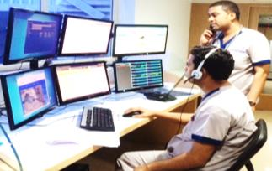
Cost Benefit Analysis
Optimal Solution
Cost
Value
Employing 6 specialist doctors in one Hospital Direct cost to exchequer is 1.44 crore annually.
Tele-Clinic and Tele-Emergency Setup customized to needs of Himachal Pradesh is
1.08 crore (including all assets and services)
At a lower cost, Tele Health project provides access to over 30 specialties and sub specialties for OP consultations in all seven days of the week and 24/7 emergency support for stabilizing patients and community awareness.
PPP model of Tele Health Services focusing on various aspects of Healthcare delivery that seamlessly integrates with the existing system.

Slide 9
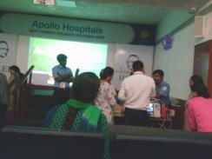
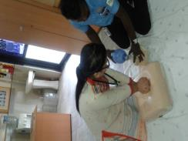
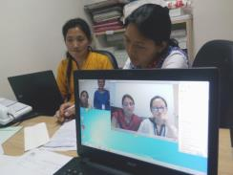
Key Design of the HP- THS Program
Result Based Public Private Partnership Framework:
A single agency for delivering the key scope of work
Technology Solution comprising Connectivity and Software solution
Frontline paramedical workforce directly managed by private sector with required training (Practical and on the job)
Community linkage for sensitising and creating the awareness among the tribal communities about the new Tele Health services
Financial & Administrative Model:
Private sector to provide the required bank guarantee and measurement based payment milestones to Government
Time bound implementation and service activation
Auditable weekly, monthly program MIS
Peer reviewed patient consultation “Quality assurance” system over Electronic medical record

Slide 11
Project Design and Conceptualization
MoU with ATHS signed in January 2015
The scope of work includes innovating healthcare delivery model to improve access to quality multi-specialty health services for over 33 thousand population of one of the remotest districts of India; Lahaul and Spiti ( Keylong and Kaza)
Virtual OPD
Tele-Emergency
Walk in OPs
Scheduled OPs
ATHS is using the Tele-Emergency ICT technology with a combination of well-defined clinical equipment’s and medical protocols to provide this service through the available front line medical officers in the CHCs in their casualty departments.
For all patients for whom the duty doctor at the CHC requires validation and advice from specific specialty or super specialty doctor
For high demand medical care specialties like:
Surgery OP, General Medicine, Obstetrics & Gynecology, Orthopedics, Pediatrics, Dermatology, Pulmonary, ENT etc.

Slide 12
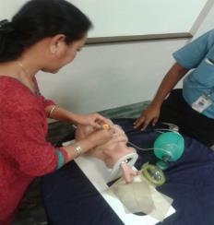
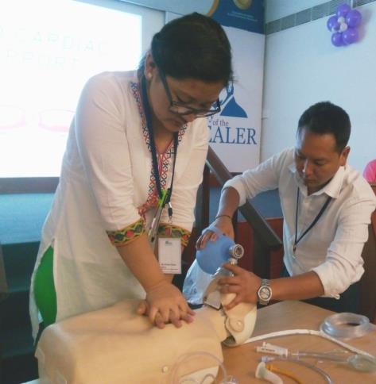
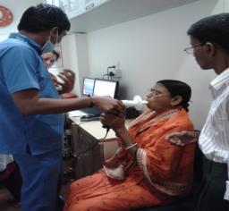
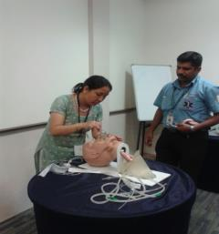
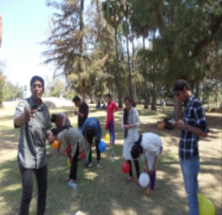
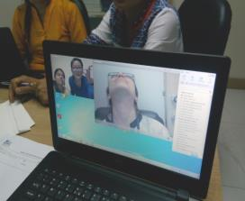
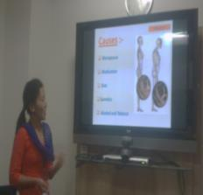
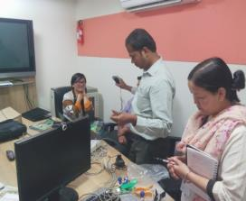
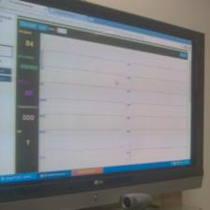
Robust On the Job Training
Field Teams were inducted into the system after 2 months of training in the following areas of operations:
Basics of Telemedicine
Using all the telemedicine equipment
IT training and trouble shooting
Internet and troubleshooting
Tele-Emergency ICT infrastructure management and trouble shooting
Tele-Radiology reporting system training
Basics of program management for enabling Tele Health services
Understanding of community linkage programs
Basics of petty cash accounting management
MIS & Reporting
Clinical Induction and Simulated Training
Community Engagement, ICT, Soft Skills
Continuing Medical Education thru the project period

Slide 13
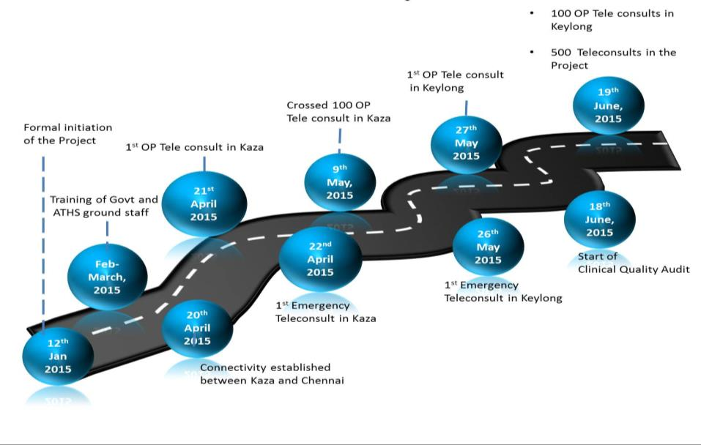
Milestones
Notes:
Less 20 days touched 100 consults

Slide 14
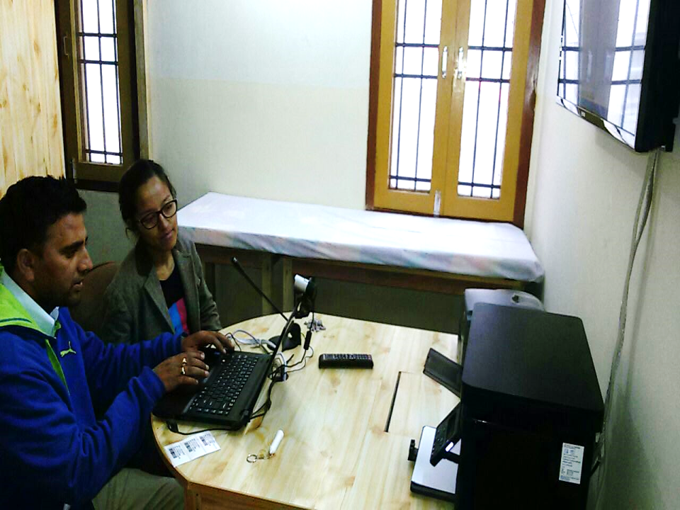
Number of Consultations | 518
Number of Emergencies | 21
Avarage Daily Consultations | 8.22
Average age of Patient | 39.32
Number of Gram Panchayats Covered | 51 (including Gram Panchayats outside Lahaul and Spiti)
Percentage of Female Patients | 66.60
As on June 22, 2015

Slide 15
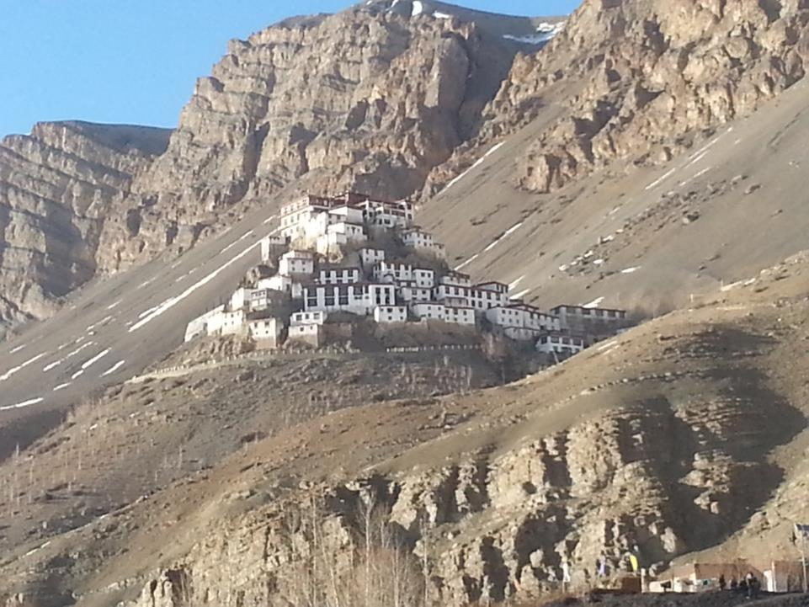
Notes:
11 Specialities with Highest Consult Ortho and Gastroenterology

Slide 17
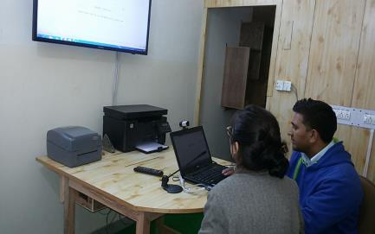
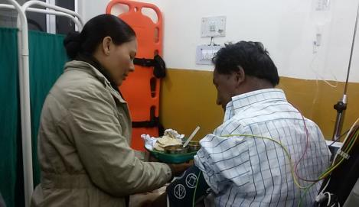
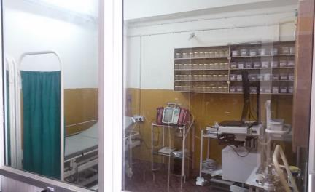
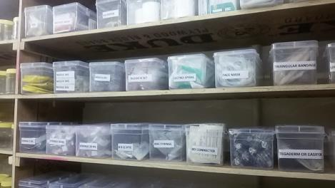
Tele Clinic and Tele-Emergency Set Up in Lahaul and Spiti

Slide 18
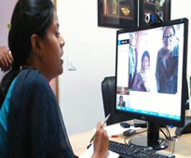
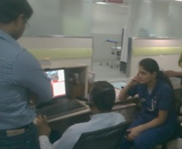
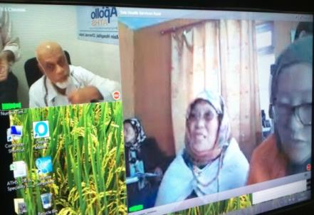
Tele Medicine and Emergency Pods in Apollo Chennai

Slide 19
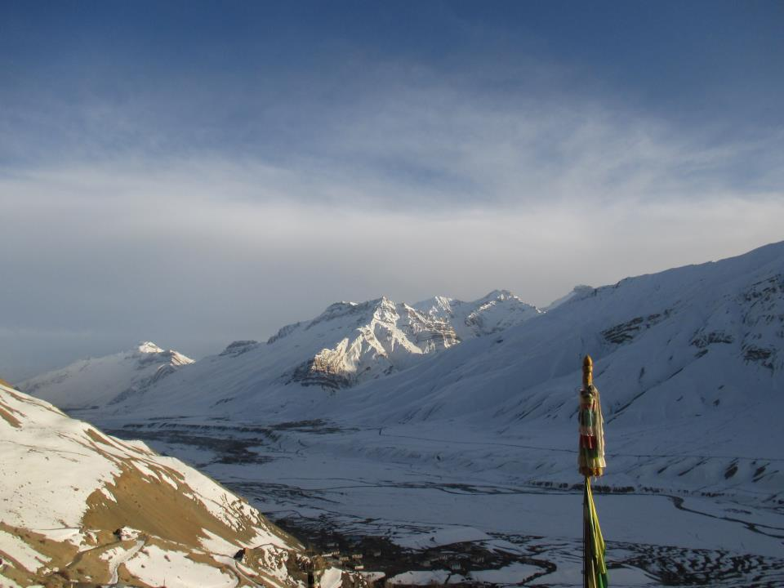
Thank You

