Slide 1
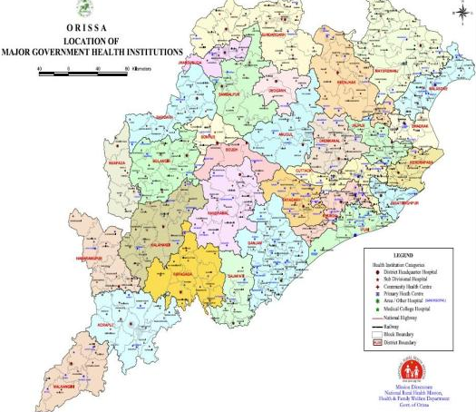
Strengthening of Human Resource for Health in Remote and Difficult Areas: Systematic Reforms and Continuing Challenges
Presented by:
Smt. Arti Ahuja, IAS &
Dr B.P.Mohapatra
H&FW Department,
Govt. of Odisha

Slide 2
Human Resource for Health
State’s Perspective for Improved HRH Management:
Robust Policy with equity focus
Decentralization and local leadership
Mutual agreement– Counseling, Bond (in process) etc.
Paying for performance
Priority on difficult areas
Expansion of scope for production of clinical HR
Commitment for additional investment
Policy
Finance
De- centralisation
Human Resource Management
Education
Mutual agreement

Slide 3
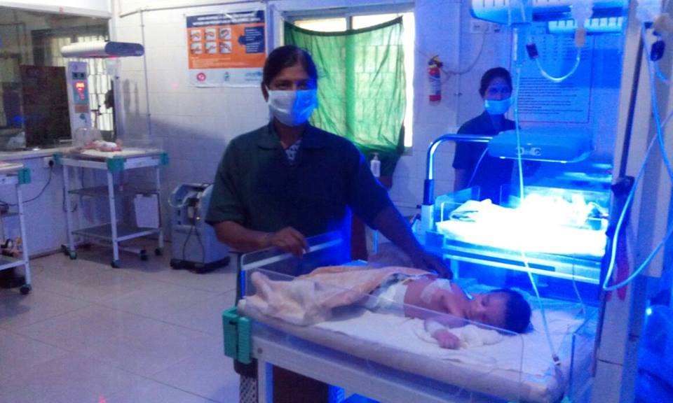
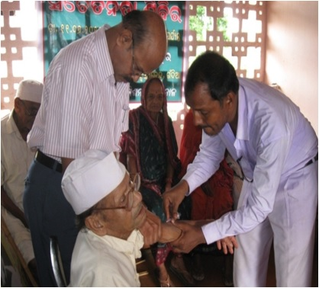
Policy : HRH in Difficult and Hard to Reach Areas
Mandate : Sourcing and retention of Human Resource in difficult and hard to reach areas
Related Policies
Corpus Fund
Place based incentives
Counseling
Exit Avenues
Other Initiatives

Slide 4
Difficult and Hard to Reach Areas in focus
Identified Difficult areas and institutions notified by Govt.
Areas included :
KBK+ Districts : 11 Districts
(covering 1,03,80,216 population)
Tribal Sub Plan Blocks : Blocks
(covering 1,04,19,514 population)
Institutions categorized : V0 to V4
Most difficult institutions (V4) - 100
Difficult institutions (V3) – 137
Key Criteria for Identification of Difficult Institutions
Difficult & backward location Tribal dominance LWE affected Communication & Transport Social Infrastructure Distance from State Hqr.

Slide 5
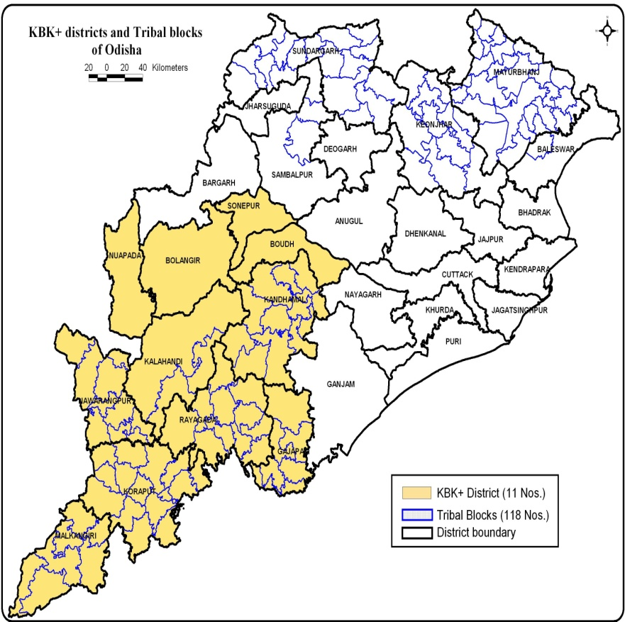
Vulnerable Districts

Slide 6
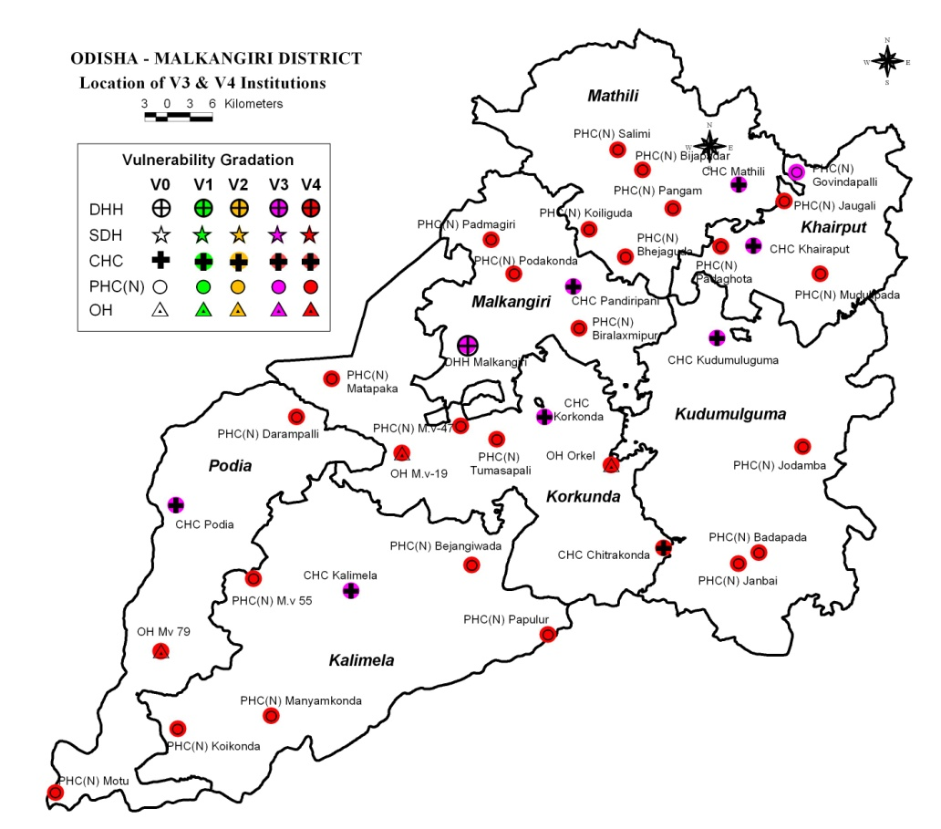
Vulnerable Institutions
Types of Insts. | Nos.
Total Institutions | 37
Total V4 Institutions | 28
Total V3 Institutions | 9
Example of a focus district i.e. Malkangiri

Slide 7
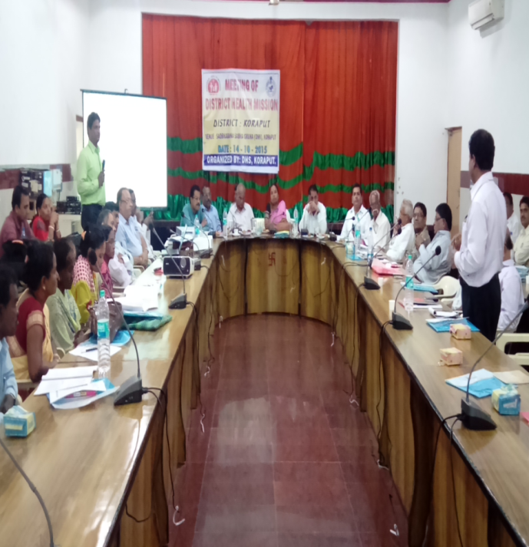
Corpus Fund
Salient Features:
Nature of funding - Untied
Provide flexibility at local level for human resources management
Fund management by Zilla Swasthya Samiti (ZSS) , Chaired by Collector
Fund is utilised to address short term needs
Permissible areas for utilisation of funds i.e. Hiring of Specialists, transportation, communi-cation, and accommodation etc.
ZSS is accountable for strengthening service delivery
Year of Implementation: 2016-17
Fund Provision: 1 Crore per district
ZSS/DHM Meeting

Slide 8
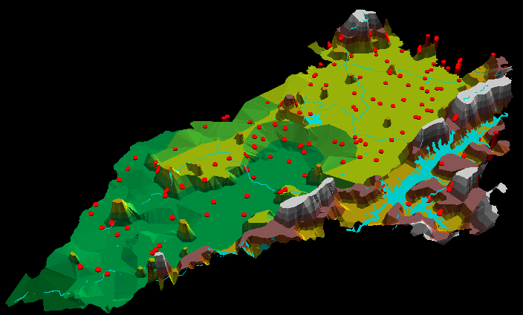
Case Study from District: Malkangiri
Major Interventions:
House rent for 10 Doctors and 20 Paramedics
Transport facilities in 4 6 PHCs Staff
Bio-metric Attendance
MALKANGIRI DISTRICT
PHYSICAL SITUATION OF HEALTH UNITS
Health Units Superimposed on Digital Terrain Model
Elevation Range : 50 to 900 mtrs.

Slide 9
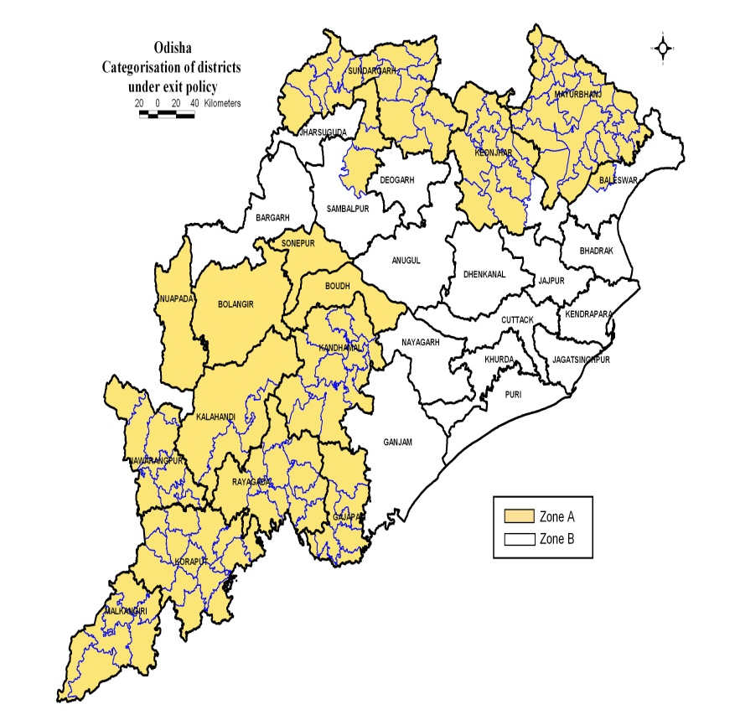
Exit Policy
Categorized entire State into 2 Zones i.e. A & B
Zone-A : KBK, KBK+ & TSP areas
Zone-B : Other Areas
Eligible: Completed tenure of services i.e 3 years for Group A ( JB) and 2 years for Group A ( SB)
Conditions for transfer: The concerned Doctor who has completed the fixed tenure shall be deemed relieved unless one applies in advance for his / her continuance in the place before six months of completion of the tenure which shall be considered by the Government.
Year of implementation : 2016-17

Slide 10
Counseling
For new Recruitments :
Institution wise list of vacancies and merit list of candidates are uploaded in the website.
Counseling and then choice locking is done as per the rank of the candidates in the merit list
For transfer :
Eligible : Transfer of Doctors in Public interest or on representation and posting of Doctors on completion of Post Graduation / Sr. Residentship
Procedures:
  Priority list prepared based on weighted score as per years of services in type of districts / institutions.
    For Male candidates: Zone A (V3 and/or V4) institutions X 4.00 / Zone B (any institutions) X 1.00
    Additional weightage For Female candidates: 2 marks for each year served in Zone A
    Counseling and choice locking – Done as in case of new recruitments

Slide 11
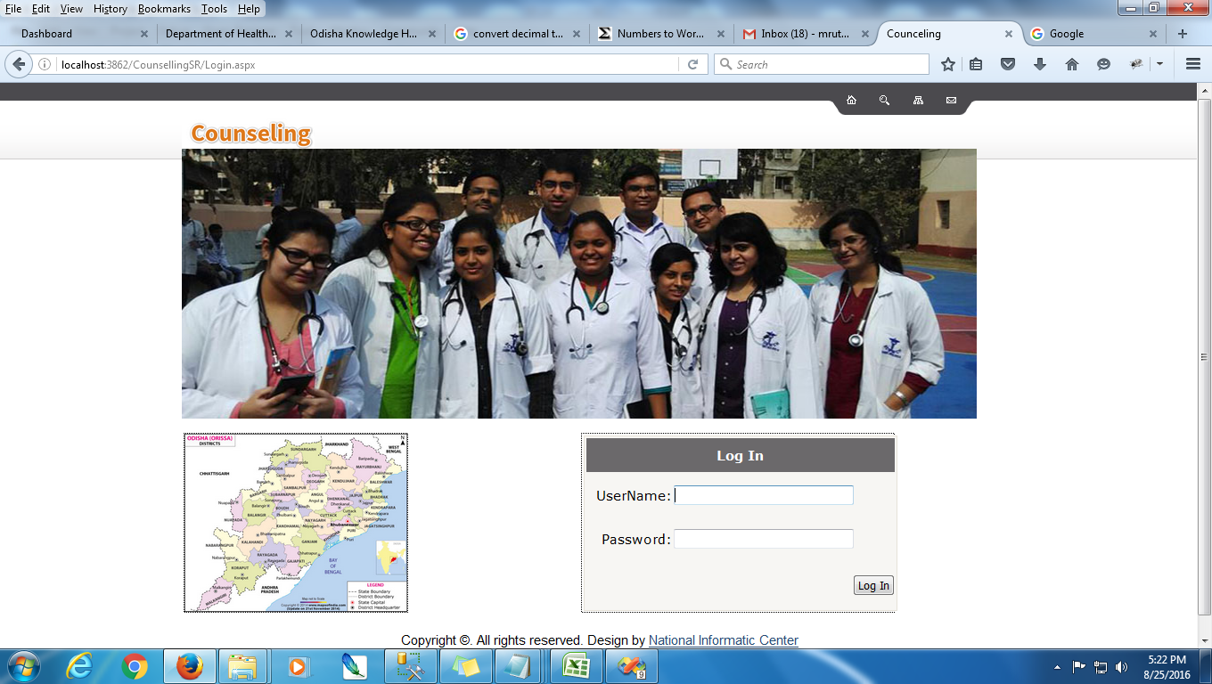
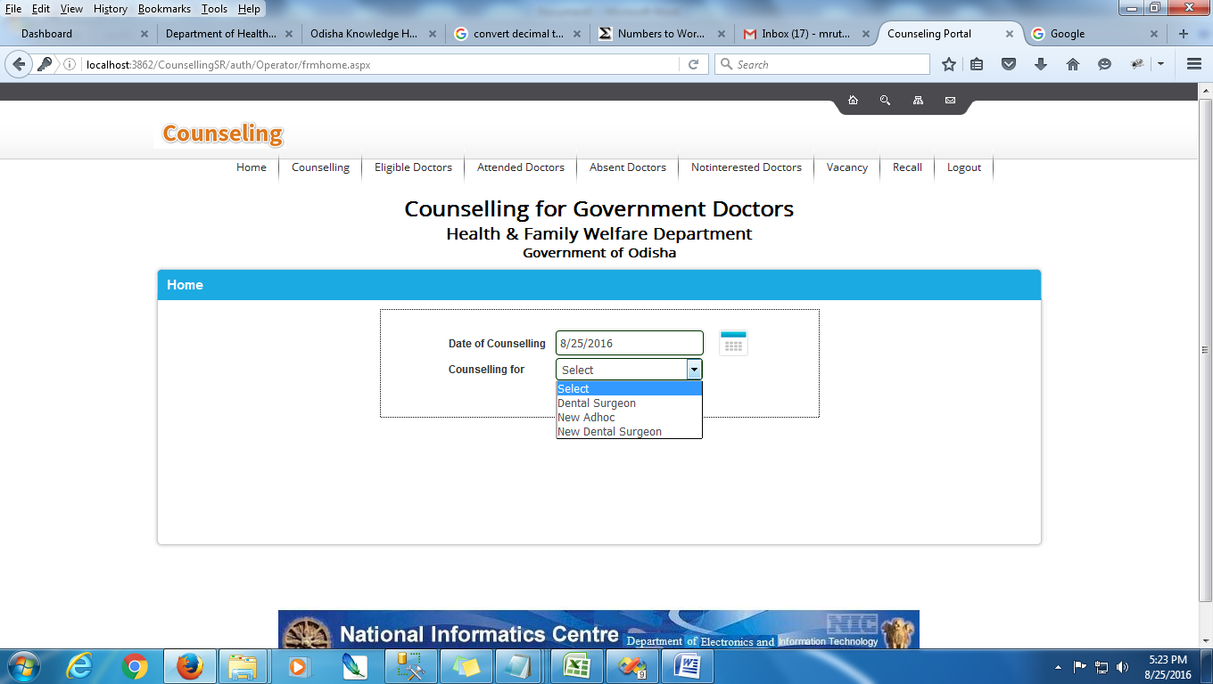
e- Counseling System
It’s a part of Odisha Health Workforce Information System

Slide 12
Place Based Incentives (PBI)
Range of Incentive :
General Medical Officer : Max. - 40000/- for most difficult V4 institutions
Specialist : Max. - 80000/- for most difficult V4 institutions
Eligibility :
Place based incentives will be admissible only on and performing the duty regularly.
The MO I/C of CHC and other Health institutions shall furnish a certificate every month to their concerned CDMOs in respect of the Medical Officers working under their administrative control to the effect that the concerned Medical Officer has stayed and performed his duty at his respective place of posting basing on which the place based incentive shall be drawn.
Year of implementation : 2015-16
Achievement till date : 628 out of 1393 (45%) doctors are getting PBI in KBK+ districts
1005 out of 4812 (21%) doctors are getting PBI in the State

Slide 13
Other Initiatives
408 long absentee doctors removed from service and 372 vacancies filled up.
596 Adhoc and 466 contractual doctors appointed.
Power vested with CDMO for posting of Contractual Doctors & Paramedics
Collectors allowed deployment of doctors within district.
Additional mark in PG entrance exam: Doctors working in V1 to V4 institutions are entitled for additional mark in PG entrance examination.
Steps have been taken to increase the intake capacity of Govt. Medical Colleges to 450 to 650 and establishment of 6 new Medical Colleges (2 in KBK+ districts) and 2 public setup undertaking in full swing to enhance availability of doctors in the State.
Additional 500 posts of doctors and 6826 posts of paramedics created, now under recruitment.

Slide 14
Outcome
Substantial decrease in vacancies of Doctors in KBK+ districts from 45.51% in 2014-15 to 32.75% in 2015-16.
12.33% increase in IPD from 2013-14 to 2015-16 in KBK+ districts.
16.64% increase in OPD from 2013-14 to 2015-16 in KBK+ districts.

Slide 15
Thanks

