Slide 1
Prenatal Screening of Antenatal Mothers for Congenital Foetal Anomalies by Ultra Sonogram through PPP Mode
National Health Mission Tamil Nadu

Slide 2
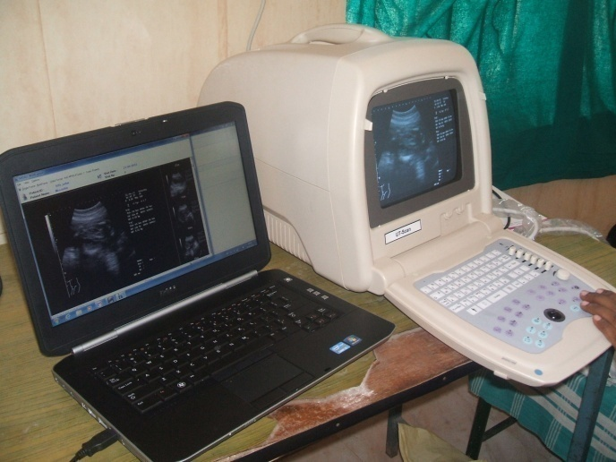
Introduction of the Programme
Implementing State:
Tamil Nadu
Started in year:
Phase – I: 2012 – 2013
Phase – II: 2013 – ongoing

Slide 3
Introduction of the Programme (contd…)
Area & Population covered:
Phase – I : 256 Upgraded PHCs
Phase – II : (i) 78 CEmONC centres + 154 Non- Upgraded PHCs
(ii) Extension of Online Auditing & Evaluation of Phase – I trained Medical Officers

Slide 4
Problem Statement
The developmental screening of neonates, infants and children is an important concept in the child care services
It involves screening of large number of congenital anomalies at the foetal stage itself & later at the time of birth and early infancy and during childhood.
Prenatal Screening is an effective tool to detect and identify major anomalies like Neural Tube defects, Congenital Heart Disease, Limb defects so that the infants can be referred for immediate corrective measures.

Slide 5
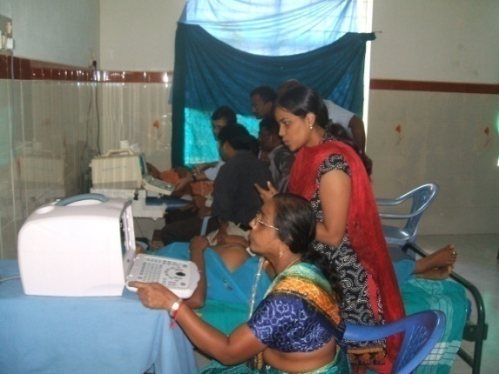
Program Description
Prenatal screening of Antenatal mothers to detect congenital fetal anomalies is an Ultrasound training given to doctors involving the concept of Telemedicine for Online auditing of images involving PPP mode.

Slide 6
Programme Schematic Diagram

Slide 7
Program Description (contd…)
This Ultrasound training involves the following components
Physical components
Availability of USG Machines
Availability of Desktops / Laptops
Installation of Software by Private parties
Accessories like Image grabber cord, video cable, etc.
to connect the USG machine to the desktop / laptops
Training components
Hands on training for a period of 12 days @ 2 days per week
On completion of training, online auditing of images and mentoring by the Private parties for a period of One year.

Slide 8
Program Description (contd…)
This project includes the involvement of two Private parties selected by Tender process
The Online training would be aimed at detection of major anomalies as well as identifying severe IUGR, Placenta Praevia, Ectopic Gestation etc
The training would also enable the trainees to document the images for audit purposes

Slide 9
Project objectives
The Objectives of the project are:
To increase the skills of Obstetricians from CEmONC centers in the usage of Ultrasound & Doppler studies during the screening of AN mothers, so as to detect the foetal abnormalities
To increase the skills of Primary Health Centre Medical Officers in the usage of ultrasound during the screening of AN mothers
To assist in the development process of Master trainers in the Government sector

Slide 10
Deliverables of the Project
Medical Officers should be provided hands on training in usage of Ultra sonogram for 12 days ;
To detect the fetal anomalies like Neural Tube Defects, Congenital Heart Disease, limb defects etc.,
To identify other gestational problems (Severe IUGR, Placenta Previa, Ectopic Gestation)
One year of online mentoring and auditing of images.
100% screening of all the Antenatal mothers in the PHC

Slide 11
Deliverables of the Project (contd…)
Each Medical Officer has to screen a minimum of 64 Antenatal mothers per month and send the quality images on case to case basis
Minimum of 16 AN cases per week totaling to 64 cases per month with a minimum of 10 to 15 images for each AN Mother
The Monitoring Officers should ensure that the above number of images are being sent regularly by concerned Medical Officers/ Obstetricians to the organization.

Slide 12
Monitoring and Evaluation
The project will be monitored at the District level (11 members team) for proper implementation and at the State level (12 members team ) for effective coordination.
The training activities will also be reviewed in the monthly State level review meeting based on the issues raised by the Organization & by the trainees

Slide 13
Monitoring and Evaluation (contd…)
DLSC will meet once in every two month to address the implementation issues of the project and help achieving successful implementation at the District and Block level.
The PLSC will meet every three months. Apart from regular reviews, the PLSC will address and resolve any management issue affecting the successful implementation of the project

Slide 14
Financial Investment under the Project
Phase – I : 2.83 crores
Phase – II : 4.24 crores*
(*Includes cost towards extension of Online Auditing & Evaluation for PHASE – I trained Medical Officers)
Item | Amount (in Rupees)
Hands on training-Course Faculty Fees | 12,500
Software cost | 10,000
Online mentoring & auditing fees | 24,000
Accessories Cost | 10,320
Total cost per MO | 56,820

Slide 15
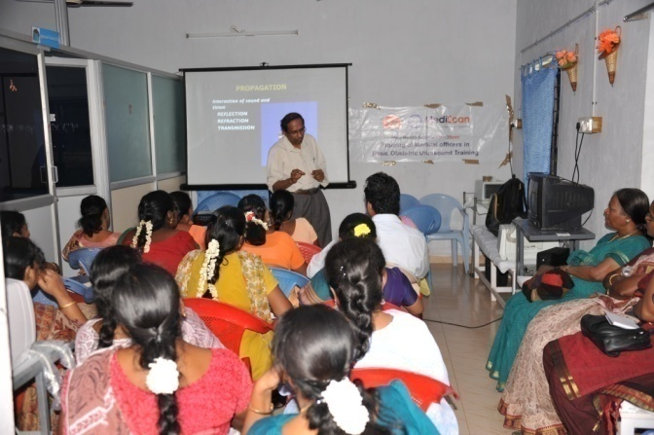
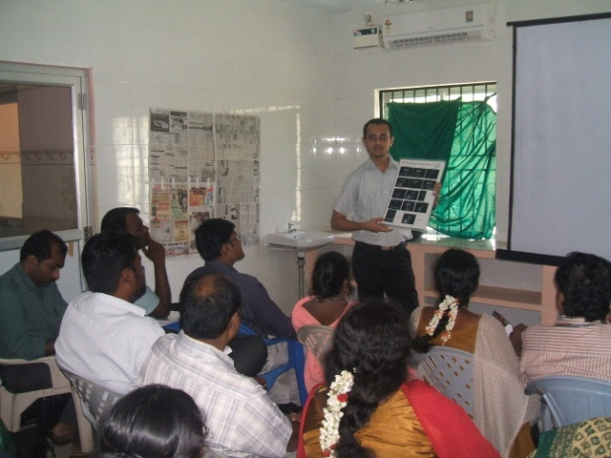
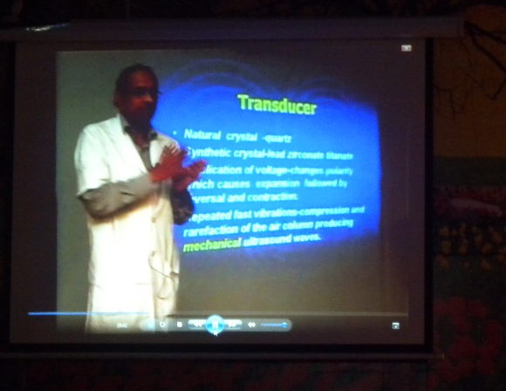
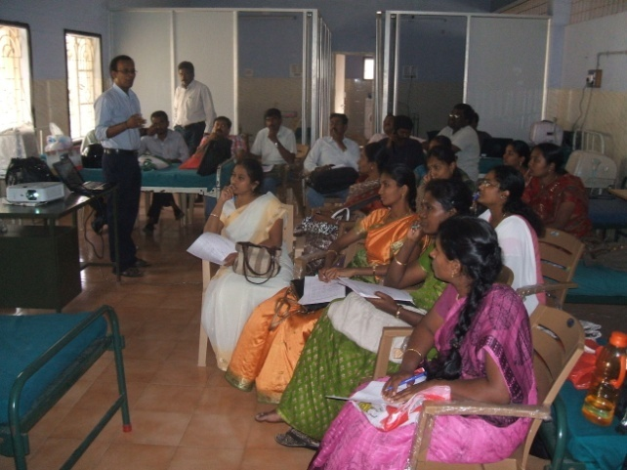
References and Partners
Medall Healthcare Systems – Chennai.
Mediscan Systems, Chennai.

Slide 16
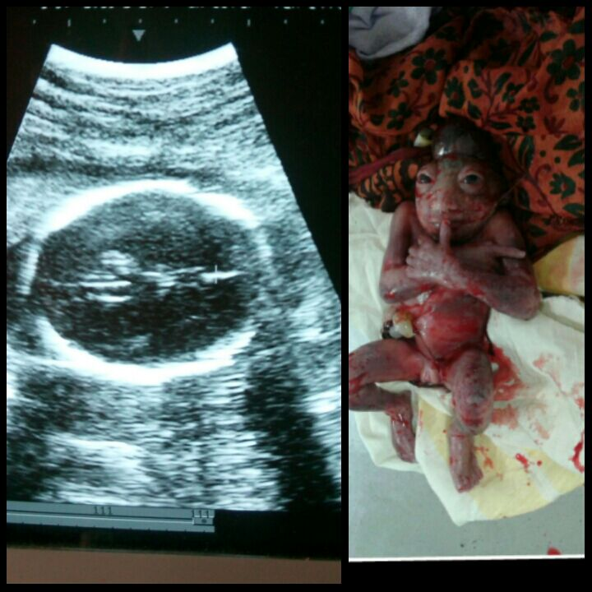
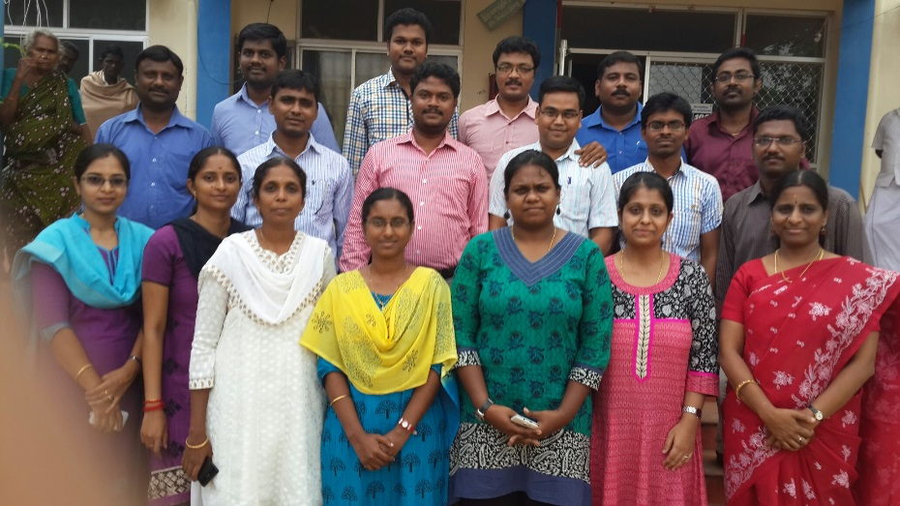
Programme Impact
During Phase I training (Period 2012 to 2013), 1% of congenital anomalies were detected by the trained Medical Officers.

Slide 17
REPORT OF DETECTED ANOMALY CASES IN PHASE 1

Slide 18
Percentage of Anomalies Reported
Private Partner |  | Cases | Anomalies | % Reported
Mediscan | Phase I | 62607 | 482 | 0.77
Medall | Phase I | 77117 | 258 | 0.33

Slide 19
Conclusions /Lessons learnt
The trained Medical Officers were able to detect the congenital anomalies as per the target based on the prevalence of congenital anomalies.
Online Congenital Anomaly Tracking System and the follow-up of Antenatal mothers needs to be strengthened.

Slide 20
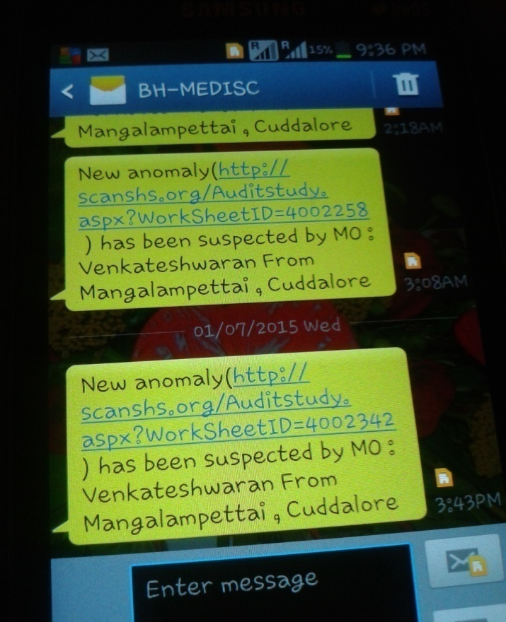
SMS Alerts & Outcome Indicator

Slide 21
Scalability
Using the trained manpower in the Public health system, it is possible to establish an effective mechanism to prevent the birth of a child with Congenital anomalies throughout the State by Capacity building of HR under Govt. sector with the help of available expertise in the Private sector.

Slide 22
Sustainability
This programme is sustainable with the linkage of potential resources available under RBSK scheme

Slide 23
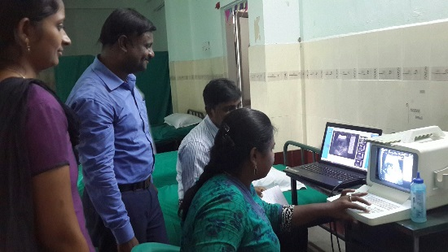
Thank you
For further details :
Dr.M.Senthilkumar
Deputy Director (Training),NHM-TN,Chennai
Mob: 09489048903
E-mail : srhm.tn@nic.in, trainingsrhm@gmail.com

