Slide 1


prasavGraph : an android based e-partograph
DR SHALINI SINGH
SCIENTIST E
DIVISION OF REPRODUCTIVE BIOLOGY & MATERNAL HEALTH
INDIAN COUNCIL OF MEDICAL RESEARCH
NEW DELHI
29-31 Aug 2016
Tirupati

Slide 2

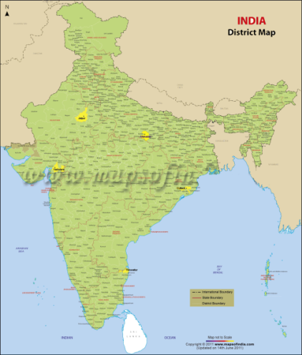
National Rural Health Mission
SBA Guidelines
Plotting partograph for every delivery is key for safe delivery and skilled birth attendance
5 district ICMR-UNFPA mixed methods study (2009-10)
indicated 15.8% partograph plotting (n= 1500 deliveries)
Reported reasons for not plotting partograph were:
Providers considered it as a complex modern technique and one junior resident said, “Plotting of partogram is not practically possible. That is a modern technique. We judge the case by calculating the expected time of delivery.”
Lack of time- “Practice of partograph? We have a shortage of staff so, practice of partograph is not followed here but, nurse who comes here for SBA training for 21 days has to make partograph as a part of training.”
Non-availability of partograph sheets

Slide 3
Partograph Knowledge & skills
A study among PGs/specialists (n=150) in 5 tertiary care public hospitals (Delhi, Meerut, Baroda, Chandigarh) indicated 28% current use of partograph (2014-15)
Competency of providers in plotting partograph using case scenarios
Hospital policy on partograph plotting | Routine plotting N=77 (%) | Do not insist on routine plotting N=73 (%) | p value
Patient Identification Data | 33 (42.8) | 20 (27.4) | 0.048
Maternal Condition | 35 (45.4) | 14 (19.2) | 0.001
Fetal Condition
Fetal Heart Rate | 58 (75.3) | 19 (26.0) | <0.001
Amniotic fluid details | 38 (49.3) | 12 (16.4) | <0.001
Labor progress
Cervical dilatation | 60 (77.9) | 12 (16.4) | <0.001
Time on X axis | 37 (48.0) | 21 (28.8) | 0.015
Uterine contractions | 15 (19.5) | 3 (04.1) | 0.005
Delivery details | 9 (11.7) | 0 (0.0) | 0.003

Slide 4
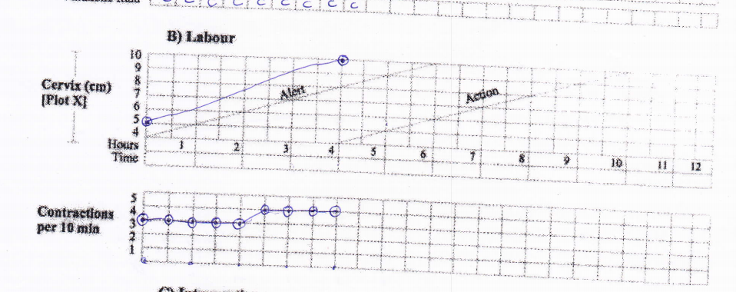
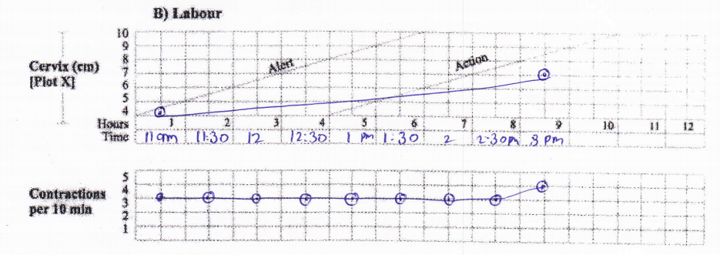
Partograph knowledge & skills
Suggestions to improve partograph use
Need better training | 24%
Simplify Partograph | 7%
Improve Partograph format Make it computerized to make it easier Make it colorful Include baby weight, sex, APGAR score Include key high risk factors of pregnancy Drug column is too small Include latent phase of labor Add Abd exam, effacement, fetal descent | 48.3%
Improvement in health systems hospital services improvement to allow time for plotting Availability of paper forms should be ensured | 20.7%
Change negative attitude of providers | 10.3%
Error in initiating plotting
Error in plotting time

Slide 5
Development of e-partograph
Objectives:
To re-design partograph (on paper) and test its acceptability
To develop a software application using mobile/smart phone technology to record partograph
To test transmission of real time partograph data from field
Study sites:
1st phase : SJH, Delhi; DH- Panchkula; Participants: Doctors
2nd phase : PGI, Chandigarh & GTB, Delhi; Participants: Student nurses
Project Advisory Committee was formed
MoU with IIT Delhi was signed for software development

Slide 6
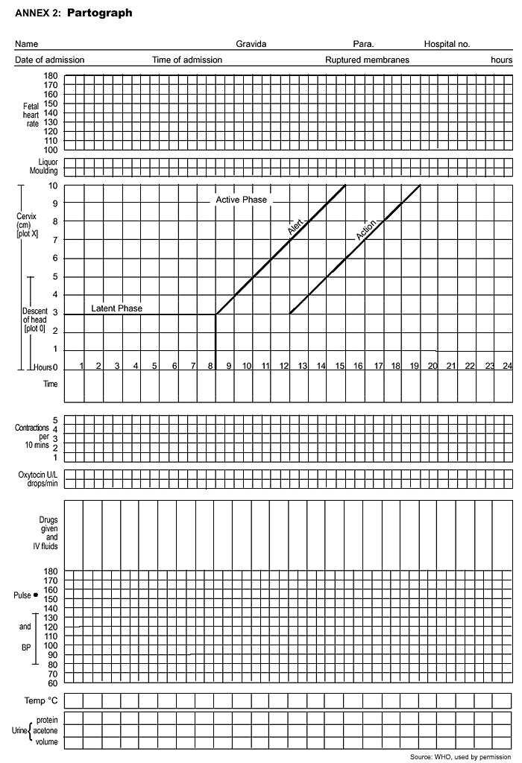
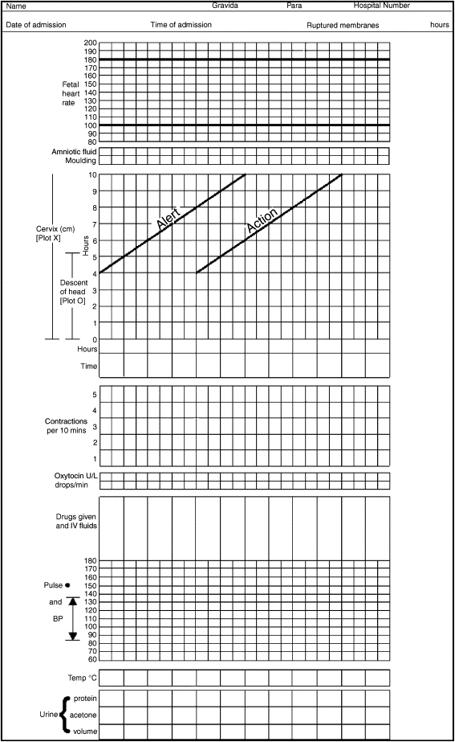
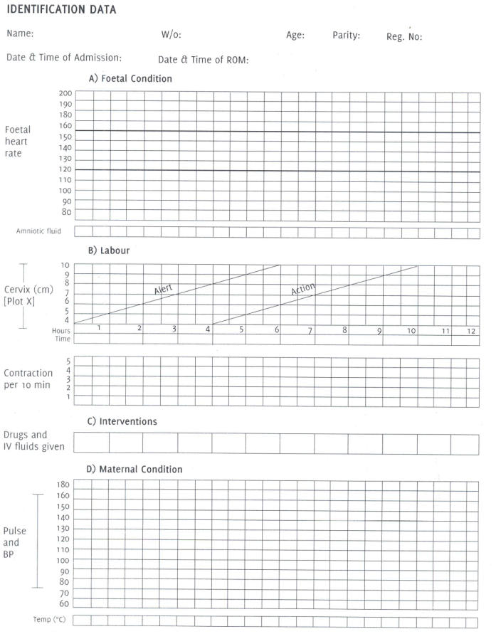
Modifications of WHO partograph
Composite partograph 1994
Modified partograph
2000
Simplified partograph 2003

Slide 7
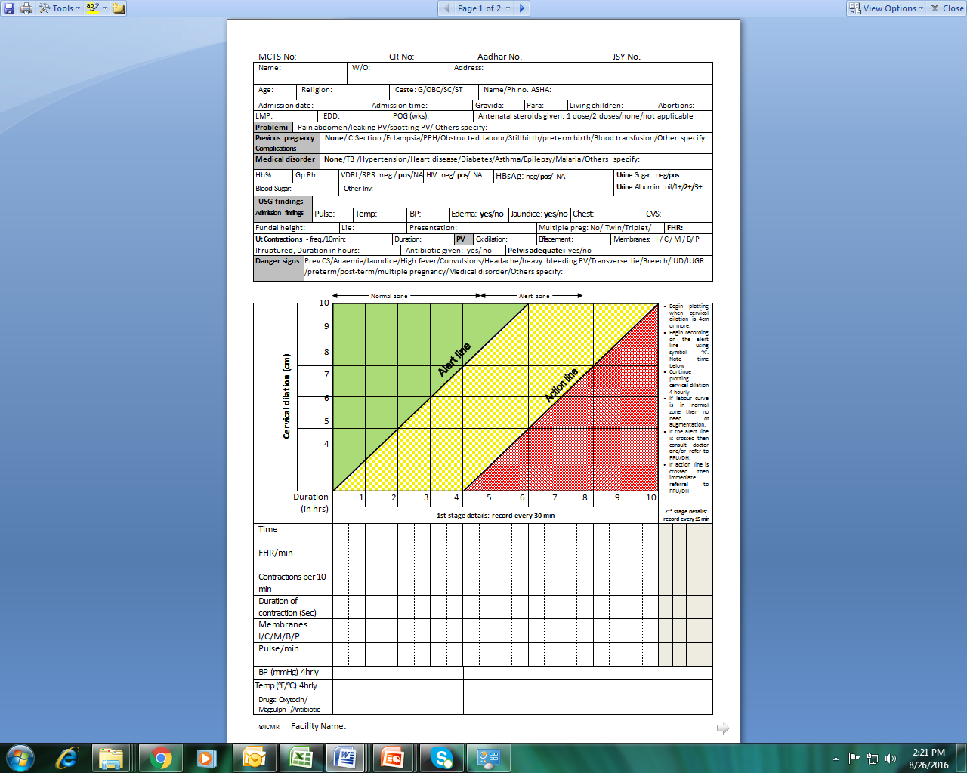
Redesigned ICMR Partograph
Special features
Training needed only for plotting cervical dilation against time.
Other parameters are only alpha-numeric entries
Provision to capture 2nd & 3rd stage and baby details
Adequate space for entering drug details
4 hrly entry of BP and temp clearly demarcated

Slide 8
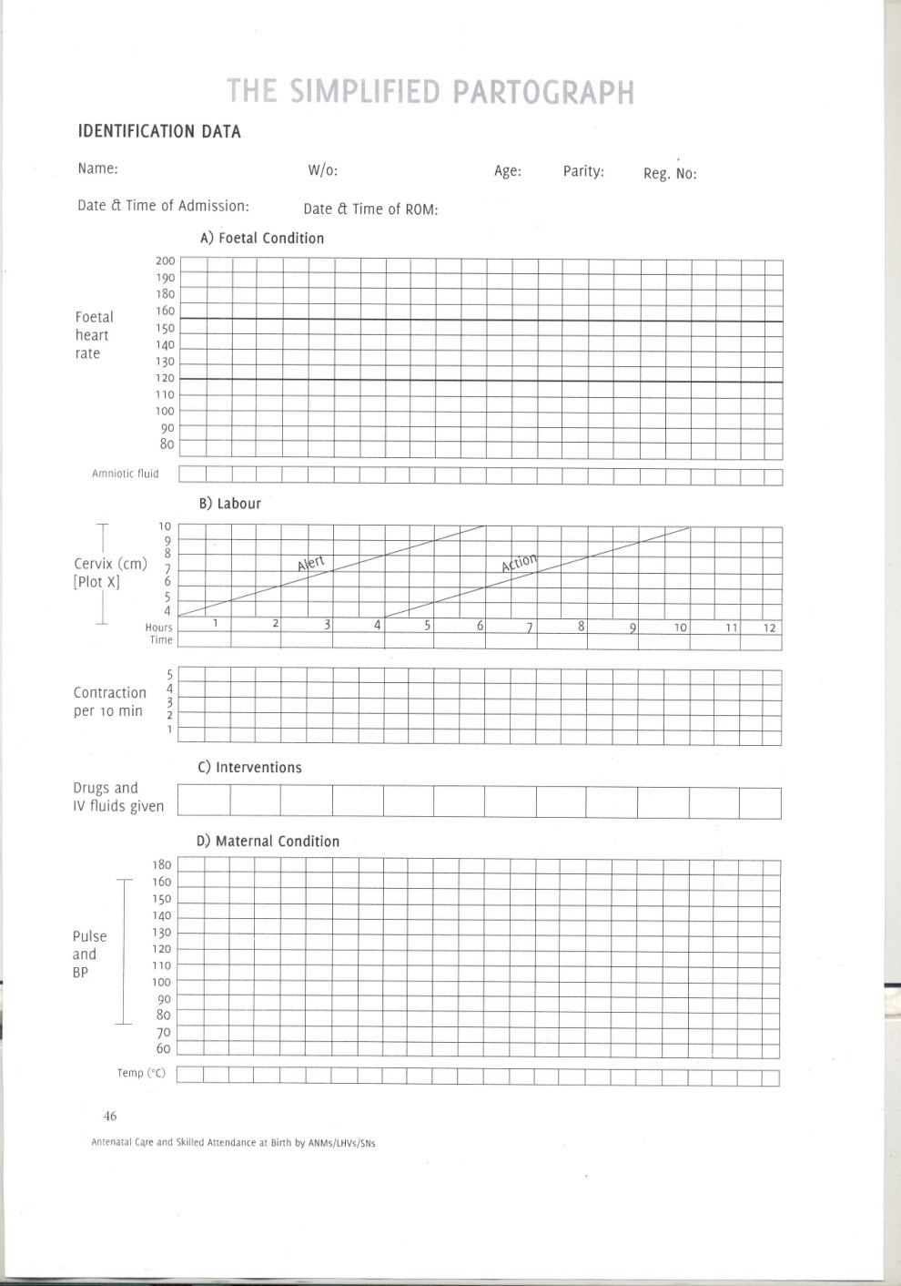

Slide 9
Acceptability of re-designed ICMR partograph
Correct/complete entries | %
Cx dilation | 87
Plotting time | 88.5
Patient ID | 100
Admission details* | >85
Obstetric findings* | >85
Parameters recorded half hourly | 50
Parameters recorded four hourly | 70
2nd stage FHR | 13
3rd stage details | >85
Baby details | >90
Parameter | % Likert Rating 4/5
Appearance | 100
Adequate space | 97.2
Easy to understand | 94.4
Comprehension of instructions | 66.7
Use in labour | 72.2
Use in second stage | 72.2
Use in third stage | 66.7
Provides adequate details on one page | 86.1
* POG, Past medical history, FH
Overall rating : Good > 75%

Slide 10
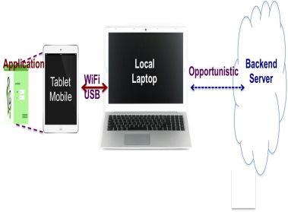
E-partograph/prasavGraph
AIMS & OBJECTIVES
Reducing errors in plotting partograph
Compliance with SBA guidelines
Providing a Delay-tolerant Infrastructure
Support analytics using digital data
Act as a training aid
Conceptual framework

Slide 11
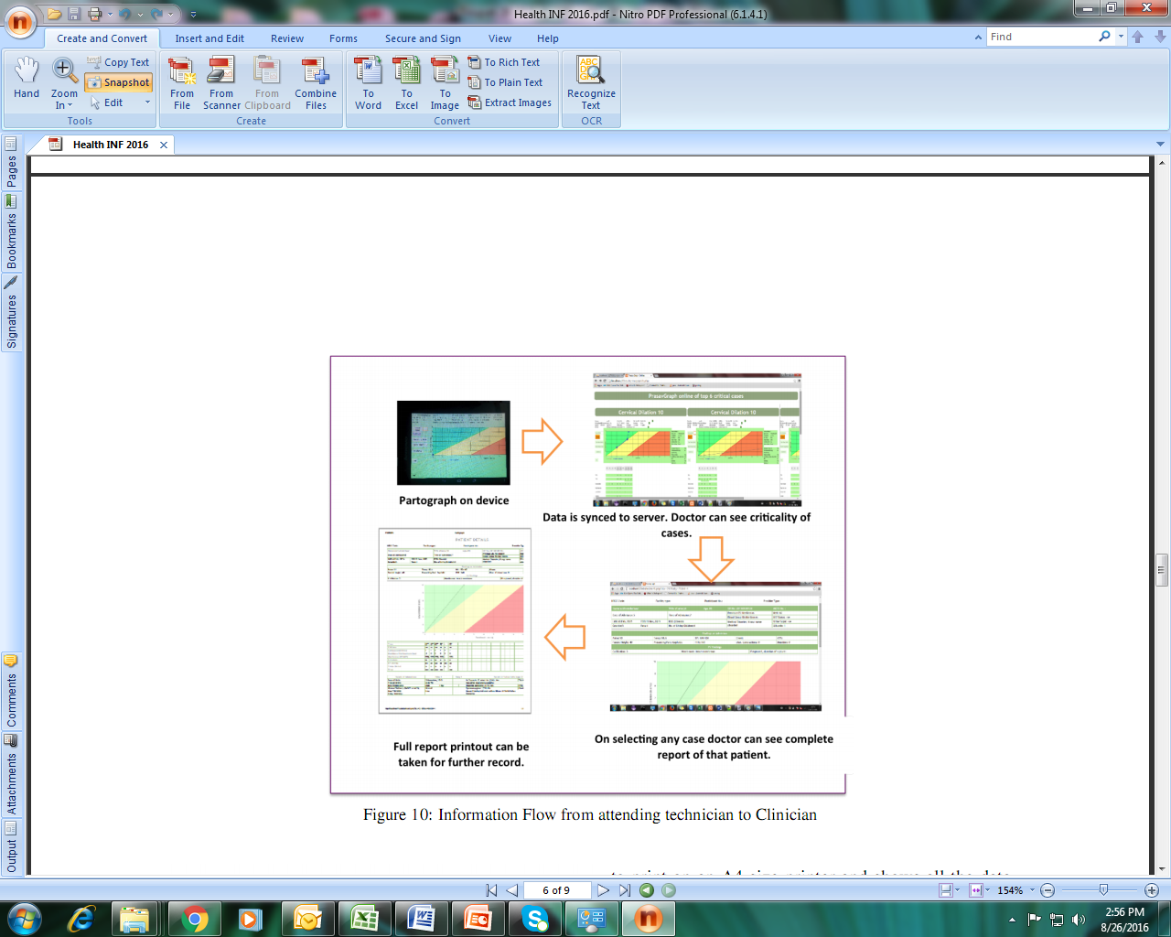
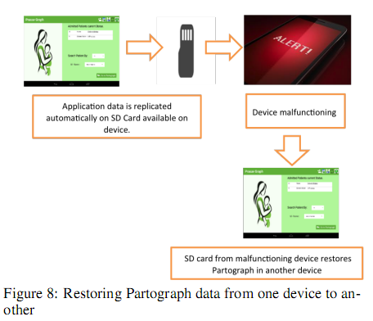
Conceptual framework

Slide 12
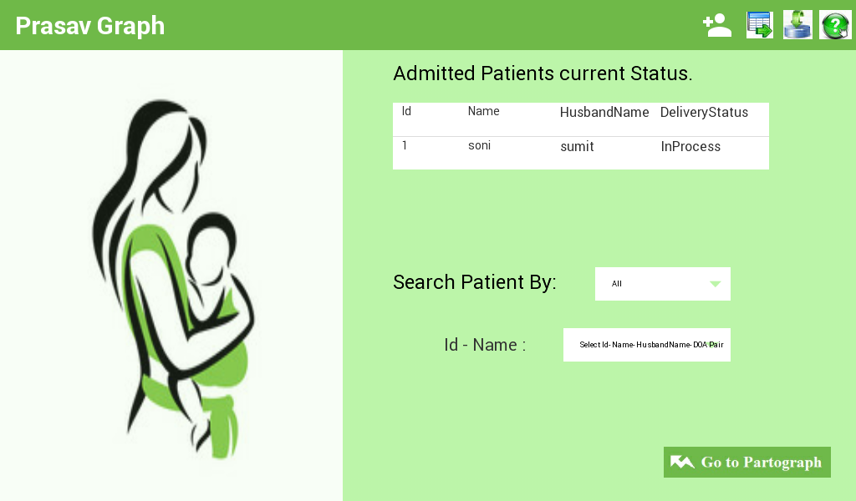
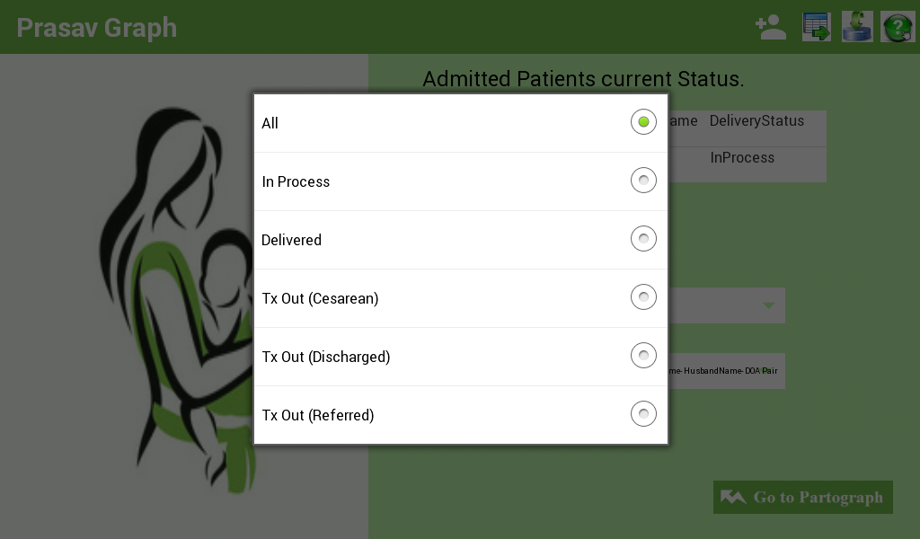
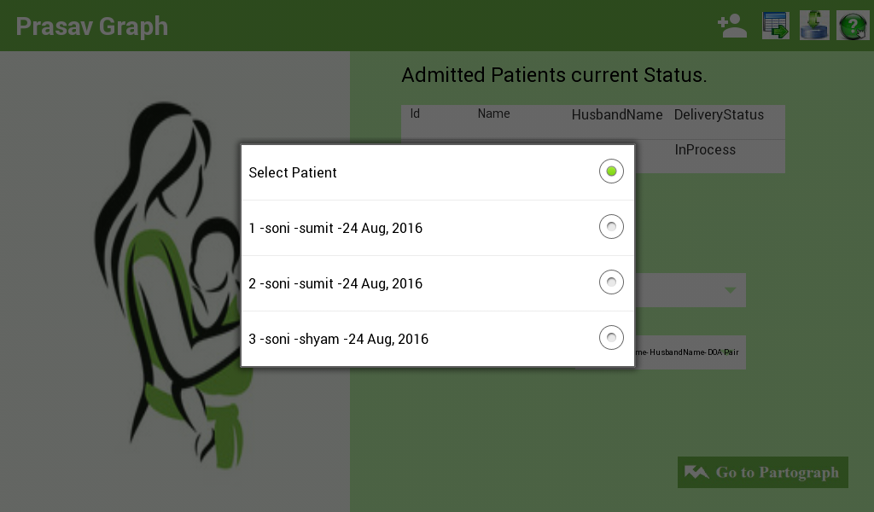
Home Screen: Screen 0
Video link: PrasavGraph

Slide 13
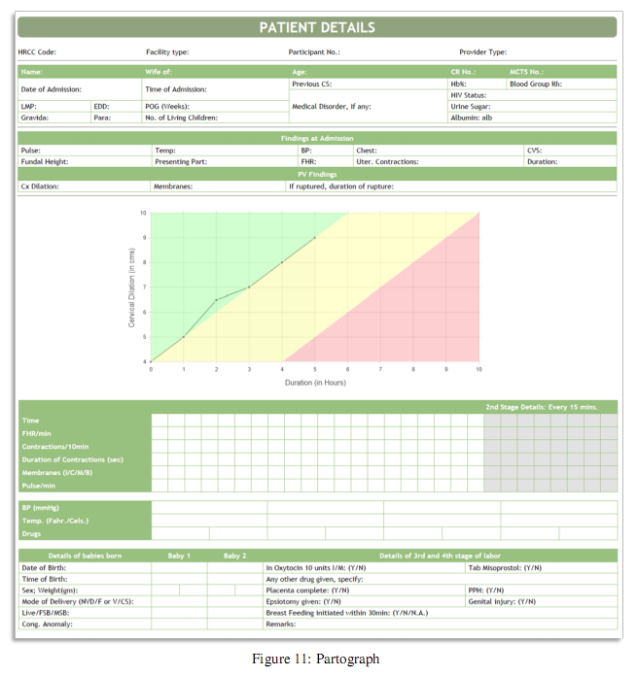

Slide 14
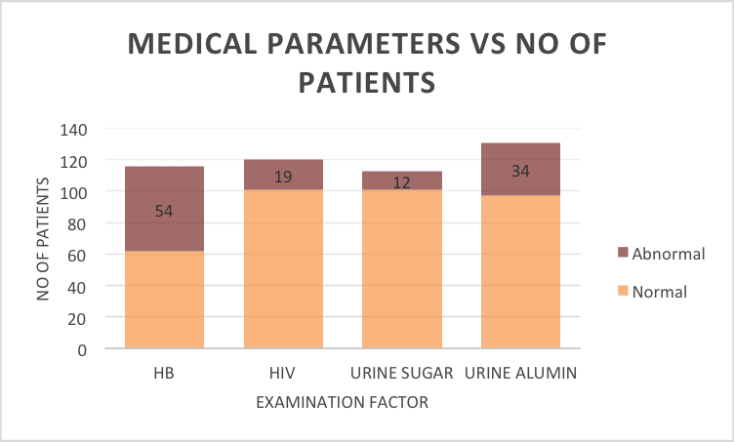
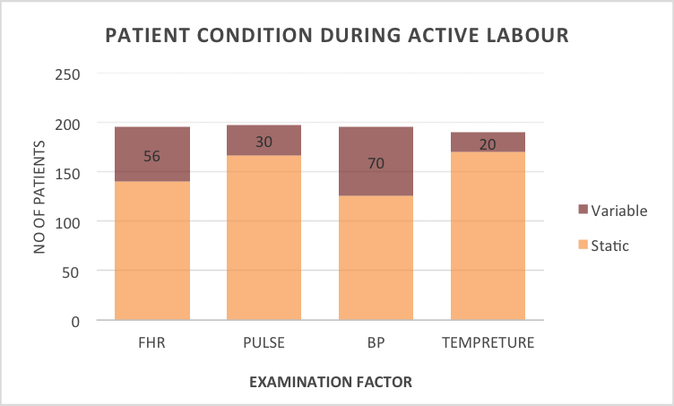
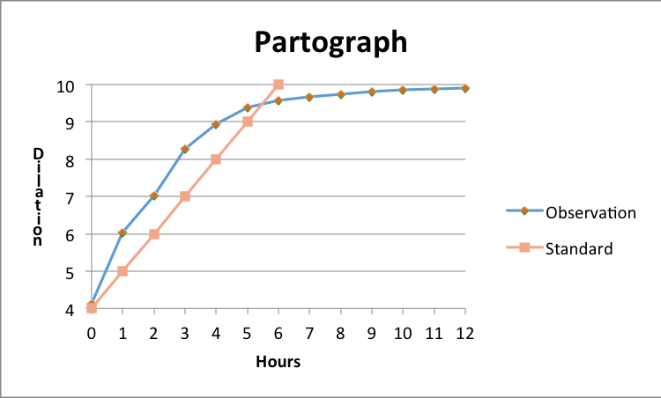
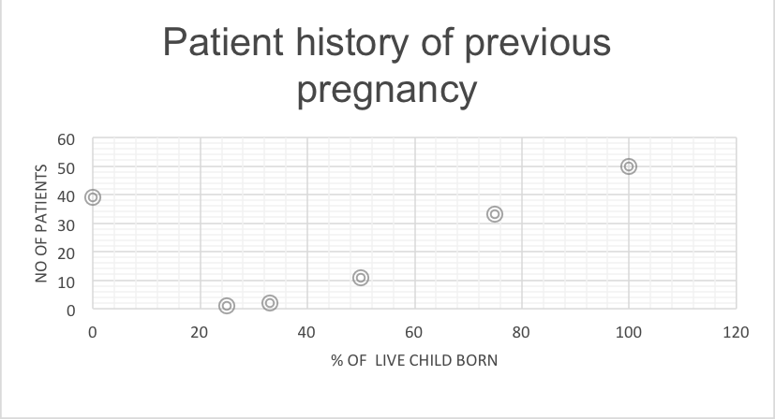
Data Analytics

Slide 15

Strengths
Accuracy
Reproducibility
Less storage space, Easy retrieval
Saves time, Economical
Assists planning
Monthly Statistics generation
Data sharing in real time
Task shifting, remote monitoring
Self learning, teaching aid
Future Work/Challenges
e-connectivity
Software maintenance
Software interoperability
Confidentiality/privacy
Provider Behaviour change
Scaling up

Slide 16
Admission Details
Name: |  |  |  |  |  |  |  | W/O: |  |  |  | Age: |  | CR No: |  |  |  | MCTS No:
Admission date: |  |  |  |  |  |  |  | Admission time: |  |  |  | LMP: |  |  |  | EDD: |  | POG (wks):
Antenatal steroids given: 1 dose/2 doses/none |  |  |  |  |  |  |  |  |  |  |  | Gravida: |  | Para: |  |  | No. of living children:
Prev. Preg. Compl. |  |  | None/APH/Eclampsia/Preeclampsia/PPH/Obstructed labour/Stillbirth/Preterm birth/ LSCS/ Other specify:
Past history |  |  | None/TB /Hypertension/Heart disease/diabetes/asthma/blood transfusion/Other specify
Hb% | Gp Rh: |  |  | VDRL: neg/pos/NA |  |  |  |  | HIV: neg / pos / NA |  |  | HBsAg: neg / pos / NA |  |  |  | Blood Sugar: |  |  | Urine Sugar: neg/pos Albumin: nil/ 1+/2+/3+
Other Inv:
USG findings
Admission findings |  | Pulse: |  |  |  | Temp: |  |  | BP: |  | Edema: yes/no |  | Jaundice: yes/no |  |  |  | Chest: |  |  | CVS:
Fundal height: |  |  |  |  | Lie: |  |  |  | Presentation: |  |  |  |  |  | Multiple preg.: No/ Twin/Triplet |  |  |  |  |  | FHR:
Ut Contractions - freq./10min: |  |  |  |  |  |  | Duration: |  |  | PV |  | Cx dilation: |  |  | Effacement: |  |  |  | Membranes: I / C / M / B/ P
If ruptured, Duration: |  |  |  |  |  |  | Antibiotic given: yes/ no |  |  |  |  |  | Pelvis:

Slide 17
Baby Details
Details Baby 1 | D.O.B. |  |  |  |  | Time: | Details Baby 2 | D.O.B. |  |  |  |  | Time:
Sex: M/F /Ambiguous |  |  |  | Weight (gm): |  |  | Sex: M/F /Ambiguous |  |  |  | Weight (gm):
Outcome: Live/ FSB / MSB/ abortion |  |  |  |  | Mode of delivery: Normal/ forceps/ vacuum/LSCS |  | Outcome: Live/ FSB / MSB/ abortion |  |  |  |  | Mode of delivery: Normal/ forceps/ vacuum/LSCS
Cried immediately after birth: Yes / no |  | Resuscitated: yes/ no |  |  |  | Baby blue: Yes/no Baby cold: Yes/no | Cried immediately after birth: Yes /no |  | Resuscitated: yes/ no |  |  |  |  | Baby blue: Yes/no Baby cold: Yes/no
Congenital anomaly: Yes / No. If yes, specify |  |  |  |  |  |  | Congenital anomaly: Yes / No. If yes, specify
Vit K given: Yes / no BCG given : Yes / no Hep B: Yes / no OPV given: Yes / no |  |  | Breast feed initiated within: 30min/1 hour/ 4 hours. If not, why? |  |  |  | Vit K given: Yes / no BCG given : Yes / no Hep B: Yes / no OPV given: Yes / no |  |  | Breast feed initiated within: 30min/1 hour/4 hours. If not, why?
Baby referred: Yes/no If yes, give reason: |  |  |  |  |  |  | Baby referred: Yes/no If yes, give reason:

Slide 18
3rd & 4th Stage Details
Details: 3rd stage of labor |  |  | Oxytocin 10 IU I/M: Yes/No |  |  | Tab Misoprostol (3 tab): Yes / No |  | Any other drug specify:
Placenta complete: Yes/No | PPH: Yes / No |  | Episiotomy given: Yes/ No |  | Genital injury: Yes/ No If yes specify, 2nd/3rd degree PT/ cervical tear/ episiotomy extension/ vulval haematoma/ rupture uterus/ others specify:
PPIUCD inserted: Yes / No | Complications during Delivery : None/ Pre-eclampsia/ eclampsia/ prolonged labour/ Antepartum haemorrhage/ fetal distress/ breech delivery/ respiratory distress of mother/ hypotension/others specify:
Drugs given if mother is HIV positive |  |  |  | Triple drug regimen/Nevirapine |  |  | Baby prophylaxis given: Yes/No
Details: 4th stage (within 2 hours of delivery) |  | Pulse: |  | Uterus well contracted: Yes / No |  |  | PV Bleeding excessive: Yes / No If yes, specify treatment:
 |  | BP: |  | Passed Urine: Yes / No
 |  | Temp:
Mother healthy at discharge: Yes/No If No, specify: |  |  |  | If Died, specify cause |  |  | If Referred, specify reason

Slide 19
Instructions
Encircle the appropriate answer or enter the data
Gravida- Enter total number of times the woman has been pregnant including this pregnancy
Para- Enter total number of babies born after 20 weeks
Membranes: I/C/M/B/P = Intact/clear liquor/meconium/blood/Purulent
If investigation report is not available write NA
NVD / F or V / CS = normal vaginal delivery / Forceps or Vacuum /caesarean section
L/ FSB / MSB= Live birth/ fresh stillbirth / macerated stillbirth
Types of genital injury: perineal tear/cervical tear/ extension of episiotomy/vulval haematoma/rupture uterus
Gross congenital anomalies: Cleft lip/cleft palate; Neural tube defect; spina bifida; meningomyelocoele; hydrocephalus; anencephaly; Down’s syndrome; Club foot; imperforate anus; Tracheo-oesophageal fistula; Others

Slide 20
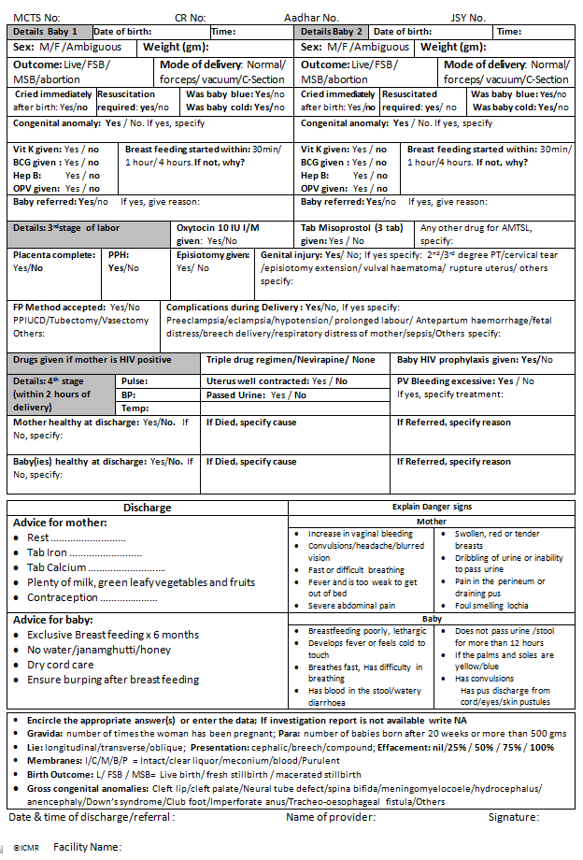
prasavSheet

Slide 21
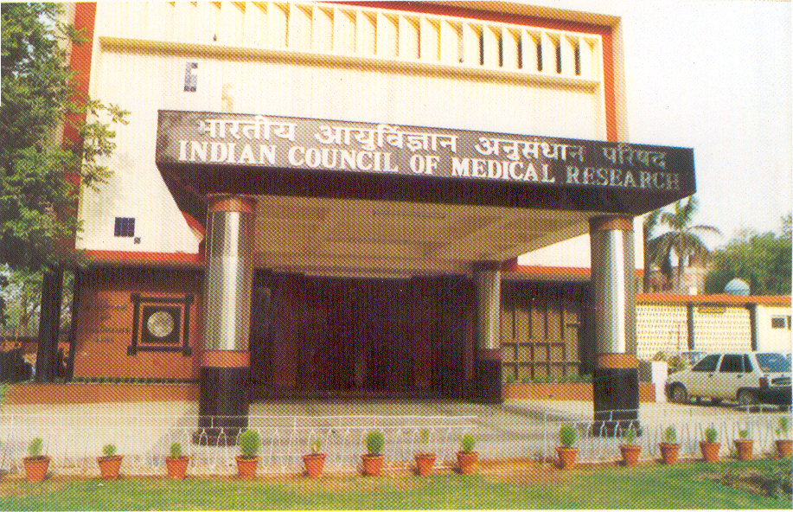
Site Investigators
SJH, PGIMER, GTB, Panchkula DH, Ambala, Meerut, Baroda
Colleagues at ICMR
Co-Investigators
Prof Sanjiva Prasad, Prof Kolin Paul - IIT Delhi
Project associates & Students at IIT Delhi
THANK YOU

