Slide 1




Onsite Mentoring for transformation of quality
of care at health facilities
Rajasthan
Dr M. L. Jain
Director
State Institute of Health and Family Welfare
Dr Apurva Chaturvedi
Health Officer , UNICEF
Under the aegis of National Health Mission, Rajasthan

Slide 2
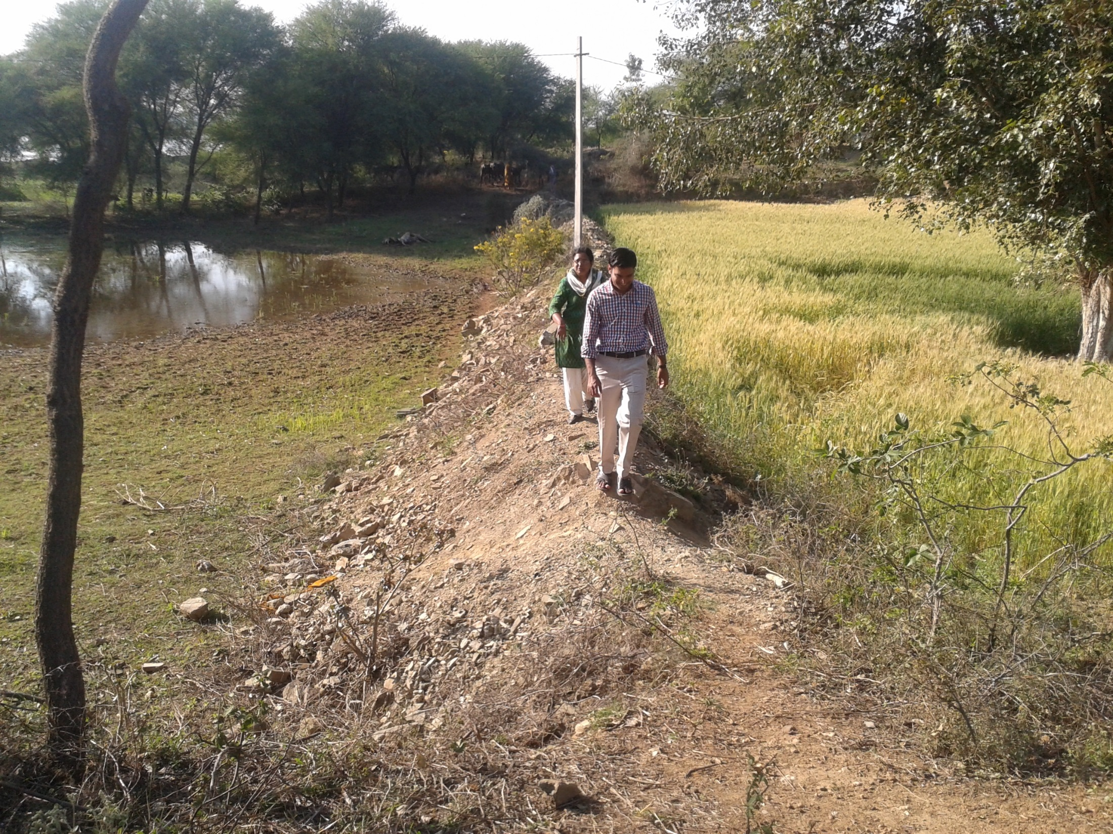
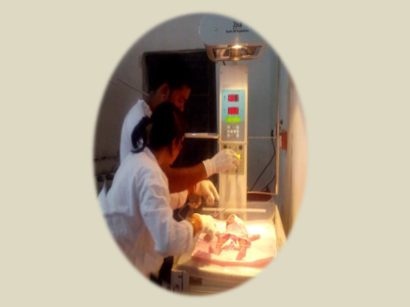
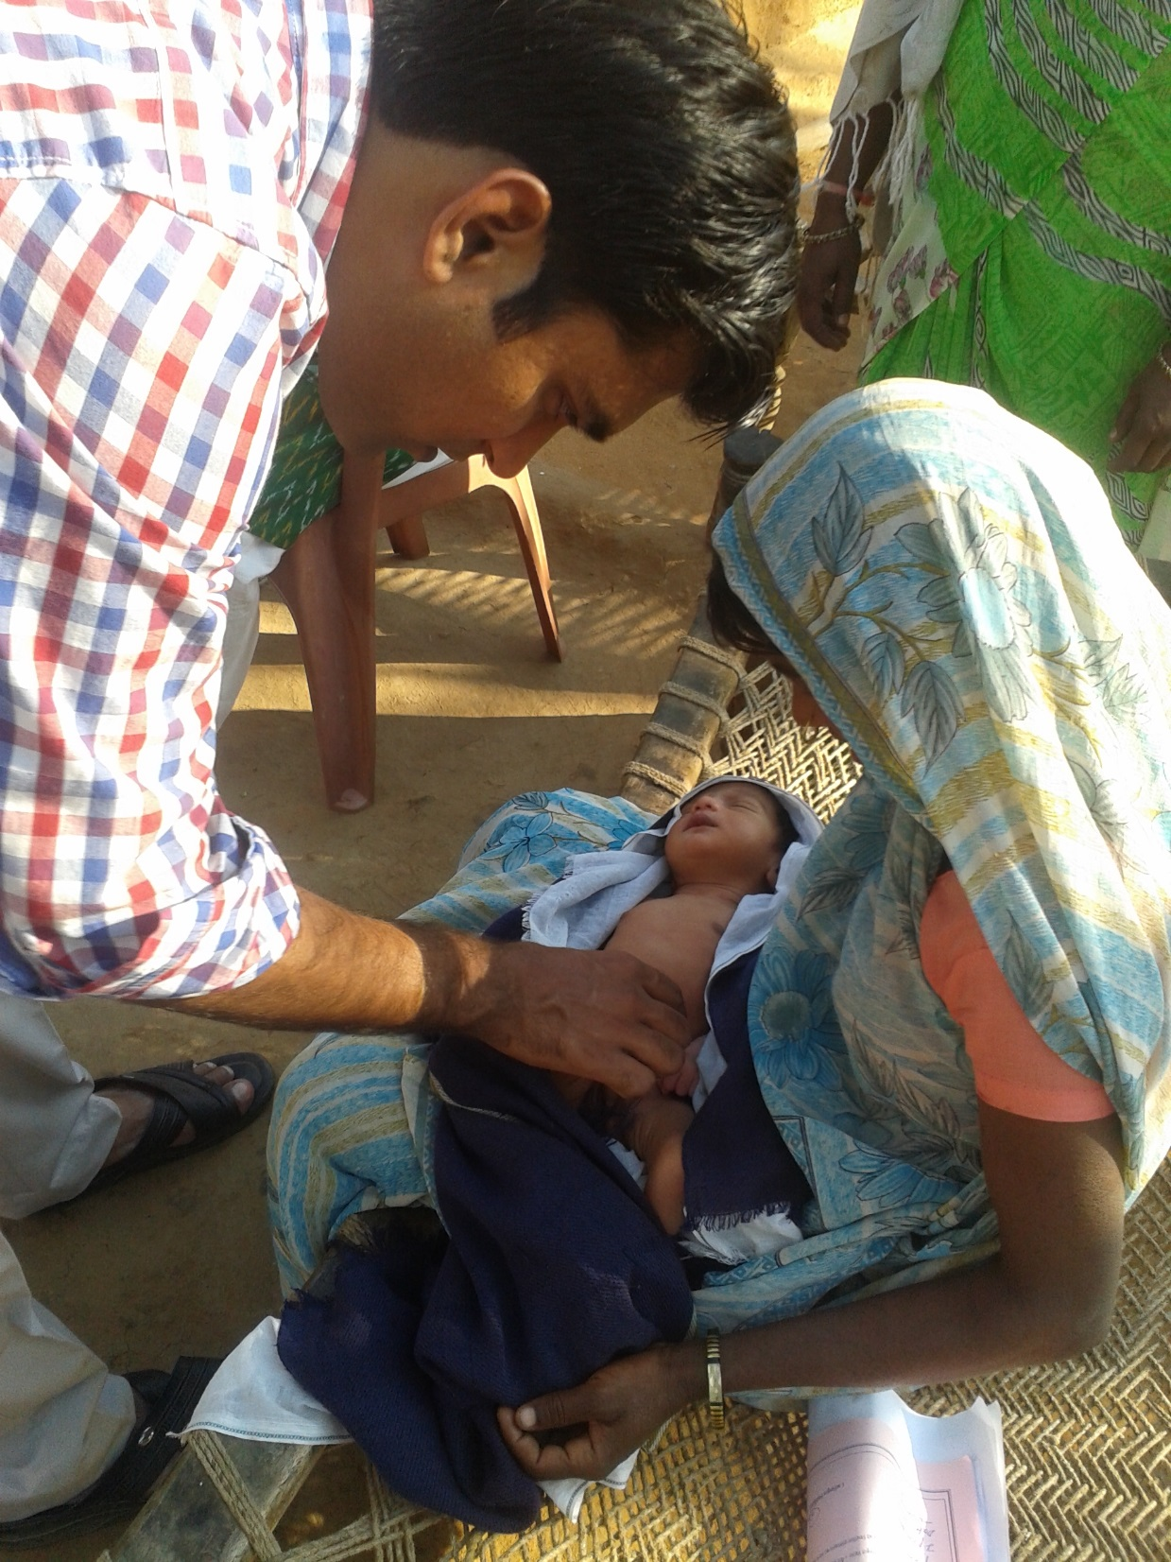
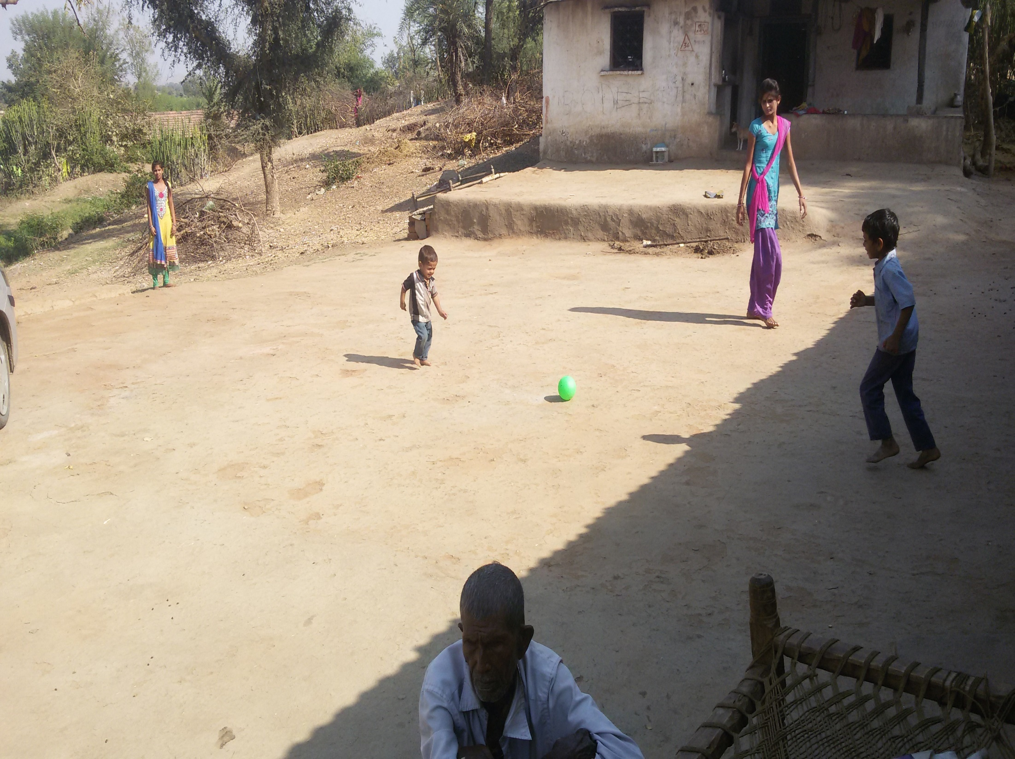
Struggle to live..
Walking Extra Miles
Transformation
Ambu bag is a magical instrument …..Staff

Slide 3

Every Health Facility is
a living organism

Slide 4
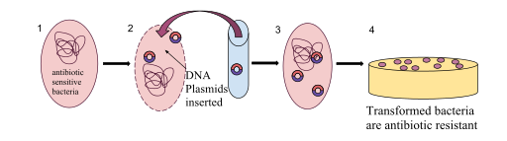
Transformation : Process of Cell Evolution to improve Cell Quality
Enabling Environment
Competence
Catalyst

Slide 5












Transformation of Health Facility Organism
Enabling Environment
Competence
Infrastructure
Supplies & Equipment
Medicines & Drugs
Human Resource (?)
Policies and Guidelines
Skills
Practices
Attitude
Behavior
Team Work
Motivation
Catalyst
Onsite Mentoring

Slide 6
Mortality Rate as per SRS
Trends of U5 Mortality : Rajasthan

Slide 7
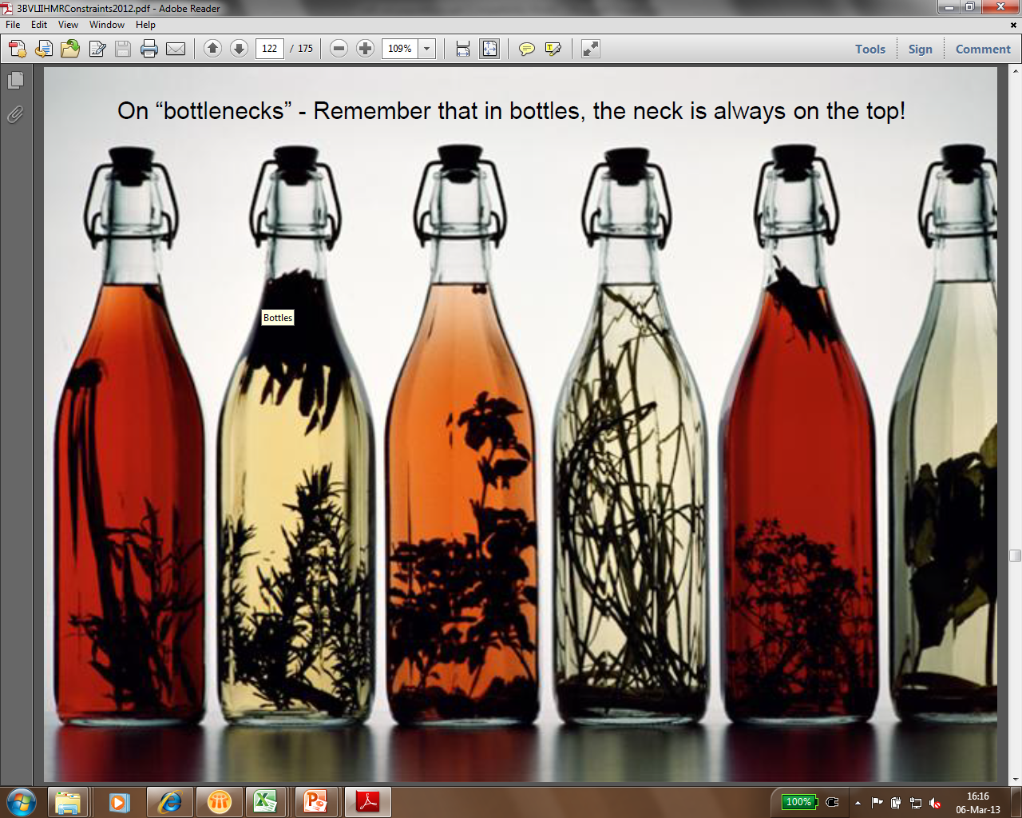

Where’s the Bottleneck???
  Skills and managerial capacity found low at every level
  Disproportionate work load, health facilities/individual
70% actions required at local level
  Skills and managerial capacity found low at every level
  Low Motivation Levels – Doctors and Paramedical staff
  Lack of Supportive Supervision Mechanism
  Standard Treatment Protocols – Poor Implementation
  Suboptimal quality /pace training on SBA and newborn skills

Slide 8
Strategic skill building
Onsite Mentoring
Low dose high frequency
Theme based
Evidence based interventions
Reaching critical mass
Supportive & respectful learning
Creating local resource pool
On spot solution of issues
Learning by doing – hands on
Team skill building
Regular post training follow up
Focus on Quality of Care (Intrapartum and essential newborn care)
Generating healthy competition

Slide 9
Intrapartum and Essential Newborn Care Focused
Themes
Newborn Resuscitation
Intrapartum Care including obstetric complications management
Care of Small and Sick Newborns
Essential Newborn Care
Infection Prevention and Management
Prevention of Parent to child transmission
Appreciative Inquiry – Discovery and Dreaming
Appreciative Inquiry – Designing & Delivery , Vision 2020
Post Partum IUCD

Slide 10
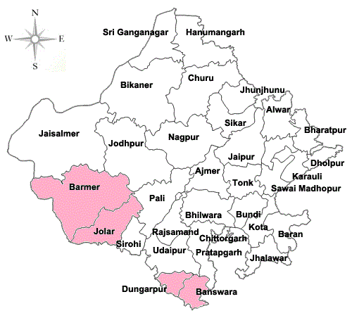
Onsite Facility Mentoring Structure
140 High Delivery Load Institutions
1.1 Lakh Deliveries per year (70% of district load )
4 High Priority Districts
42 Mentoring Teams
2 Members Per Team
Avg 3 Facilities per team
Bimonthly Thematic Visits
Android based checklists
    Motivator , Examiner , Negotiator ,Teacher , Organizer , Reviewer
Notes:
Size of Barmer

Slide 11
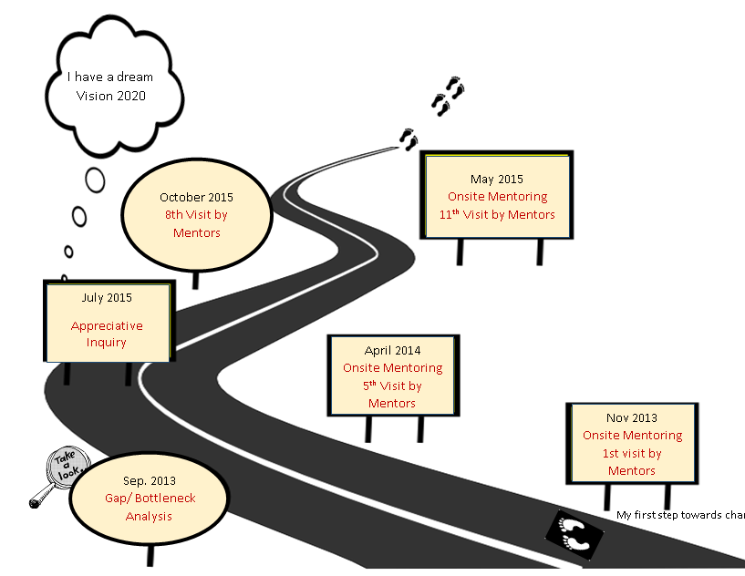
Journey on Road to Transformation
2016 The Journey Continues …

Slide 12

Transformed Living Organisms…Health Facilities

Slide 13
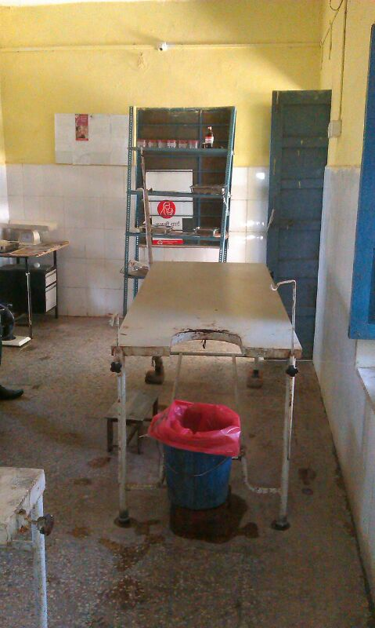
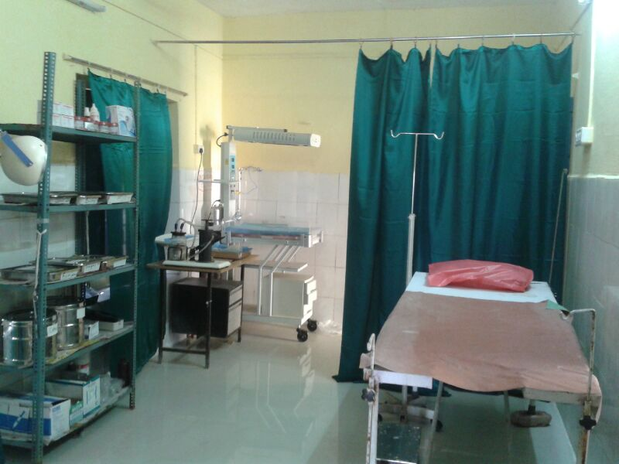
Transformed Facilities
Enabling Environment

Slide 14
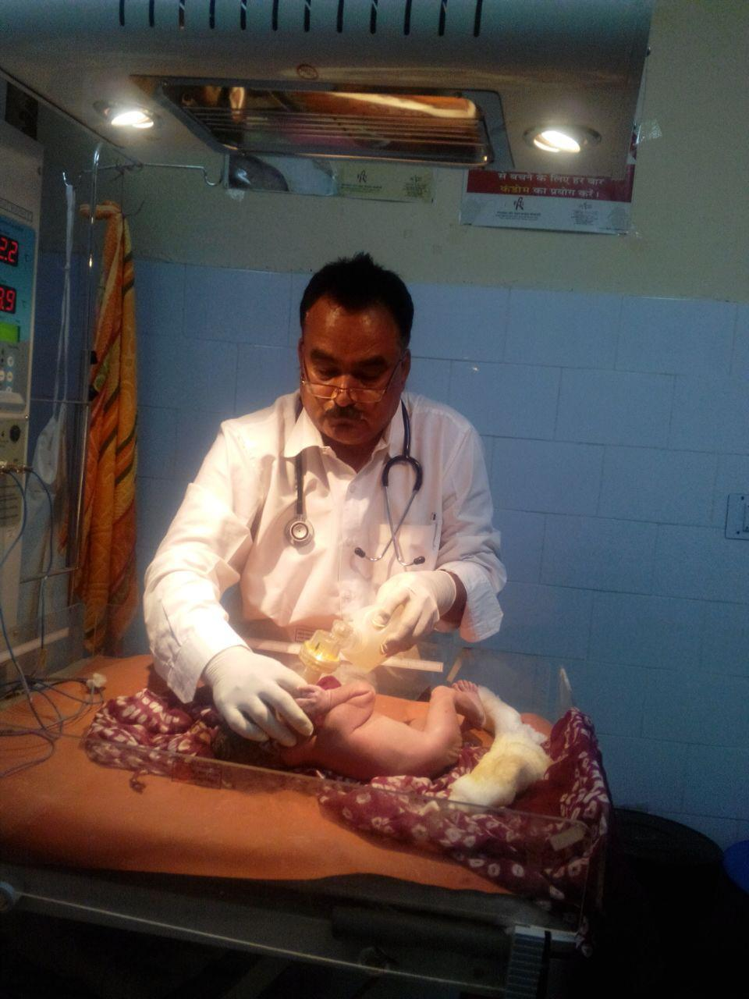
Competence
Enabling survival with skills and confidence

Slide 15
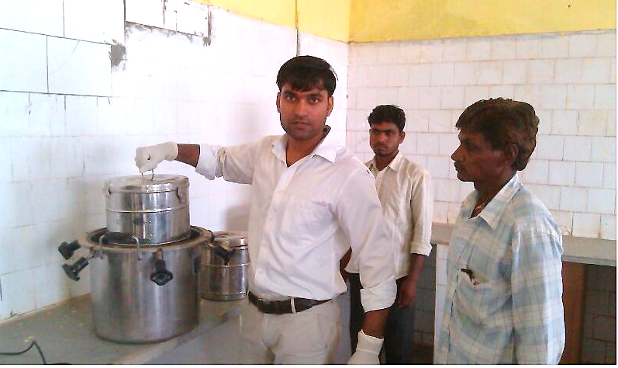
Most neglected is now in focus

Slide 16
Infrastructure for ANC, Natal and PNC care
Quality ANC
Quality Intranatal and ENC
Quality PNC
Bio Medical Waste Management
Recording & reporting
Capacity Development
Transportation
Cold Chain Management
Supportive Supervision
N=140 Health Facilities

Slide 17
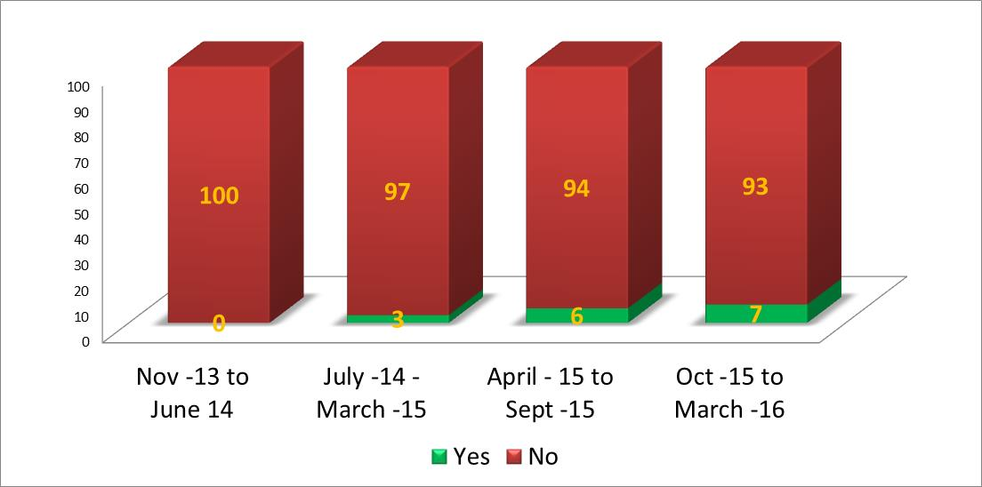
% of Pregnant Women Observed During Delivery Whose Partograph Was Maintained Correctly (n=936 )

Slide 18
% Of Pregnant Women Whose Third Stage Of Labour Was Managed Actively (n=936)

Slide 19
% Newborns observed who received Essential New-born Care Thermal Regulation Breastfeeding and Asepsis (n=936)

Slide 20
17% decline in Still Birth Rate : Source HMIS and Facility passbooks

Slide 21
% mentored facilities where PPIUCDs services are provided through trained staff (n=140)
* Data Not Available from Nov -13 to June 14

Slide 22
PPIUCD Journey in Rajasthan

Slide 23

Every day a small step would take us there !!
600 Facilities in 2016-17
across the state….

