Slide 1
Establishment of District NCD Complex under NPCDCS and NPHCE in Odisha
An innovation in Public Health Care System

Slide 2
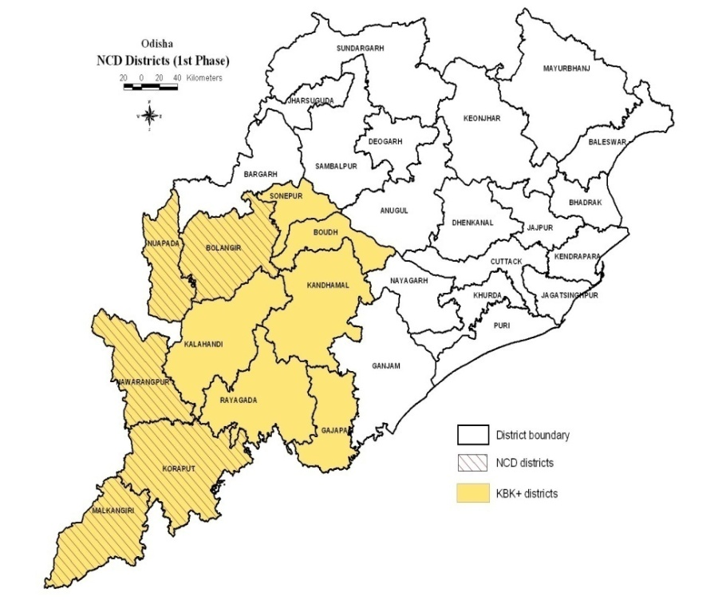
Background
The NPCDCS and NPHCE were launched together during 2010-11 in the 5 selected KBK and most challenged districts in Odisha as far as infrastructure and HR are concerned
Those districts were Malkangiri, Koraput, Nabarangpur, Bolangir and Nuapada.
OPD was congested and over crowded barely any space for NCD activities.
It was difficult to deliver services like critical care through 6 bedded ICU, elderly care through 10 bedded Geriatric ward, Day Care Cancer Chemotherapy through 4 bedded Day Care unit, PT unit, NCD clinic and NCD Cell within District hospital.
No built-up area in existing building for indoor Services

Slide 3
Program Description
An innovation was planned to utilize funds released Rs. 80 lakhs for construction of 10 bedded Geriatric ward under NPHCE and 20 lakhs for construction of 6 bedded ICU together under NPCDCS.
The engineering division of NRHM was requested to develop building plan of an integrated NCD Complex which will accommodate 10 bedded geriatric wards, 6 bedded ICU, 4 bedded Chemo unit, PT unit, NCD Clinic, Patients waiting space, Lab etc under one roof.
Plan was drawn and with estimation within Rs.1.0 cr.
The building plan was approved by State NCD Cell and Administrative approval was given to line department by Director Health Services and funds were released from both the programs.

Slide 4
The construction works were continuously monitored by the Principal Secretary, Health & FW in every monthly meeting with Works department.
In the mean time tendering process was initiated for procurement of ICU equipments, Geriatric beds, physiotherapy equipment, chemo equipments, lab equipments and furniture.
Within one and half years the construction works completed.
In the mean time the necessary staffs under NPCDCS and NPHCE like counselor-1/each district under NPCDCS, PT-1/2 for each district, Staff nurses-5-8 per districts under NPHCE/NPCDCS/ICU for NCD clinic, district cancer facility and ICU were engaged.
3-4 doctors were deployed to ICU but theirs services could be utilized in Geriatric ward, chemo wards and NCD OPD.

Slide 5
State govt created additional posts for ICU @ 3 doctors, 10 staff nurses, 1 pharmacist, 1 lab. Technician, one X-ray technician, one gas technician and 3 ward attendants.
A capsular course of 3 months on critical care and ICU management was developed and training was started at Apollo Hospital, Bhubaneswar.
The NCD complex was made functional in all 5 districts with starting of ICUs along with geriatric wards, physio unit, and NCD clinic.

Slide 6
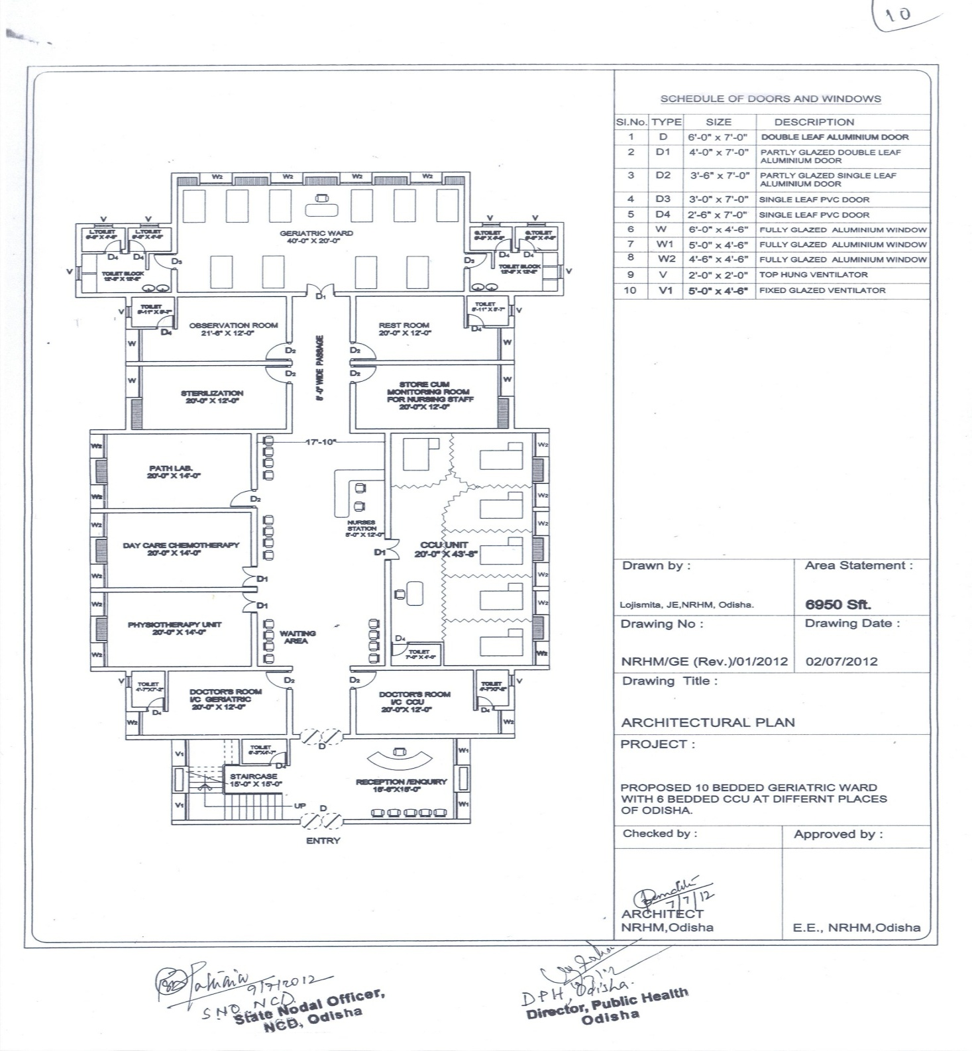
Layout map of NCD Complex
Service Components of NCD Complex:
NCD Clinic
6 bedded ICU
10 bedded Geriatric Ward
4 bedded Chemo Unit
Physiotherapy Unit
Tobacco Cessation Unit
Lab
Pharmacy
Patient waiting space with all necessary amenities

Slide 7
Establishment of District NCD Complex and its operationalization within the District HQ Hospital premises resulted in development of one asset for district to deliver comprehensive care to NCD patients under one umbrella including critical care through ICUs and Cancer chemotherapy and counseling through NPCDCS staff and PT care and Geriatric medical care by NPHCE staffs &
Programme Outcome
The tobacco cessation unit has also become a part of NCD complex. This complex has resulted in rational utilization of HR in a more comprehensive manner.

Slide 8
NCD Complex also helped in rational utilization of services of staffs appointed under both the programs and under ICU in a more comprehensive manner.
Multi-skilling of these staffs gave us better scope to functionalize all the service components of NCD Complex

Slide 9
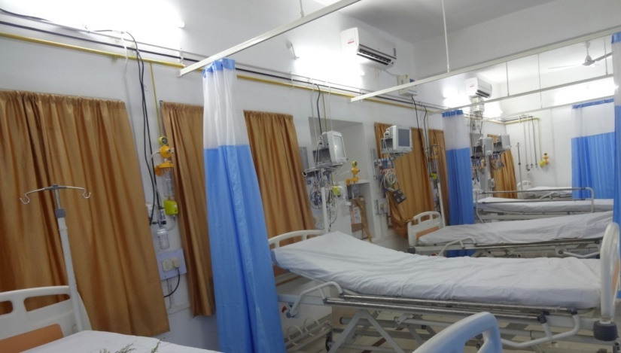
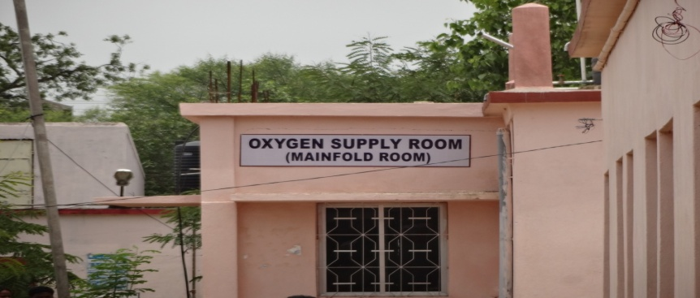
Operationalisation of 6 bedded ICU/CCU and 10 bedded Geriatric wards

Slide 10
Scalability Civil components of NPHCE and NPCDCS and other NCD programs can be clubbed and utilized to construct a comprehensive NCD Complex. Utilization of funds and HR will be more rational.

Slide 11
Implementing partners NPCDCS, NPHCE, District Health System and R&B of Sate Govt.
Financial Implications Cost for setting up District NCD complex was Rs.1.00 cr. on civil work
and for Rs.1.37 crs for equipments and furniture

Slide 12
Establishment of District NCD Complex is An example towards Sustainable Development Goal

Slide 13
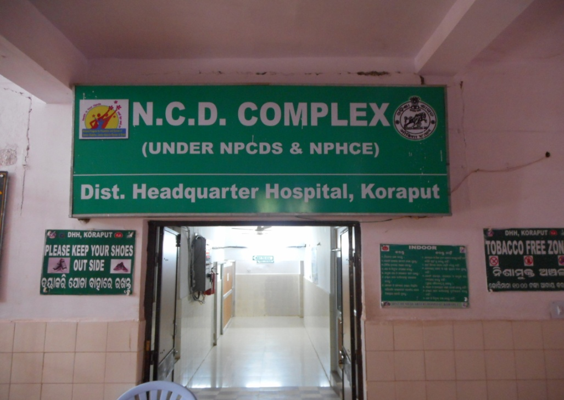
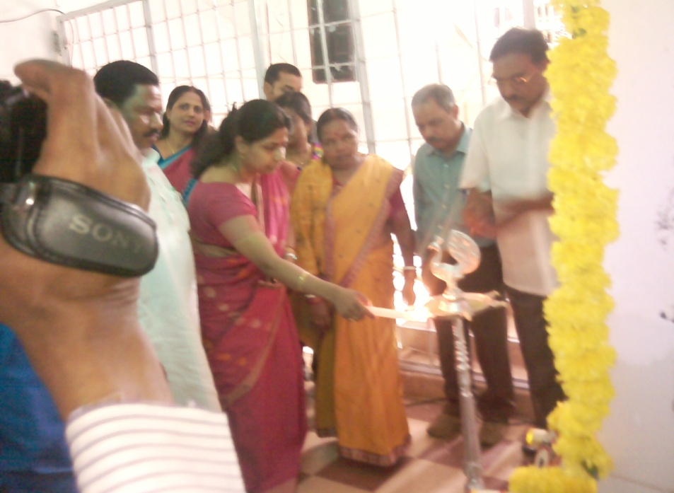
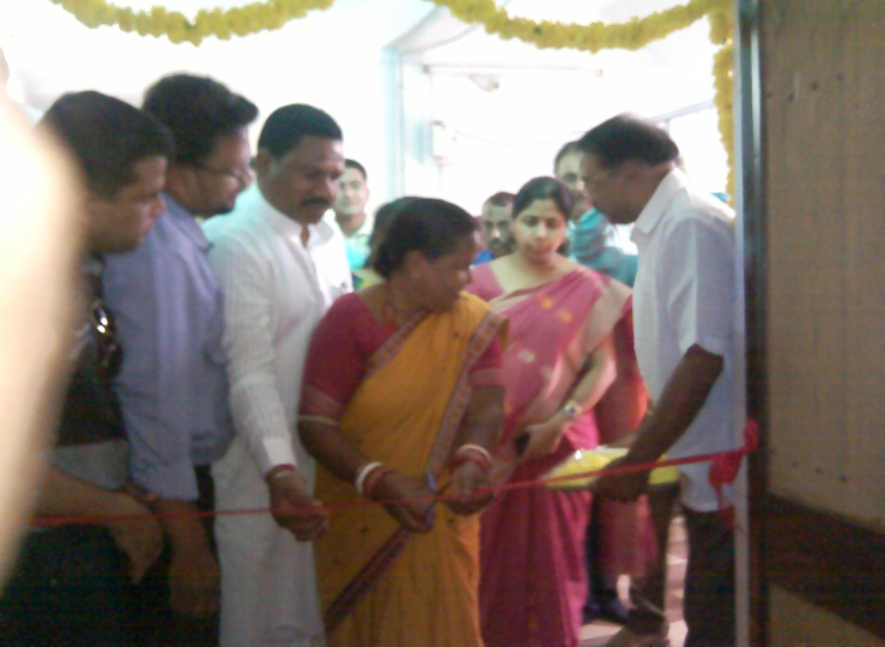
NCD Complex Koraput inaugurated on 04.07.2014 by Zilla Parishad Chairperson

Slide 14
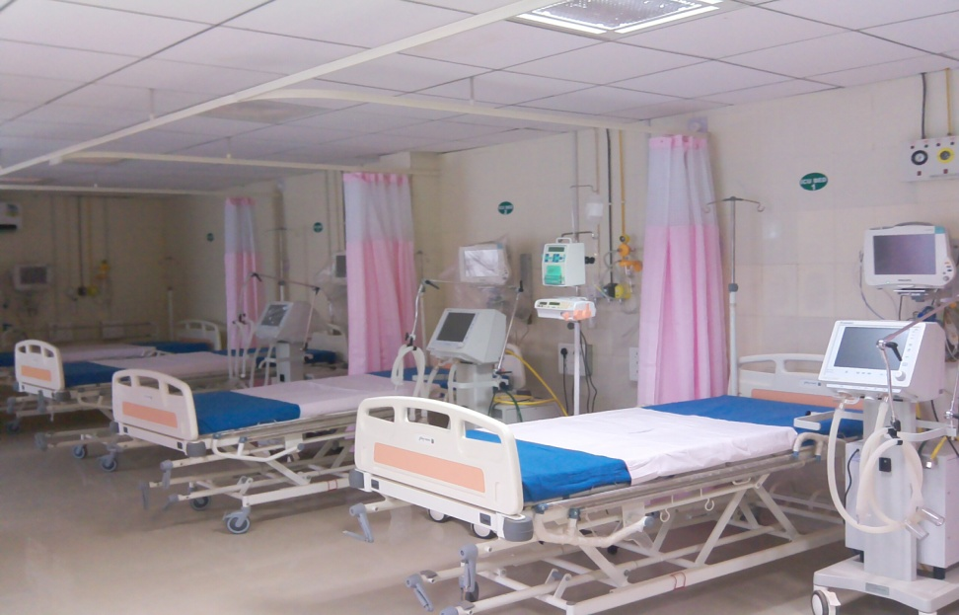
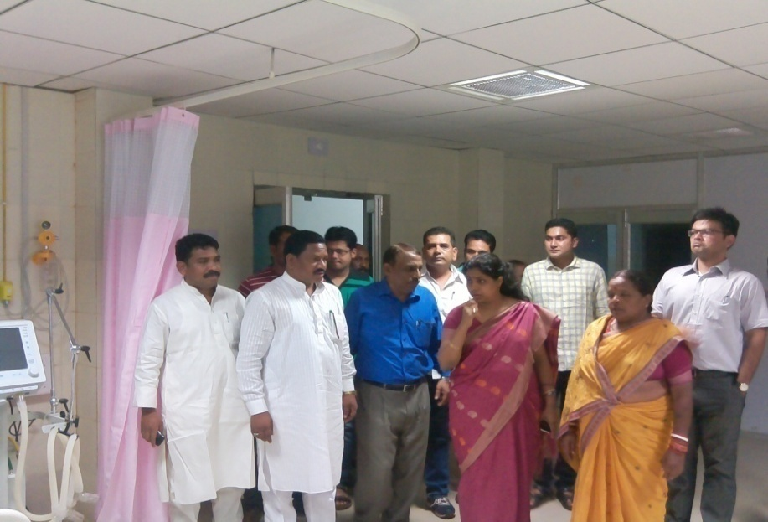
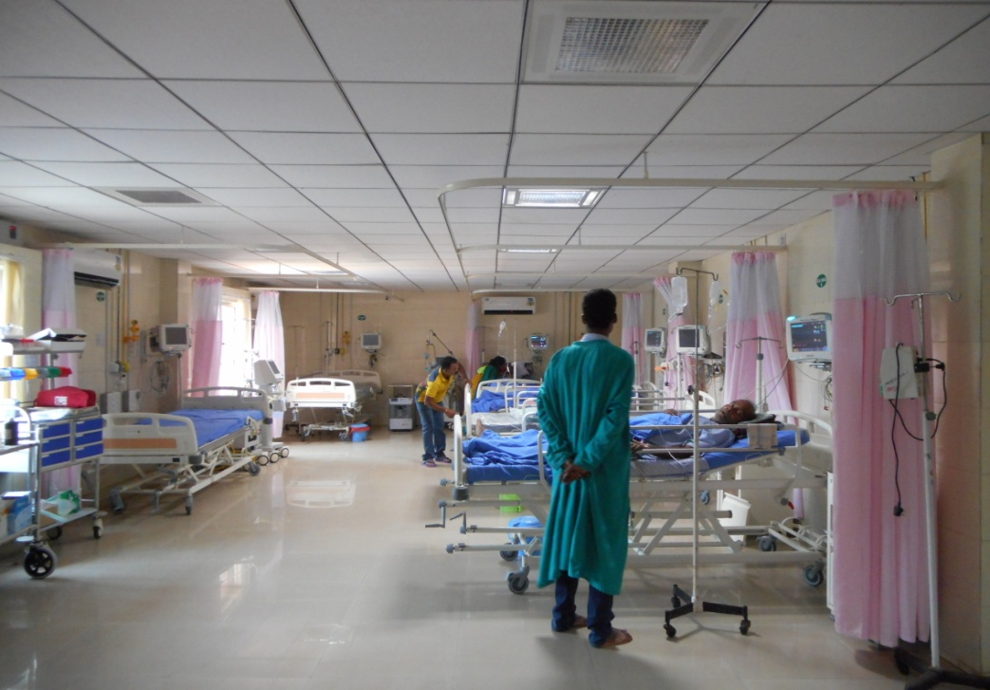
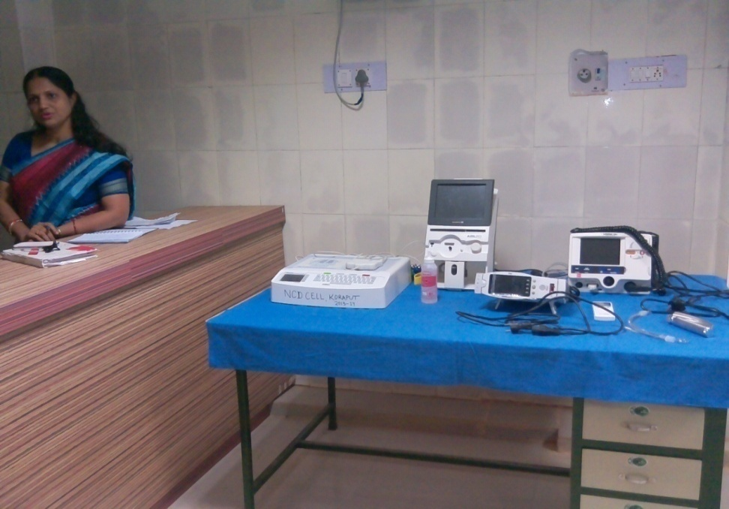
NCD Complex of Koraput District Hospital

Slide 15
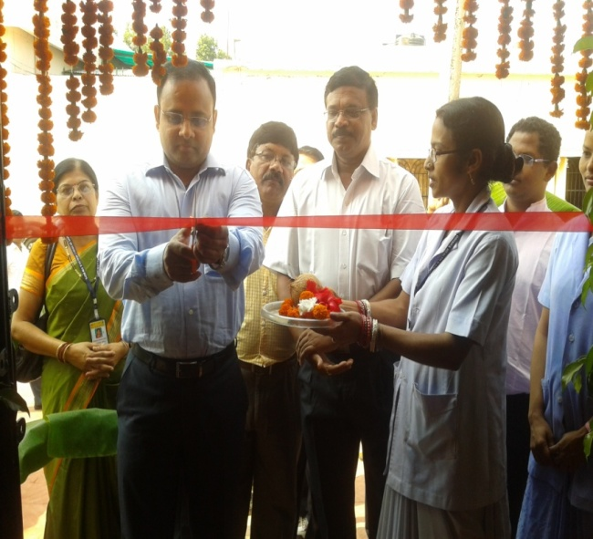
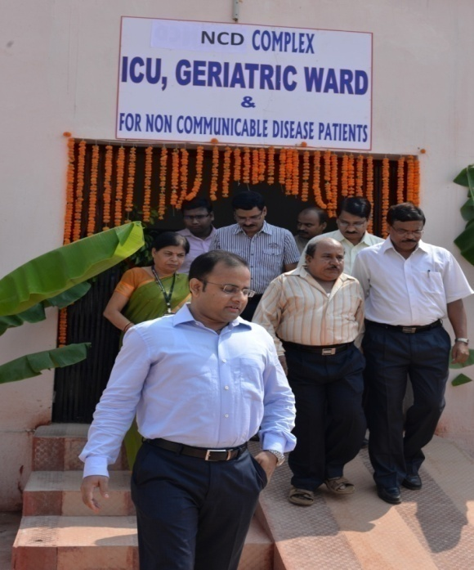
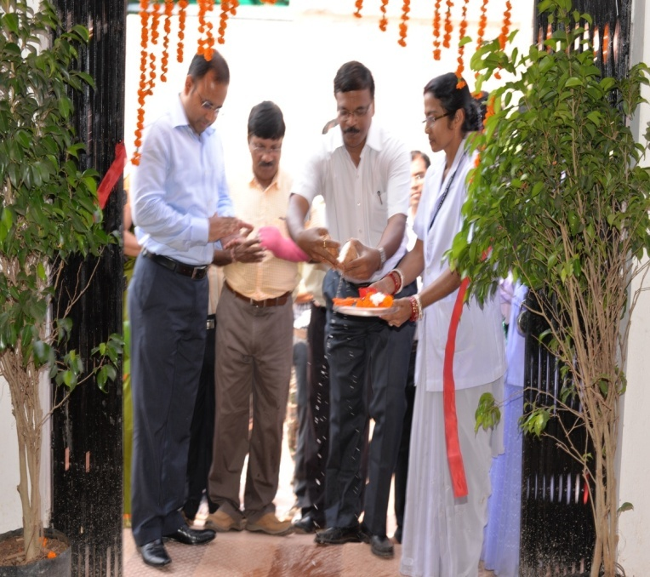
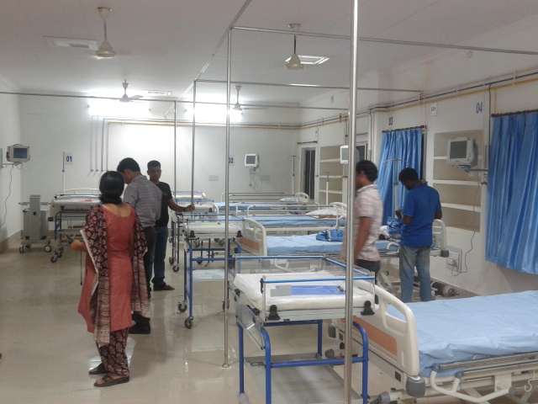
NCD Complex of Nabarangpur
Inaugurated by Collector cum DM of Nabarangpur District

Slide 16
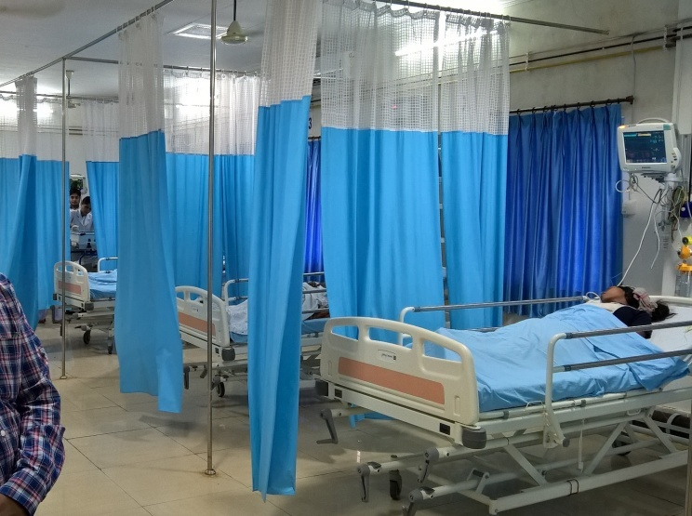
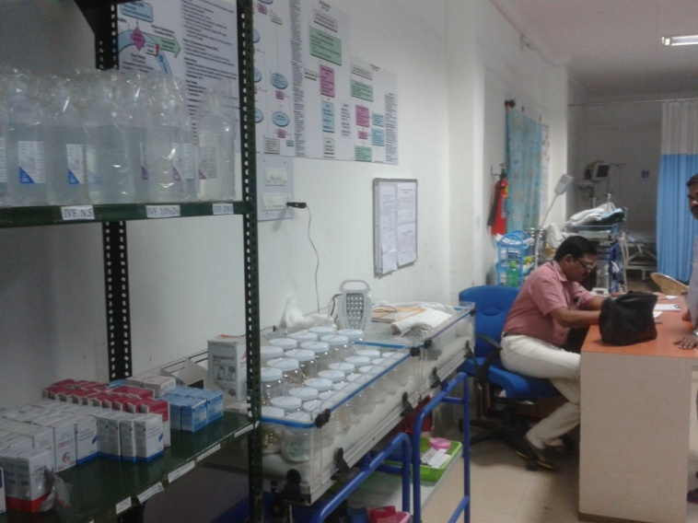
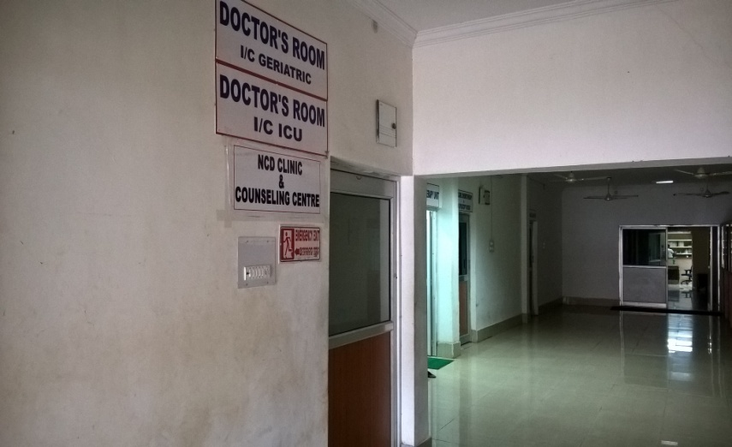
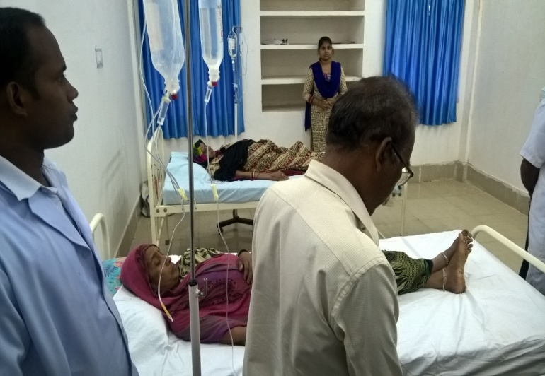
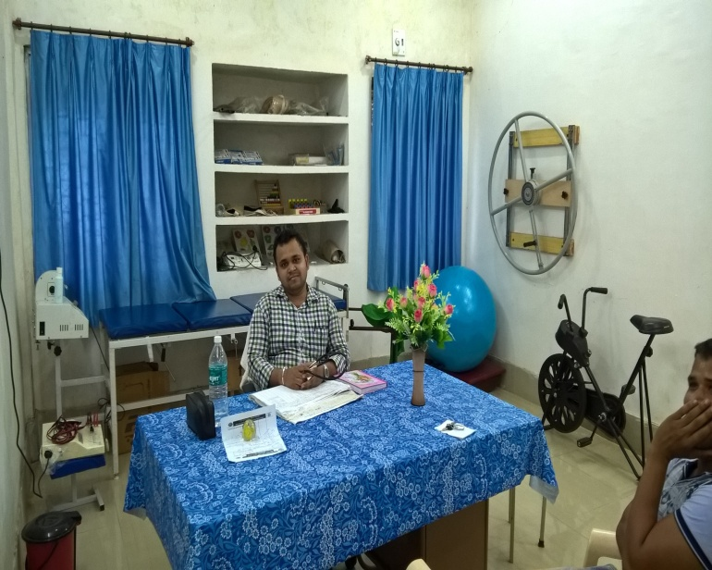
NCD Complex Nabarangpur
NCD OPD Clinic
ICU
Pharmacy
Chemo beds
PT unit

Slide 17
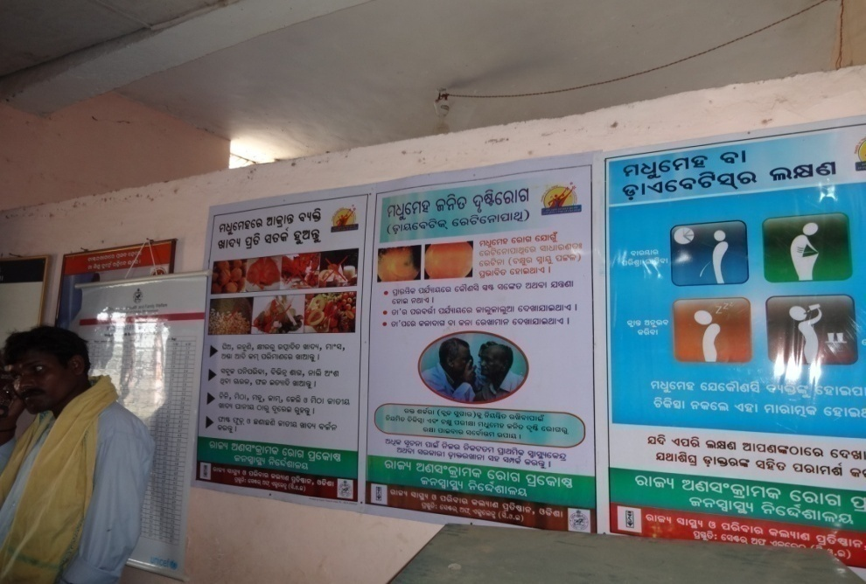
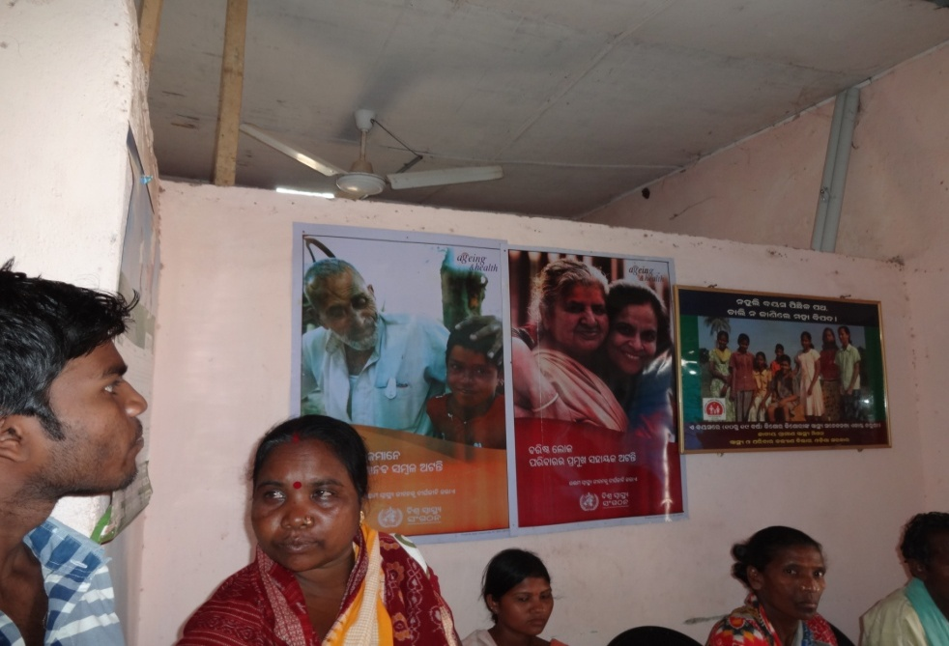
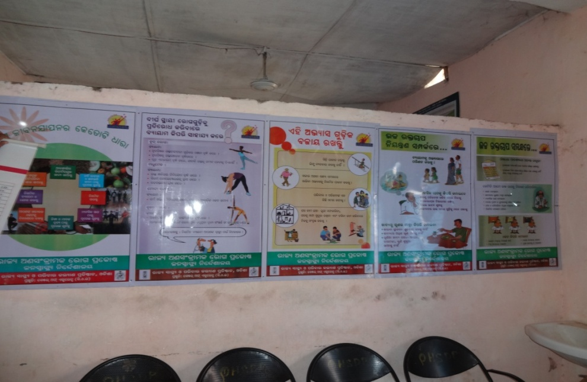
IEC activities
Multi colored Tin Plates showing 10 different IEC messages on Diabetes, CVD, Stroke and Health Care of Elderly were desplayed on the wall of NCD Complex

Slide 18
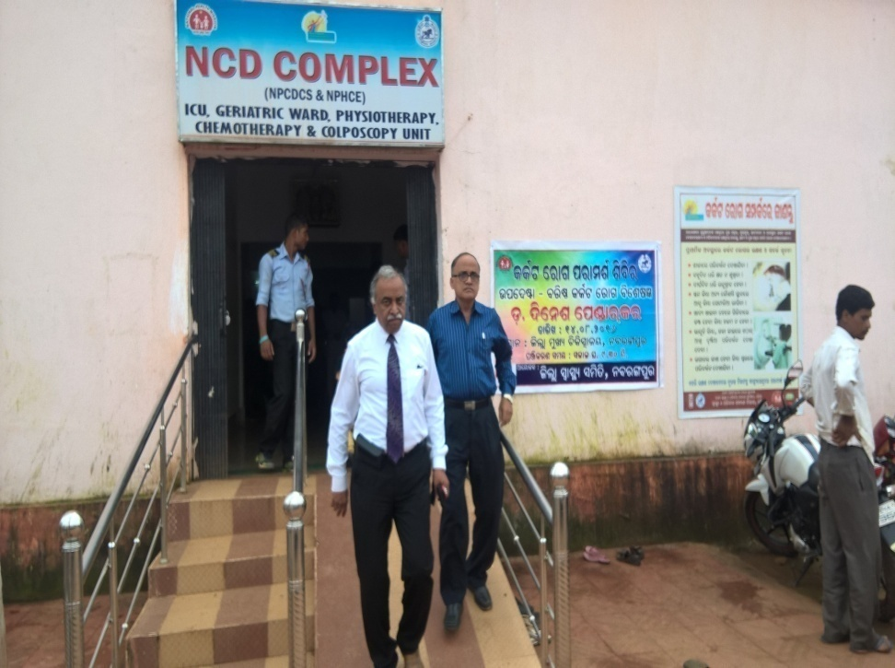
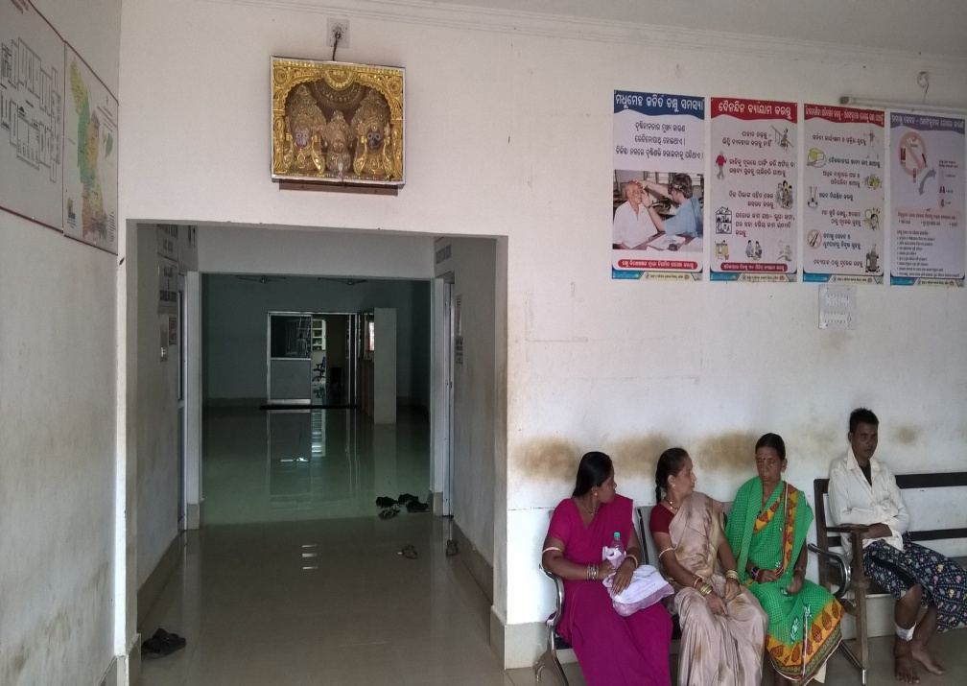
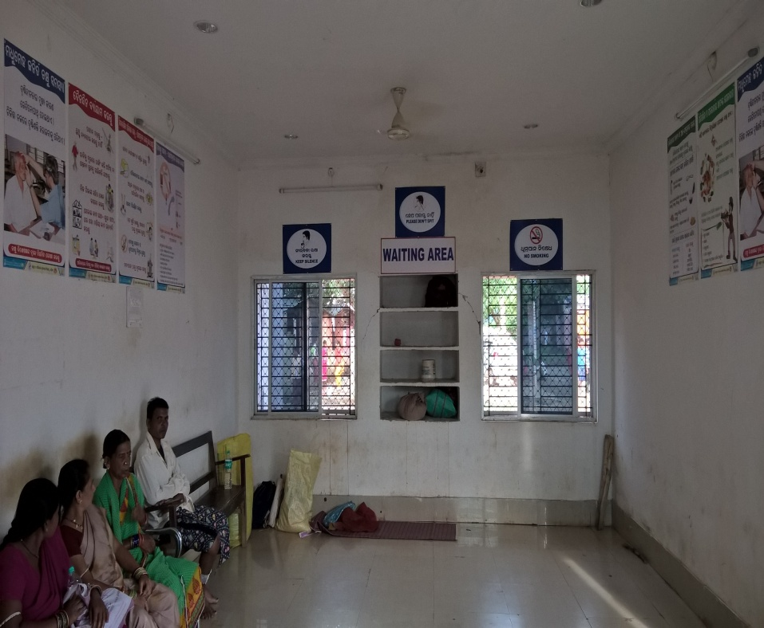
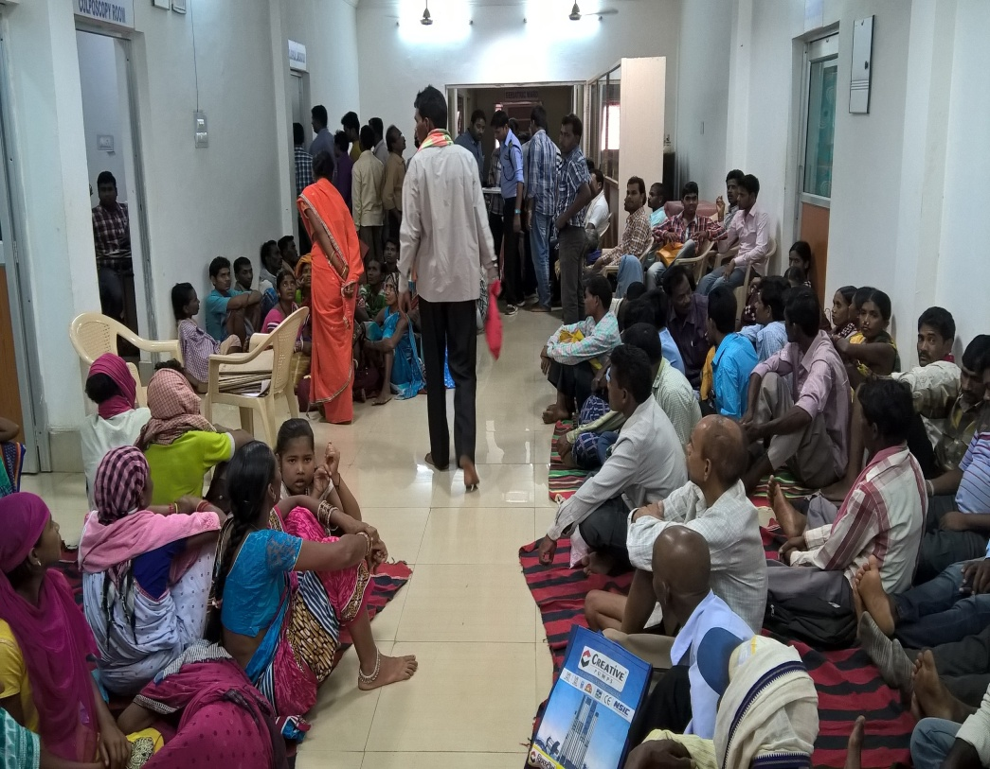
Pts waiting space
Pts waiting space
Pts waiting space

Slide 19
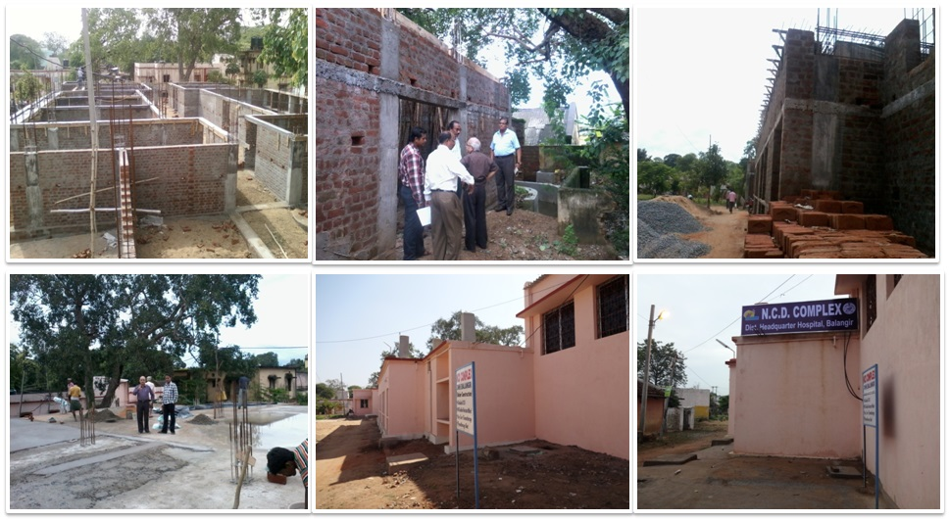
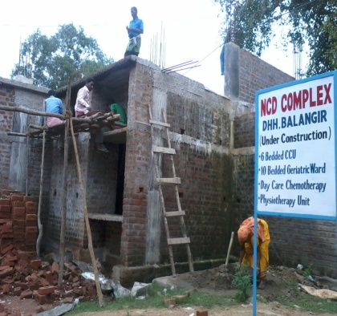
NCD COMPLEX,DHH, BALANGIR

Slide 20
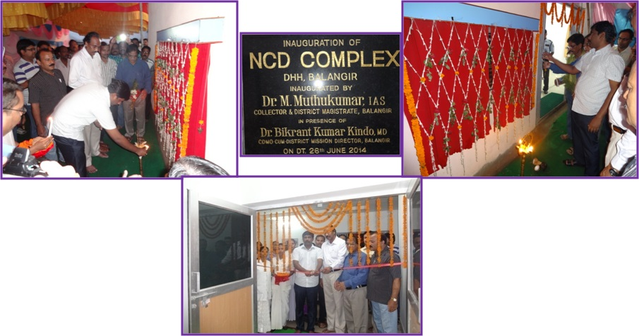
NCD COMPLEX inaugurated by Collector & DM, Balangir on dt.26.06.2014

Slide 21
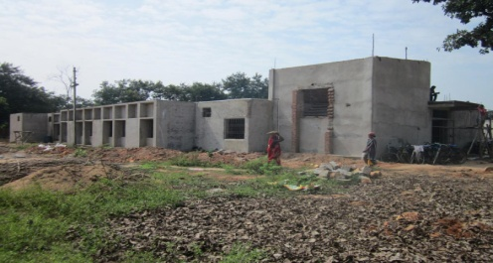
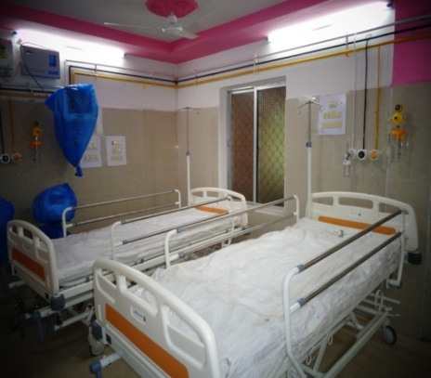
NCD Complex of Nuapada District
NCD Complex of Malkangiri District

Slide 22
Operationalisation of 6 bedded ICU/CCU and 10 bedded Geriatric wards

Slide 23
Thanks

