Slide 1
Mobile Mamta Diwas: Gujarat Experience
National Health Mission,
Health and Family Welfare Department,
Government of Gujarat

Slide 2
Problem Statement of Kaprada Taluka
Valsad District is predominantly tribal with population of 17,03,068 (Census 2011)
63% is rural population, 54.8% of it is tribal (Census 2011).
Kaparada Taluka having 100% tribal population – about 260,000
Hilly terrain, covered with dense forests
Very scattered and distantly located population divided in small hilly and remote hamlets
Extremely difficult to provide regular and continuous health services to all
Some areas were completely left out in providing services despite best planning, dedication and efforts from the Health Department.

Slide 3
Proactively Reaching the Unreached
Objectives
Ensure immunization of all pregnant women, children and adolescent girls.
Ensure ANC and PNC
Make quality services available to habitants of difficult to reach areas
Ensure appropriate health messages and counselling services reach out to all
Strategy
These areas would be covered as per the pre-formulated route plan.
The route plans prepared at the district level as a part of VHND micro planning activity.
Each vehicle leaves respective PHC in the morning, reach the pre-decided static point in the identified area and cover the target population.
The vehicle also carries the Bio Medical Waste back to the PHC.

Slide 4
Reaching Out to Difficult Areas

Slide 5
Planning the Route to Reach Out to the Unreached

Slide 6
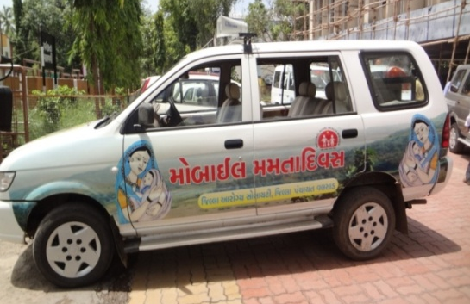
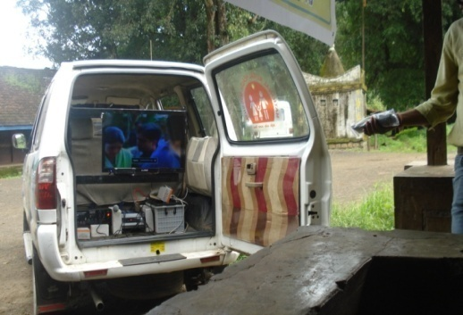
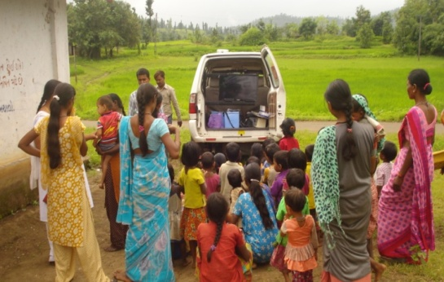
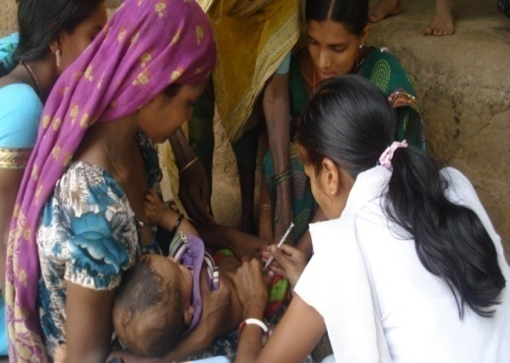
Service Delivery through Mobile Mamta Diwas
Launched on 31st August, 2013
ANC & PNC Check-up
Immunization Services
IMNCI & HBNC assessment
Counselling of adolescent girls, eligible couples and antenatal women.
Nutrition Services & Growth monitoring of children (0-5 years)
IPC activities through customised way

Slide 7
Project Support
Human Resources involved in Mobile Mamta Diwas:
One ANM/FHW and one MPW
ASHA and AWW for mobilization and prior communication
Operational & Monitoring Support
Special high chassis Vehicle for hilly region;
IEC- TV Display for wider dissemination
District Officials route plan for supportive supervision
Regular Monthly Review on physical and financial performance

Slide 8
Cost Implication of the Project
Financial Support for this Year in NHM PIP 2015-16 (cost Rs. 5,22,000/ Per Unit/Year)
BL B.14.5.6 Mobile Mamta Divas under State Innovation
Sr. No. | Particular |  | Unit | Unit Cost | Month | Total
1 | Rented Vehicle |  | 4 | 35000 | 12 | 1680000
2 | Operation Cost |  | 4 | 2000 | 12 | 96000
3 | Additional Staff |  | 4 | 6500 | 12 | 312000
 | Total |  |  |  |  | 20,88,000

Slide 9
Improvement in Maternal Health in Kaparada Taluka (Figures in Percentages)

Slide 10
Improvement in Immunization Services

Slide 11
Potential for Scaling Up
Being Cost-effective Experiment, this project has a potential for being scaled up to cover all difficult and hard-to-reach areas of the State
Over the next 3 – 5 years this Service would be scaled up across all the High Priority Talukas of Gujarat

Slide 12
Thanks

