Slide 1



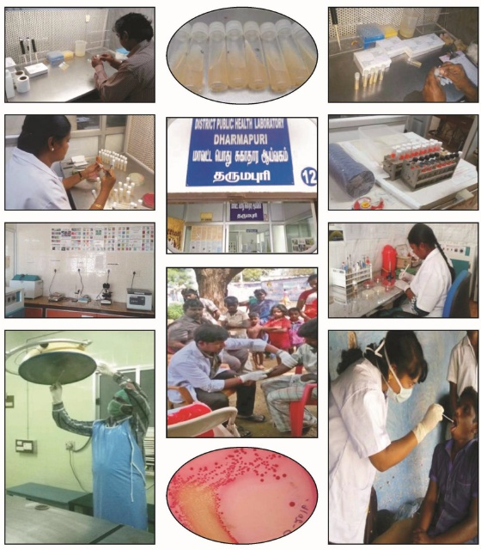

DISTRICT PUBLIC HEALTH LABORATORIES
IN
TAMIL NADU
Dr.Darez Ahmed,I.A.S.,
Mission Director(SHS), Tamil Nadu
3rd National Summit on Good and Replicable Practices and Innovations in Public health Care
Venue : Tirupathy
Date : 30th Aug 2016

Slide 2
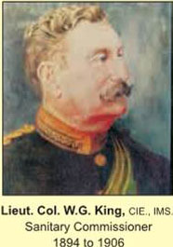
The First Sanitary Commissioner of
Tamil Nadu
Established King’s Institute of Preventive Medicine & Research in 1894
State Apex Lab for Public Health

Slide 3
Tamil Nadu Public Health Service
Separate Directorate of Public Health and Preventive Medicine functions since 1923
Lead by Public Health qualified professionals right from Periphery to Headquarters(DPH&PM)
Own budget (2488 cr/ 25% of state health budget)
Legislative and regulatory underpinnings for Public Health Services (Tamil Nadu Public Health Act, 1939)
32 Revenue Districts including Chennai
  larger districts have two Health Unit Districts (42 HUDs)

Slide 4
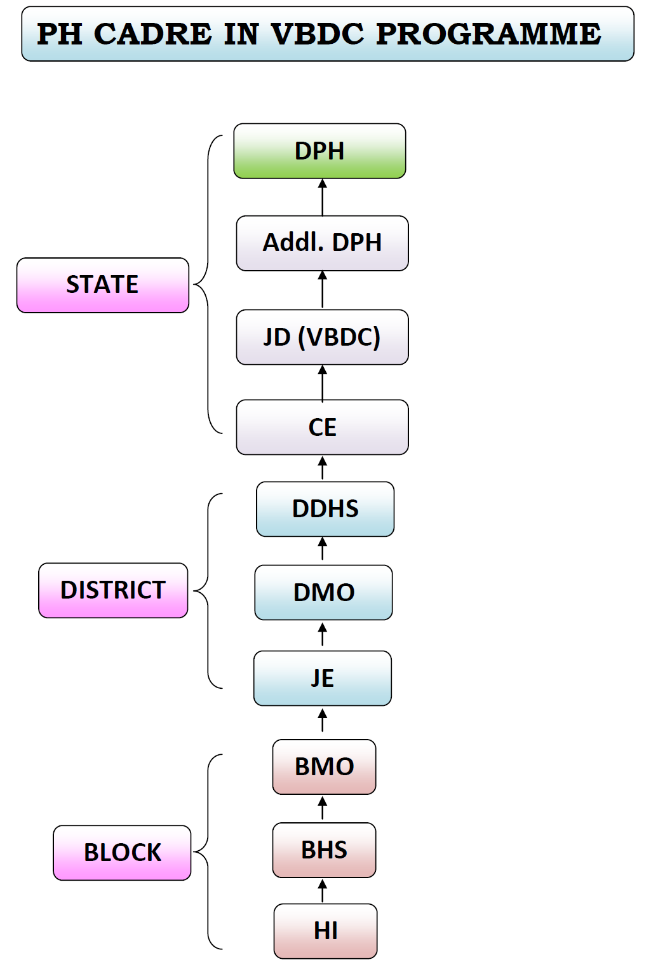

Slide 5
PHL - Background
Public Health Laboratories (PHL) play an important role in the Disease Surveillance Programmes.
DPHL - Backbone of the laboratory network under IDSP for the prevention and control of Epidemic Prone Diseases in Tamil Nadu.
Rationale for Developing DPHL
In 2010, New Concept evolved by GoI to develop District Labs for diagnosis of Epidemic Prone Diseases.
2 Priority District Labs in Cuddalore & Ramanathapuram developed under IDSP in March 2011.
Based on the success, GoI approved 6 DPHL in 2011-12 and 24 DPHL in 2012-13 under IDSP in Tamil Nadu
DPHL attained functional status in May 2013 after the recruitment of Microbiologists

Slide 6
Government Health Care Facilities
 |  | Medical Colleges 21 (+ 1 under establishment) Medical College Hospitals 48
DPHL established under IDSP at Dist.HQ.Hospitals |  | Taluks 16 Non-Taluks 79 HQ Hospls 31
 |  | HSCs 8706 PHCs 1765 UPHCs 134
DME
Tertiary care
DMS
Secondary Care
DPH
Primary Care

Slide 7
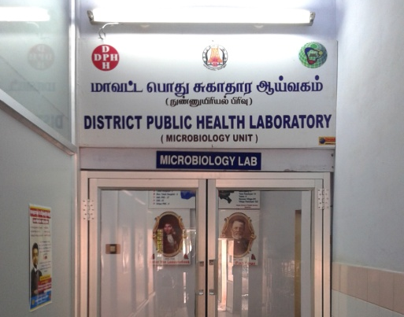
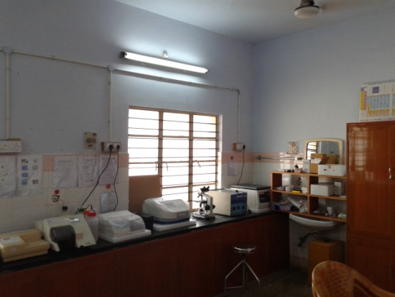
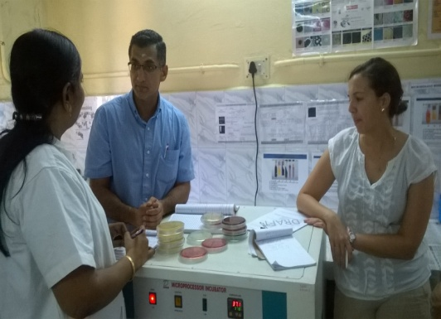
Strategic Location of DPHL
Not established as a stand alone laboratories
Located in the District Head Quarters Hospitals
Dual role supporting the patients for better clinical management and the community for confirmation of epidemic prone diseases.

Slide 8
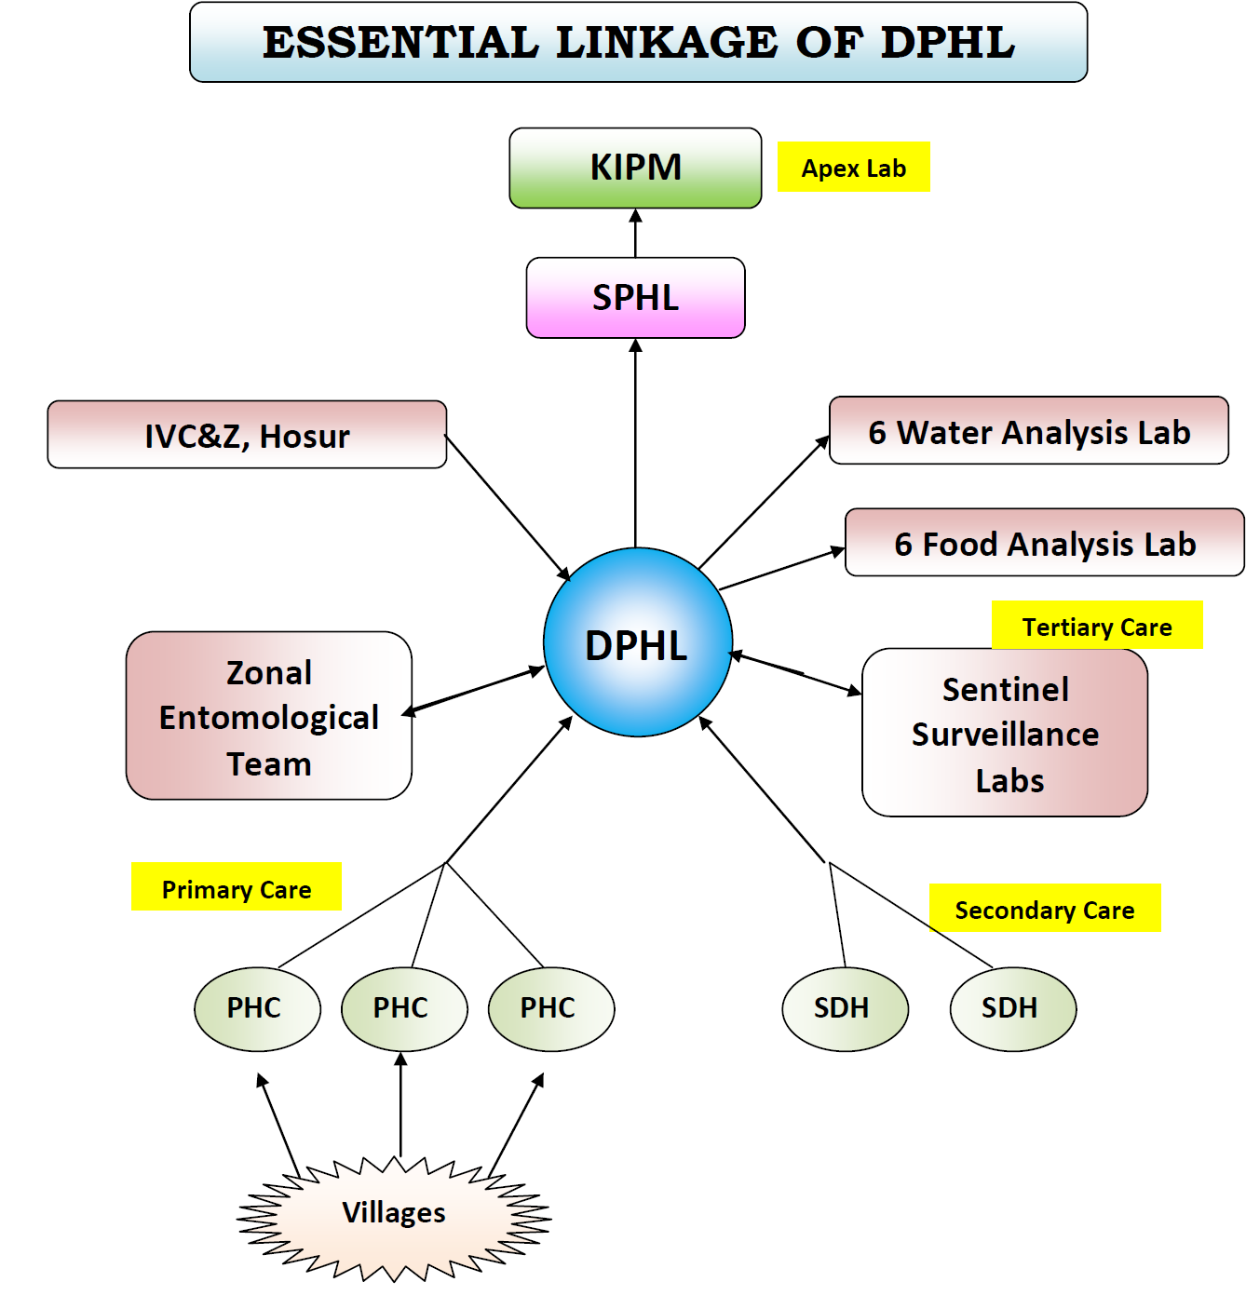

Slide 9
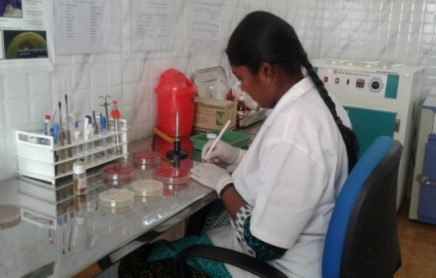
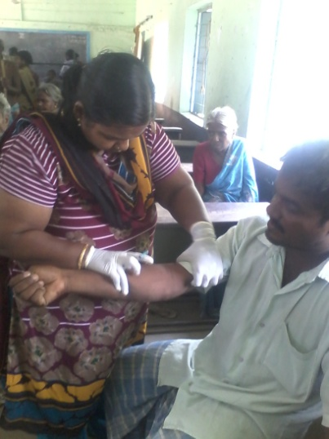
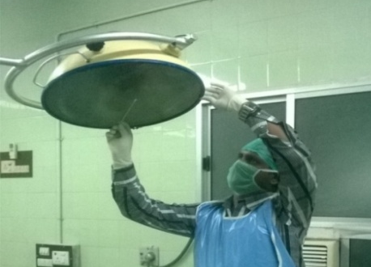
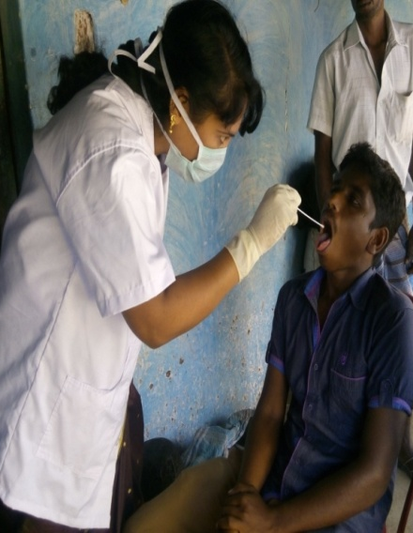
Role of the DPHL
Lab Activities
Field Activities

Slide 10
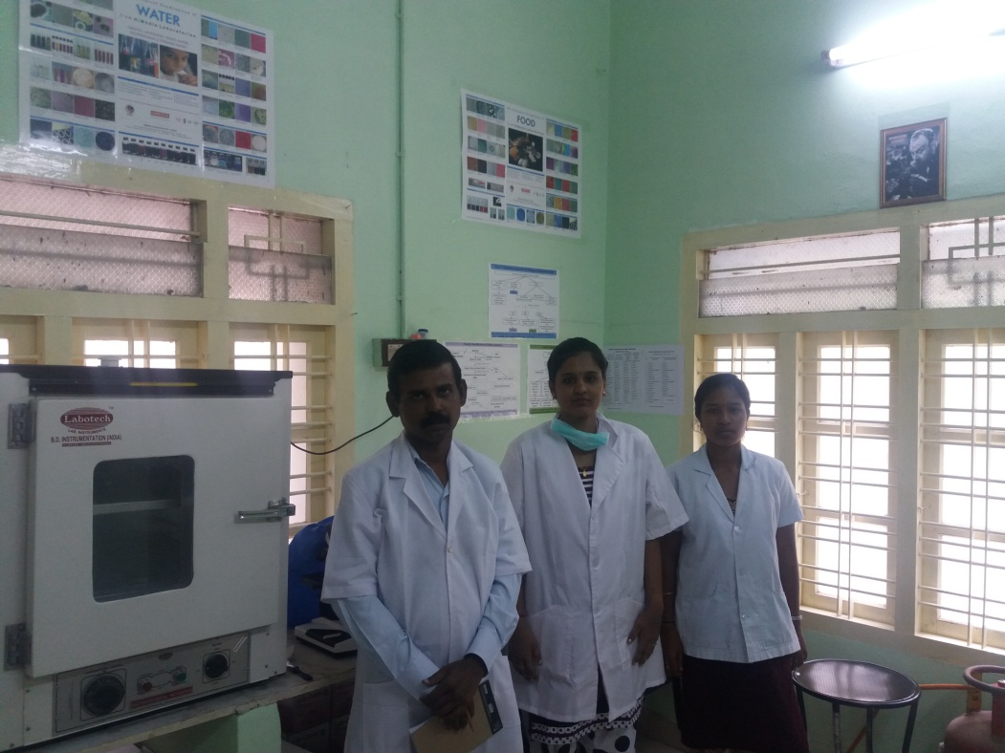
Human Resources
One Microbiologist
One Lab. Technician
One Lab. Attendant

Slide 11
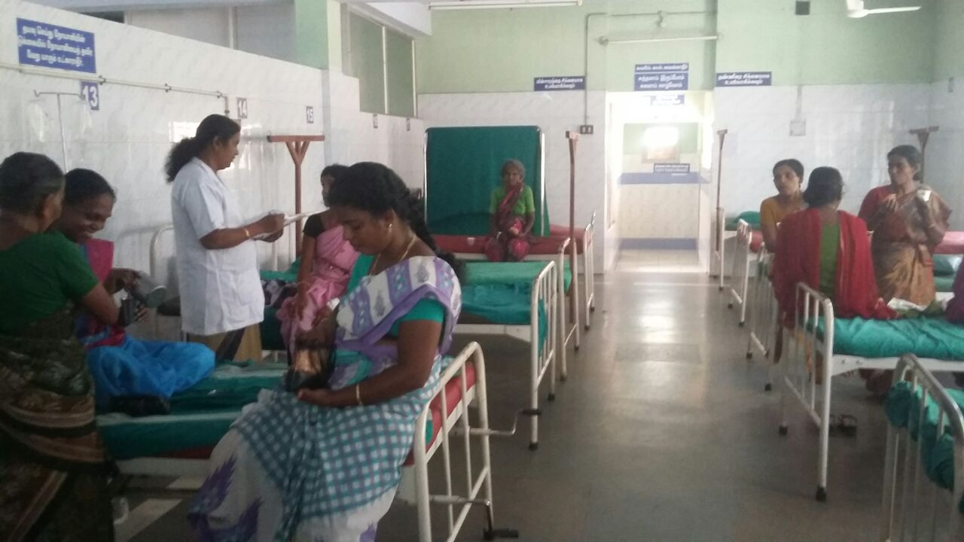
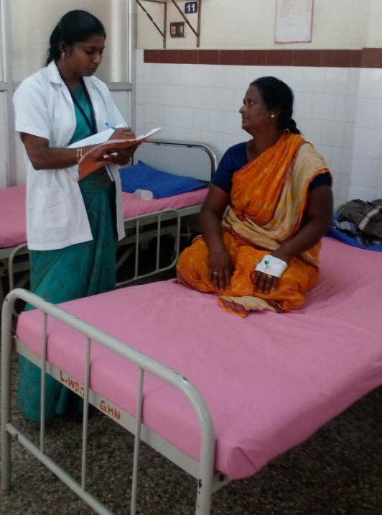
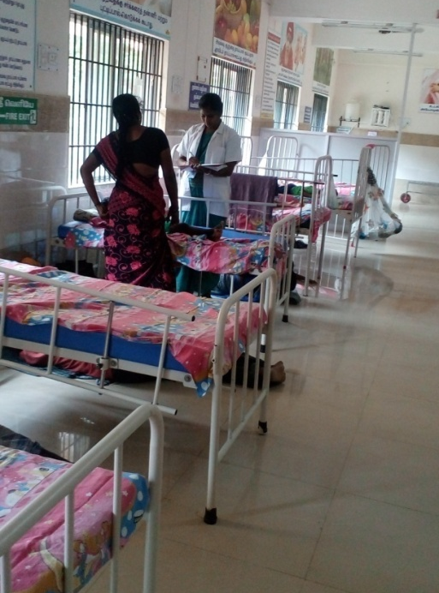
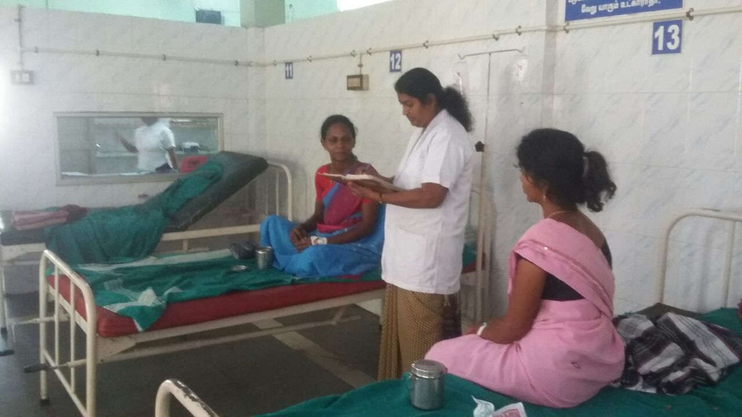
Daily Ward Visits
Detect Clustering of Cases(EWS)

Slide 12
Daily Situational Analysis
Daily admission of Fever, Diarrhoea, Jaundice and AES cases reported.
Line list of all the cases captured.
Clustering of cases notified to PH authorities
Early Warning Signals of impending Outbreaks detected
Prevention of Outbreaks

Slide 13
Diagnostic Services Provided in DPHL
Routine Analysis for,
    Stool Culture & AST
    Blood Culture & AST ( Enteric and Non-enteric Pathogens)
    Culture & AST of other Clinical Specimens
    Serology/ELISA for Dengue, Chikungunya, Viral Hepatitis–A& E, Measles, Leptospirosis, Scrub Typhus, JE etc.,
Operation Theatre Swab Analysis
Bacteriological Analysis of Drinking Water
Some of them are able to generate revenue for the hospital by doing culture and sensitivity test for patients covered under state insurance scheme for dianostics.

Slide 14
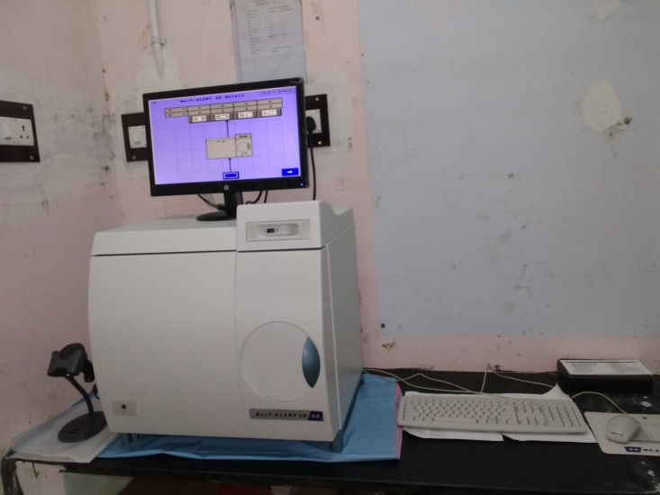
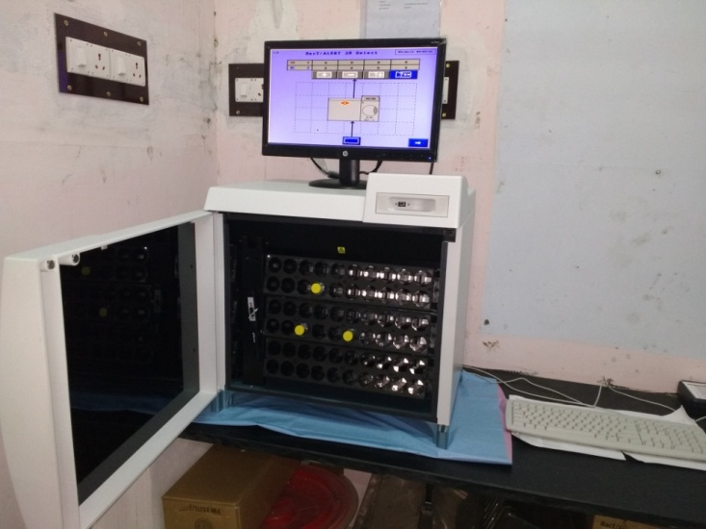
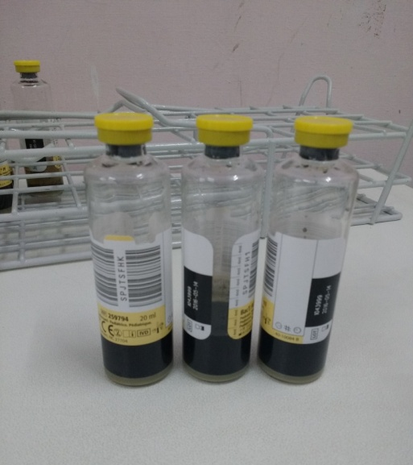
Automated Blood Culture System in DPHL, Perambalur

Slide 15
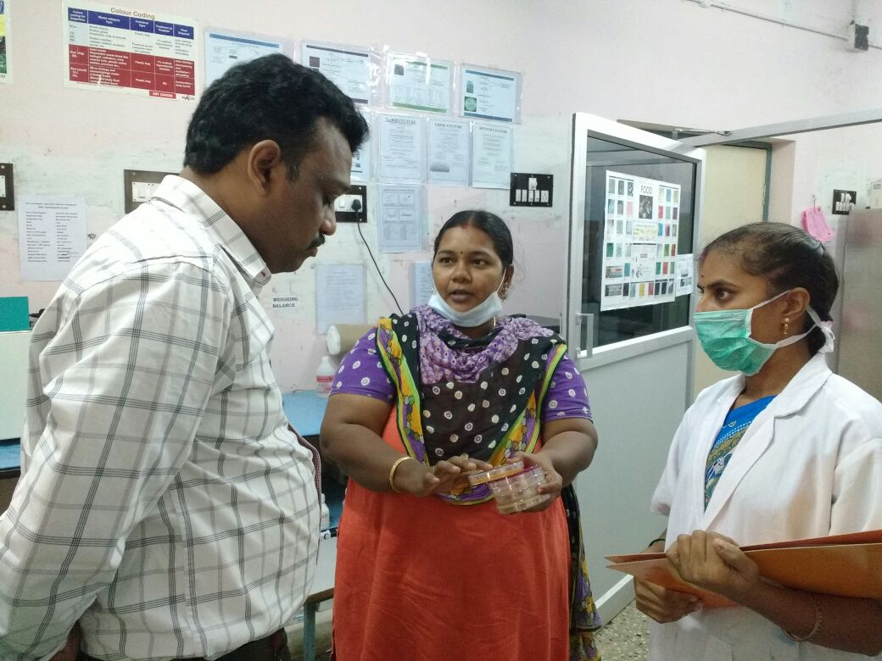
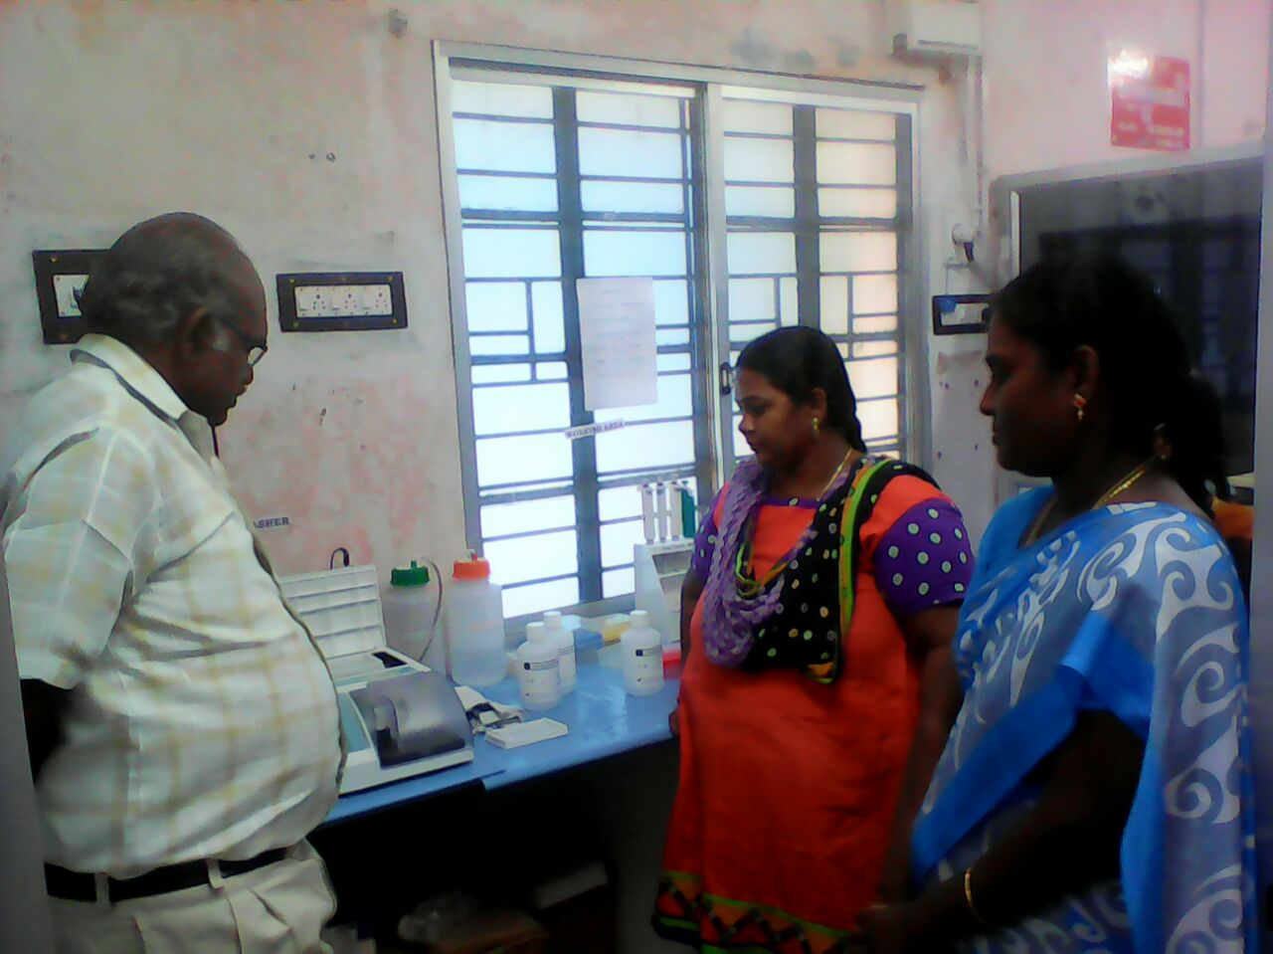
Physicians/Pediatricians regular visit to DPHL

Slide 16
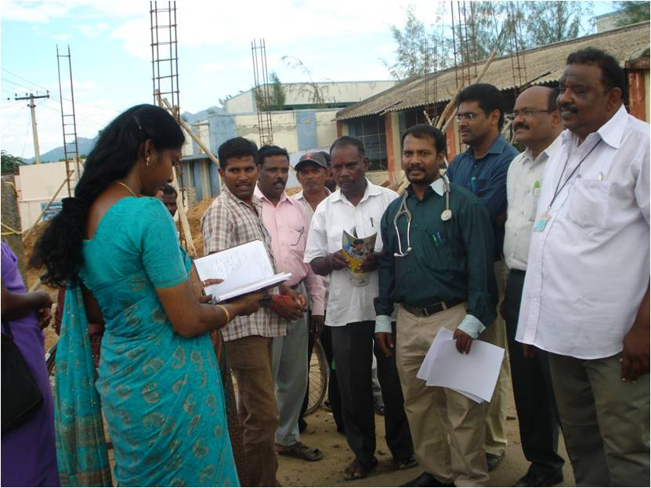
DPHL in Out Break Investigation

Slide 17
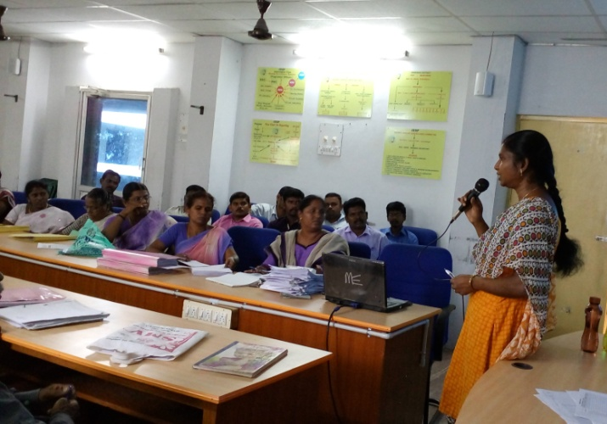
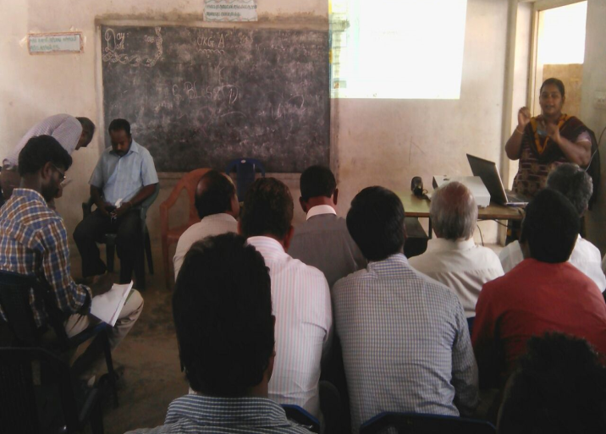
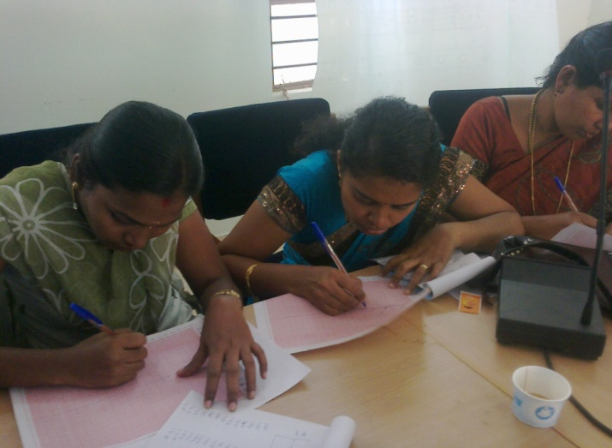
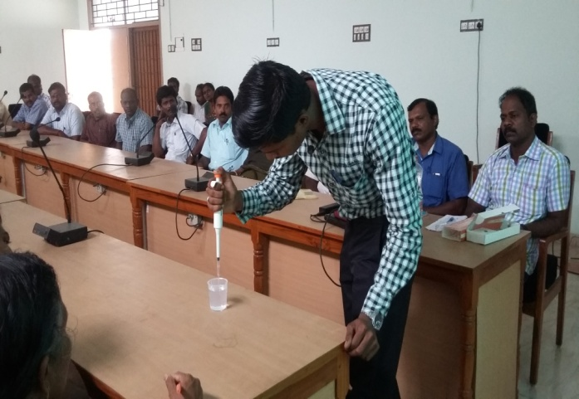
Conduct Review Meetings / Trainings
LT Review Meeting
Sample Collection Training to HIs
EQAS training to LTs
Good pipetting Techniques
training to LTs

Slide 18
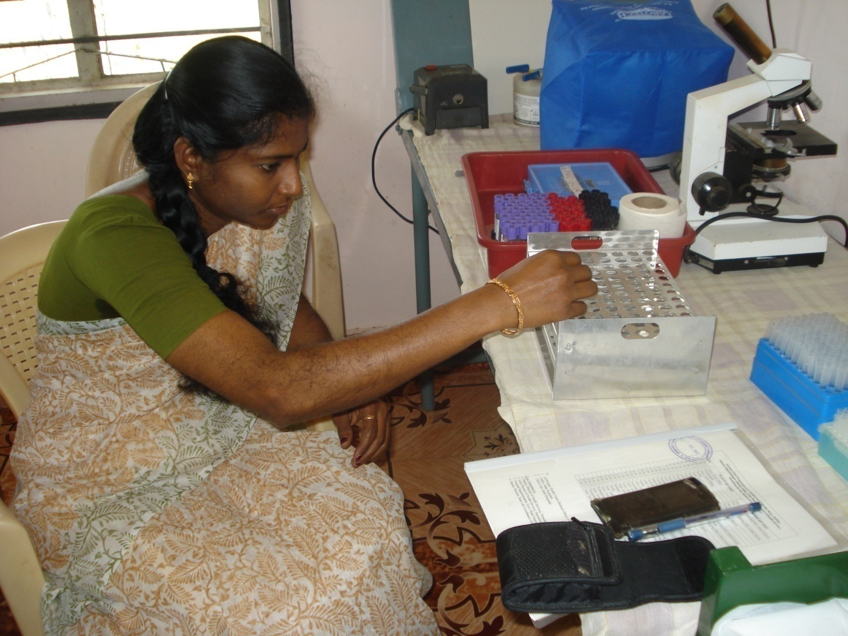
PHC Lab Visit – Ensure Lab. Quality

Slide 19
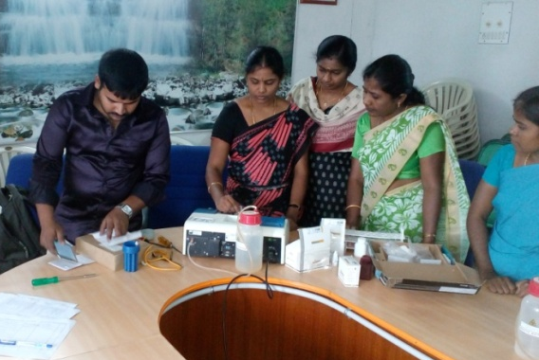
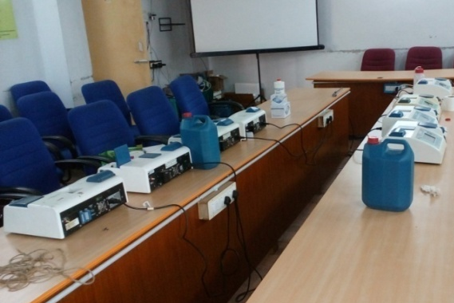
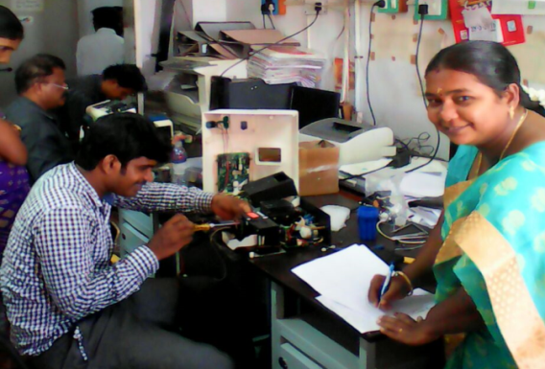
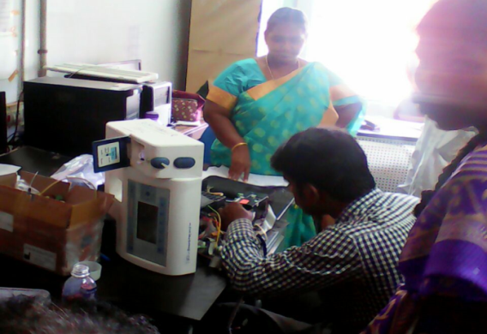
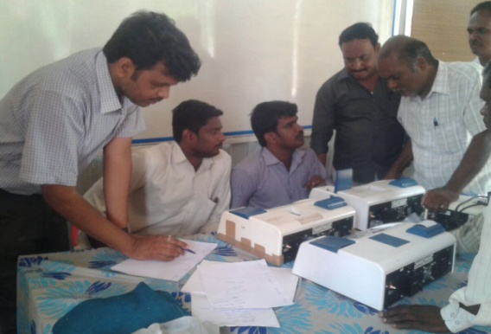
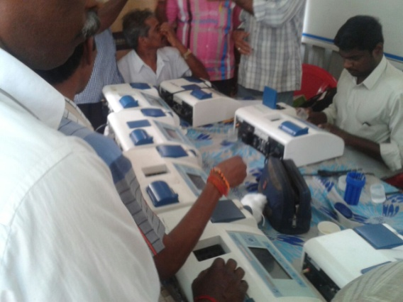
Ensure PHC Lab Equipment Quality
Semi- Auto Analyzers Service Camps
Namakkal
Perambalur
Thiruvannamalai

Slide 20
CMC Vellore –Biochemistry EQAS RANKING -2015
List of TN Institutions in first 20 Ranks
Glucose Testing
(n=5731)
Sl.No | District | Place of Institution | PHC/GH | Group | Rank
1 | Namakkal | Sendamangalam GH | GH | Group I | 3
2 | Namakkal | Velur GH | GH | Group I | 4
3 | Villupuram | Anniyur | PHC | Group I | 5
4 | Namakkal | Thirucengode GH | GH | Group I | 6
5 | Namakkal | Komarapalayam GH | GH | Group I | 7
6 | Villupuram | Kanai | PHC | Group I | 9
7 | Namakkal | Rasipuram GH | GH | Group I | 10
8 | Thoothukudi | Ettayapuram GH | GH | Group I | 12
9 | Kanyakumari | Padmanabapuram HQ | GH | Group I | 15
10 | Thiruvannamalai | Nammiampattu | PHC | Group I | 17
11 | Villupuram | Vikkaravandi | PHC | Group I | 18

Slide 21
How to Ensure Quality in Our DPHL?
Quality Management System(QMS) Plan for DPHL

Slide 22
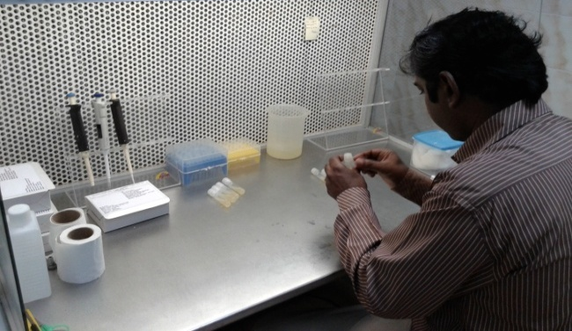
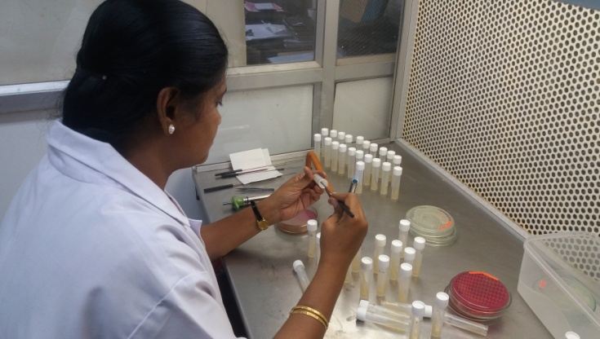
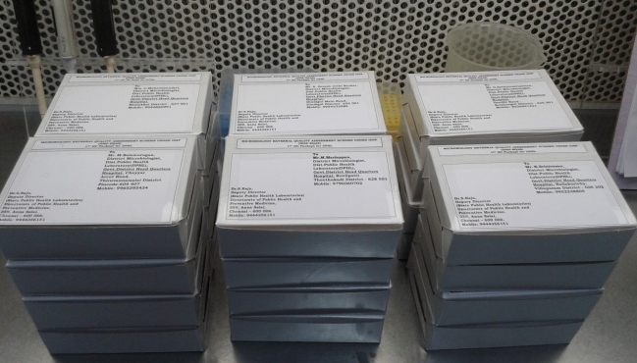
EQAS- Proficiency Testing(PT) Panel to DPHL
4rd PT Panel
(n=26)
Correct Report
Wrong Report

Slide 23
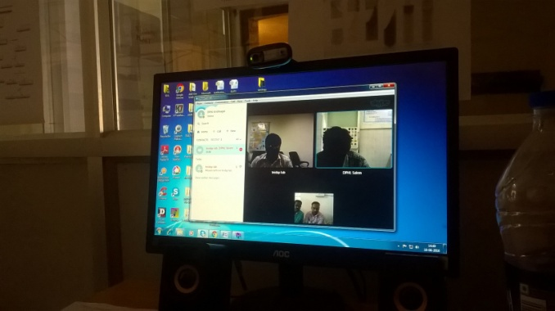
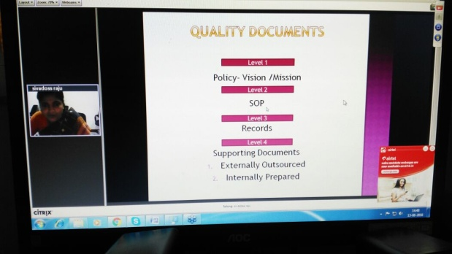
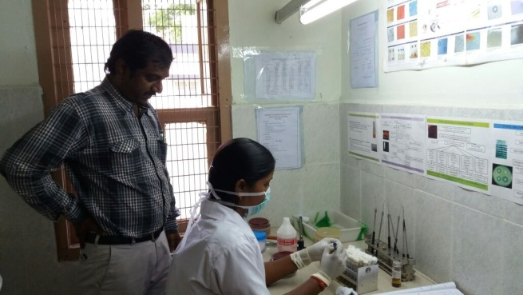
On-line & On-site Monitoring and Mentoring
Situation Analysis -Through Skype Call
Everyday
Teaching -Through Webinar
Every Monday
Monitoring –
Direct Field Visits

Slide 24
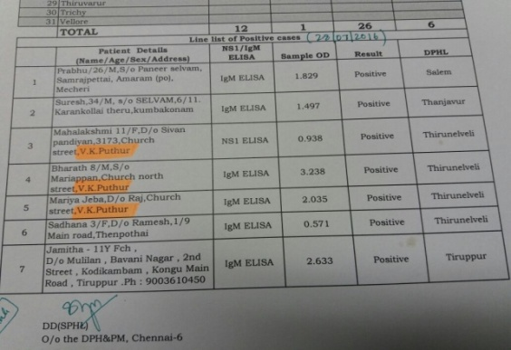
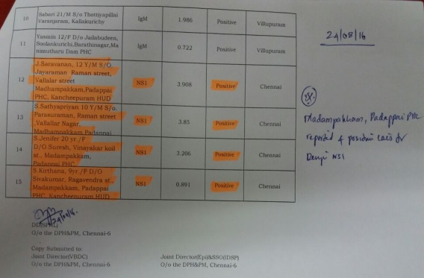
Role of DPHL in EWS
Early Detection of Dengue Outbreaks
Thirunelveli District
Kancheepuram District
EWS
Whatsapp Messages
DPH / VBDC
Action Taken
Prevention of OB

Slide 25
DPHL, TAMIL NADU – Tests Performance
2013 – 2016(upto July)

Slide 26
Outbreaks Reported under IDSP-TN
2006-2016 (up to July)

Slide 27
IDSP
Positive Trend in Lab Confirmation of Outbreaks

Slide 28
DPHLs Role in Laboratory Confirmation of Outbreaks
2013 to 2016(up to July)
313
270
152
63.3%
33.8%
23.1%
76
6.4%
55
47
17
38
OB-Lab Confirmed

Slide 29

Thank You

