Slide 1
Innovations in Bihar
AMANAT (Mobile Nurse Mentoring)

Slide 2
Agenda
1
Need for training the nurses in the state of Bihar
2
Mobile Nurse Mentoring (MNM) Pilot and its results
3
Lesson learnt and scale up plan

Slide 3
1
Analysis of issues contributing to mortality and morbidity led to identification of skill gaps at facilities
MATERNAL MORTALITY RATE
Human Resources
Shortage of doctors and nurses at the facilities
Male doctors do not enter labor room and hence contribute very less to patient care
Misconceptions/contentions
Quality of training ???
Poor Infrastructure and Management
Poor access to facilities (1 PHC: 1.5-2 lakh population)
Poor usage of available resources
NEONATAL MORTALITY RATE
Challenges with Patients
Gender and social inequity
Poor economical background

Slide 4
1
MNM was introduced to improve knowledge and skills of nurses to ensure effective Emergency Obstetric & Neonatal service and Family Planning
Defines patient care in the hospital
Identification, management and referral of patients
Prescribe and administer drugs
ANM/GNM
Major role in every initiative of the government
Effective management of routine deliveries
Decrease in complications caused due to mismanagement
Handling neonatal complications as per protocol
Decrease in number of post FP procedural complications
Improved quality of care at the facilities – including family planning
Taking proper infection control measures
Since nurses have such a huge impact on health outcomes, need for training of nurses was identified

Slide 5
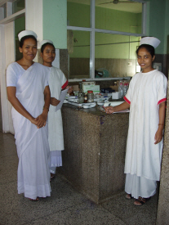
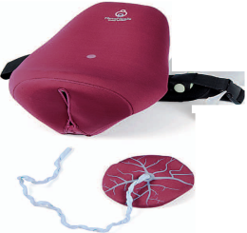
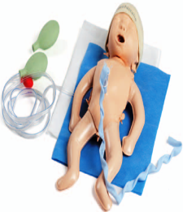
2
Mobile Nurse Mentoring Model – On the job, on the site mentoring
Trainers
Types of training sessions
One Master Mentor (M.Sc. nurse) per 2 teams
Two Mentors (B.Sc. Nurse) / 4 facilities per District
On-site training and mentoring in labour rooms/ NBCCs/ OTs
Mini Skill Lab- Simulation trials
Use of Audio video material
Aspects of training
Basic Nursing Procedures
Antenatal/ Intra-natal/ Postnatal care
New born Care
Early identification, management and referral of complications
Infection Control
Family Planning
Team Building, Value Sensitization
Record Keeping/documentation

Slide 6
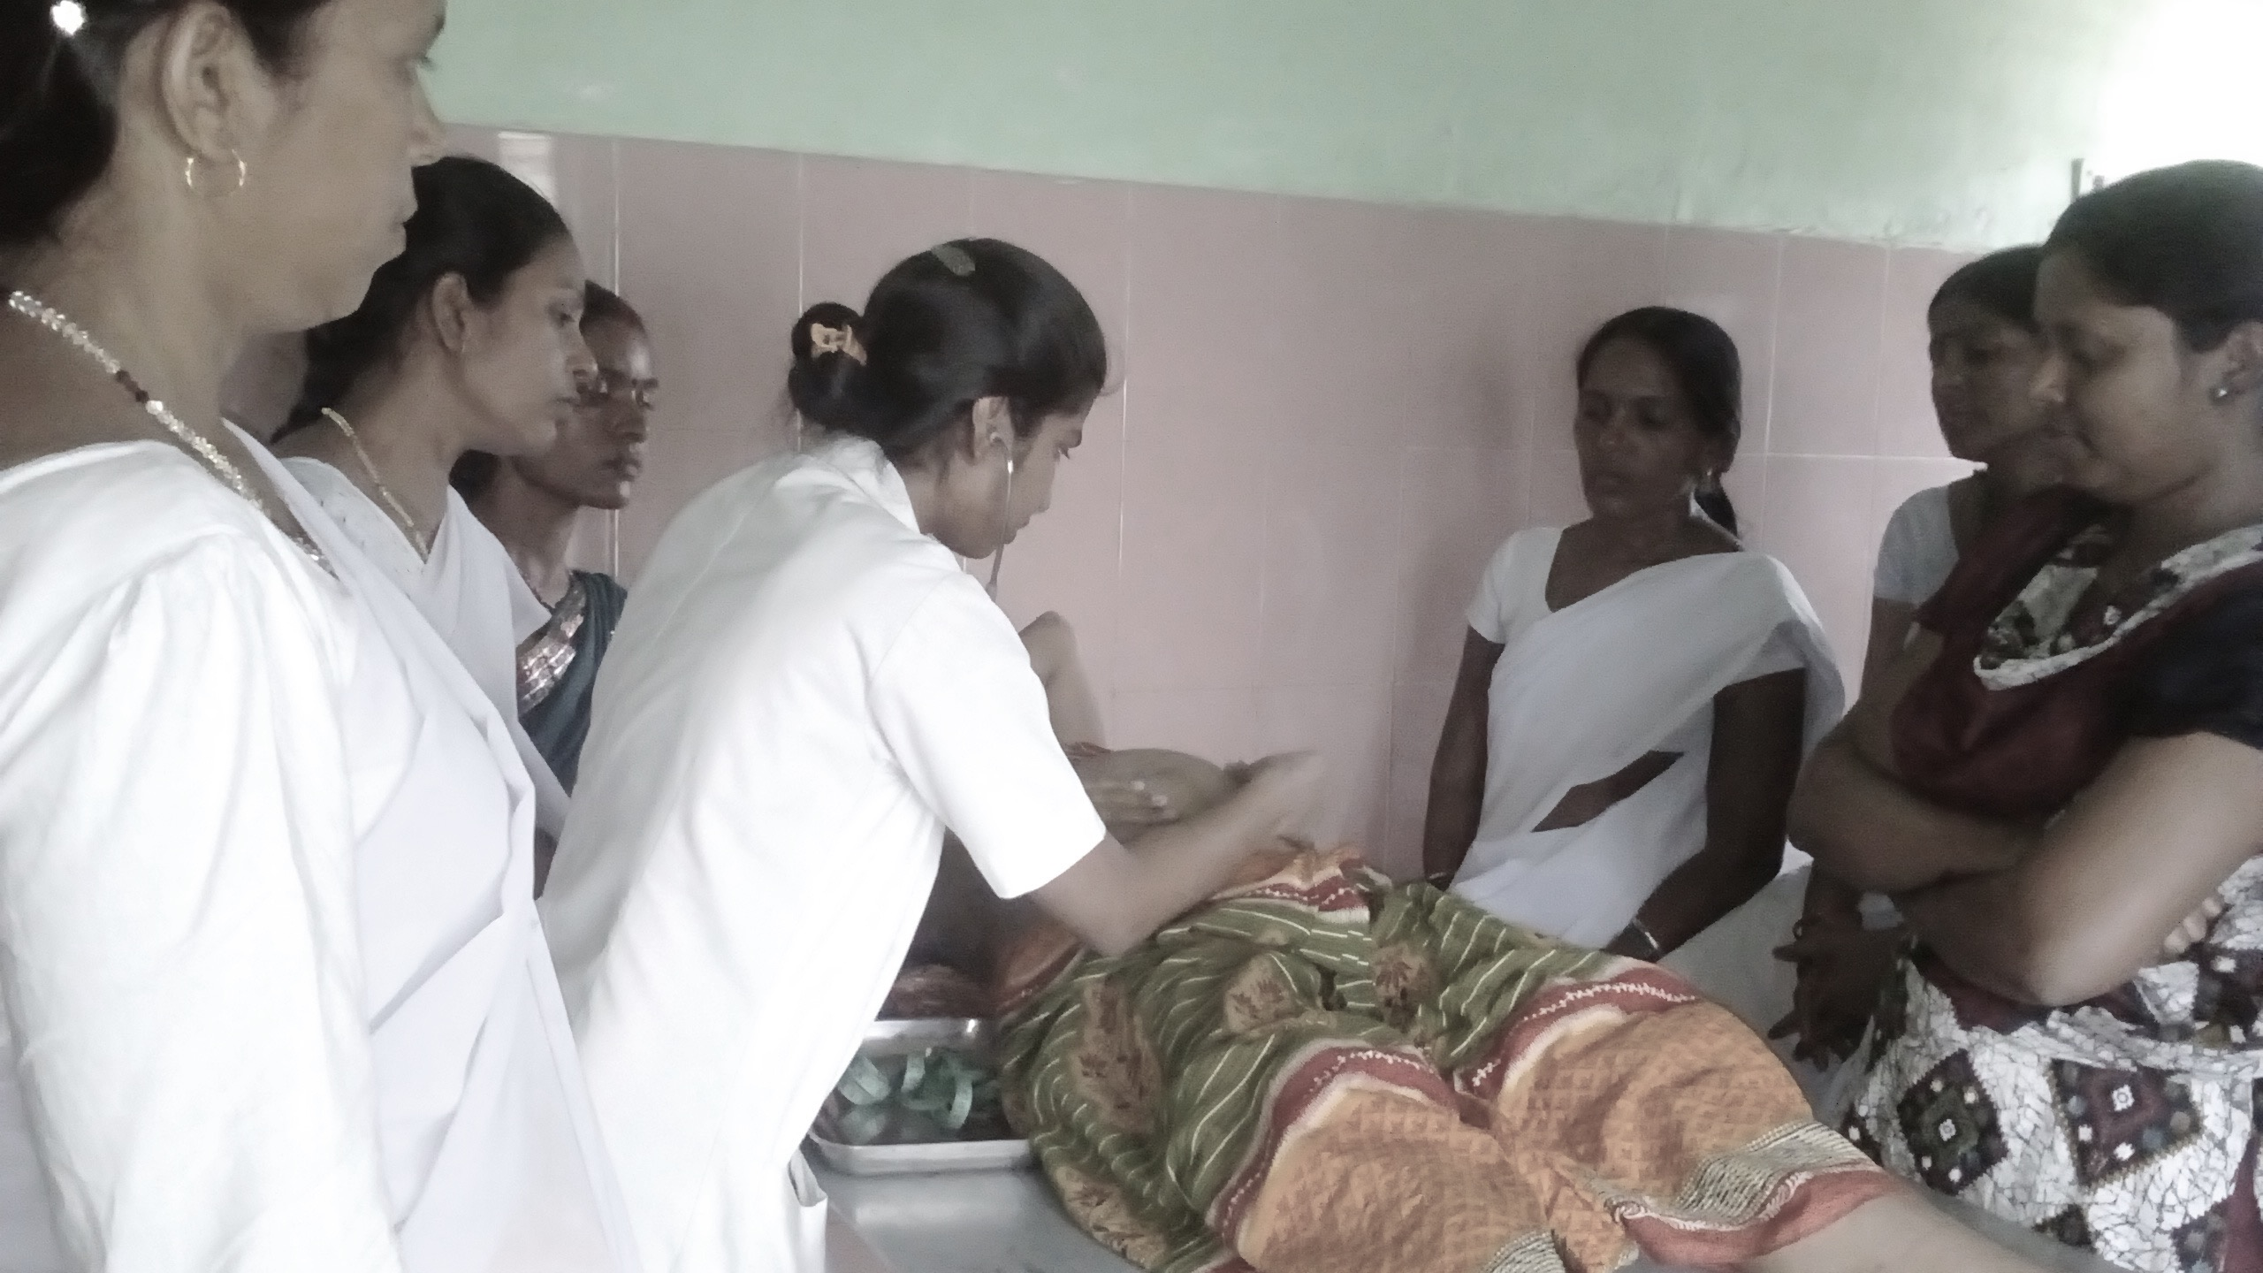
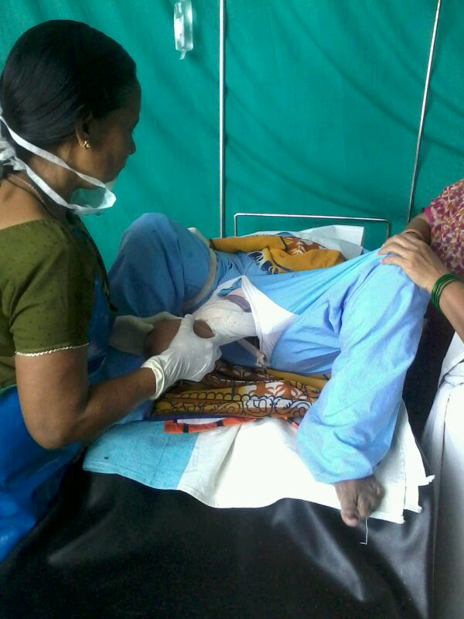
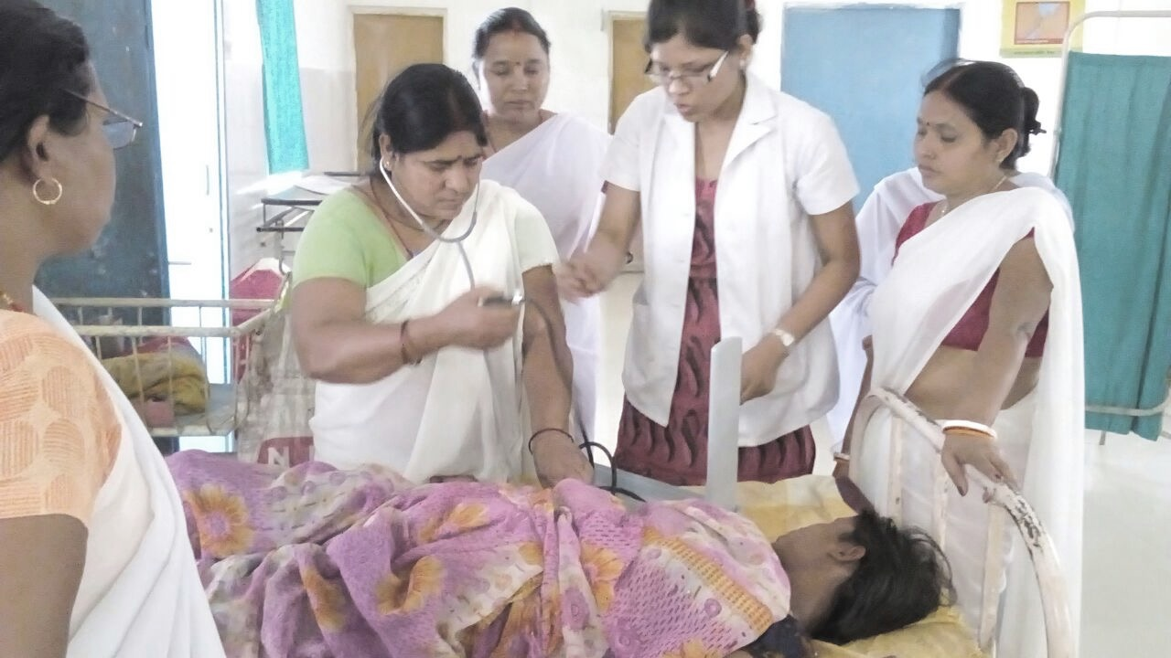
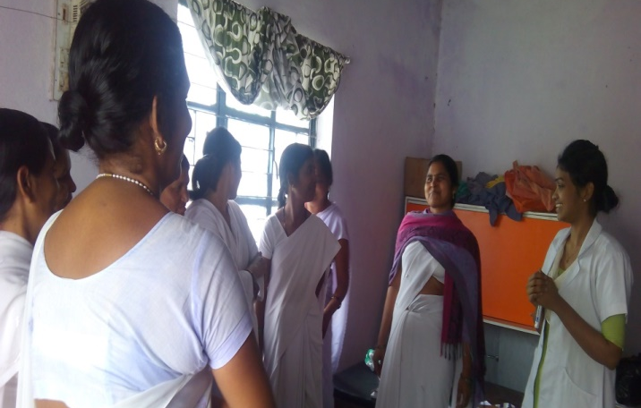
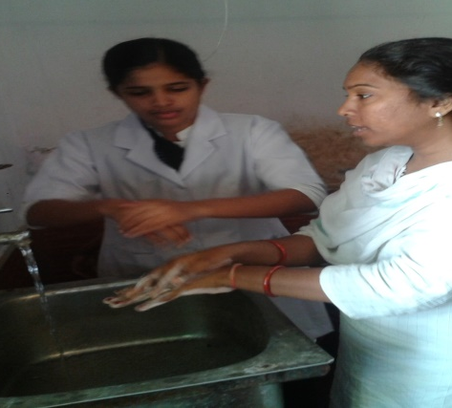
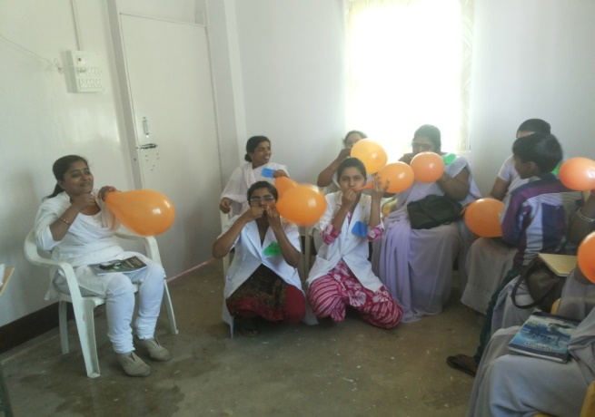
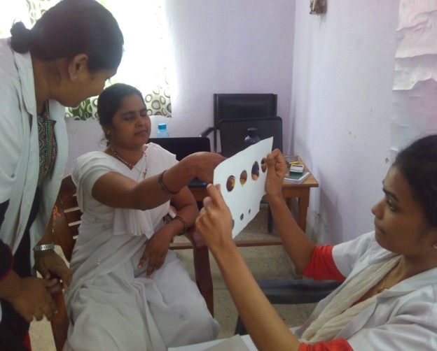
2
Methods of mentoring
Bedside Mentoring
Simulations
Demonstrations & Discussions
Activities
Simulation Video -PPH

Slide 7
2
Pre-requisites
Selection and facility preparedness
Pre-training preparations
Selection based on criteria by the district authority.
Complementary quality improvement interventions in facilities :
Gap Analysis
Supporting the hospital authority to plan the budget
Infrastructure strengthening
Ensuring the availability and accessibility to supplies
A well planned flexible curriculum with learning goals for each week and month.
Lesson plans for all the topics in the curriculum
Simpacks for all the complication-based simulations
Activity plans
Mannequins for demonstration
Video library – GOI, WHO, UNICEF etc
English videos dubbed in Hindi for better understanding of mentees.
Video camera for recording simulations and playback for de-briefing.
Guidelines & protocols Library- GOI, WHO
Modules in Hindi for all the mentees.

Slide 8
2
Pre-requisites – Availability of mentors
Training of mentors
2 week long Induction training by experts for all the mentor teams.
1 week of training on Simulation (PRONTO International)
Field exposure for 3 days per facility with a Direct Observation of Delivery checklist to understand gaps in Obstetric Care.
Week long Clinical Practicum in labour rooms of reputed hospitals of Bihar.
Refresher training
Appointment of mentors
Mentor retention
Stringent selection process
B.Sc Nurses as Nurse Mentors
M.Sc Nurses as Master Mentors
Decent Salary
Comfortable Stay at the district head quarters with proper security
Appropriate Transportation system
Flexible Curriculum
Supportive Supervision

Slide 9
Timeline
2
Pilot Phase
2012
8 Districts
80 facilities
32
48
Phase 1: BEmONC
Phase 2:
39 BEmONC &
9 CEmONC Centres
551 Nurses
207
380
Phase 1:
Grade A- 60
ANM- 147
Phase 2: Grade A-147
ANM- 233
2014

Slide 10
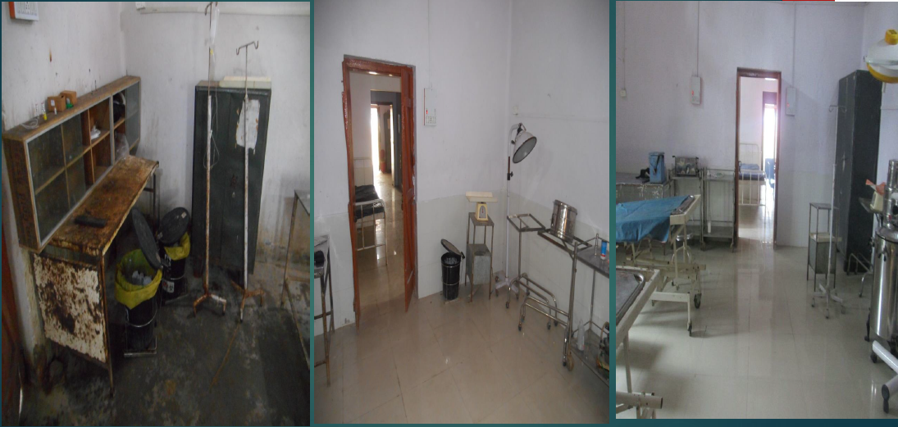
2
MNMT results – Labor room reorganization
Before
In Process
After

Slide 11
2
MNM Pilot results
Indicators | Before Mentoring % | 6 months after Mentoring %
Oxytocin for AMTSL | 8.6 | 75.0
Fundal pressure applied | 32.0 | 03.6
STSC initiated | 30.9 | 62.5
BF initiated in LR | 49.1 | 71.5
Handwashing correct (All six steps) | 14.0 | 36.8
Sterile instruments used | 13.0 | 43.5
Attendant wore gloves | 76.0 | 90.4
**Based on independent observations of 600+ deliveries after pilot phase of AMANAT

Slide 12
Key Takeaways from the pilots were used to scale up the program
3
Challenges | Steps taken to cater to these challenges
Gathering the mentors | Out Sourcing to competent agency Comfortable salary, stay and facilities
Extending the Mentoring locally/ refreshers | Identification of 2-3 nurses as local mentors in each batch of mentees Insistence on the other staff to learn the skills
Local leadership taking responsibility to sustain change in practices | Written Memorandum of Understanding between the SRU & MOs i/c of the PHCs, countersigned by the Civil Surgeon Written orders to ensure facility strengthening. Sub Committee for Capacity Building within DQAC. A State Task force on Capacity Building – to review AMANAT every 3 months Full involvement of the hospital administration. Supportive supervision by the district health authorities

Slide 13
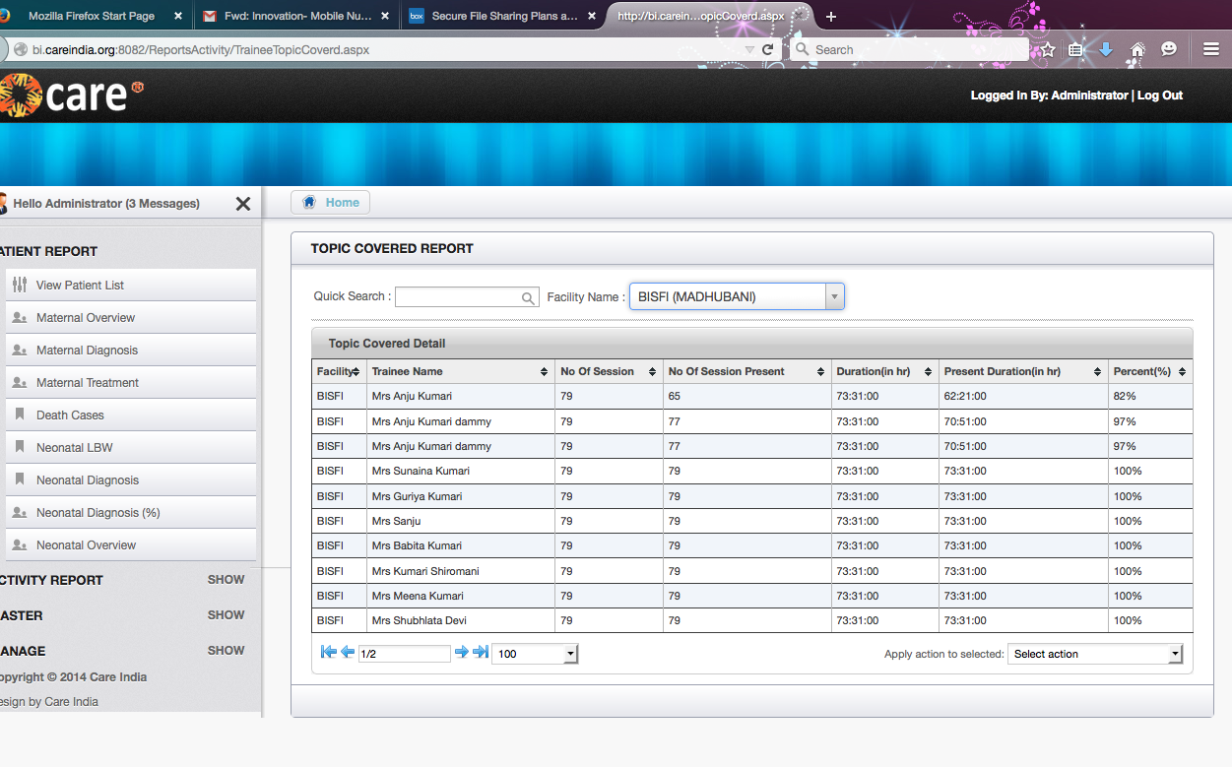
3
Monitoring Mechanism : Facility Information System
Training details including the topics taught, nurses attended and methodology used
Clinical Log to track appropriate treatment and change in management over time

Slide 14
Scale up plan
3
Scale up
2015
State wide roll out- 38 districts
376 facilities
(320 BEmONC & 56 CEmONC Centres)
~2750 Nurses
2016-17

Slide 15
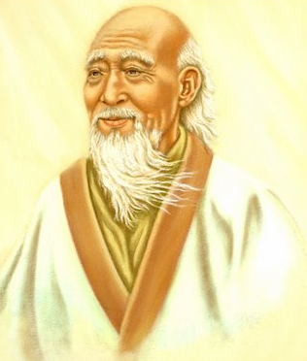
Go to the people.
Live with them.
Learn from them.
Love them.
Start with what they know.
Build with what they have.
But with the best leaders,
When the work is done,
The task accomplished,
The people will say
‘We have done this ourselves’.
- Lao-tse in 7th century B.C.
THANKS
Notes:
15

