Slide 1
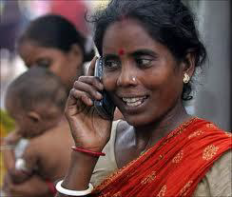
Mobile Money Transfer (MMT) Mobile Based Payments - Bihar
Mode of Incentive Disbursement to ASHA from Health System
This is a collaborative effort of State Health Society Bihar (SHSB), State Bank of India (SBI), Eko Aspire Foundation and Norway India Partnership Initiative (NIPI) Programs.

Slide 2
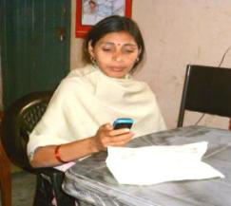
Mobile Money Transfer (MMT) Mobile Based Payments - Bihar

Slide 3
Key Features
Mobile phone is compulsory
Relaxed KYC document of No-Frill Saving Account is required
Mobile number becomes SBI mini saving account number
Authentication
Okey Key
Mobile No.
Pin
Basic banking services to ASHAs
Deposit
Withdrawal
Money Transfer
Account Information
(Balance Check, Mini-Statement)

Slide 4
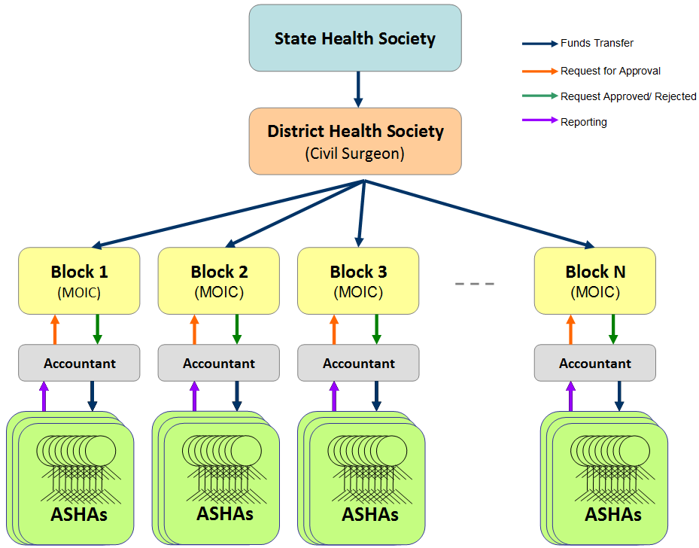
Background: Incentive Payment Challenges
Long delays in payment
ASHA travelling multiple times
Absence of concerned authority
Cheque clearance delay
Distant bank branches
Long queues at branches
Multiple Accounts
Multiple Cheques
Accounting & Audit
Inefficient audit, complaint processes

Slide 5
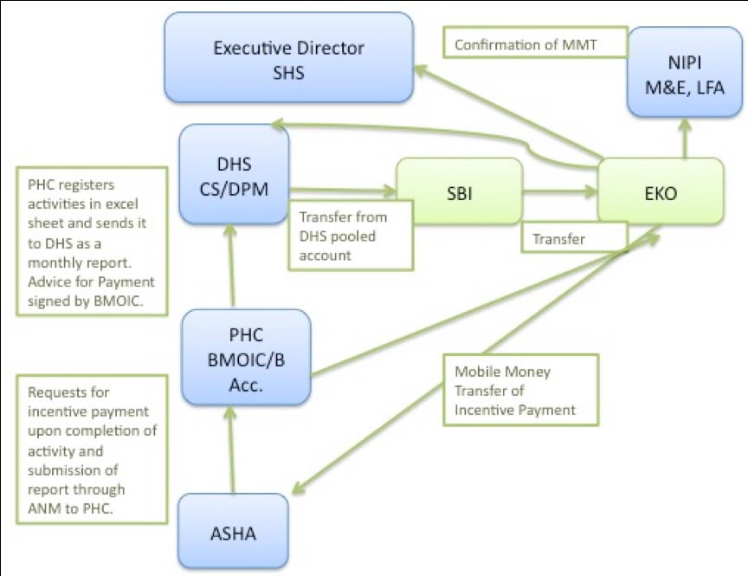
To over come the challenges........... Mobile Money Transfer.... ..............a technology at hand
Started in Jan 2011
piloted in six Primary Health Centres (PHCs) of Sheikhpura district reaching up to 420 ASHAa.
District Health Society opened an SBI account specifically for ASHA incentives payments.
ASHAs opened no-frill accounts with SBI (powered by Eko’s mobile banking infrastructure).
Eko has neat usability trick for such customers to set the account number to be the same as their mobile number.

Slide 7
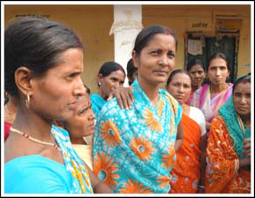
Process Flow

Slide 8
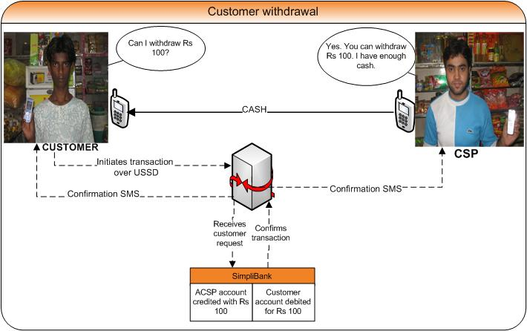
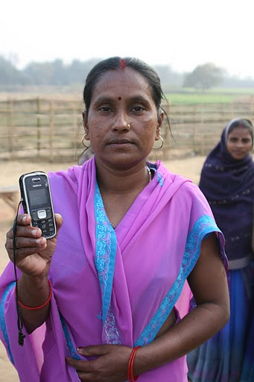
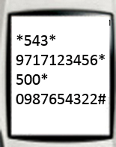
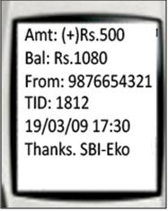
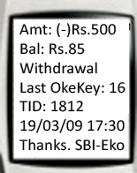
Withdrawals
Can I withdraw Rs.500?
Yes. I have enough money in my till.
Electronic cash
USSD String
*Short code*CSP Mobile No.*Amt* Customer OkeKey with PIN#

Slide 9
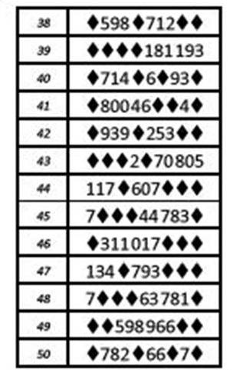
Security of Transactions
Three level security:
⁄ Mobile number
⁄ OkeKey
⁄ PIN
The OkeKey is used only to debit one’s account. For e.g.
Customer | CSP
Withdrawal | Deposit
Money Transfer | Account Opening

Slide 10
vksdsdh esa fiu dk bLrseky dSls djsa
Ikgys vki 4 uEcj lksfp;s tks vki ges'kk ;kn j[kuk pkgsaxsA ;kn jf[k;s fd dksbZ ml uEcj dks vklkuh ls ;kn u dj ldsA mlds ckn mudks vksdsdh esa ^* ds LFkku ij Mkfy,A
mnkgj.k ds fy,% vxj esjk fiu gS 1234 vkSj esjk vksdsdh gS% 723456 rc eSa vius vksdsdh esa ^* ds txg ij bu uEcjksa dks Mkywaxk %
blfy, vksdsdh bl rjg ls fn[ksxk % 7213425364

Slide 11
Aided Transactions
Aided Transactions are conducted by the CSP.
Aided transactions are conducted when:
• The customer is not comfortable / not confident of conducting a transaction on his own
•Each Transaction starts with *543*9*customer mobile no.
• The CSP must handover his phone to the customer to enable the customer to enter his/her OkeKey & PIN
•Post Transaction messages are received by both the CSP & the customer

Slide 12
Aided Transactions
Withdrawal | Balance Inquiry
CSP Dials *543*9*Customer Mobile No*Amount* Customer Okekey with PIN# | CSP Dials *543*9*Customer Mobile No*123#

Slide 13
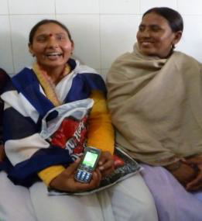
Benefits to ASHA
Timely disbursal of incentive.
Increasing graph of workers’ earning.
Comfortable in dealing with neighbour shop-owner
Own saving account (Financial Inclusion)
Simple, secure and control (Women empowerment )
Easy and anytime access

Slide 14
Benefits to Society
Low cost disbursal network.
Financial inclusion
Increased utilisation of allotted funds.
Increasing graph of work quantity
No more cheque writing
Signaturee agnostic process
Huge man-hour saving

Slide 15
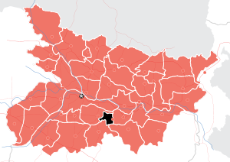
Overview - Sheikhpura
Total ASHAs enrolled | 433
No. of ASHA who received payments | 415 (96%)
No. of Payments requests (9 Months) | 45
Total value of payments processed | Rs. 90 Lakhs (approx.)
Average Monthly Disbursal | Rs. 8 Lakhs (approx.)
Avg Incentive disbursal per ASHA per month | Rs. 2,380 (approx.)
No. of CSPs in Sheikhpura | 30

Slide 16
Payment distribution

Slide 17
Fund Utilization

Slide 18
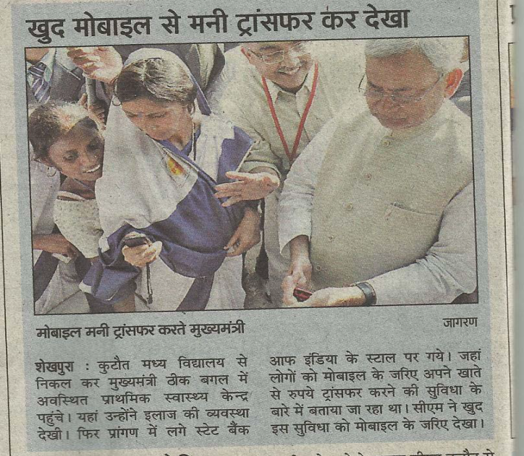
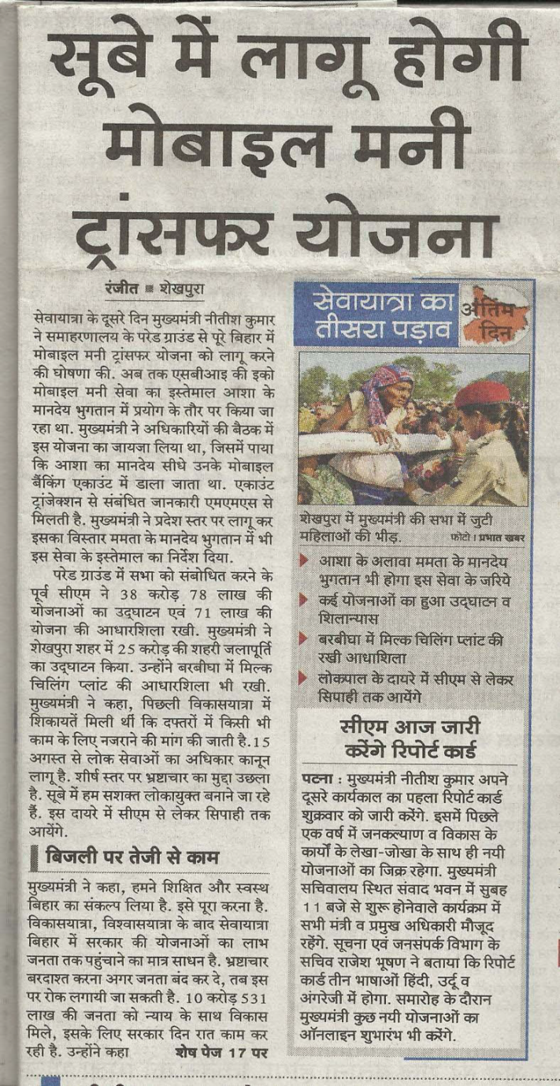
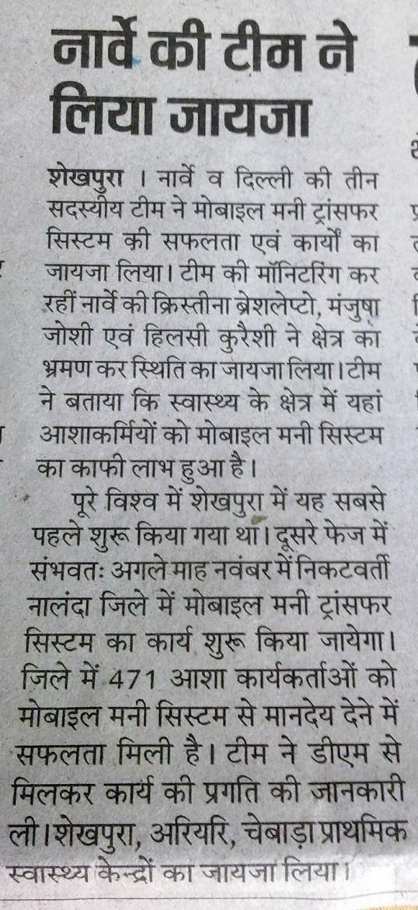
Media Coverage

