Slide 1
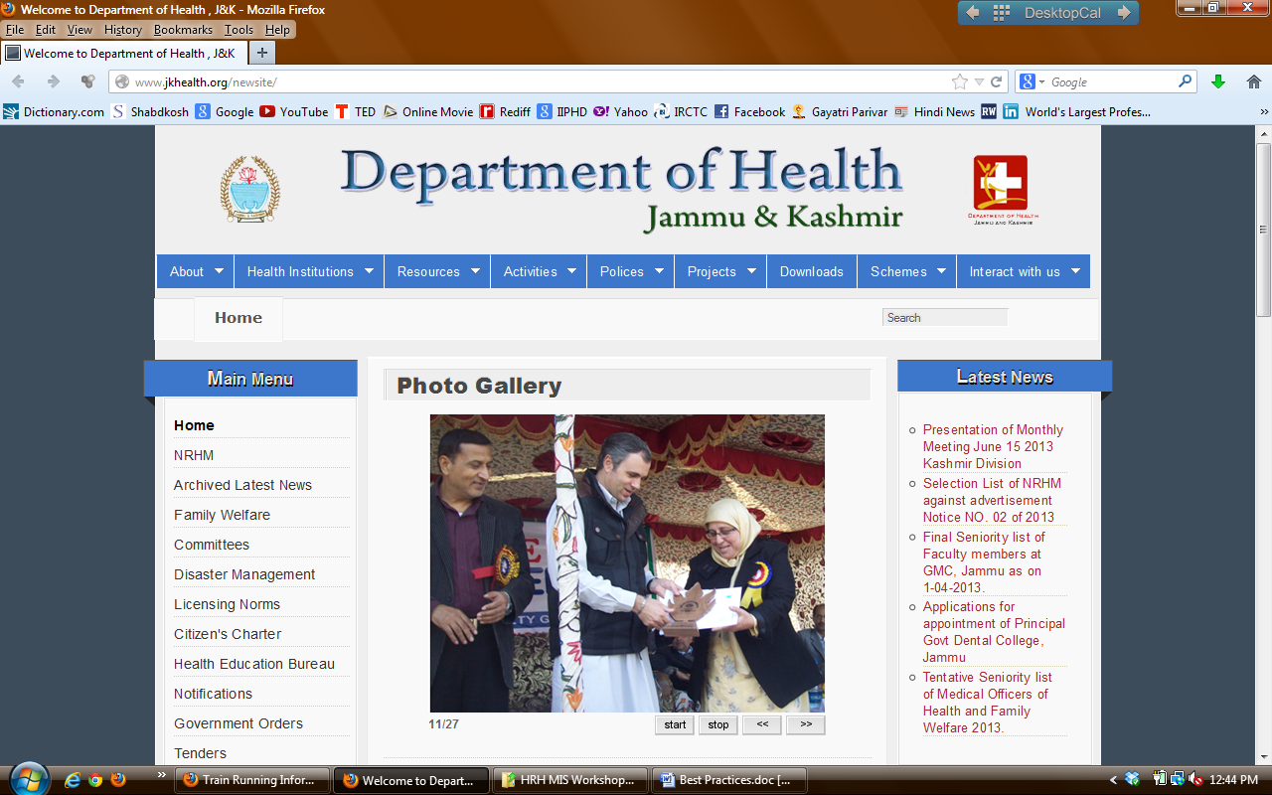
e-Performance Audit using J&K Web Portal
www.jkhealth.org
Mission Director, NRHM , J&K

Slide 2
Background
Public Health Planning Process through District Action Plans & State PIPs was affected in the J&K due to lack of updated information on public health indicators esp. – HRM, Infrastructure & Service Delivery Statistics.
Most of this data was Paper –based , was highly fragmented & incomplete.
Systemic data-gaps, poor quality which was not updated from time to time.
Timely access to this information was also an issue.
Existing IT systems were also not being able to accommodate information needs of the State with respect to the facility planning and monitoring.

Slide 3
Introduction
The Department of Health J&K launched a web portal www.jkhealth.org in 2009 to solve information issues.
Provide information on key public health parameters.
Provide information about the manpower
Information accessible to every program manager at all levels.
Data ownership and decentralised decision making.
Single source to be used for planning and monitoring, so as to improve trust on data.
Low cost technology solution to enable limited fund expenditure on technology solution and more on action.

Slide 4
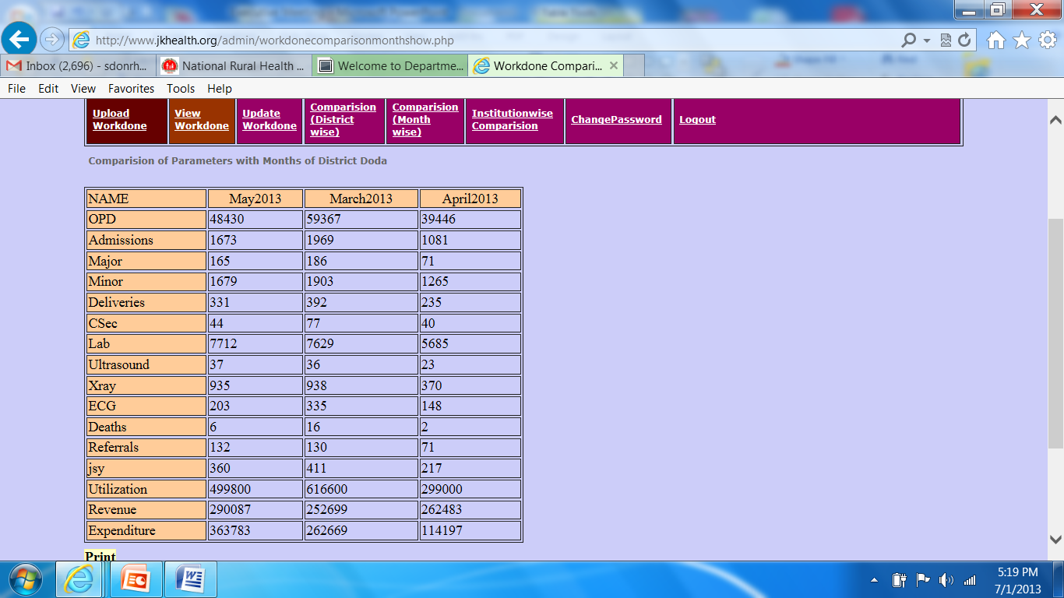

Slide 5
J&K Web Portal: Contents
On line service records of all Doctors employed in Public Health System.
Province-wise details of health delivery institutions.
Institution wise service delivery statistics on key parameters i.e. IPD, OPD, Surgeries, Deliveries, Lab test/ investigations, revenue and expenditure is available.
HRH- Doctors records
Public Health Institutions
Key Service Delivery Indicators

Slide 6
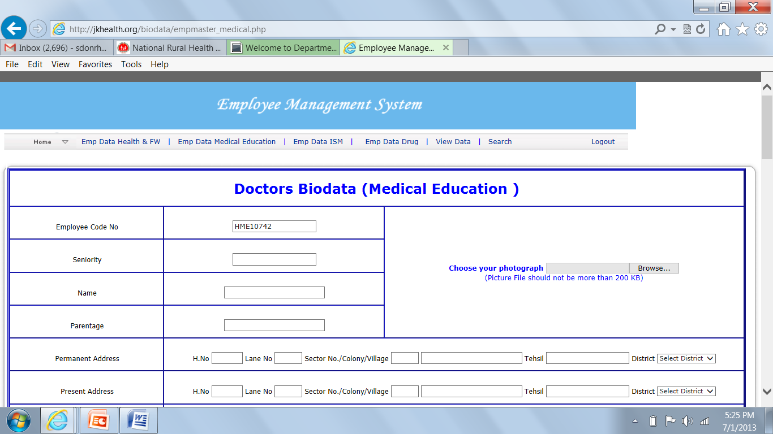

Slide 7
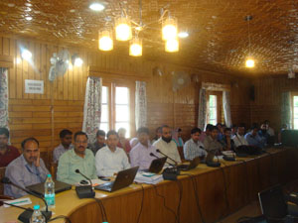
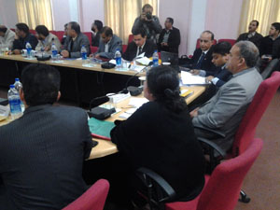
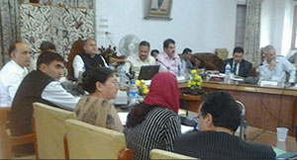
Performance Audit Meetings
Monthly Review Meeting on Fixed dates on 10th at Jammu and 15th at Kashmir

Slide 8
Annual Publication –Performance Review
Facility-wise data is compiled and published annually.
Published data is made available to each district/ block for district health planning, monitoring, and management.

Slide 9
Annual Performance Audit
Using the data of the Web Portal an Annual Performance Audit is conducted for each facility.
Performance review is conducted on three major parameters-
Service delivery Indicators
Health Facility Improvements.
Human Resource availability and performance.
Performance gaps are indentified and based on these an action plan is developed.
Annual Action Plan becomes basis for planning, resource allocation and monitoring.

Slide 10
Impact
With the help of J&K Web Portal the Annual Performance Audit has become a powerful tool for performance review, monitoring, planning and management.
Service delivery indicators have improved over a period of time due to evidence based planning, monitoring and supervision.

Slide 11
Percentage increase in Various Parameters over the year 2008 (Jan -Dec) ( Fig in lacs)
 | 2008 |  |  | 2012
 | Jammu Div | Kashmir Div | Total | Jammu Div | Kashmir Div | Total | % Increase
OPD | 43.75 | 59.29 | 103.04 | 86.73 | 92.52 | 179.25 | 74
IPD | 1.41 | 2.84 | 4.25 | 3.6 | 4.7 | 8.3 | 95
Inst. Deliveries | 0.27 | 0.49 | 0.76 | 0.46 | 0.59 | 1.05 | 38
C-Section | 0.034 | 0.036 | 0.07 | 0.1 | 0.11 | 0.21 | 200
Ultra Sound | 0.57 | 0.72 | 1.29 | 1.54 | 1.98 | 3.52 | 173
Revenue | 139.44 | 376.65 | 516.09 | 1239.67 | 1963.39 | 3203.06 | 521

Slide 12
Impact
System has helped in ensuring transparency in transfers and posting with availability of online information.
Overall data quality and information used has also improved in the State.
Looking at the positive impact additional information has been incorporated on the activities of the department is incorporated in portal.
In addition department directory, institution-wise contact details also made available through Web Portal.
Color Coding and Design of Hospital Buildings

Slide 13
Further Developments
Additional details about major projects, infrastructure projects, tenders, licensing norms, citizen charter, conferences/workshops, important days observed in the health department is also available in the J&K Portal.
To make the portal more interactive ‘feedback’, ‘complaints’, ‘suggestions’ and ‘contact us’ forms have been devised to allow all the stakeholders to contribute towards making this portal a vibrant media for interaction.

Slide 14
Other Best Practices
District Monitors
NRHM Sammelans
Simulators

Slide 15
Thank You!!

