Slide 1
Comprehensive PHC through Health and Wellness centres
With a focus on NCD
Jan Swasthya Sahyog, Chhattisgarh

Slide 2
The Problem
While the infections and MCH can be managed through institutions and communitised somewhat, the NCDs need a model of community management
The compliance rates with treatment in most NCDs are below 50%
The present HR focus in our health system is on a doctor and an ASHA, and some minor focus on the ANM
Mid level HW is the need
IT has been often thought of as a game changer in health systems that can provide STP and also allow monitoring

Slide 3
The structure of our intervention (Rural Bilaspur, CG)
Comprehensive primary health care and not selective health care, responsiveness to the people’s needs.
Immunization provided by the public system,
Screening camps for NCDs and for common cancers
HR
Asha,
Senior health workers and ANMs,
cluster / RCH/Asha coordinator,
Doctor/pharmacist/lab tech/ records person team

Slide 4
The Sub centre…. Health and wellness centres
Phone, and refrigerator, net book and paper records
Senior health workers: community health skills, clinical skills and lab skills, and ANMs
Training and educational centre and a centre… for the health workers

Slide 5
HWC functions
Run as a first contact site for difficult problems
Animal bite care, deliveries, step down nursery
Chronic ongoing care for NCDs
Screening of cancers and NCDs
Disease based peer support groups
Common emergencies
Training site for various cadres
Other care: Guided by Unmet Need
maternal care, contraception, care of emergency care, epidemic responsiveness, end of life care

Slide 6
Role of information technology
There are guidelines, not like STP- to support, but has little role in financing and monitoring
Training
support and organization of work elements are what one hears.
It helps , but it is not the game changer

Slide 7
Use of Information technology
We use IT for enabling primary providers and ….
not to monitor them
Interactive voice recording system to exploit audio literacy , and developing a people based EMR

Slide 8
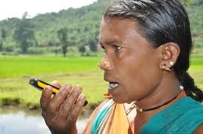
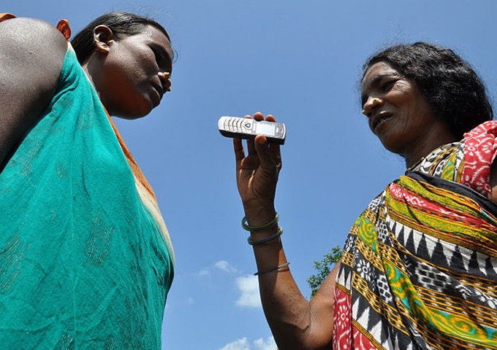
Interactive voice recording technology
Data collection
Surveillance
Mobile health
Training

Slide 9
Laboratory Support in primary care
VHW and SHW do many tests on their own
The Lab supports every week ( 30% of people undergo lab tests)
Referral of samples goes
through an elaborate
mechanism of runners , and
reports reach via cell phones
and EMR

Slide 10
STG/individualised care
Individual plans are guided by STG but determined by physicians for each person with a Chronic illness,
And followed by SHW or Asha- Ensuring Continuity of Care
STGs don’t lend themselves into automated plans

Slide 11
Disease based patient groups
30 such
Illnesses such as alcohol dependence, Diabetes, Hypertension, mental illnesses, epilepsy, sickle cell disease, ABCD, rheumatoid arthritis, Asthma and other lung disorders
Meet once a month, share their news, support compliance issues, discuss and learn about a new thing, play and do some physical activity, micro-finance,and some take up some livelihood; have some food together; also find other people with the same illness in the community.
Patient advocacy with the system and with providers

Slide 12
The Human resources
Mitanins at about 200- 250 people
Senior health worker and the ANM at about 3000-4000 ( trained by us – 9 months)
B Science community Health, or an augmented ANM or LHV
weekly doctor
Referral centre runs like a CHC
local recruitment and local training and deployment- largely from within the community

Slide 13
Roles of Health workers
The Senior or middle level Health worker : and ANM/ Male MPW, Looks after chronic illnesses and acute severe illnesses
 MCH: Auxiliary Nurse Midwife
 Asha: acute moderate illnesses and help run patient groups

Slide 14
Human Resources: whither doctors?
Not over dependent on a doctor, but not without a doctor
Sub centre supported by a team of a doctor, a lab tech , a pharmacist and a record keeper on a fixed periodic day
Can’t trivialise primary care; plus legality ensured

Slide 15
Supportive Supervision
Both Administrative and Clinical, and through on job training
Coordinator for RCH: Antenatal clinics, postpartum care, newborns and under 3 kids, and cancer screening for Breast and Cervical cancer
Cluster coordinator: NCD care along with the SHW
Asha/referral centre coordinator: supporting village based care/ malaria
Monthly meeting is the strategic pathway

Slide 16
Cost of running this programme
The per capita cost of providing Comprehensive Primary Health Care
Rupees 554 per person per year; 3.2 visits per capita per year
Of which 16% is secondary or tertiary care, and 84% is primary care ( Village/ hamlets 51% care, Health and wellness centres 33% care) and Referral centre 16%)
performance based financing or financial incentives of any kind. But reliable and timely payments of the modest sums agreed

Slide 17
Lessons learnt
It is possible to provide providing good quality of care at affordable costs using a level of human resource which is more or less consistent with what is envisaged in draft national health policy and in the Indian Public Health Standards and the existing financing packages and strategies
The game changer is really the organization of service delivery ( to make it comprehensive) and the quality of training and support provided, and not IT or STP

