Slide 1
NATIONAL HEALTH MISSION
Presentation on
Urban Health Kiosks - Punjab
For
National Summit on Best Practices and
Innovations in Public Healthcare Systems
At
Tirupati
Hussan Lal, IAS
Secretary Health-cum-Mission Director-NHM, Punjab

Slide 2
NUHM IN THE STATE –
DEMOGRAPHIC PROFILE
Total Population in Lakhs | 2.77 Crore
Total Urban Population as per census 2011 in lakhs | 1.04 Crore | 37.55%
Total Number of cities/ towns/ Kasbas | 161 | 40 cities covered under NUHM
Total Urban Population in 40 Cities covered under NUHM in lakhs (Population more than 50,000) | 0.78 Crore | 75% of total Urban Population coverage under NUHM
Number of Slums | 1296 | 1126 notified
Population of Slum Areas (in lakhs) | 0.28 Crore | 26.94% of the Urban Population
Vulnerable Population (in lakhs) | 0.07 Crore | 10% of the Urban Population under NUHM

Slide 3
NUHM IN THE STATE –
DEMOGRAPHIC PROFILE
Cities covered under NUHM | 40
Number of Metro cities | 0
Number of Million + cities (> 10 lakh population) | 2 (Ludhiana, Amritsar)
Number of cities with 1 to 10 lakh population | 14
Number of towns with less than 1 lakh but more than 50 thousand population | 23
Number of State HQs/District HQs which have less that 50 thousand population but are covered under NUHM | 1 SBS Nagar

Slide 4
URBAN HEALTH KIOSKS - PUNJAB
In cities Ludhiana, Amritsar, Jalandhar, Bathinda, nearly 40% population is living in slums/ slum like conditions.
Ludhiana being an industrial town there is concentration of poor population in industrial areas
Jalandhar is a hub of leather/ sports industry and most of the slums are congested
There are certain areas in the city Malerkotla and Mohali which are dominated by vulnerable and migratory population where services are deficient.
There are congested localities and people are more prone to poor health, occupational hazards and accessibility to basic health care services and it is not possible to establish a UPHC.

Slide 5
URBAN HEALTH KIOSKS - PUNJAB
Challenges
How to provide the services in Urban Slums not-listed/ unauthorized/ temporary/construction sites.
No land is available
Staff will not be able to reach within the colony.
Urban Health Kiosks
23 Urban Health Kiosk in the heart of slums and the areas dominated by vulnerable population i.e. Rag Pickers, Street Children, Domestic Helps and other groups.
Amritsar (2), Bathinda (4), Jalandhar (6), Khanna (1), Ludhiana (6), Patiala (1), Malerkotla (1) and SAS Nagar (2)
All essential primary health care services are provided in these Kiosks.
Monthly/ fortnightly outreach camps are being organized.

Slide 6
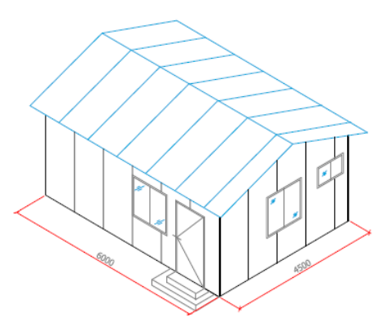
URBAN HEALTH KIOSKS - PUNJAB
Material Used –Aerocan Puff Panel-50mm
Kiosk – a fabricated structure which can be setup and removed easily.
Dimension of 15' x 12' x 10' with a partition for ANM & privacy, examination room, immunization cabins, toilet & running water supply, electricity connection & power backup (inverter).
Capital cost – Rs. 6 lakh
Operational cost - Rs. 20000/- per month per Kiosk including salary of ANM

Slide 7
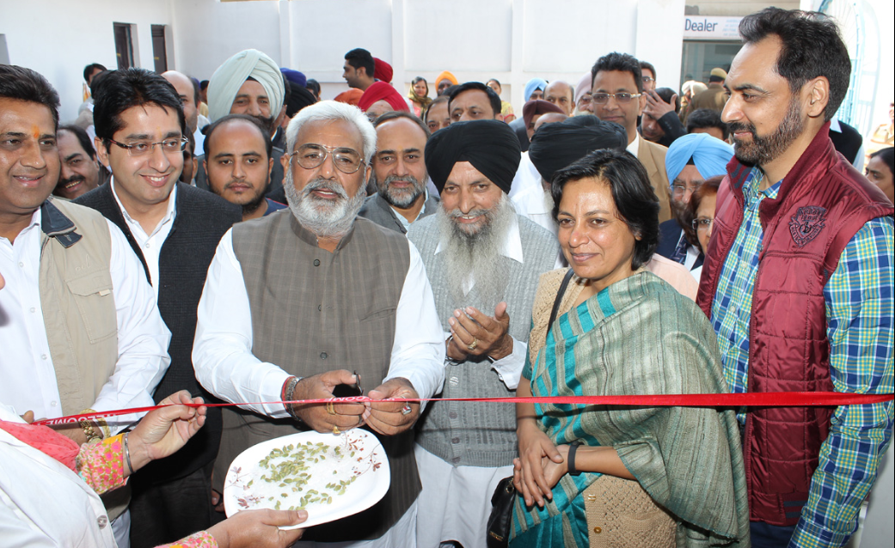
Inauguration of Urban Health Kiosk

Slide 8
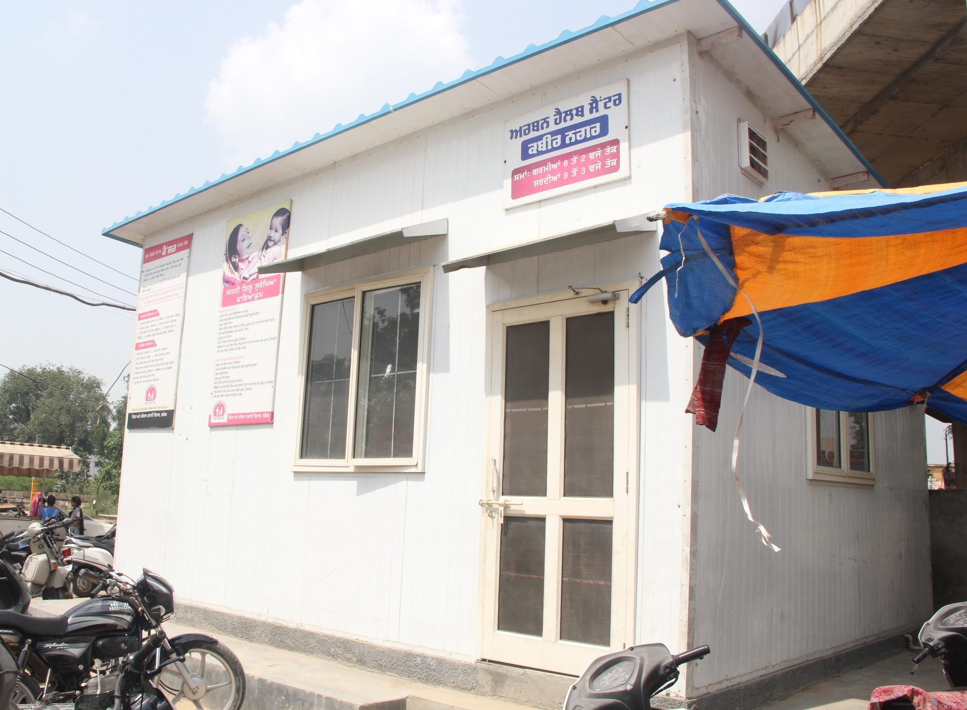
Urban Health Kiosk

Slide 9
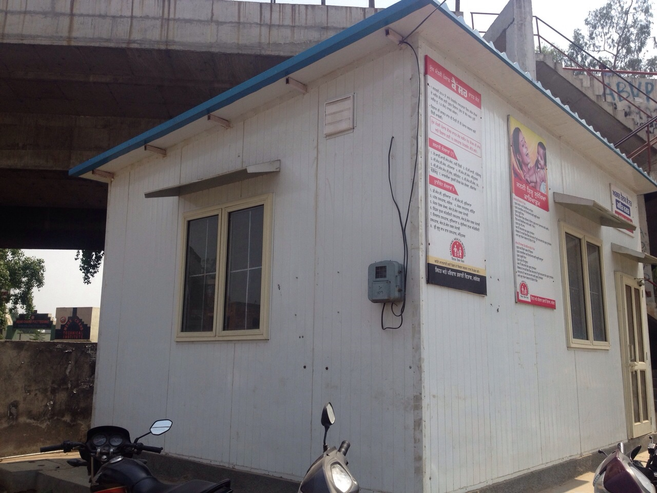
Urban Health Kiosk

Slide 10
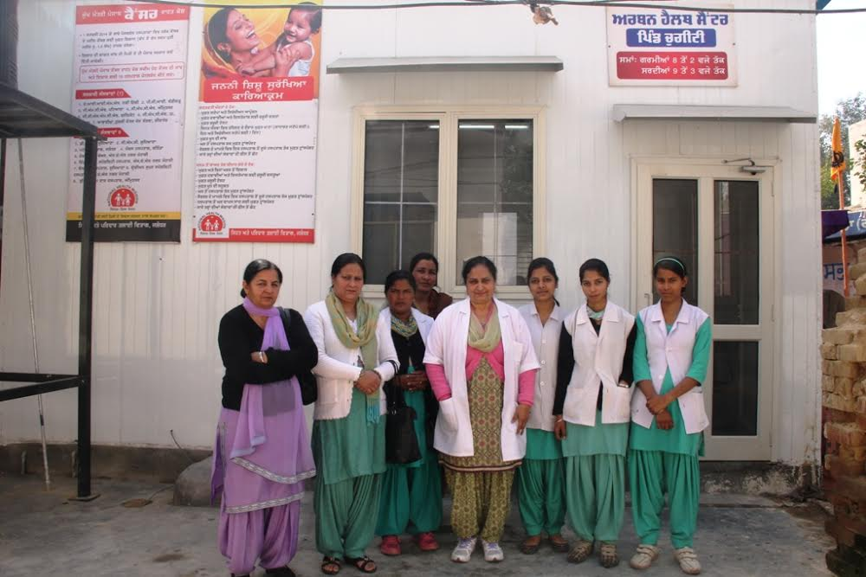

Slide 11
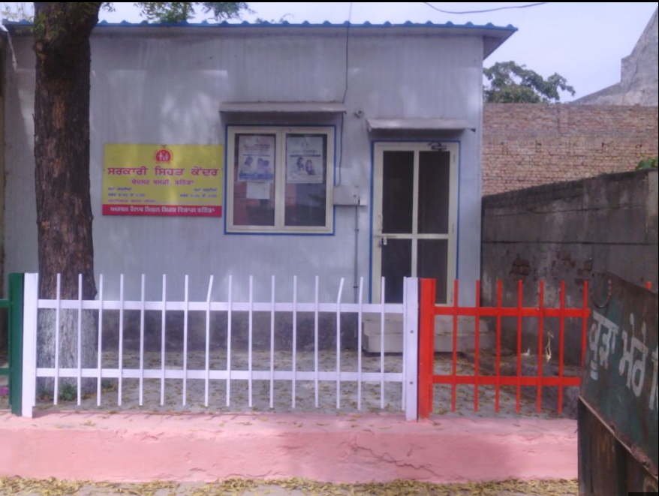
Outer View of Urban Health Kiosk

Slide 12
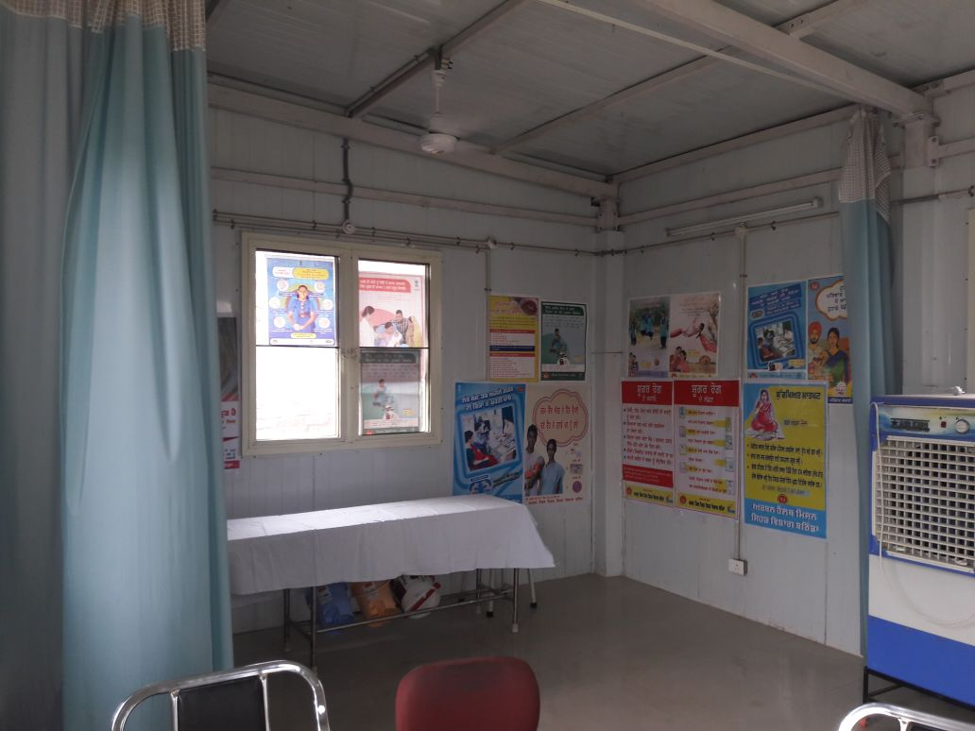
Inner View of Urban Health Kiosk

Slide 13
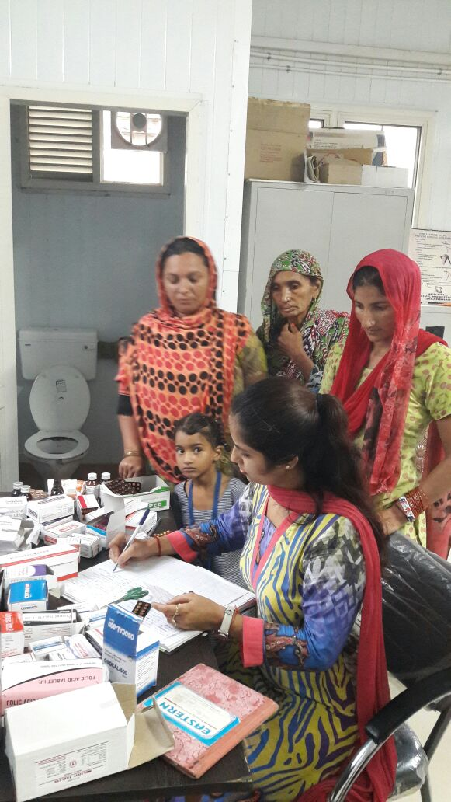
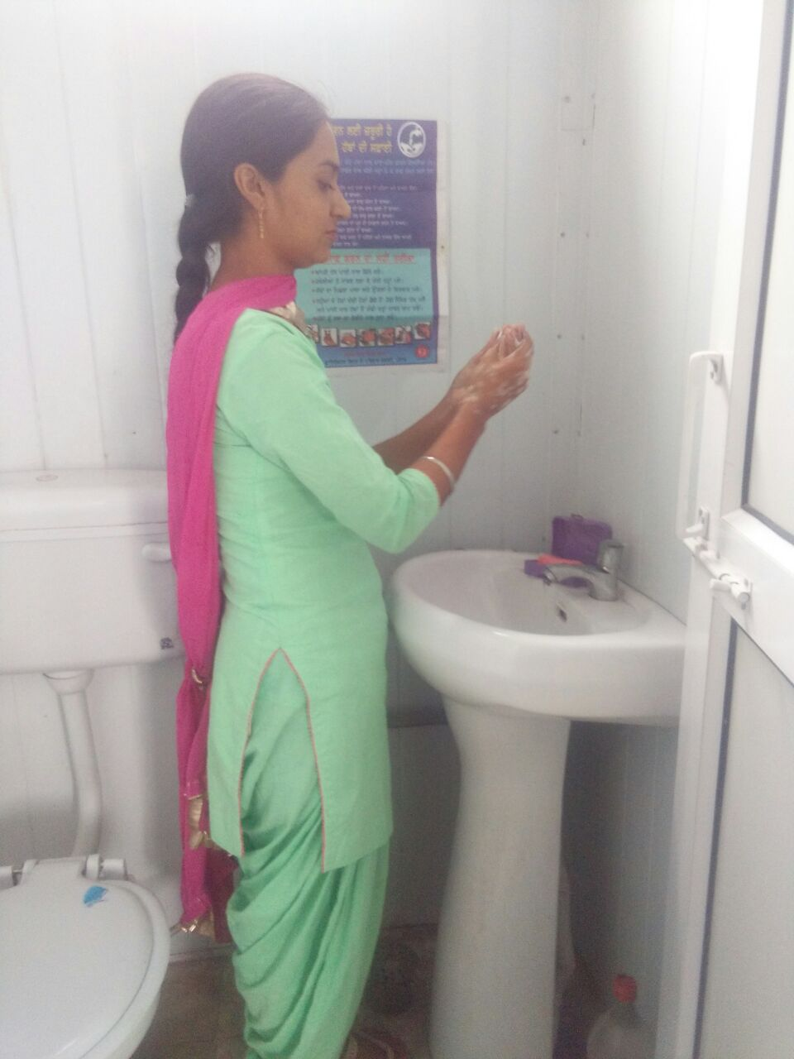
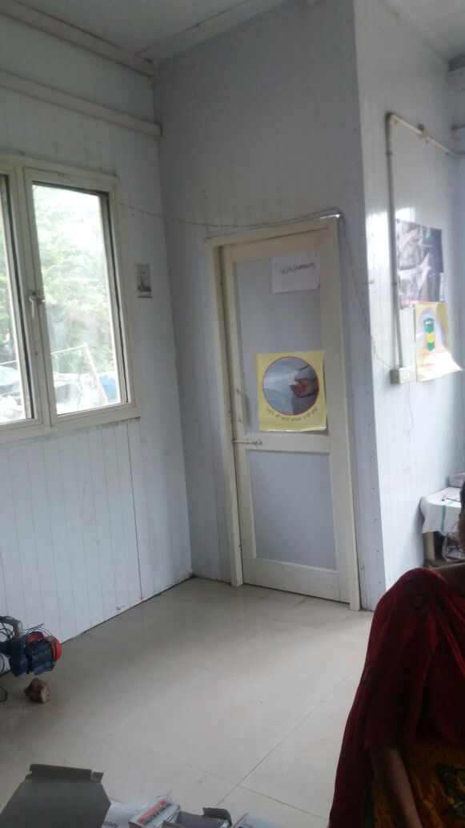

Slide 14
URBAN HEALTH KIOSKS - PUNJAB
Equipments
Basic office furniture | Examination Table | Patient Stool
Bench in waiting area | BP Apparatus | Stethoscope
Thermometer | Weighing Machines (Adult & Infant) | Vaccine Carrier
HB Meter | Glucometer | Needle Hub Cutter
Other equipments as per Sub-centre list

Slide 15
URBAN HEALTH KIOSKS - PUNJAB
Drugs & Consumables
Basic Drugs for Common Ailments | PCM | Anti Allergic Drugs
IFA Tablets & Syrup | ORS & Zinc Sulphate | Vitamin-A
Calcium | Albendazole tablets | Povidone Iodine Ointment
Cotton bandage etc. | Pregnancy Testing Kits | Oral Contraceptive Pill
Emergency Contraceptive Pill | IUCD | Misoprostol Tablets
Other Drugs & Consumables based on the requirement during OPD and Outreach Camps

Slide 16
URBAN HEALTH KIOSKS - PUNJAB
Management of Kiosks
Kiosks act as an entry point for service delivery to the poor population at their door step in inaccessible congested areas.
Operationalized under the supervision & control of Medical Officer of the nearest Urban Primary Health Centre.
Services
All “Minimum Assured Services” or Essential Services as envisaged in the Sub Centre are available, which includes preventive, promotive, few curative and referral services in addition to all the national health programmes

Slide 17
URBAN HEALTH KIOSKS - PUNJAB
Routine services at Kiosks
1. General Health Examination
2. Antenatal care
Pregnancy detection through Nishchay Kit
General ANC check-up – provision of IFA, TT
Identification & management of high-risk pregnancies
Referral
3. Advice & Counselling for safe Deliveries:
Institutional
Deliveries by trained persons
4. Postnatal care, identification and management of any complication

Slide 18
URBAN HEALTH KIOSKS - PUNJAB
5. Immunization services
6. Management of newborns and childhood diseases- ARI/Diarrhea
7. Counselling of birth spacing
8. Counselling for Adolescent Health, Menstrual Hygiene, RTI/ STI and Iron Supplementation.
9. Laboratory services- Hb, Urine Examination (Glucose & Protein), Blood slide collection for Malaria and other tests.
10. Sputum collection for detection of TB
11. Referral
12. IEC and BCC

Slide 19
URBAN HEALTH KIOSKS - PUNJAB
Routine OPD at Kiosks
Population per Kiosk – 6000-10000.
Human Resource – 1 ANM in all Kiosks and 1 Staff Nurse in Kiosks which are in industrial area.
OPD timings - from 1:00 pm to 7:00 pm (in Summers), from 12:00 noon to 6:00 pm (in Winters).
23 Kiosks are fully functional from June 2015.
Outreach Camp at Kiosk
Monthly outreach camps are organized at Urban Health Kiosks.
74 outreach camps organized in 2016-17 (upto July).

Slide 20
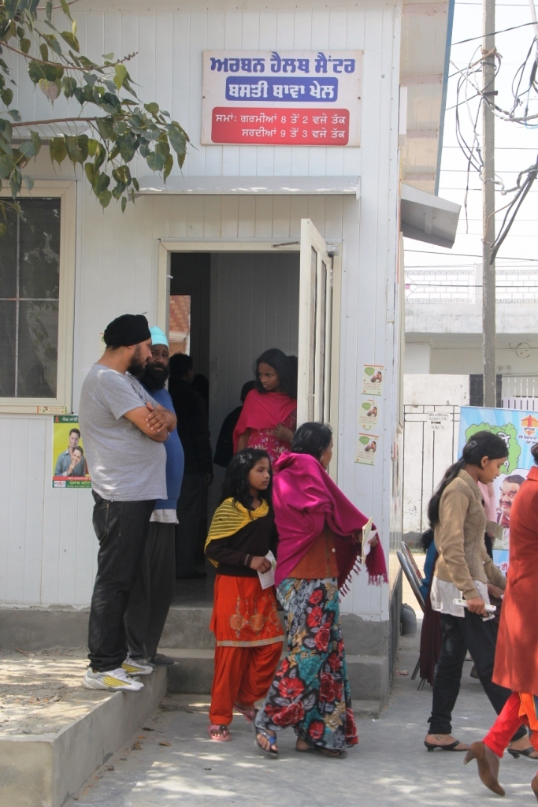
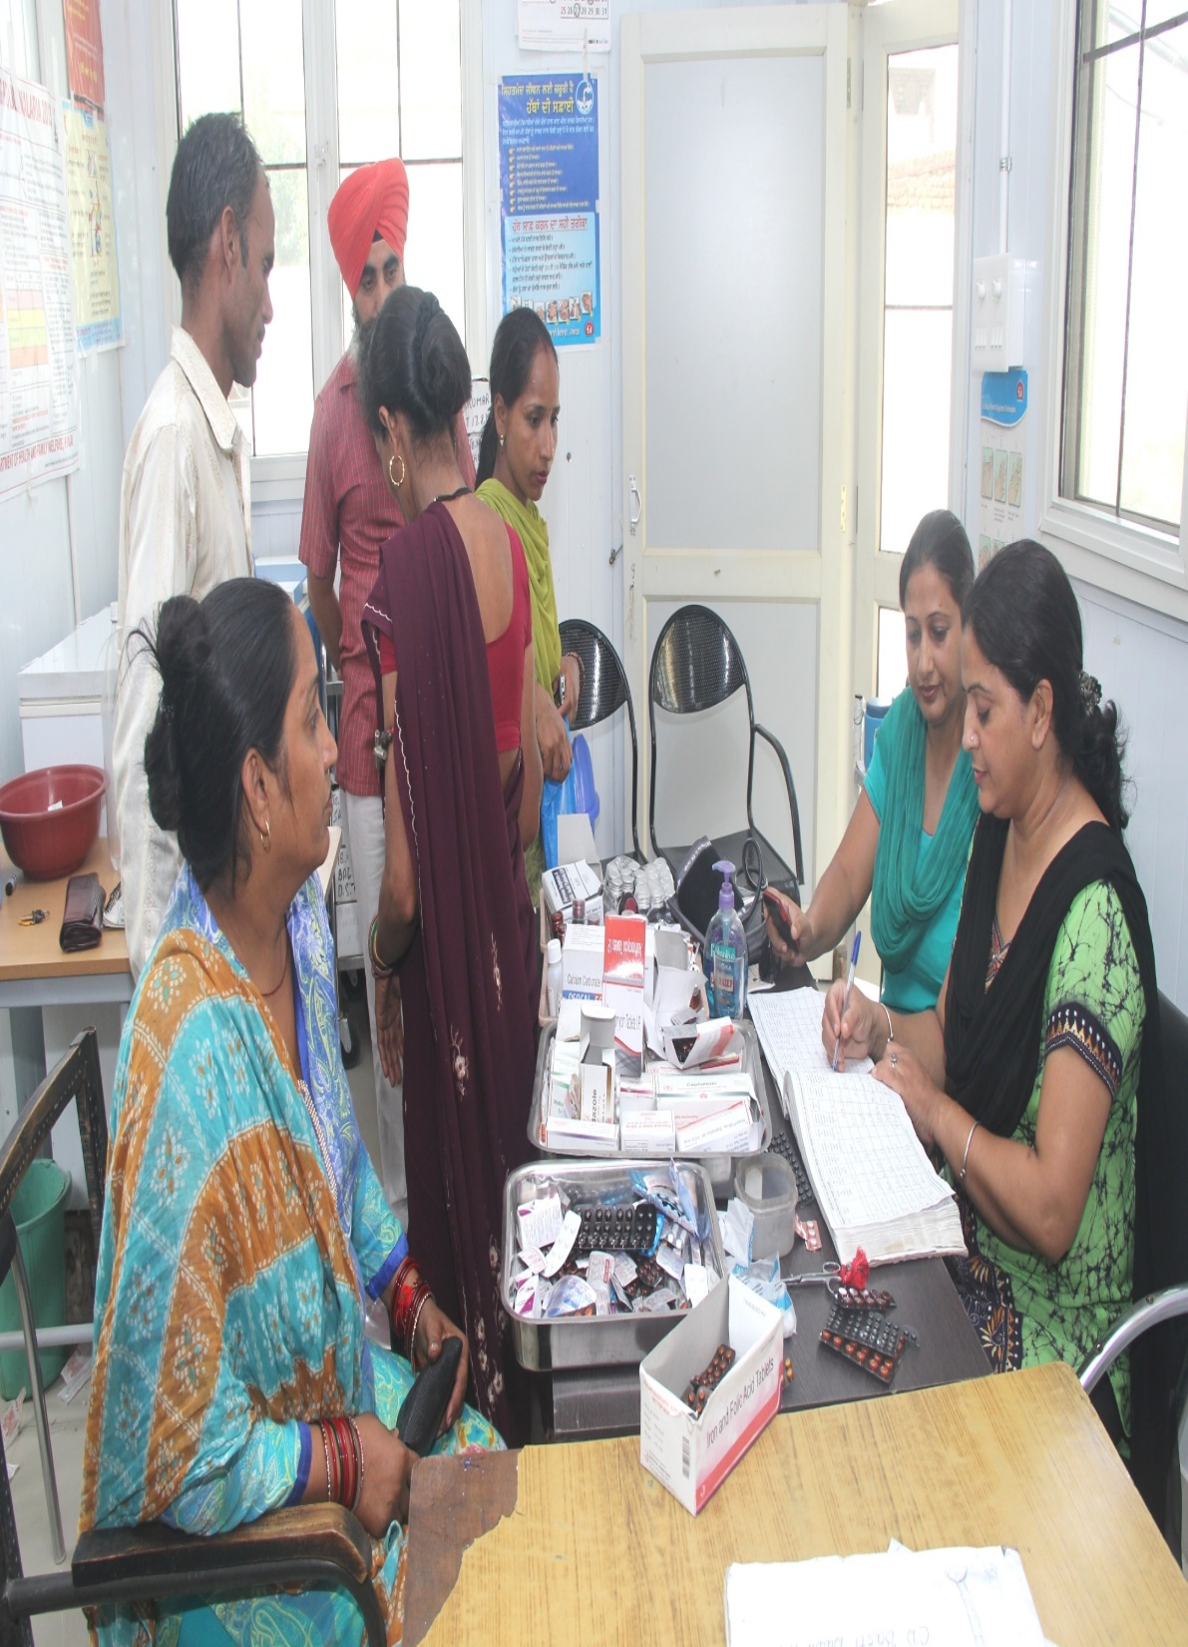
Service Delivery during OPD at Kiosk

Slide 21
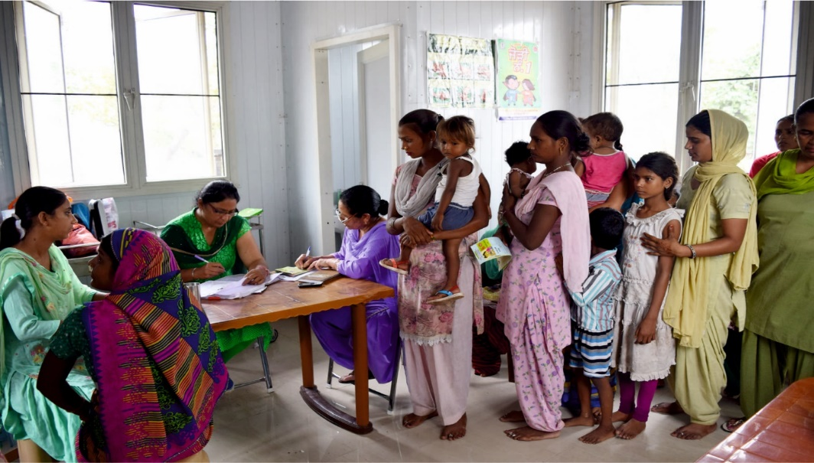
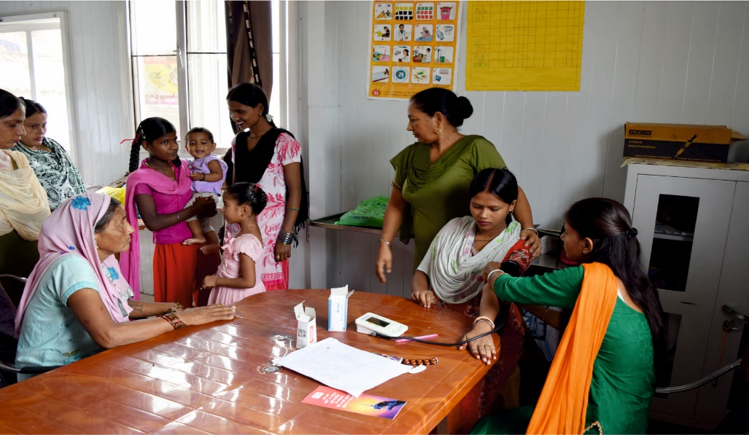
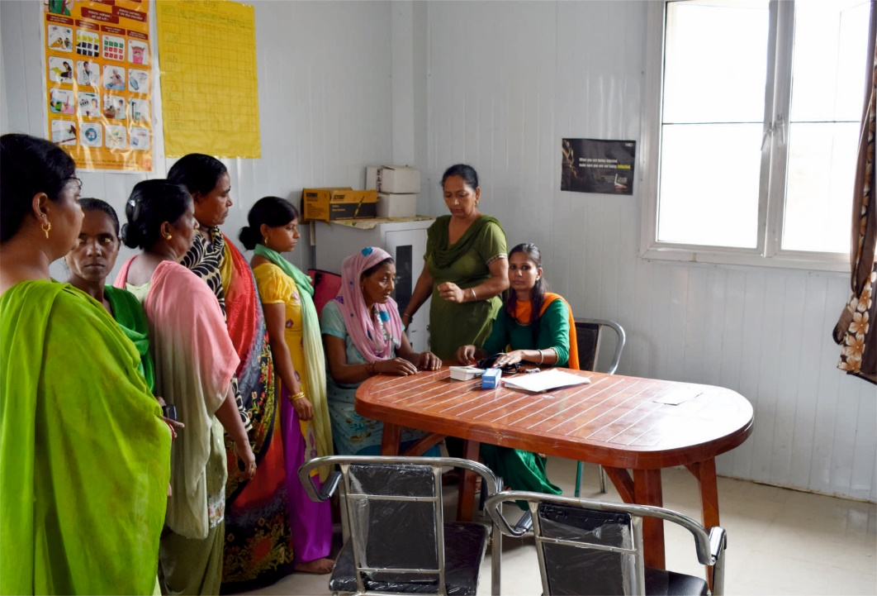
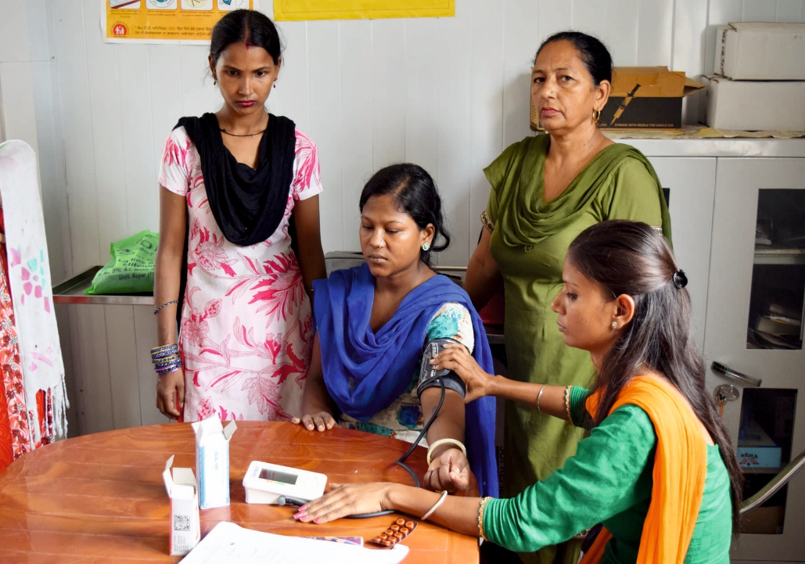
OPD at Kiosk

Slide 22
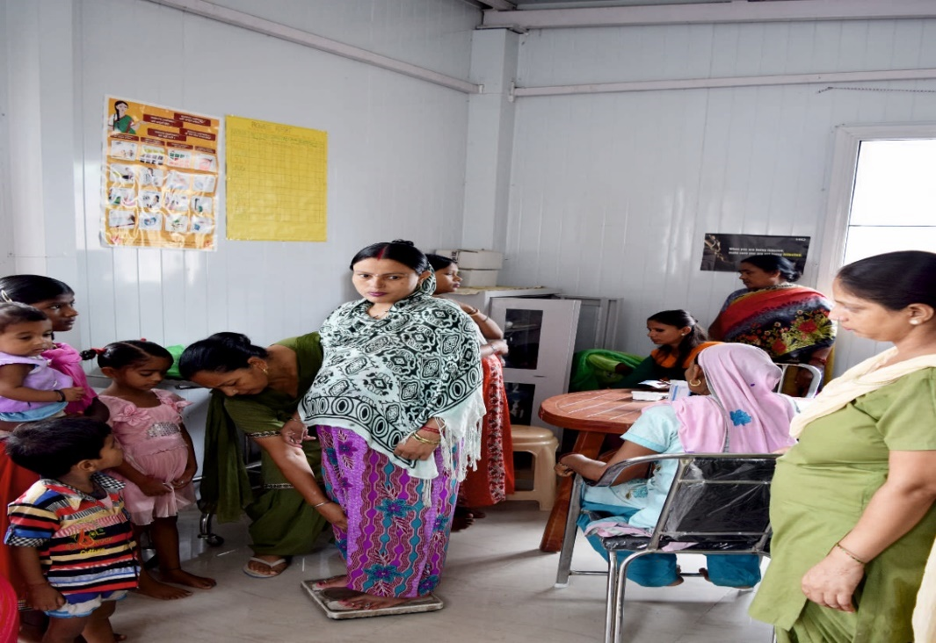
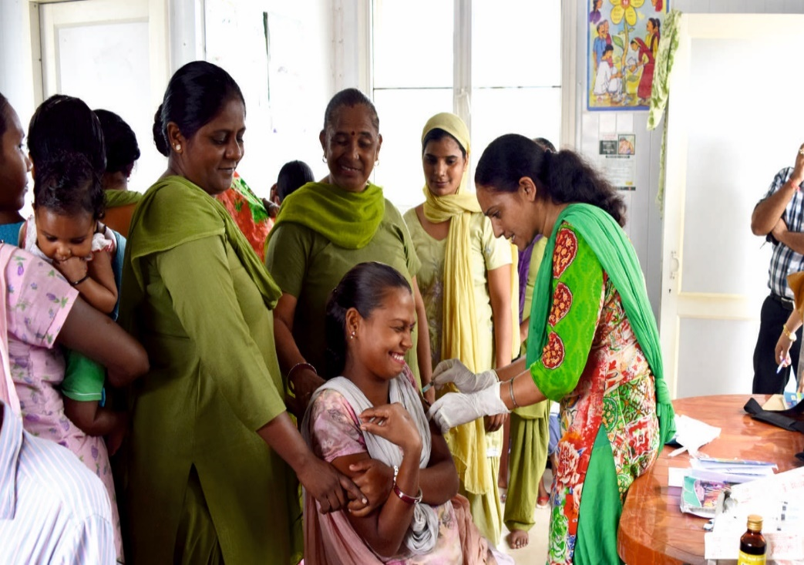
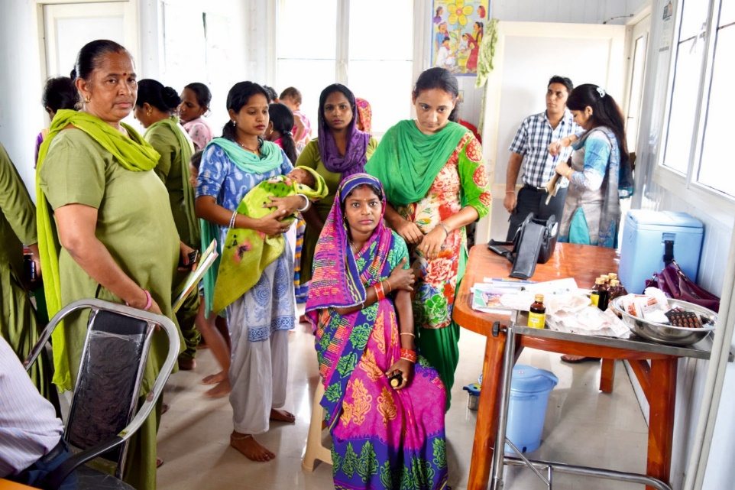
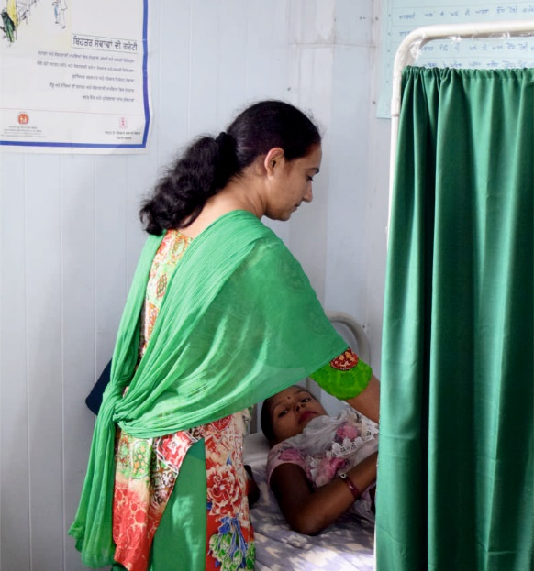
ANC-PNC/ Immunization Services at Kiosk

Slide 23
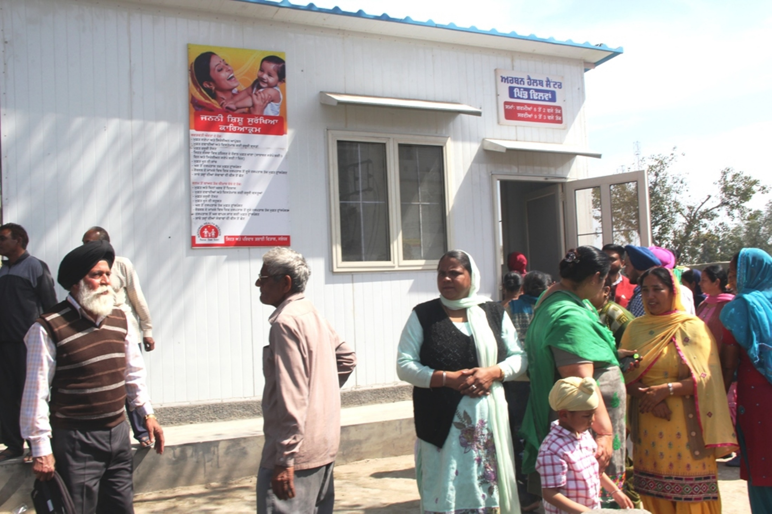
Outreach Camp at Urban Health Kiosk

Slide 24
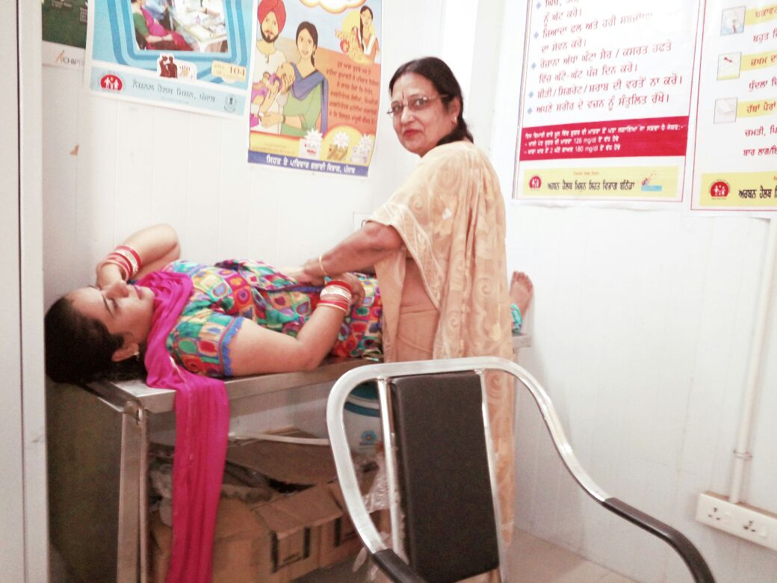
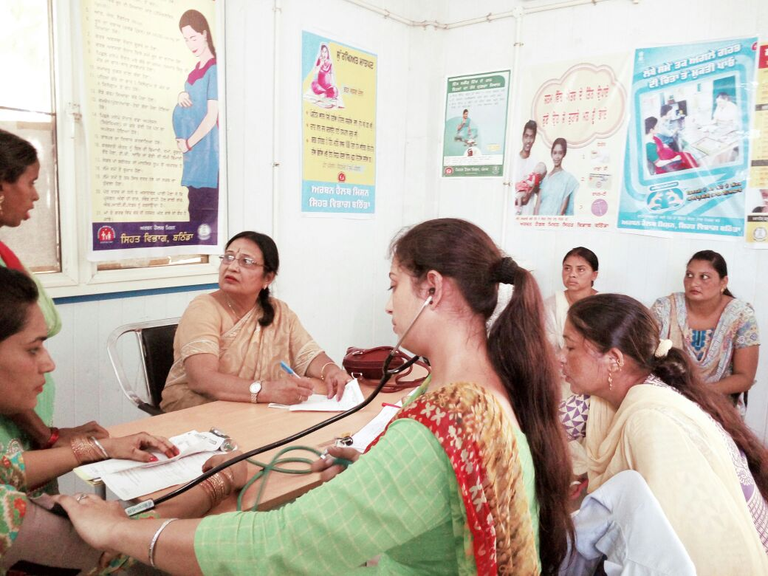
Outreach Camp by the Specialists at Kiosk

Slide 25
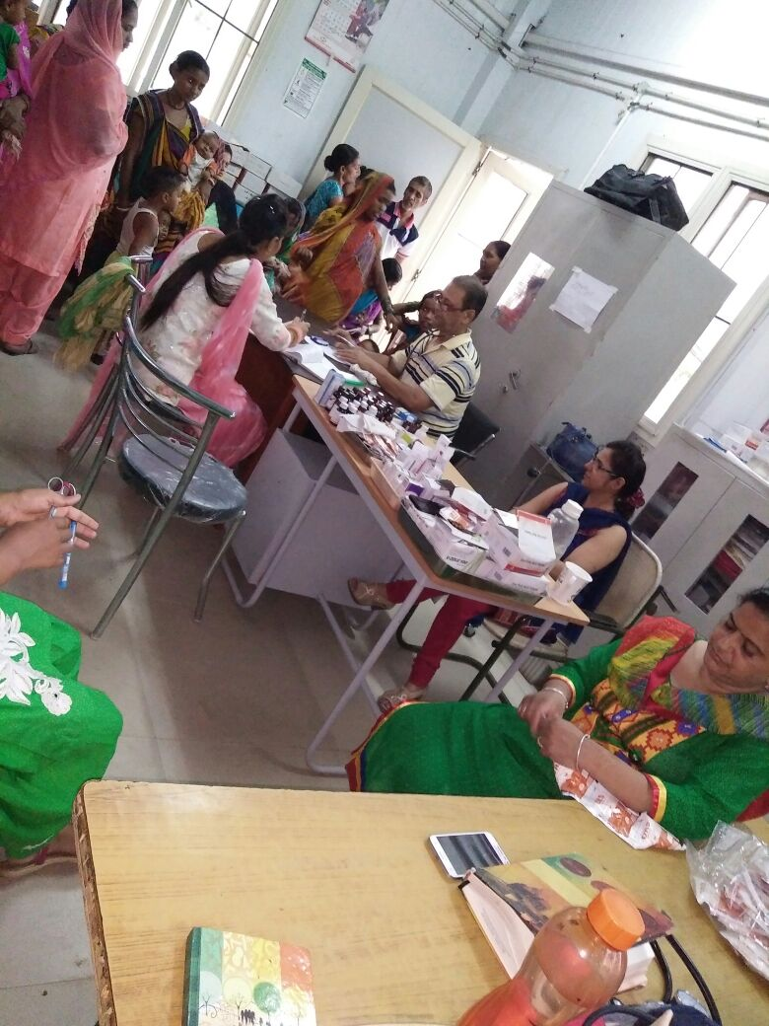
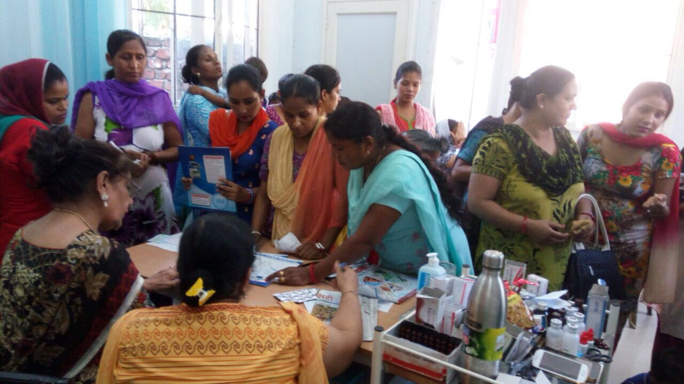
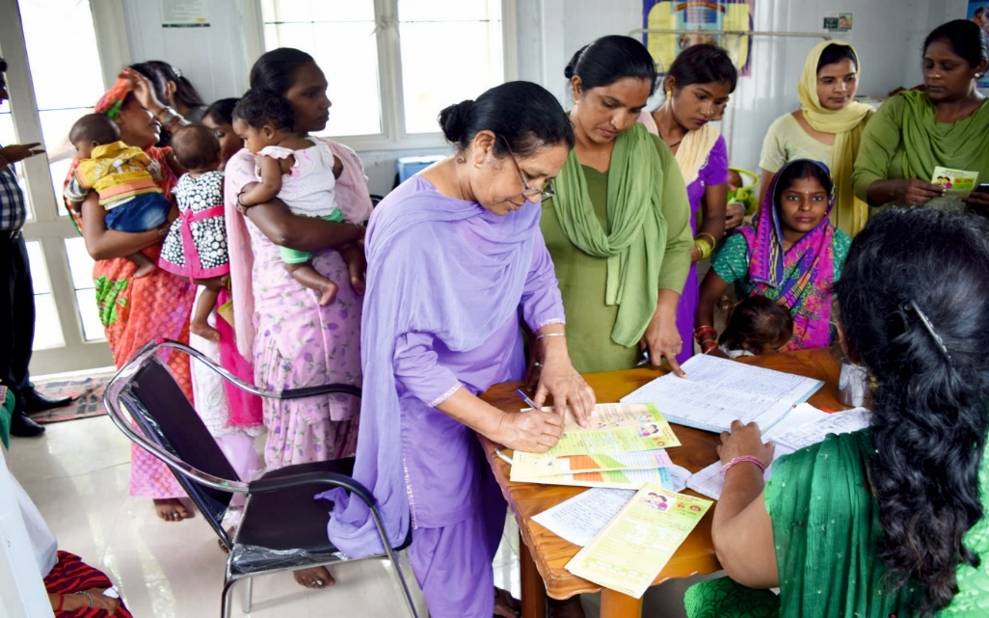
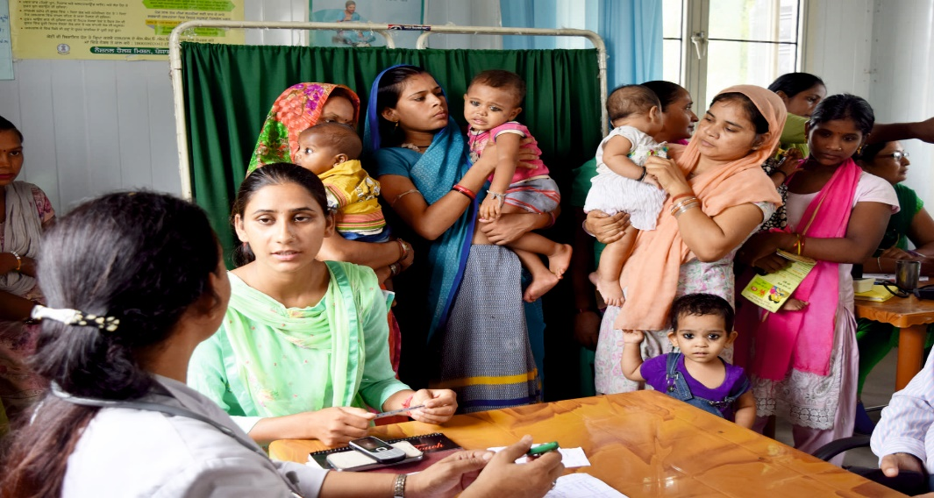
Outreach Camp at Kiosk

Slide 26
Progress – Urban Health Kiosks
 | 2015-16 | 2016-17 (Upto July)
Total Patients Examined | 30446 | 23551
Pregnant Women examined by the Specialists/ Medical Officer | 3293 | 2060 | 128 high risk pregnancies identified and referred to higher institutions
Identification of High Risk Pregnancies | 49 | 128
Severely Sick Infants | 159 | 109
RTI/STI | 265 | 244
Lab Investigations during camps | 5656 | 4382
Immunization | 8664 | 4957

Slide 27
Progress – Urban Health Kiosks
Average OPD per camp is 100-150 (370 maximum and 70 minimum).
Daily OPD by ANM – maximum OPD 40 per day in a Kiosk at Chugitti (Jalandhar)
More than 90% pregnant women are registered (prior to operationalizing the Kiosk it was 60%)
More than 90% immunization of the children living in these areas.

Slide 28
DISEASES – OPD/ OUT REACH CAMPS

Slide 29
New Initiatives
Weekly OPD by Medical Officer.
Medical Colleges at Amritsar and Patiala are providing support at urban Kiosks (2 at Amritsar and 1 at Patiala)
Weekly OPD on Thursday (4:00 pm to 7:00 pm) will be made functional by deputing 2 Junior Residents.
Outreach camps by the specialists from Medical Colleges at Urban Kiosks.
Weekly Counselling Services by ICTC Counsellors for Adolescent Health Issues, Family Planning, RTI/ STI and HIV & Testing.

Slide 30
Way Forward
Initiating the screening for Non-Communicable Diseases: -
Screening for Hypertension and Diabetes
Cataract & other eye diseases
Oral Health
Provide more lab testing services – HIV
Sputum collection and DOT Centre under RNTCP
Kiosks in Transport Area, Industrial Area will be strengthened as a hub of health awareness counselling and other services by counsellors, coordinating with TI projects, MPHW(M).
Keeping in view the success of Urban Health Kiosks, Punjab Building & Other Construction Workers Welfare Board (Department of Labour, Government of Punjab) has supported for establishing 50 more Health Kiosks in the Urban Areas. Process of land identification for 33 Kiosks have been completed.

Slide 31
THANK YOU

